Slide 1
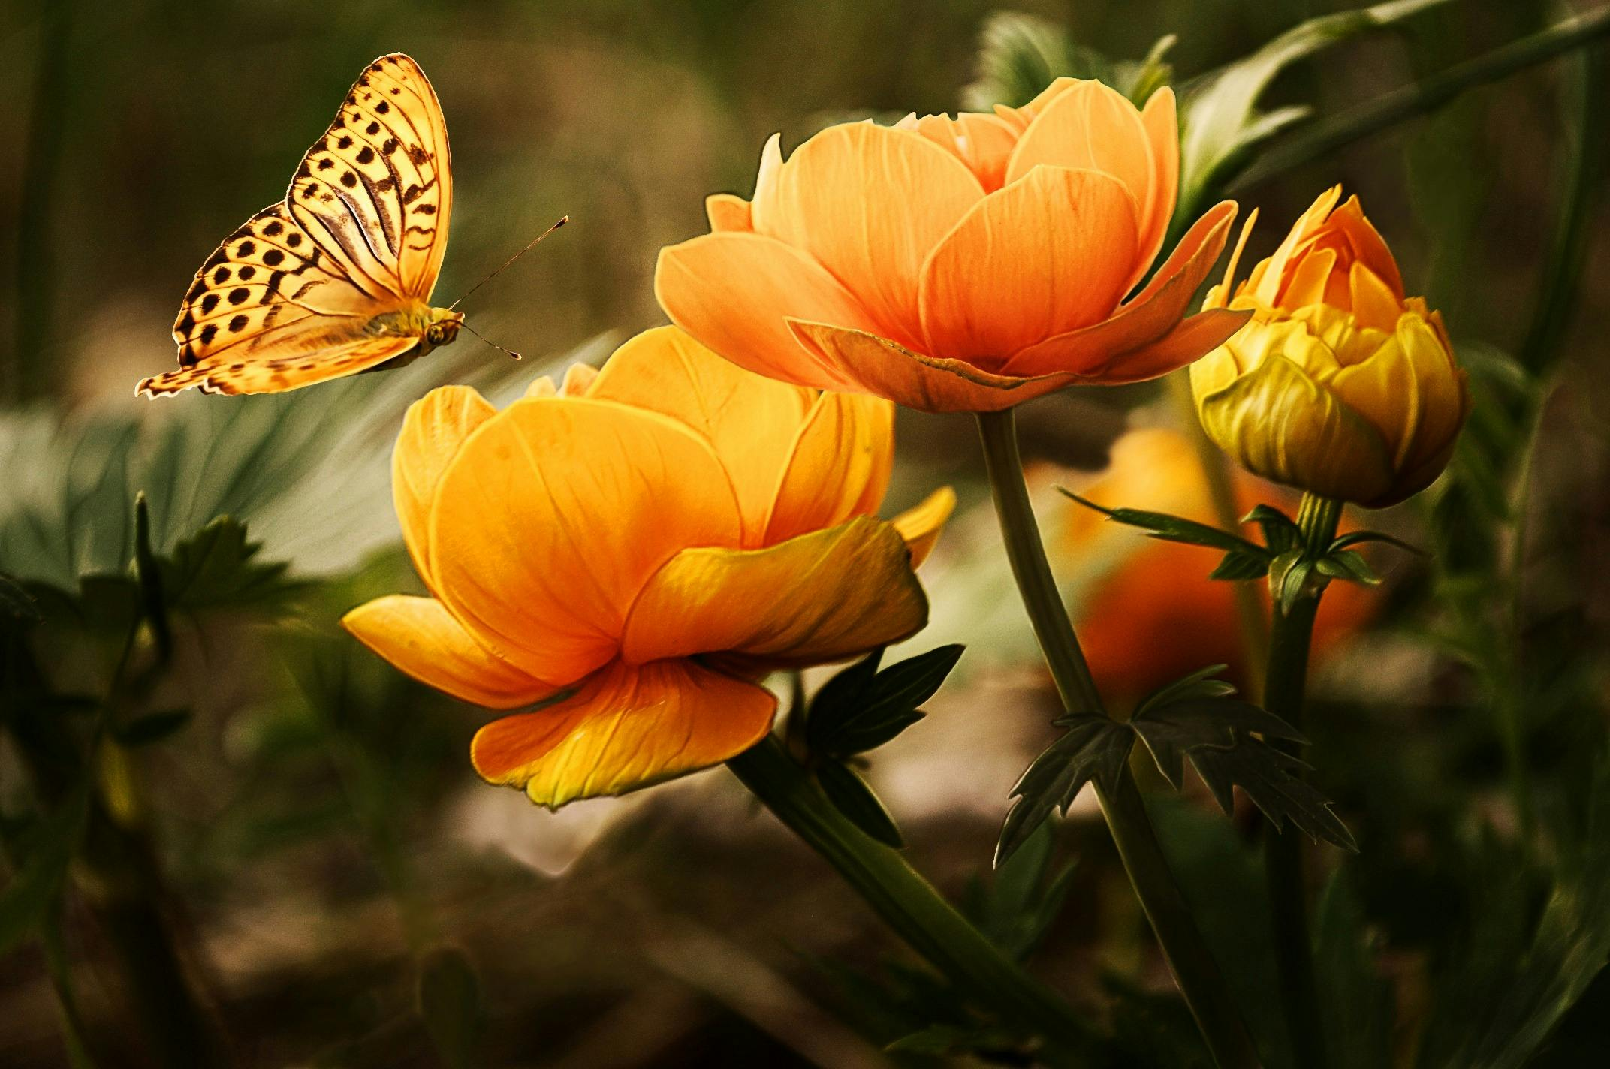
Welcome

Slide 2
Introduction
Teacher
Lesson
Anwarul Islam
Polashbari Chimnia Dakhil Madrasha
Dhamoirhat, Naogaon
Class Eight
Experience-1
Beauty of Poetry
Competency-5
Class Duration-35 minutes
Date-03/04/2024

Slide 3
Simile and the example of simile.
After Reading the Lesson we can Learn.

Slide 4
What are you seeing?

Slide 5
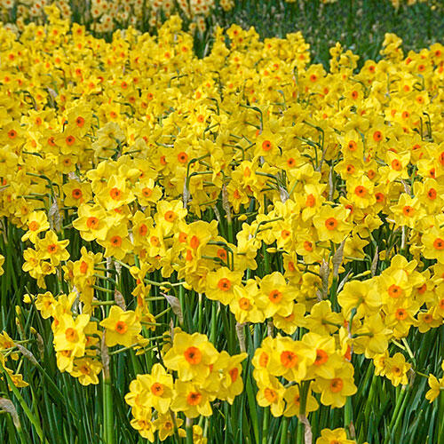
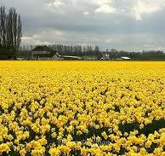
What kind of images?

Slide 6
A simile is defined as “a word or phrase that compares something to something else , using the words like or as.” For example ,as white as milk, black like hair,brave like a lion ,busy like bees, as fast as cheetah, as cold as ice, l like a stars,like a fish. So Simile is a powerful tool for making language more interesting, descriptive, and creative.
Definition of simile: A simile is a figure of speech and it is mainly used to compare two or more things that possess a similar quality.
Or
The comparison of unlike things using the words like or as known to be simile.

Slide 7
A simile is defined as “a word or phrase that compares something to something else , using the words like or as.” For example ,as white as milk, black like hair,brave like a lion ,busy like bees, as fast as cheetah, as cold as ice, l like a stars,like a fish. So Simile is a powerful tool for making language more interesting, descriptive, and creative.
Definition of simile: A simile is a figure of speech and it is mainly used to compare two or more things that possess a similar quality.
Or
The comparison of unlike things using the words like or as known to be simile.

Slide 8
Read the texts and find out similes
I wander lonely as a cloud
WILLIAM WORDSWORTH
I wandered lonely as a cloud
That floats on high o'er vales and hills,
When all at once I saw a crowd,
A host, of golden daffodils;
Beside the lake, beneath the trees,
Fluttering and dancing in the breeze.
Continuous as the stars that shine
And twinkle on the milky way,
They stretched in never-ending line
Along the margin of a bay:
Ten thousand saw I at a glance,
Tossing their heads in sprightly dance.
The waves beside them danced; but they
Out-did the sparkling waves in glee:
A poet could not but be gay,
In such a jocund company:
I gazed—and gazed—but little thought
What wealth the show to me had brought:
For oft, when on my couch I lie
In vacant or in pensive mood,
They flash upon that inward eye
Which is the bliss of solitude;
And then my heart with pleasure fills,
And dances with the daffodils.

Slide 9
True Royalty
by Rudyard Kipling
There was never a Queen like Balkis, From here to the wide world’s end; But Balkis talked to a butterfly As you would talk to a friend.
There was never a King like Solomon, Not since the world began; But Solomon talked to a butterfly As a man would talk to a man.
She was Queen of Sabaea— And he was Asia’s Lord— But they both of ’em talked to butterflies When they took their walks abroad.

Slide 10
What is simile? Write some examples of simile.

Slide 11
That is all for today .Thank you everybody.

