Slide 1
Expressing a Solution to a Problem
Presented by-
Sultana Razia
Assistant Teacher, Hazi Madbar Ali Hasania Dakhil Madrasha

Slide 2
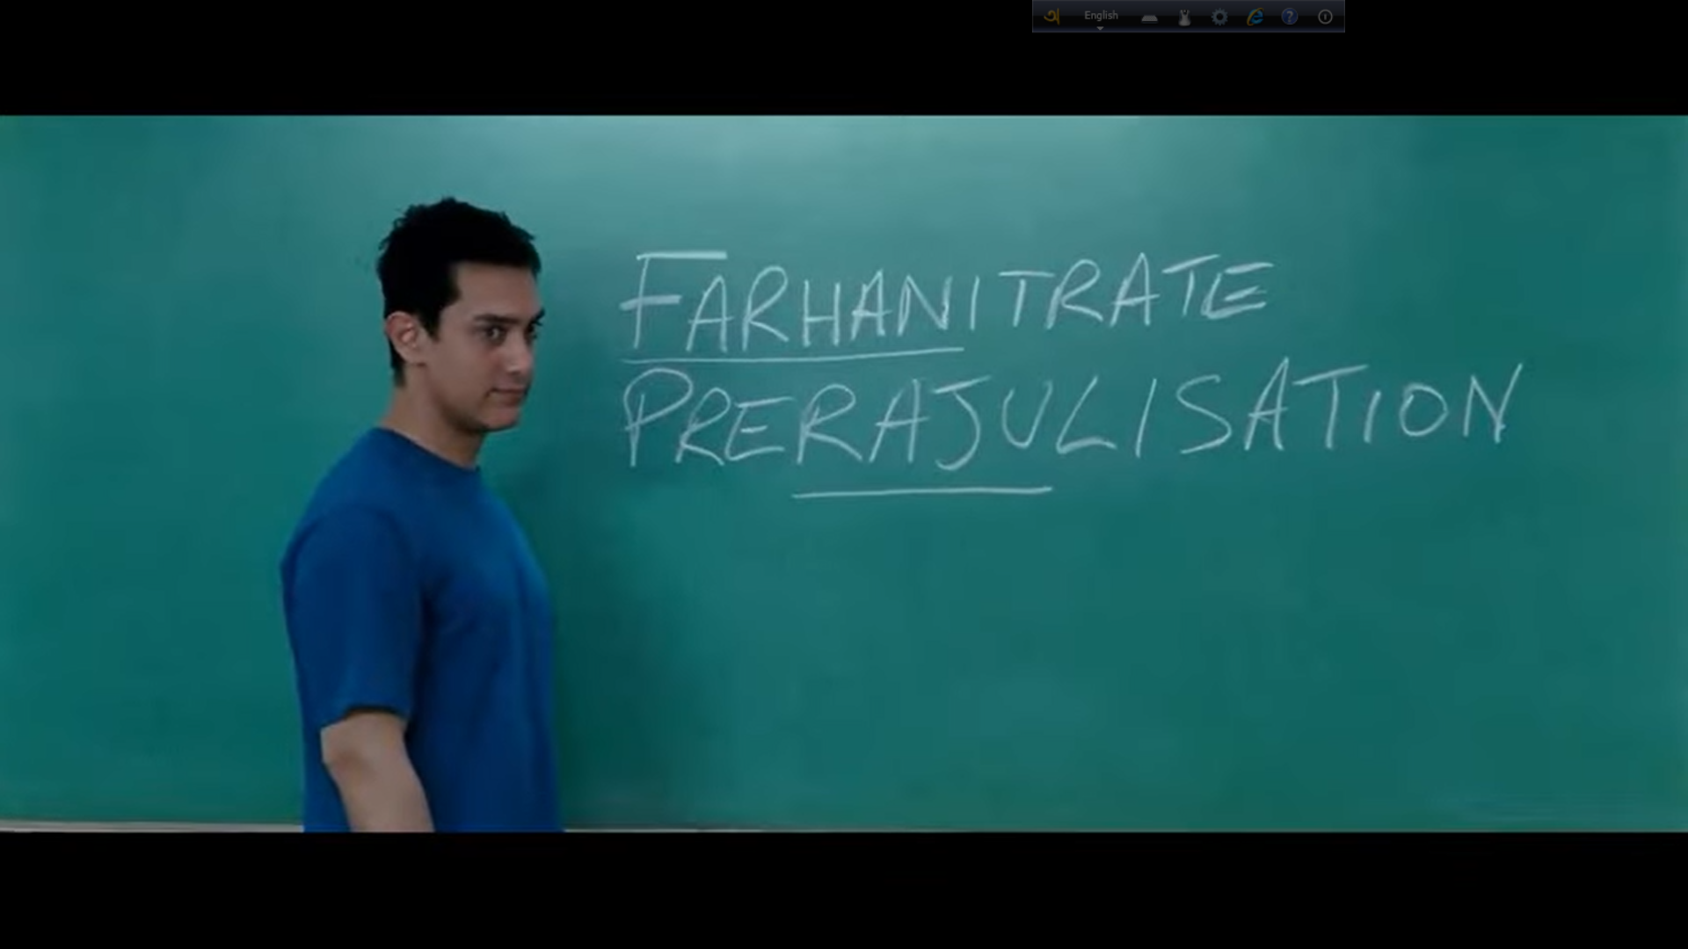
Think Out of the Box!

Slide 3
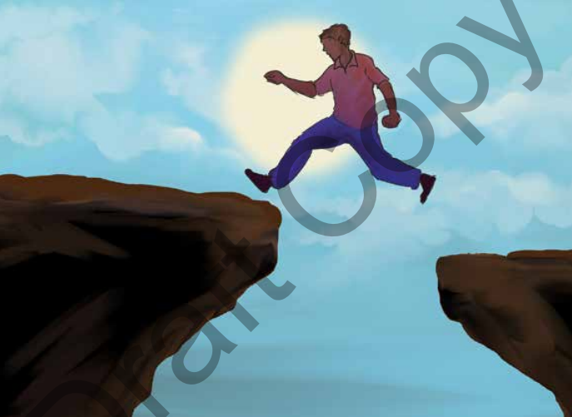
5.1.1 Expressing a Solution to a Problem

Slide 4
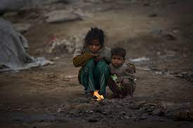
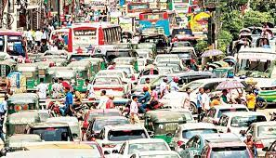
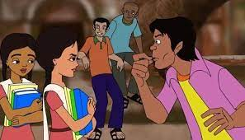

What’s Your Thought About the Following Issues?

Slide 5
5.1.2 A Day of Challenges
Today is my exam day, and it feels like one of the toughest days of my life. I had high hopes for this exam, but unfortunately, I couldn’t finish the entire syllabus due to my health problems. The thing is, my mother has been suffering from a high fever for a couple of days. So, I couldn’t bring a tiffin and bought snacks from the roadside shop. Probably that caused a digestion problem, and I have been in severe pain for the last two days. It’s been hard to concentrate on my studies.
On the exam day, I started to go to the school in scorching heatwave. It was burning outside, and I was desperately looking for a rickshaw. Unfortunately, none were in sight, and with no shade nearby to wait, I began to walk, thinking about the consequences of not planting trees and preserving the greenery that protects our lives.
By the time I reached school, the exam had already started. I was so stressed that I couldn’t answer all the questions. Feeling unsatisfied, I completed the exam and left the hall. While leaving, I met my friend, and to my surprise, I noticed she intentionally avoided me. I remembered she had sought my help previously, but I couldn’t assist her due to my health. Her avoidance added to my sadness, reinforcing the belief that “Life is not easy and comes with many problems that demand attention.”

Slide 6
5.1.2 A Day of Challenges
1. Why does Rifa believe ‘Life is not easy’?
2. What are the problems do you notice in her life?
3. Do you face problems like Rifa? If so, what are they?
4. How do these problems affect you, your family, and your friends?
5. How do you solve these problems?
Did you face such situation/problem in your life?

Slide 7
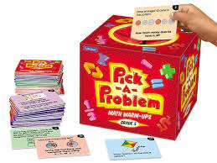
5.2.1 Problems & Solutions

Slide 8

5.2.1 Problems & Solutions
How can the problems be solved?

Slide 9
5.2.2 Requirements to be a Good Problem Solver
Which of the following steps did you follow in doing previous activity?
The Steps | Yes | No
Identify the problem
Find out the reasons causing the problem
Identify the necessity to solve this problem
Find out some possible solutions first
Then, identify the effective solutions to the particular problems
Consider that the suggested solutions are realistic and implementable
Think about the duration of time it will take to solve the problem
Consider, how it would look like after the solution has been implemented
Let’s be better problem-solvers!

Slide 10
Thank You
Any Questions?

