Slide 1
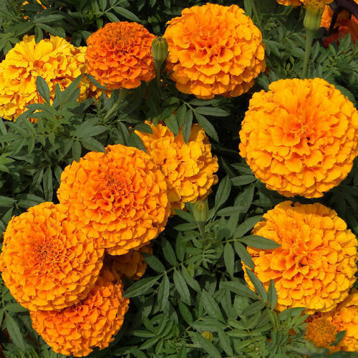
Welcome

Slide 2
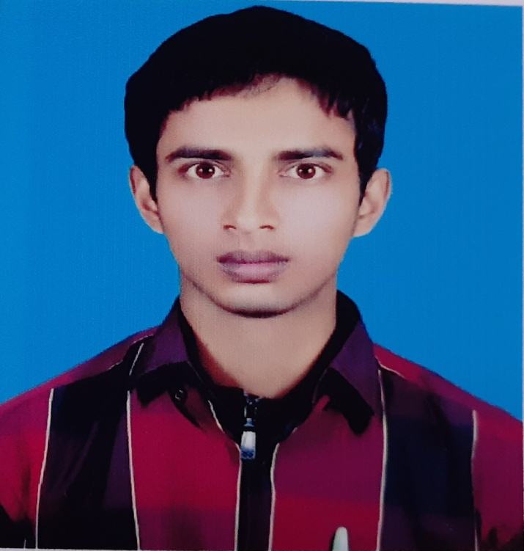
Identity
Md. Iftekhar Alam
B.A (Hons) M. A in English B.Ed
Assistant Teacher (English)
Karai Nurul Huda Kamil Madrasha, Joypurhat
Subject: English 1st paper
Class: Ten
Unit: 05
Lesson: 02

Slide 3
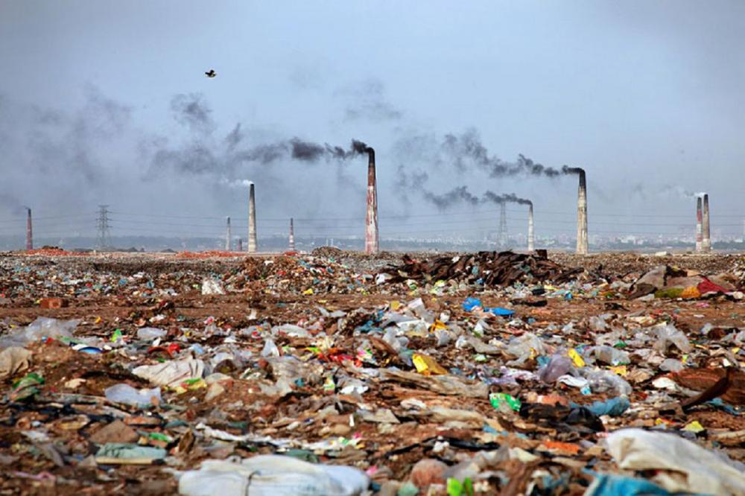
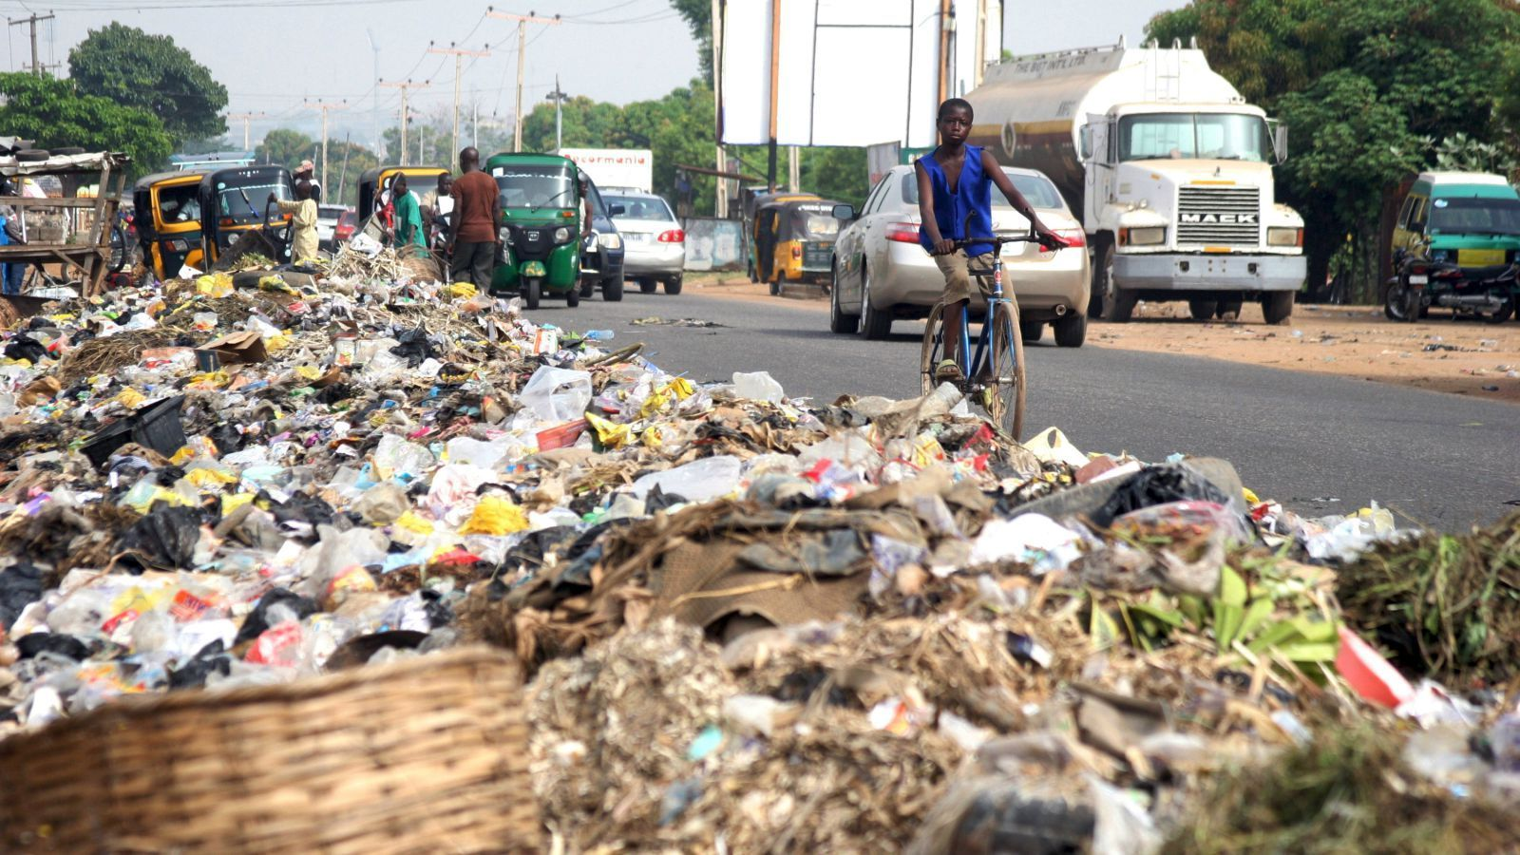
Look at the pictures

Slide 4
Today’s topic
Environment Pollution

Slide 5
Learning Outcomes
1. Tell about pollution
2. Tell about the causes of pollution
3. Encourage people to prevent pollution

Slide 6
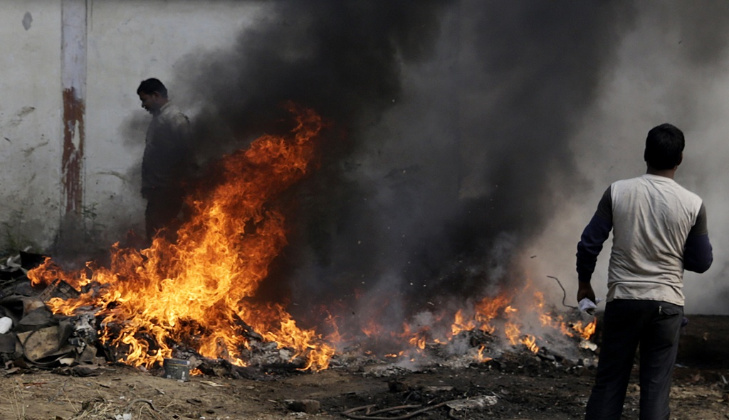
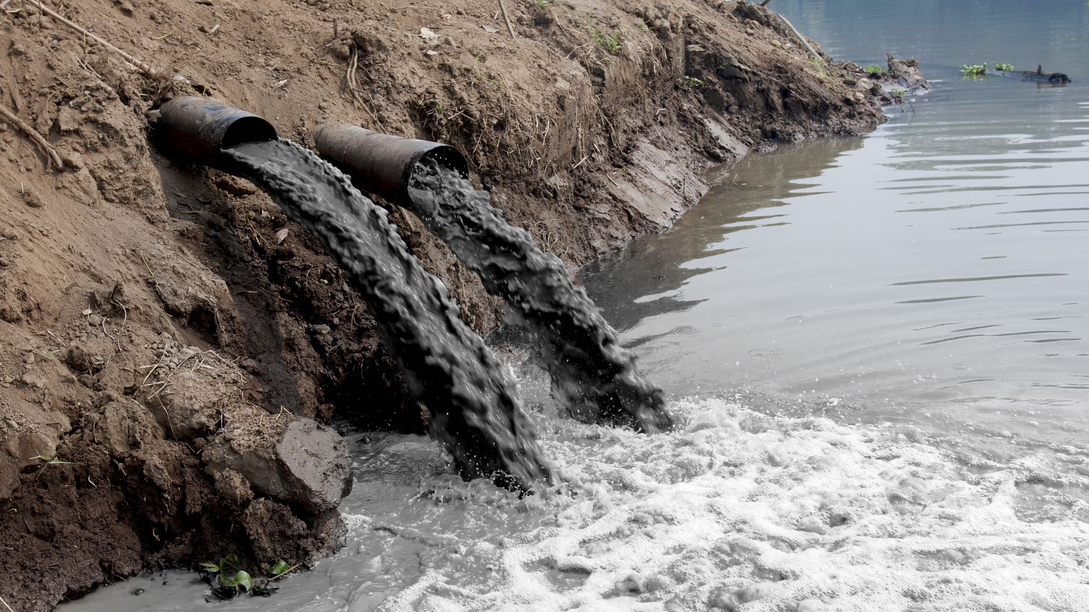
Picture: 1
What do you see in the pictures?
What do you see in the pictures?
Picture: 2

Slide 7
Read the passage silently and answer the following questions:
Where does water pollution occur?
Explain two causes of water pollution?
What measures should be taken to prevent water pollution?
Do you think the people of Dhaka city are at risk now?
What should we do to prevent environment pollution?

Slide 8
Fill in the gaps with appropriate word
Air is one of the most important elements of natural (a)…….. But it is being polluted in many ways. The most serious air pollution (b)……. in big industrial areas where there are many mills and factories. Besides burning of mineral gas and oil are also(c)……. for serious air pollution. However, people need to(d)…… air pollution at any cost. Use of CNG and LPG and the relocation of the factories can be(e)……. In this regard.

Slide 9
Home work
Write a paragraph on “Environment Pollution. ”

Slide 10


