Slide 1




Welcome to All

Slide 2
Teacher’s Introduction
Md. Morsalin
Assistant English Teacher.
Paharipukur Dakhil madrasah

Slide 3
Letter:
fvlv‡K wj‡L cÖKvk Kivi mvs‡KwZK wP‡ýi bvg Letter. Bs‡iwR‡Z Letter `yB cÖKvi| h_vt 1. Vowel 2. Consonant
What is Vowel?
‡h mKj Letter m&qs/wb‡R wb‡R D”PvwiZ n‡Z cv‡i Zv‡`i‡K Vowel e‡j| Vowel cuvPwU| h_vt a, e, i, o, u.
What is consonant?
‡h mKj Letter ¯^qs/wb‡R wb‡R D”PvwiZ n‡Z cv‡i bv Zv‡`i‡K Consonant e‡j| Consonant (21 ) GKzkwU| h_vt
b c d f g h j k l m n p q r s t v w x y z

Slide 4
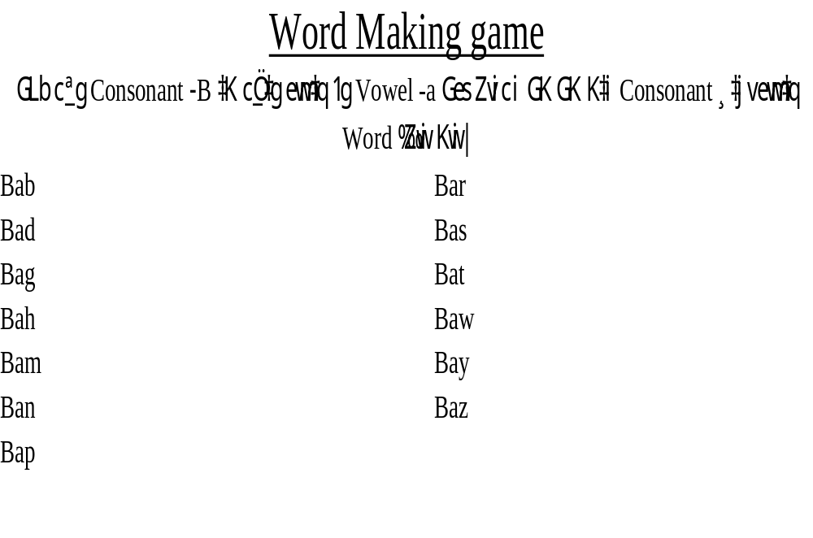

Slide 5
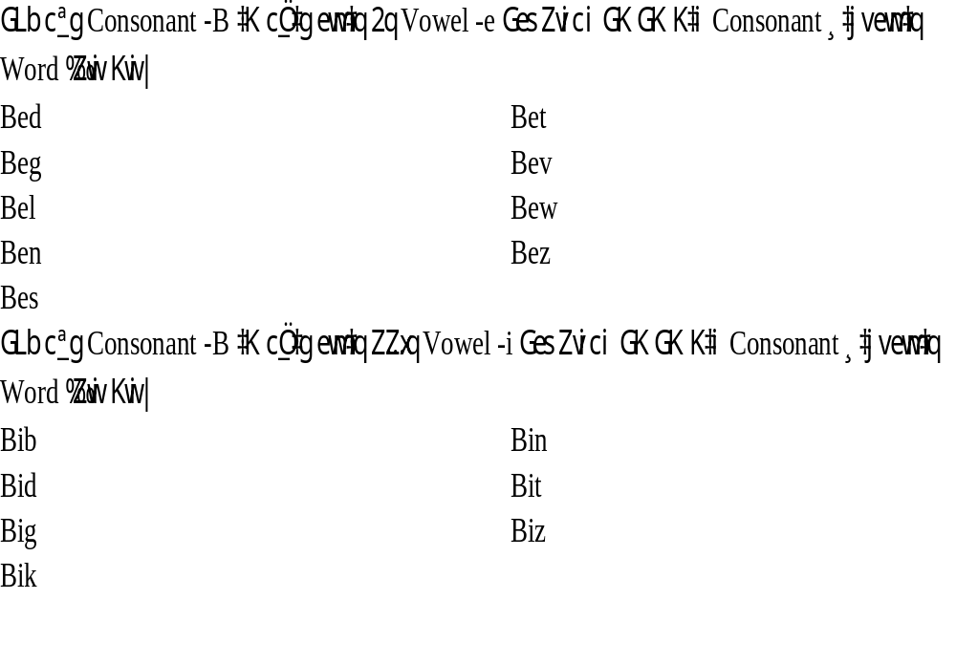

Slide 6
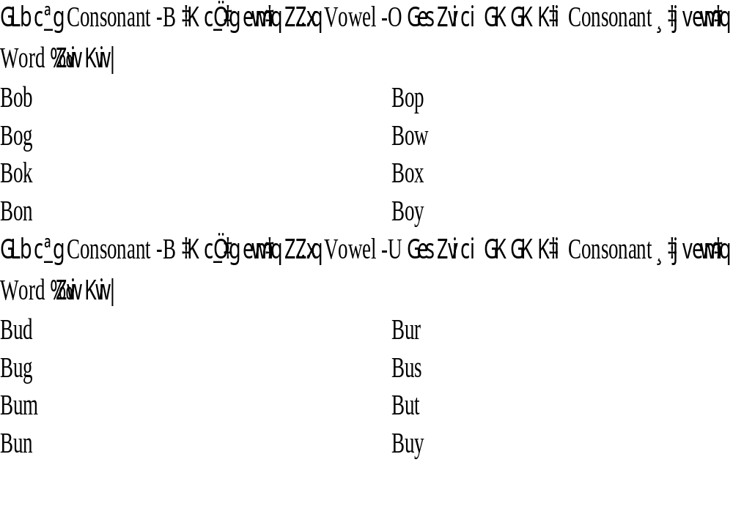

Slide 7
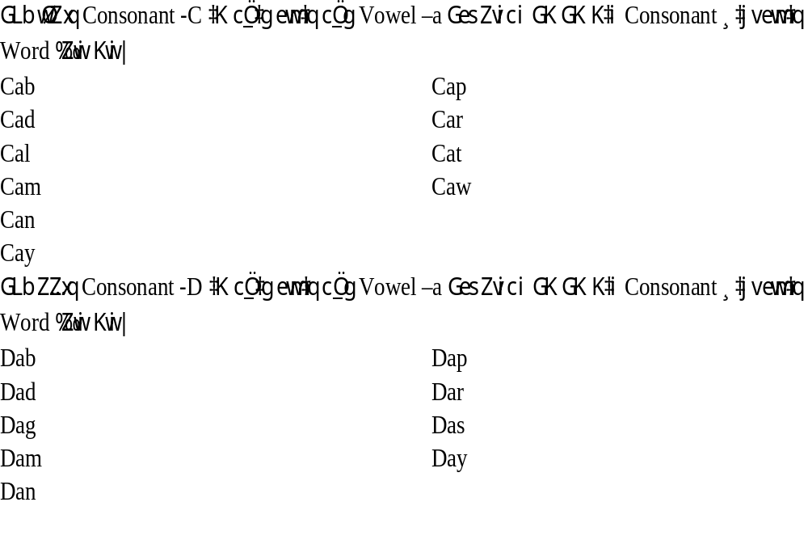

Slide 8
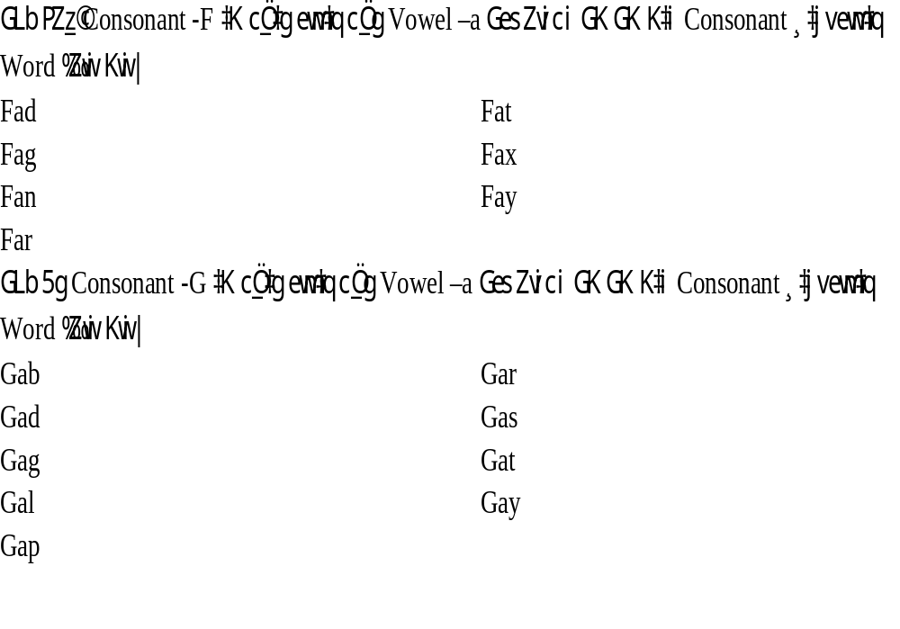

Slide 9
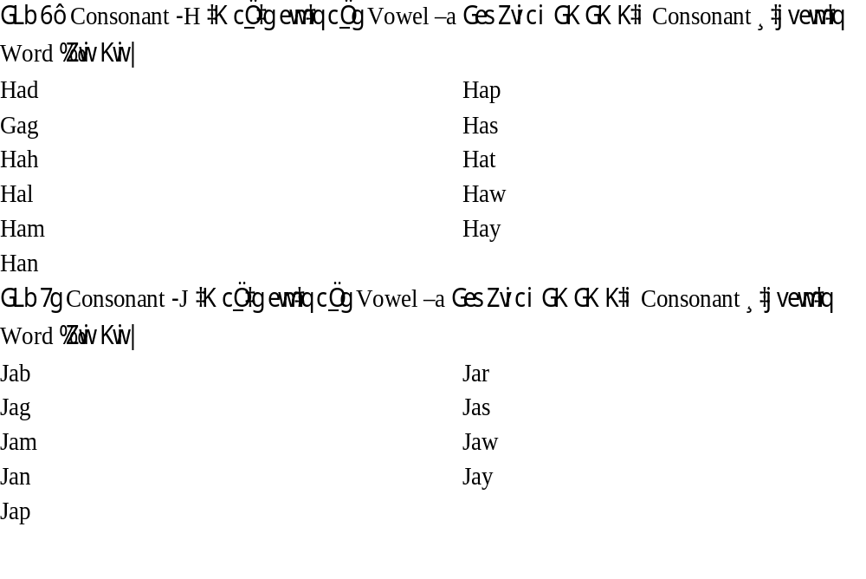

Slide 10
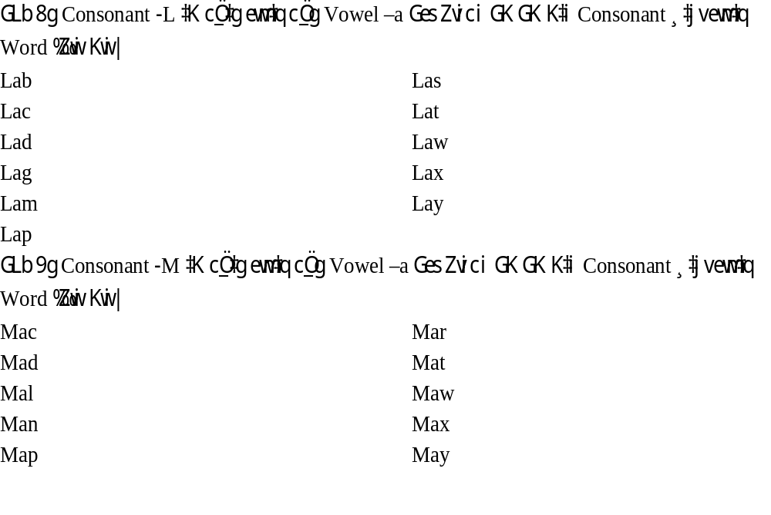

Slide 11
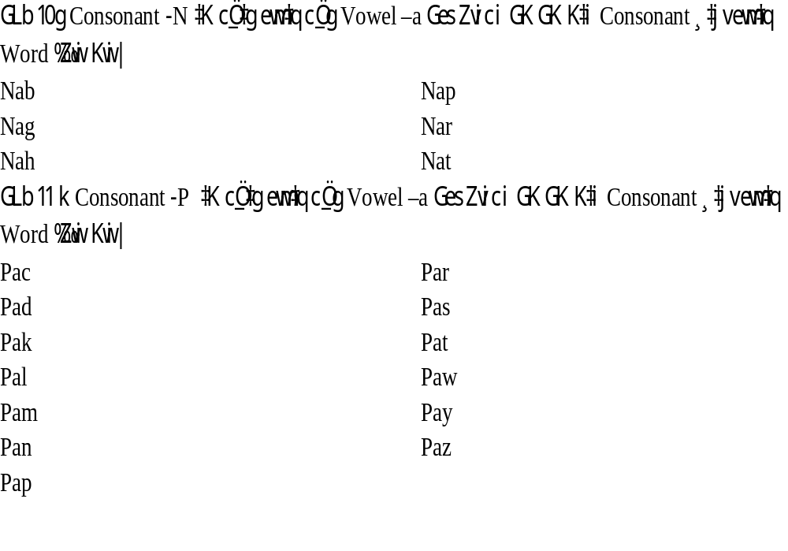

Slide 12
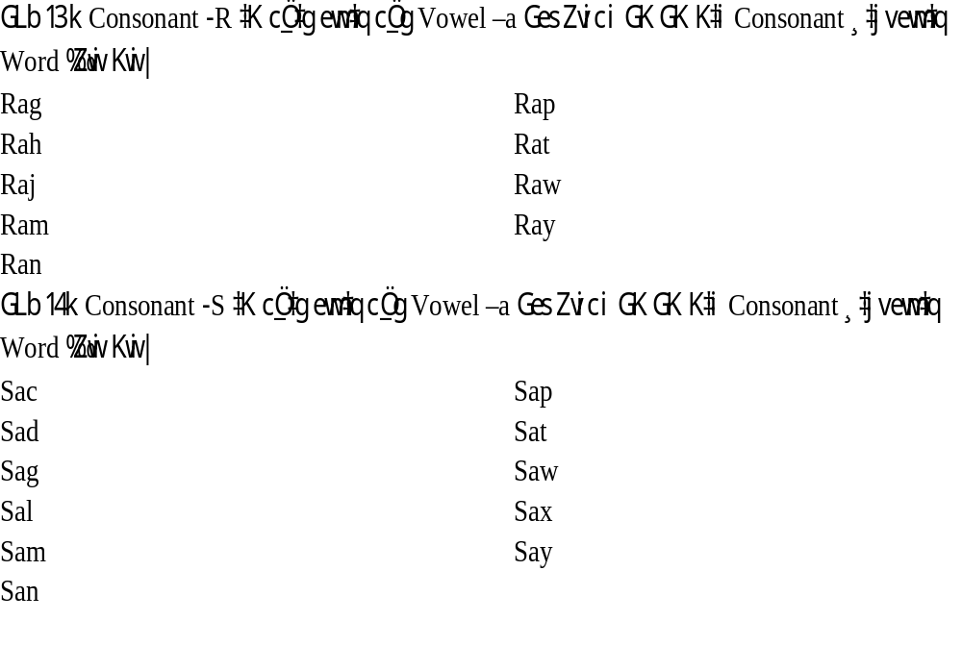

Slide 13
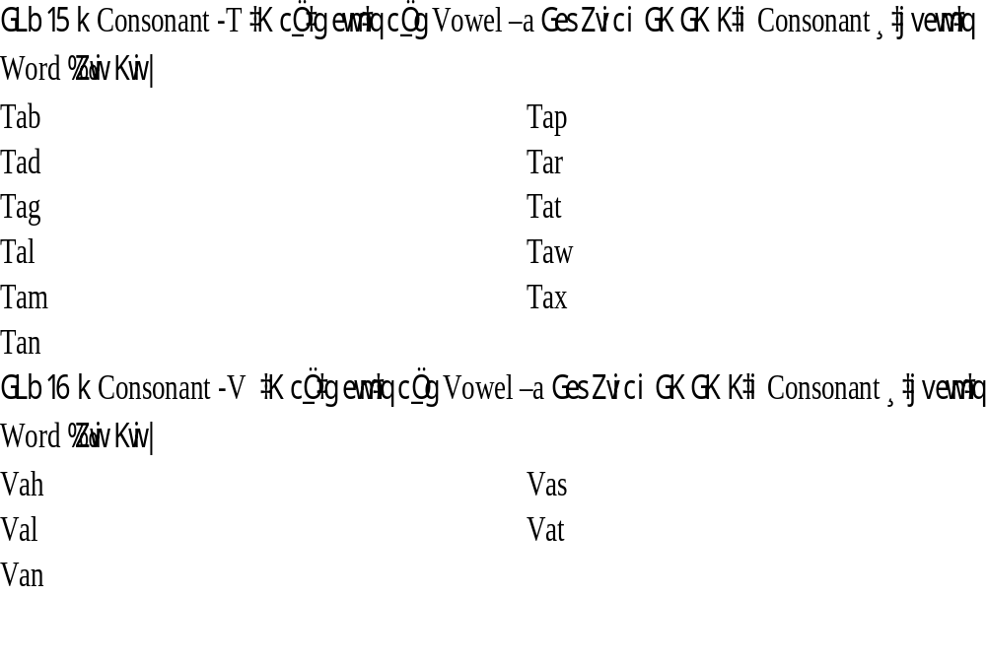

Slide 14
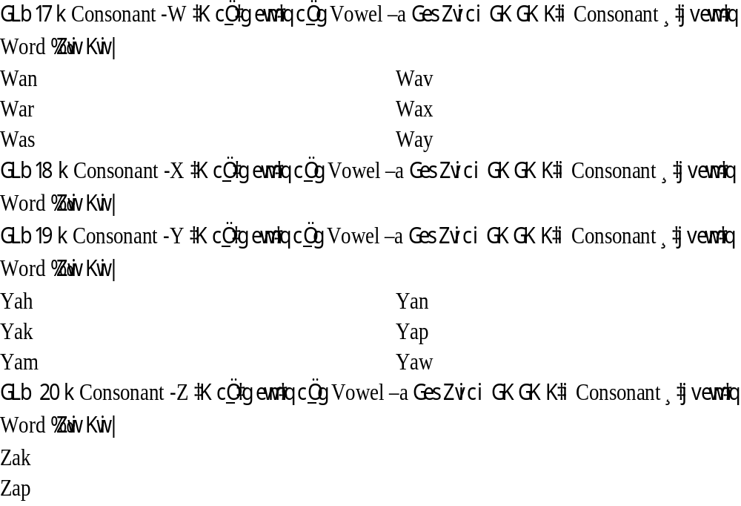

Slide 15
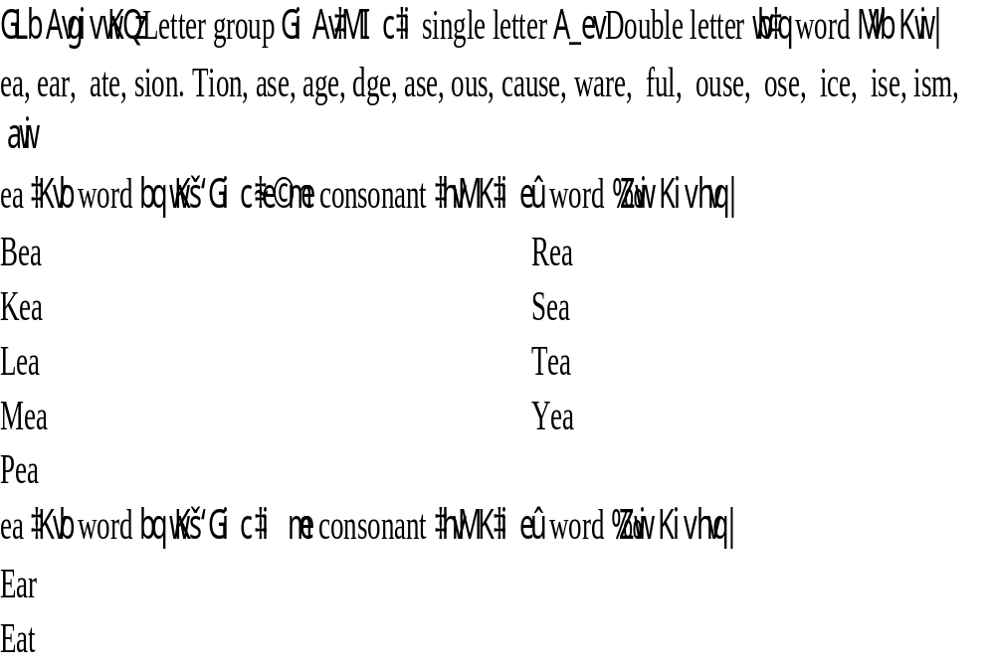

Slide 16
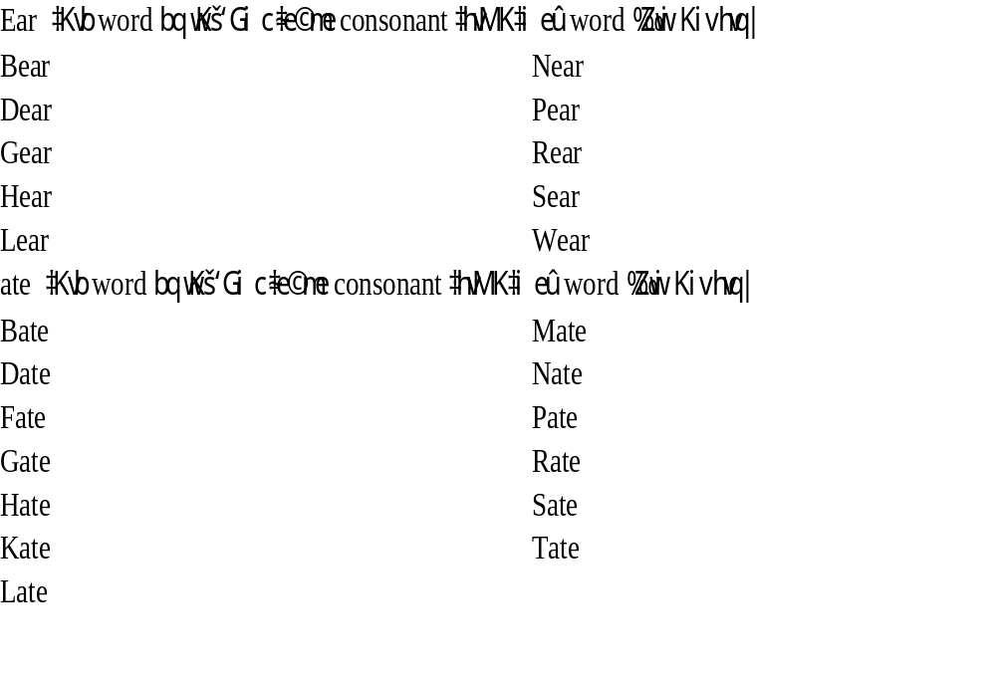

Slide 17
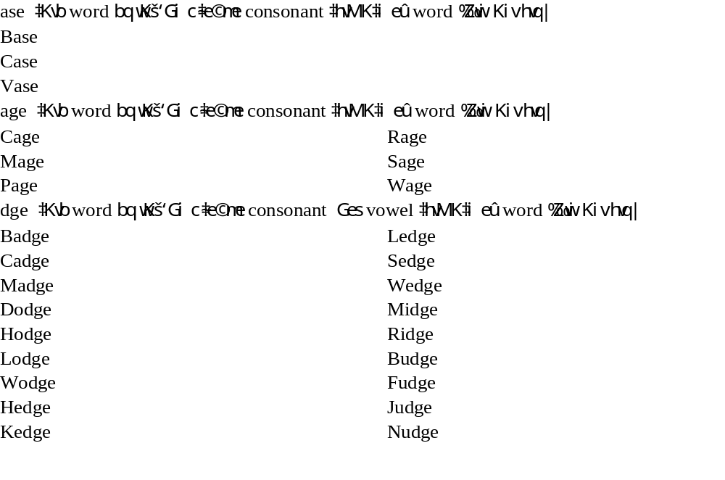

Slide 18
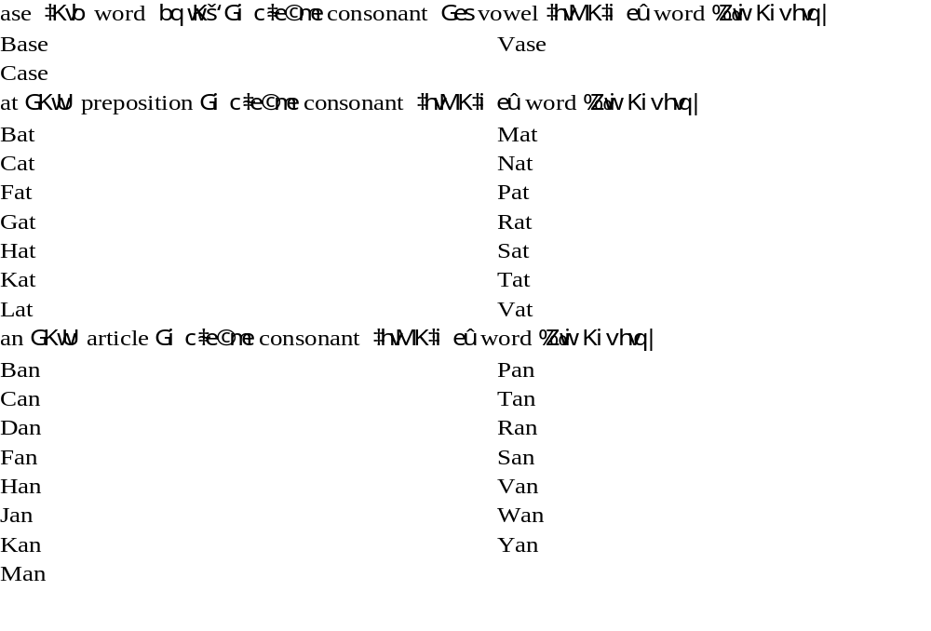

Slide 19
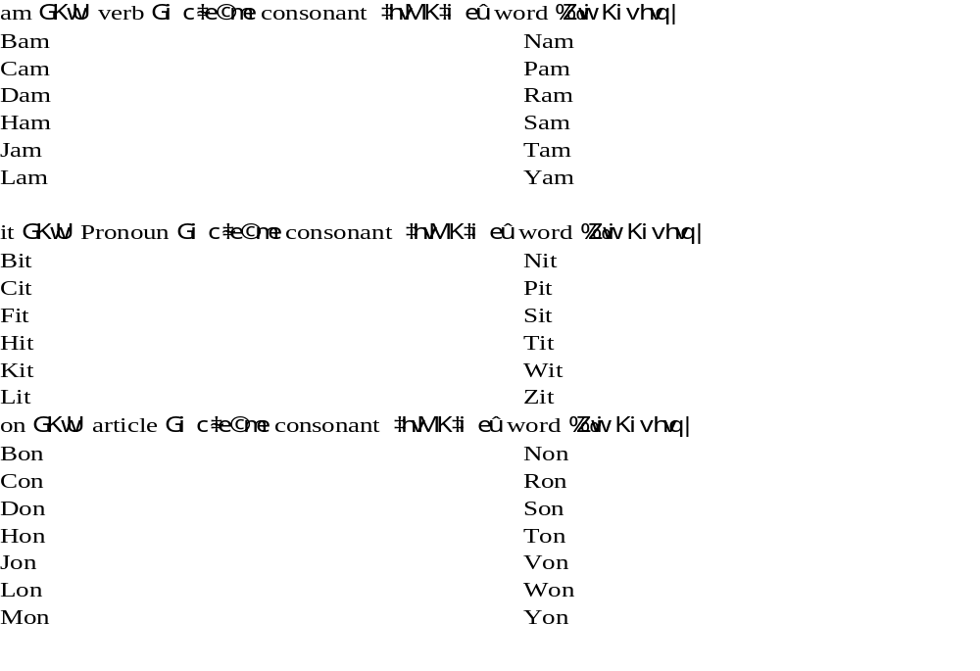

Slide 20
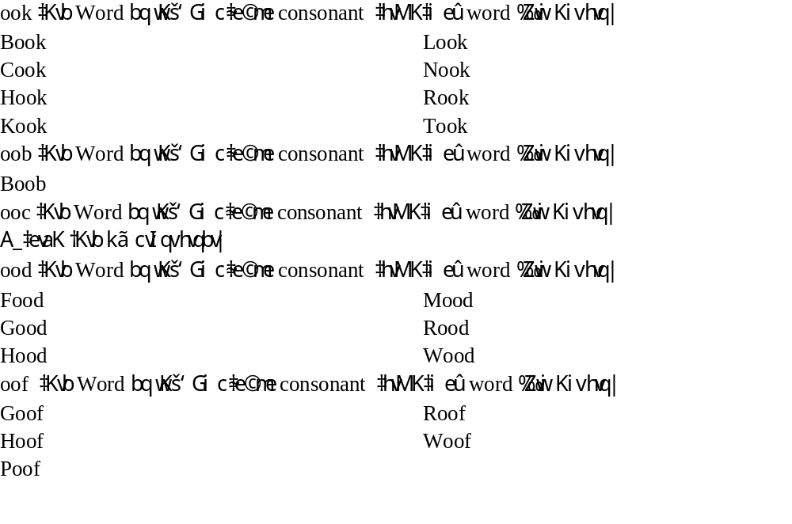

Slide 21
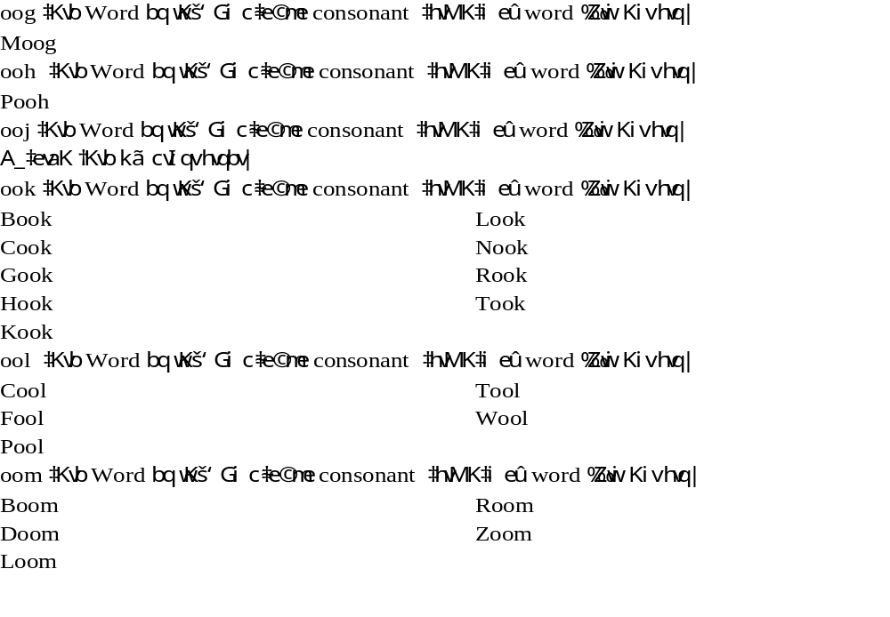

Slide 22
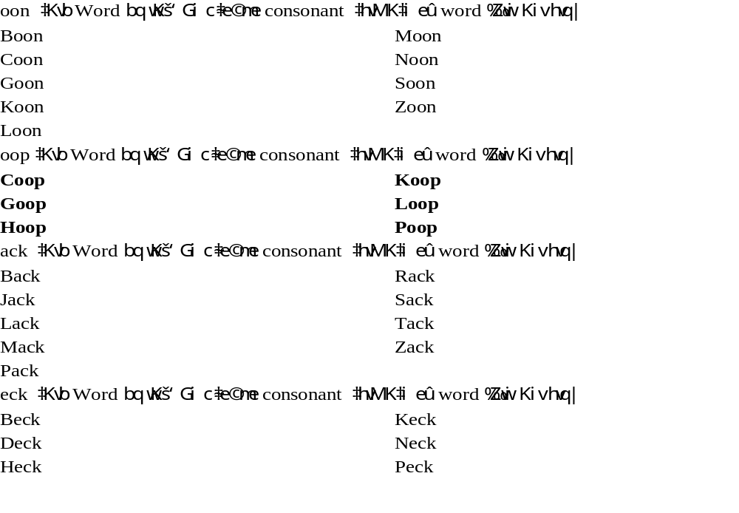

Slide 23
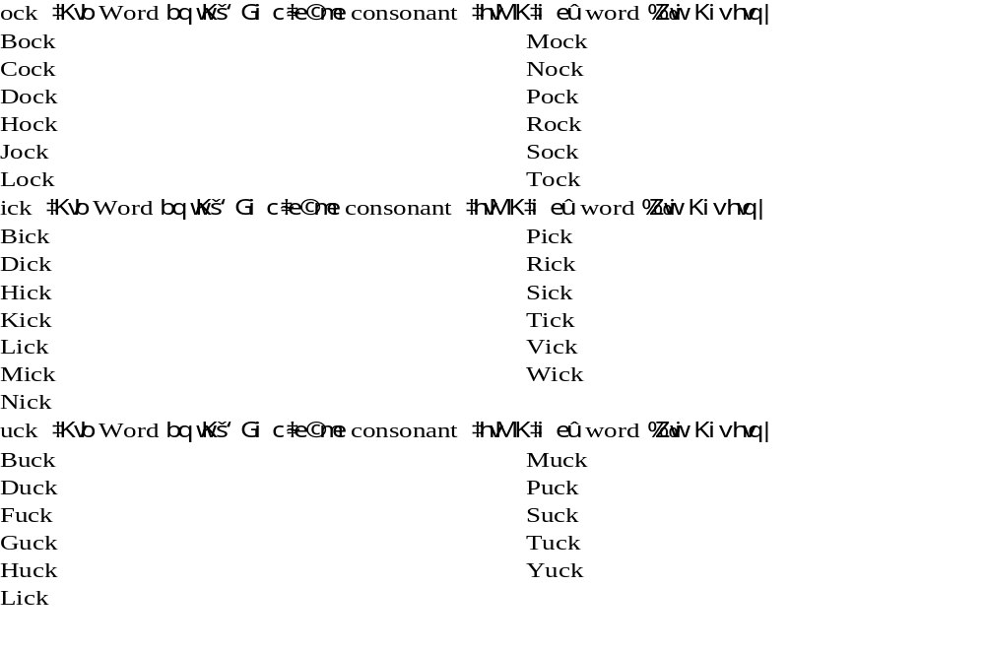

Slide 24
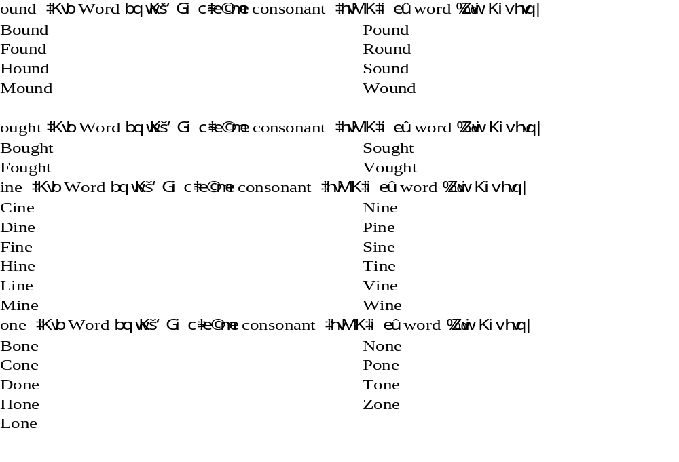

Slide 25
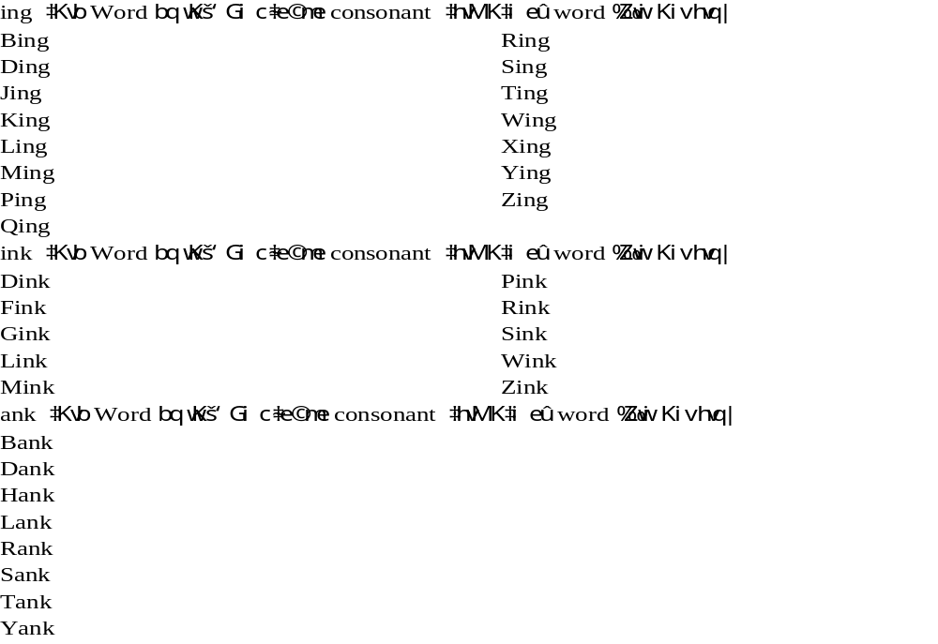

Slide 26
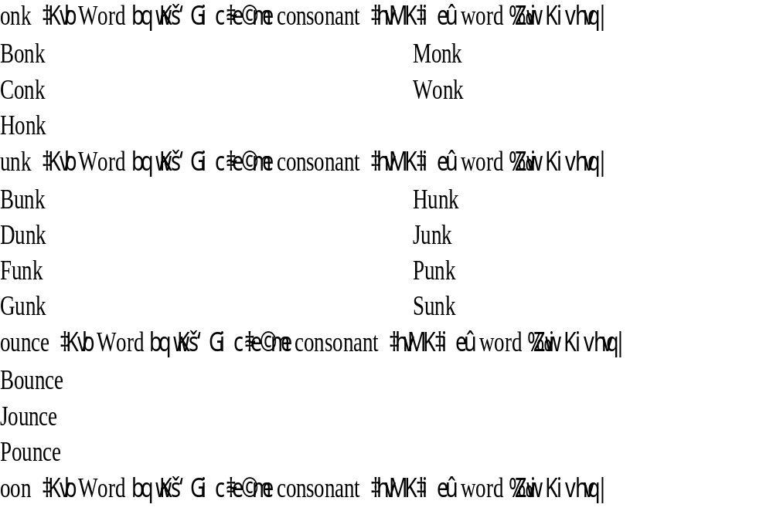

Slide 27

Let’s Finish Today.
Hope You All Enjoy the Class.
See You Tomorrow
And Thanks to ALL

