Slide 2
WELCOME

Slide 3
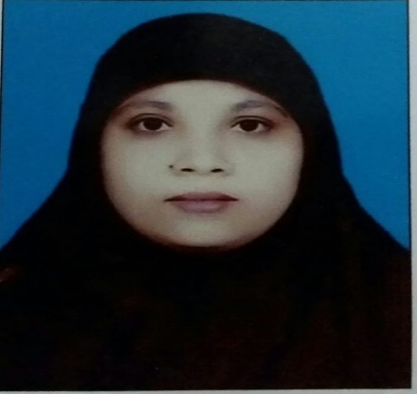
Presented By
Muktamony
Head teacher
Atashia Government Primary School
Shibpur , Narsingdi .

Slide 4
Lesson Introduction
Lesson’s Title : Write to me soon
Class : Five
Subject : English
Unit : 8, Lesson : 1
(Sima is…………..well soon.)
Time: 45 minutes
Date : --/-- /2024
Page-30

Slide 5
Learning Outcomes
Students will be able to- Listening:
1.2.1 recognize which syllable in a word is stressed.
1.3.1 recognize which word in a sentences are stressed. Speaking:
1.1.2 say sentences with proper intonation. 6.1.2 say what other are doing. 6.2.1 talk about people, objects, events etc. Reading: 5.1.1 read silently with understanding paragragh.

Slide 6
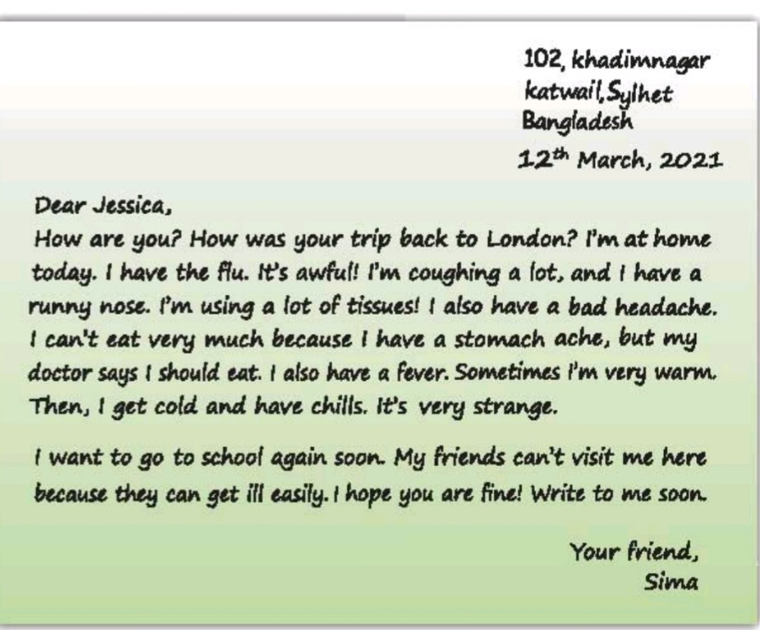
What can you see at the end of the letter ?
Can you guess, what may be our today’s lesson ?

Slide 7
Our today’s lessonOur
Write to me soon!

Slide 8
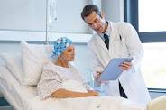
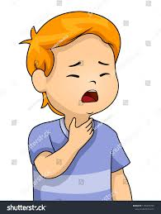
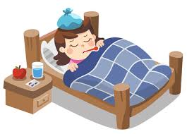
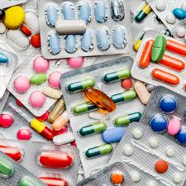
Doctor
Sima
Sima is at home today. She did’not go to school because she is ill. She has a cough and a shore throat.
She also feels warm today because she has a fever.

Slide 9
m
Medicine—ঔষধ
Sima needs some medicine.

Slide 10
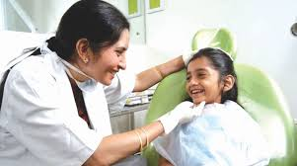
Home—বাড়ি
Sima is at home today.

Slide 11
Cough—কাশি
Sima has a cough.

Slide 12
Sore throat—গলা ব্যাথা
Sima has a cough and a sore throat.

Slide 13
Fever—জ্বর
Monir has a fever.

Slide 14
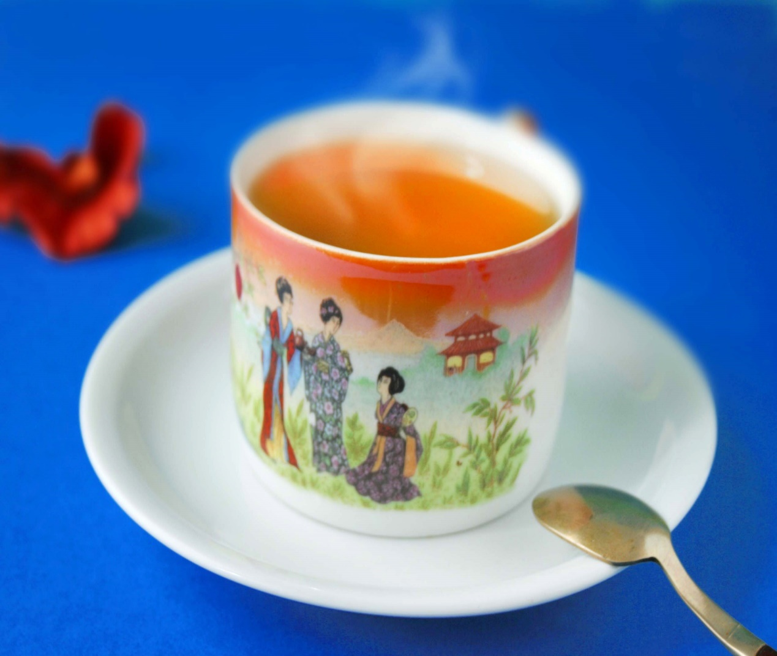
Warm—উষ্ণ
Dina feels very warm

Slide 15
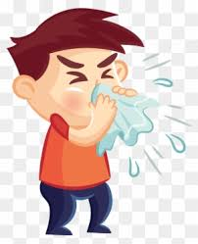
Flu—এক ধরনের ভাইরাস
Sima has the flu.

Slide 16
Home-বাড়ি –house
Ill-অসুস্থ —sick
Sore-পীড়াদায়ক – painful
Flu-এক ধরনর ভাইরাস – one kind of virus
Cough-কাশি —expelling air from the lungs
Medicine-ঔষধ —drug
Fever-জ্বর —increase of temperature in body
New words

Slide 17
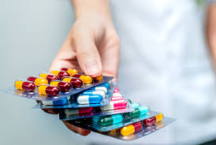
One day one word
Medicine -- ঔষধ
Sima needs some medicine.

Slide 18
Model reading

Slide 19
Write true or false
1. Sima is at school today. False
2. She has the flu. True
3. The nurse visited Sima last night. False
4. She needs no medicine . False
5. She has a fever and a cough . True

Slide 20
Questions
Where is Sima today ?
Answer : Sima is at home today.
b. Why did she not go to school ?
Answer: She didn’t go to school because she is ill.
c. What does she have ?
Answer : She has a cough and a sore throat.
d. What does she need ?
Answer : She needs some medicine.
e. Who visited Sima last night?
Answer : The doctor visited Sima last night.

Slide 21
Fill in the blanks with suitable words from the box.
Energy | patients | Some | illness | student | do | doctor | healthy
1.Sima is a ---------------------- .
2. Sima didn’t go to school because of her –---
------------
3. The ---------------------- visited Sima last night .
4. Sima needs ---------------------- medicine.
5. Foods give our body ---------------------- .
student
illness
doctor
some
energy

Slide 22
Group Work
Make sentences:
Rose:
Home, cough, flu
Lily:
Medicine, warm,visit

Slide 23
Homework
1.Write a short composition about Sima’s illness. (Write at least five sentences to the topic . Remember to use capital letters, punctuation, correct spelling and sentence structure.)

Slide 24
GOOD BYE

