Slide 2
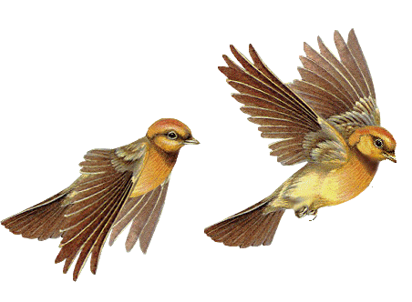
Welcome
Everybody

Slide 3
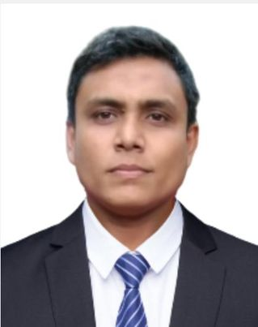
Teacher’s Identity
Mehedi Hasan Razib
Assistant Teacher
Charni lokkhi Govt. Primary school.
Kapasia, Gazipur.
Mob: 01914694764
Email: mhrazib735@gmail.com

Slide 4
LESSON INTRODUCTION
Class : Five
Subject : English
Unit : 14
Lesson : 2
Lesson Title : The hare and tortoise
Page : 55
Date: /07/2024

Slide 5
Learning Outcomes
At the end of class, Students will be able to
Listening
1.3.1.recognize which words in a sentence are stressed.
4.2.1.understand & enjoy simple stories.
Speaking
1.1.1.say words, phrases & sentences with proper sounds & stress.
1.1.2.say sentences with proper sounds & intonation.
6.2.1 talk about people, objects, events, etc
Reading
1.5.1 read words, phrases and sentences in the text with proper pronunciation, stress and intonation.
1.7.1 read paragraphs, dialogues stories, letters and other texts.

Slide 6
Let’s watch a video

Slide 7
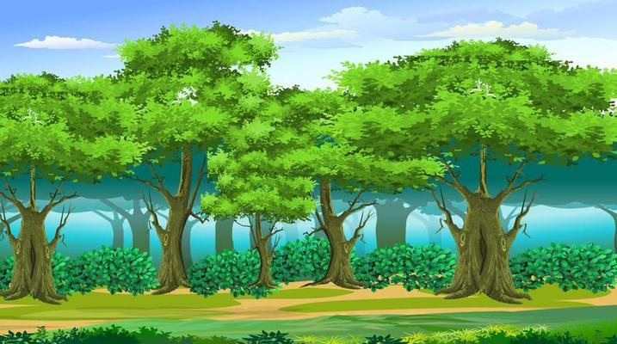
What do you see in the picture?
This is a forest.
Tortoise
Hare

Slide 8
Justify the previous knowledge
Who is the fastest animal in the forest?
The hare
Who is the slowest animal in the forest?
The tortoise

Slide 9
Today’s lesson
Story:
The hare
and
the tortoise

Slide 10
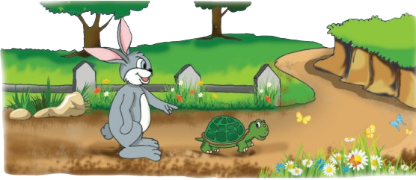
What do you see in the picture?
What can you see in the picture?
A hare and a tortoise
Who are there in the picture?
A hare and a tortoise
Where are they?
In a forest
What are they doing?
They are talking and walking.

Slide 11
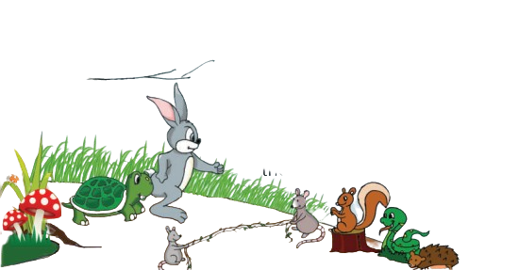
What do you see in the picture?
What are they doing?
They are beginning the race.
What are the other animals doing?
Watching the race.
Why are they holding the twig?
because the race will start here.

Slide 12
What do you see in the picture?
Where are the tortoise and the hare now?
in a race.
What is the hare doing?
taking rest
Why do you think the hare is taking rest?
Because the tortoise is far behind

Slide 13
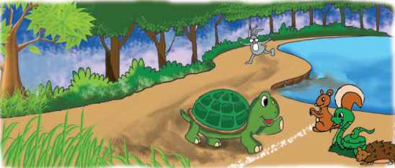
What do you see in the picture?
What can you see in the picture?
Final moment of the race.
Who won the competition?
the tortoise.
Why do you think the tortoise won the competition?
“Slow but steady wins the race”

Slide 14
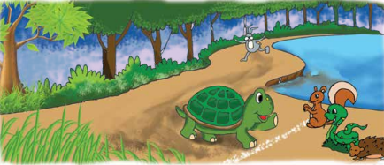
Teacher’s reading
Open your text book at page no: 55
Everybody put on your finger on the text sima and listen to me attentively
The hare ran quickly and in a few minutes the hare was out of sight. The hare said to himself, “The tortoise is very far behind. I can see the finish line. I have time for a nap!” Soon the hare was asleep under a tree next to the path.
The tortoise walked steadily, on and on. He didn’t stop. Soon, he passed the sleeping hare
The hare slept for an hour. When he finally woke up, he looked at the finish line. He couldn’t believe his eyes! Tortoise was almost at the finish line! The hare ran as fast as he could, but it was too late. The tortoise crossed the finish line and won the competition! The hare was furious!
The tortoise looked back at the hare and smiled. Then he said, “Slow but steady wins the race!”

Slide 15
Teacher’s reading
Everybody put on your finger on the text sima and listen to me attentively
The hare ran quickly and in a few minutes the hare was out of sight.
The hare said to himself, “The tortoise is very far behind. I can see the finish line.
I have time for a nap!” Soon the hare was asleep under a tree next to the path.
The tortoise walked steadily, on and on. He didn’t stop. Soon, he passed the sleeping hare.

Slide 16
Teacher’s reading
Everybody put on your finger on the text sima and listen to me attentively
The hare slept for an hour. When he finally woke up, he looked at the finish line.
He couldn’t believe his eyes! Tortoise was almost at the finish line!
The hare ran as fast as he could, but it was too late.
The tortoise crossed the finish line and won the competition! The hare was furious!
The tortoise looked back at the hare and smiled.
Then he said, “Slow but steady wins the race!”

Slide 17
New words
far
দূরে
out of sight
দৃষ্টি সীমার আড়ালে
behind
পিছনে
steadily
ধীরস্থিরভাবে
finish line
প্রান্ত বিন্দু
competition
প্রতিযোগিতা
nap
বিশ্রাম
furious
ক্রোধান্বিত
asleep
ঘুমন্ত
crossed
অতিক্রম করল

Slide 18
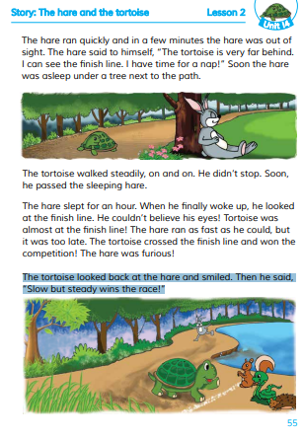
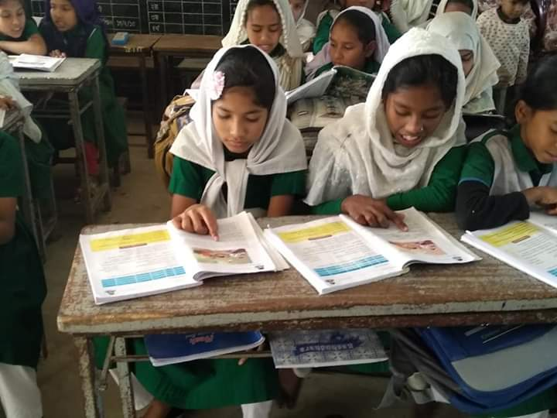
Pair work
Student Reading
Read the text attentively

Slide 19
Assessment
Read out the text.

Slide 20
Assessment
Why did the hare decide to take a nap?
What did the hare see when he woke up?
Why did the hare become furious?
How long did the hare sleep?
Where did the hare sleep?

Slide 21
Home work
Page- 55
Activity-A

Slide 22
Thank
You
All
See
You
Next
Class

