Slide 2
Welcome
Everybody

Slide 3
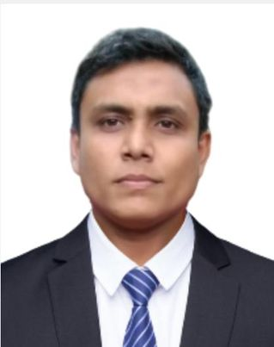
Teacher’s Identity
Mehedi Hasan Razib
Assistant Teacher
Charni lokkhi Govt. Primary school.
Kapasia, Gazipur.
Mob: 01914694764
Email: mhrazib735@gmail.com

Slide 4
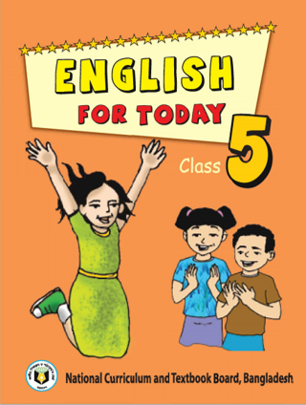
LESSON INTRODUCTION
Class : Five
Subject : English
Unit : 15
Lesson : 1
Lesson Title : Happy Birthday
Page : 58
Date: /07/2024

Slide 5
Learning Outcomes
At the end of class, Students will be able to
Listening
1.3.1.recognize which words in a sentence are stressed.
3.4.1 understand statements made by the teacher and students.
Speaking
1.1.1.say words, phrases & sentences with proper sounds & stress.
6.1.2 say what others are doing.
6.2.1 talk about people, objects, events, etc
Reading
1.5.1 read words, phrases and sentences in the text with proper pronunciation, stress and intonation.
1.7.1 read paragraphs, dialogues stories, letters and other texts.

Slide 6
Let’s watch a video

Slide 7
Justify the previous knowledge
Answer the following questions?
Do all of you know when your birthday is?
What do you do on that day?
Do you know when your family members’ birthdays are?

Slide 8
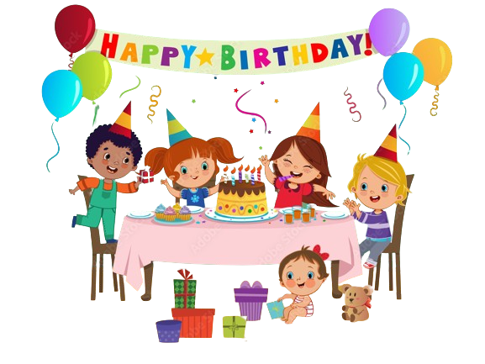
Let’s we see a picture
What do you see in the picture?
Happy Birthday

Slide 9
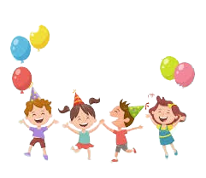
Today’s lesson
Our today’s lesson is………
Happy Birthday

Slide 10
What do you see in the picture?
What can you see in the picture?
A birthday party.
What is happening in the picture?
Celebrating a birthday.
Who are there in the picture?
Person, parents, friends and family.
What are they doing?
They are celebrating a birthday.
What is written on the top of the picture?
“Happy Birthday”

Slide 11
What do you see in the picture?
What do these packets look like?
Gift packets
What do we do with these packets?
To give different ceremony.
When do we present these to others?
Any occasion.

Slide 12
Teacher’s reading
Open your text book at page no: 58
Everybody put on your finger on the text sima and listen to me attentively
A person’s birthday is a special day. This is the date when the person was born. People around the world celebrate birthdays in different ways. In many countries, people celebrate with a cake. There are candles on the cake. There is one candle for each year of the person’s life. People sing a song for the person. At the end of the song, the person blows out the candles. How old is the birthday girl in the picture?
In some countries, there is often a party for a child’s birthday. The child’s friends come to the home. There is special food, like sweets. The children play games and sing. The friends often bring a birthday gift for the child. The gifts are wrapped in colourful paper. The gift may be a toy, a book or some clothes. In some countries, the friends don’t bring gifts. The most important thing is to enjoy the day and spend time with friends and family.

Slide 13
Teacher’s reading
Open your text book at page no: 58
Everybody put on your finger on the text sima and listen to me attentively
A person’s birthday is a special day. This is the date when the person was born.
People around the world celebrate birthdays in different ways. In many countries, people celebrate with a cake.
There are candles on the cake. There is one candle for each year of the person’s life. People sing a song for the person.
At the end of the song, the person blows out the candles. How old is the birthday girl in the picture?

Slide 14
Teacher’s reading
Open your text book at page no: 58
Everybody put on your finger on the text sima and listen to me attentively
In some countries, there is often a party for a child’s birthday. The child’s friends come to the home.
There is special food, like sweets. The children play games and sing.
The friends often bring a birthday gift for the child. The gifts are wrapped in colourful paper.
The gift may be a toy, a book or some clothes. In some countries, the friends don’t bring gifts.
The most important thing is to enjoy the day and spend time with friends and family.

Slide 15
New words
Birthday
জন্মদিন
Candle
মোমবাতি
Blow out
মোমবাতি
Special
বিশেষ
Born
জন্মগ্রহণ করা
Gift
উপহার
Celebrate
উদযাপন করা
Wrap
মোড়ানো
Cake
পিঠা
Enjoy
উপভোগ করা
Children
ছেলে মেয়েরা
Spend
ব্যয় করা

Slide 16
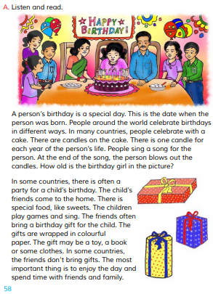
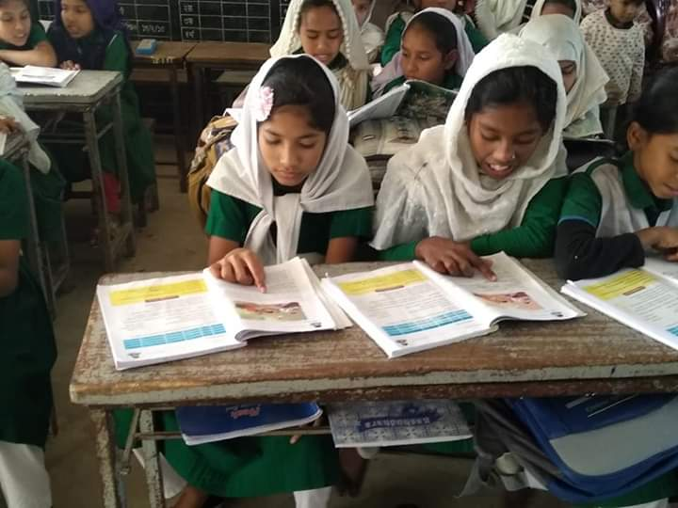
Pair work
Student Reading
Read the text attentively

Slide 17
Assessment
Find out the answer to the following question?
1. Do people around the world celebrate birthday in the same way?
Ans: No , people around the world celebrate birthday in the different way.
2. How do people celebrate birthday in most of the country?
Ans: People celebrate birthday with a cake in most of the country.
3.How many candles are put on the cake and why?
Ans: There is one candle for each year of the person’s age.
4. What do people bring to a birthday party?
Ans: People bring a birthday gift to a birthday party.
5. What is birthday?
Ans: A person’s birthday is a special day because this is the date when the person was born.

Slide 18
Assessment
Why did the hare decide to take a nap?
What did the hare see when he woke up?
Why did the hare become furious?
How long did the hare sleep?
Where did the hare sleep?

Slide 19
Home work
Page- 58
Activity-A

Slide 20
Thank
You
All
See
You
Next
Class

