Slide 2
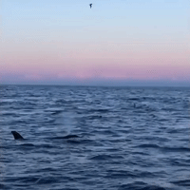
w
L
O
E
E
C
M

Slide 3
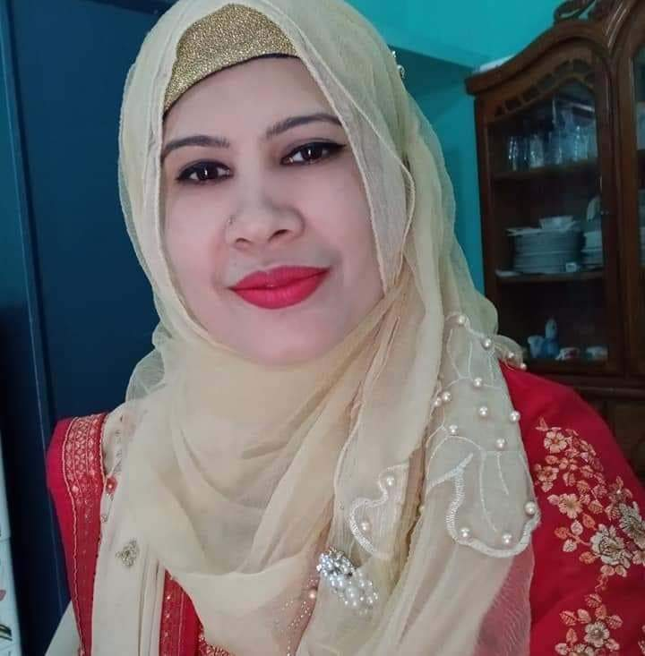
Teachers Idenity
Lesson introduction
Class :5
Unit :2
Lesson :1-2
Lesson Title :See you
Today’s lesson : A . Read and Say
Rupali khanom
Assistant teacher
Bhawakhali G.P. S
Narail Sador, Narail.

Slide 4
Learning outcomes: Students will be able to---
Listenig
1.3.1 recognize which words in a sentence are stressed
1.4.1 recognize and use intonation patterns for Yes\No and WH question
1.4.2 recognize and use intonation patterns for greetings and statements
3.2.1 understand question about family and friend of students
Speaking
1.1.1 say words phrases and sentences with proper sounds and stress
1.12 say sentences with proper intonation
2.1.1 exchange greetings and farewells
3.1.1 ask and answer with question
8.1.1 take part in conversation on appropriate topic
Reading
1.6.1 recognize and read statements ,commands ,greetings
1.7.1 read dialogues stories,letters and other texts

Slide 5
Let’s listen to a dialogue between two students

Slide 6
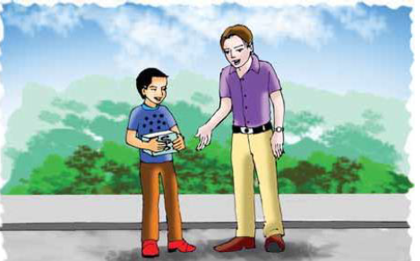
Let’s see a picture
Do you know Who they are? Now I will introduce you to them. They are Andy and Tamal.

Slide 7
Todays lesson
See you:A

Slide 8
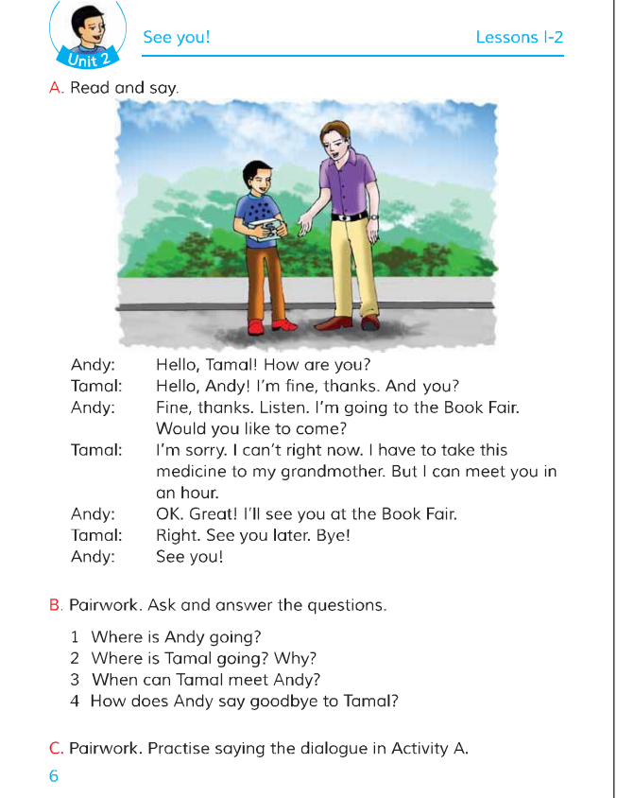
Open your textbook page at 6 and Let’s read the lesson carefully .

Slide 9
Pair work
Ask and answer the questions.
1.Who are speaking?
2.Who speak first?
3.Where is Andy going?
4.Who needs medicine?
Ans:Tamal and Andy
Ans:Andy.
Ans:Bookfair.
Ans:Tamal’s grandmother.

Slide 10
Let’s find out some new words from our today’s lesson:
Bookfair, right now, medicine, grandmother, great, later.

Slide 11
Make pair and practice this dialogue Again and again.
Make five groups and find out unknown words of this lesson(see you)
Rose | Bally | Lily | Lotus | Tulip
Find out unknown words | Find out unknown words | Find out unknown words | Find out unknown words | Find out unknown words

Slide 12
Evaluation
a. Dear students, Say five words from your text book one after one
b. Answer the flowing question:---
1.Who is going to the bookfair?
2.When can Tomal meet Andy?
3.How did Andy and Tamal take leave of each other?
Ans:Andy is going to book fair.
Ans:From an one hour.
Ans: See you later, bye---

Slide 13
Home task
Read out the lesson and find out some new words from your textbook tomorrow at home.

Slide 14
GOODBYE

