Slide 1
Welcome to today’s class.

Slide 2
Teacher’s Identification
Name: Tania Sultana
Designation: Assistant Teacher
School’s Name: Hossainpur Govt. Primary School
Sonargaon, Narayanganj.

Slide 3
Lesson Introduction
Class: 3, Subject: English
Unit: 21, Lesson: 1-2
Topic: Occupations
Parts of the lesson: Activity A
Time: 50 Minutes, Date: 26/06/2023

Slide 4
Learning Outcomes:
At the end of the lesson the students will be able to
Speaking:
1.1.1 repeat words, phrases and sentences after the teacher with proper sounds and stress.
6.2.1 talk about people and objects.
Reading:
1.4.1 read and match words and sentences with pictures.
Writing :
3.1.2 write words, phrases and sentences using non-cursive small letters.

Slide 5
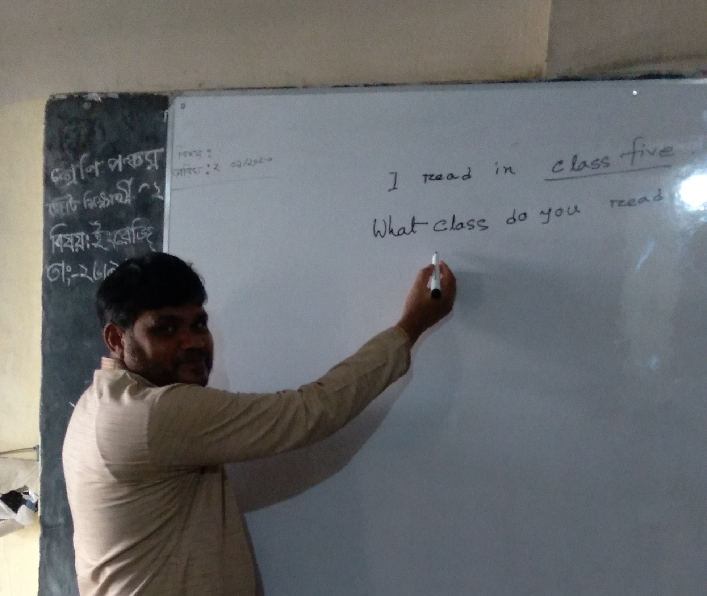
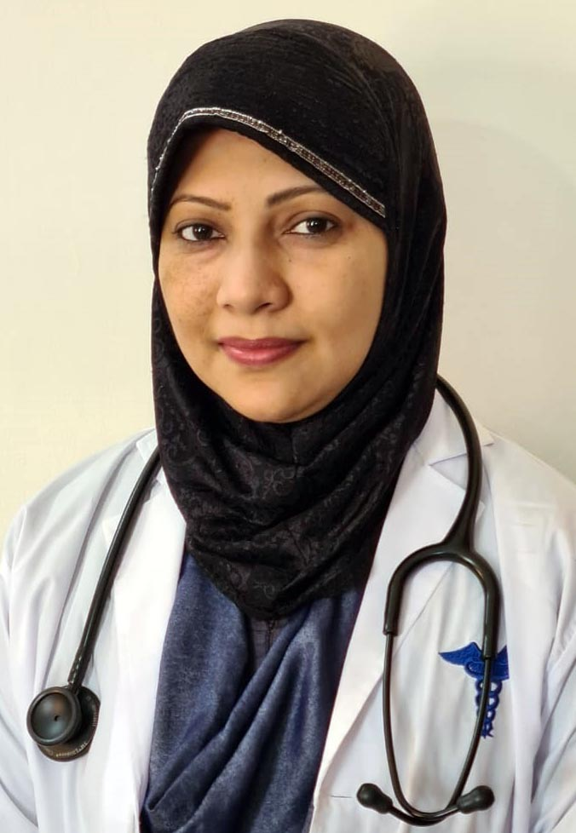
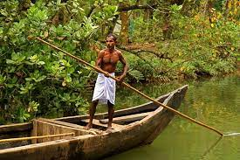
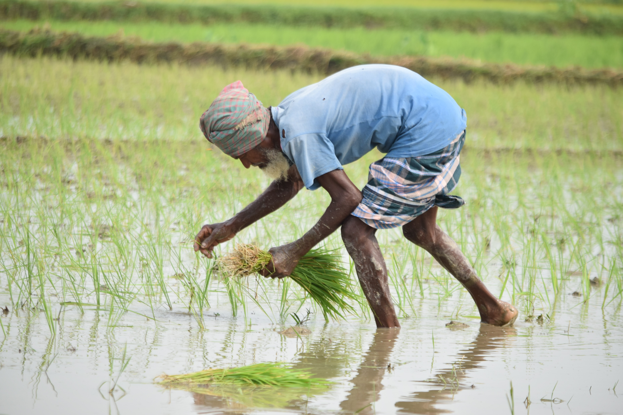

Slide 6
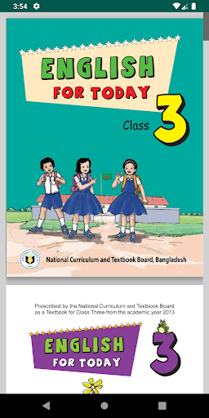
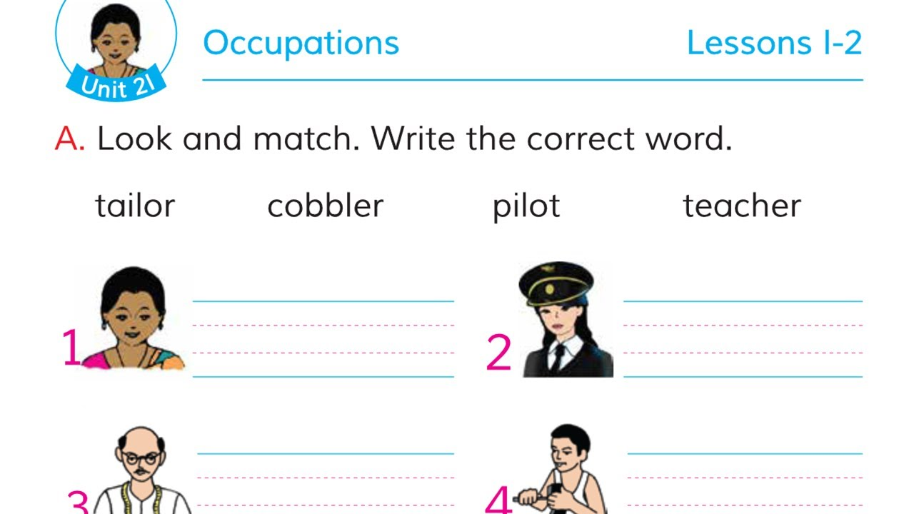
Now, open your English book ,page no 42.

Slide 7
Point the picture and say .
Teacher
Pilot
Tailor
Cobbler

Slide 8
Pair work
tailor
Look and match
cobbler
pilot
teacher

Slide 9
Individual work
Write the correct word.

Slide 10
You will write 5 sentences about your favourite occupation, and show me tomorrow.
Homework

Slide 11
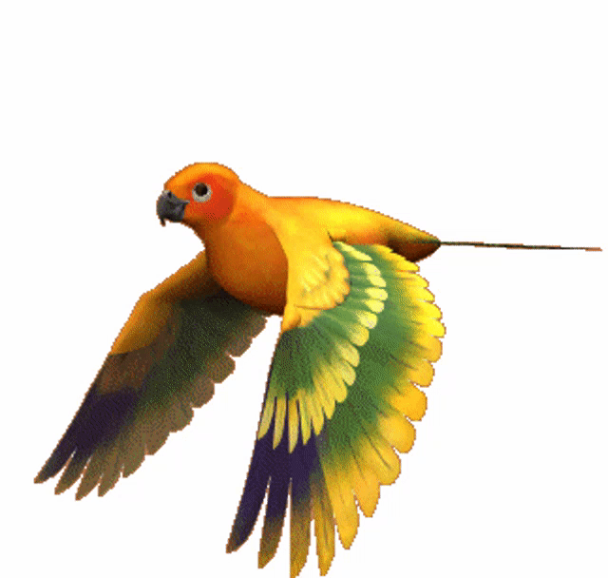
Goodbye, see you later in another class.

