Slide 1
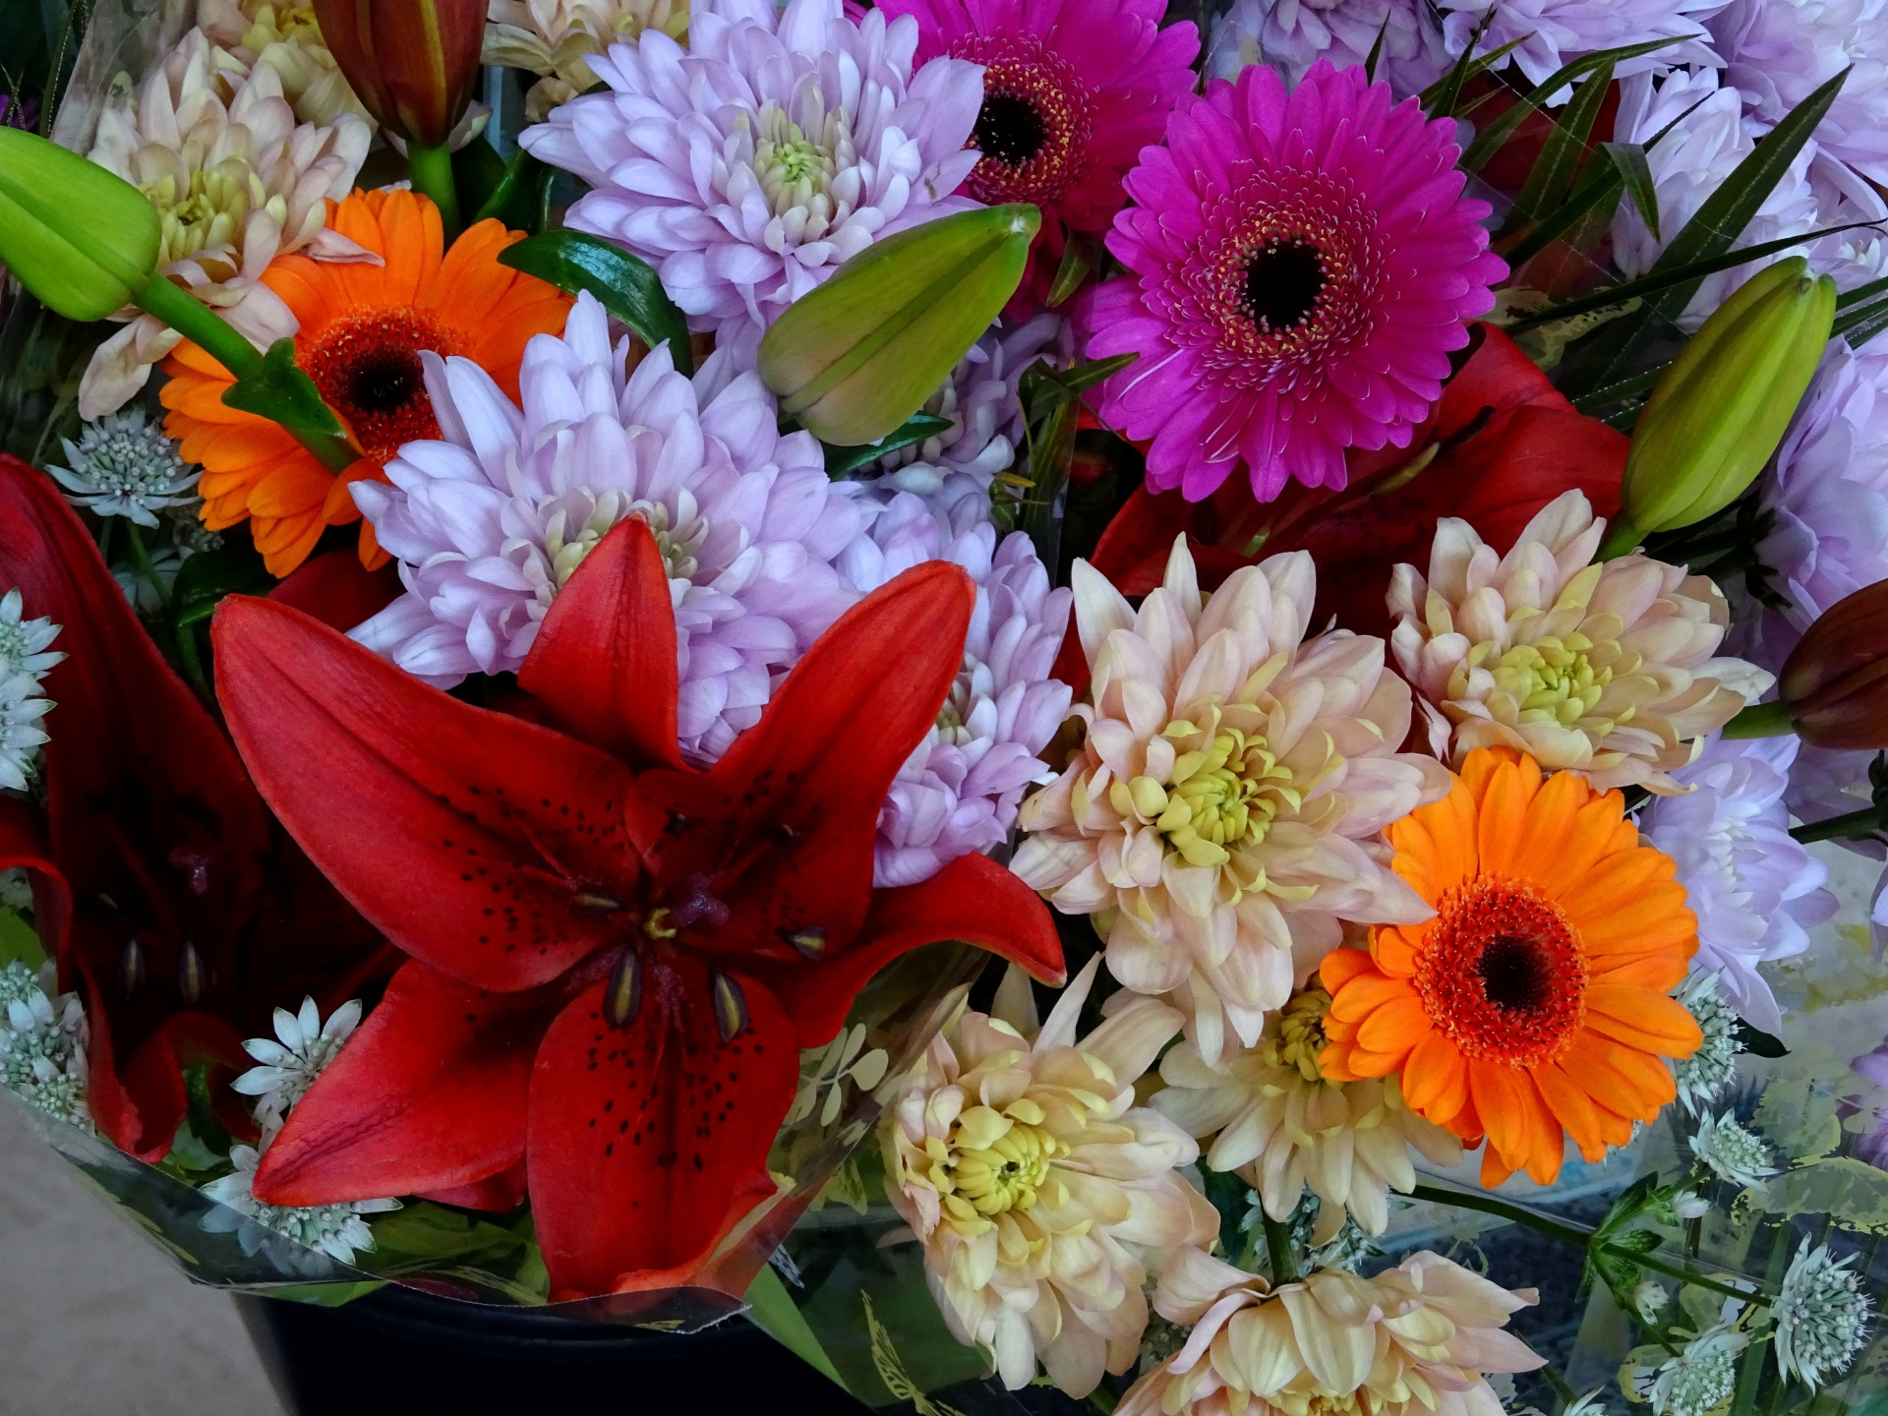
Welcome To My Class

Slide 2
Teacher’s Introduction
NASRIN AKTER
Assistant English Teacher.
Debpur Modinatul Ulum Dakhil madrasah

Slide 3
Subject: English Class : Nine Unit:2 Lesson : Nature’s Tapestry Prepared By:Nasrin Akter

Slide 4
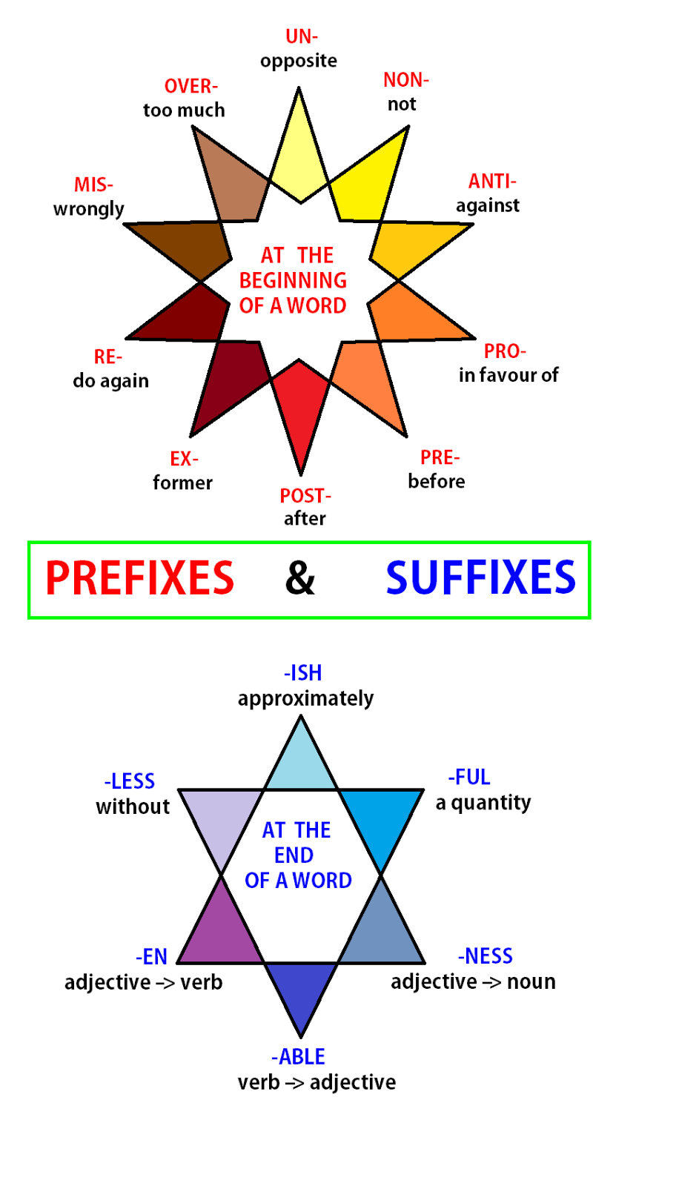

Slide 5
What do you see in the Picture?
Ans: SS
Yes, You are absolutely right.
We will Discuss about the “Suffix & Prefix” today.

Slide 7
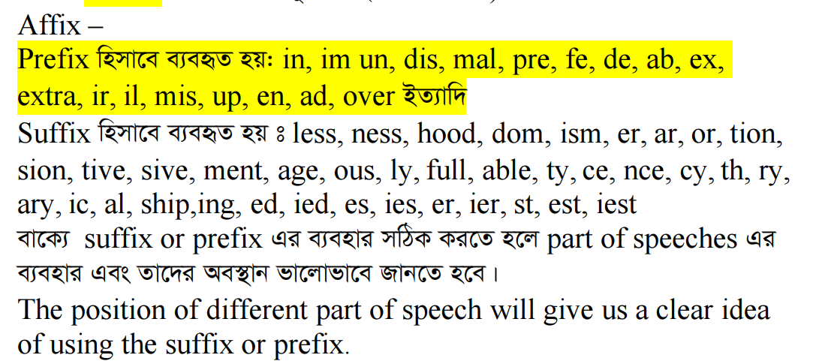

Slide 8
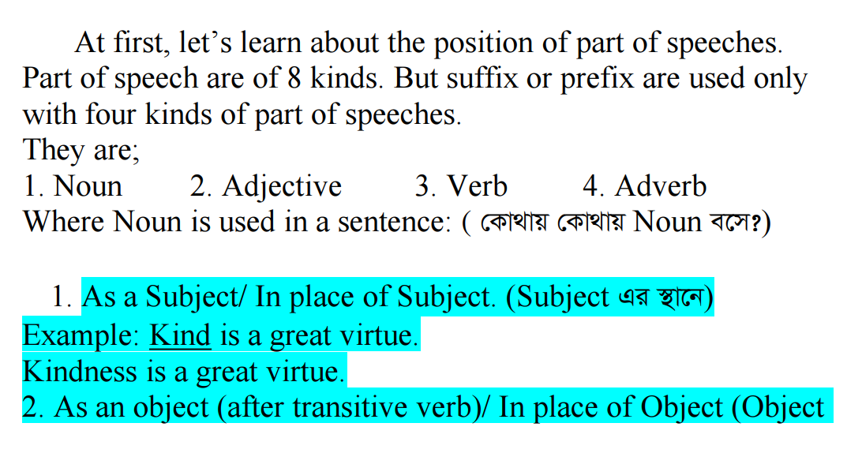

Slide 9
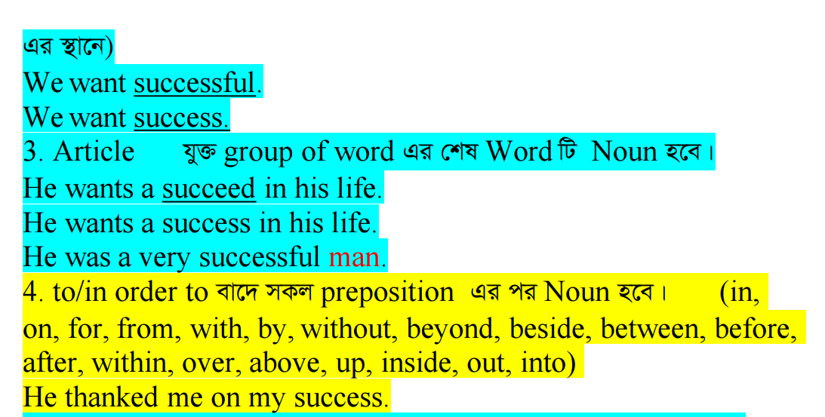

Slide 10
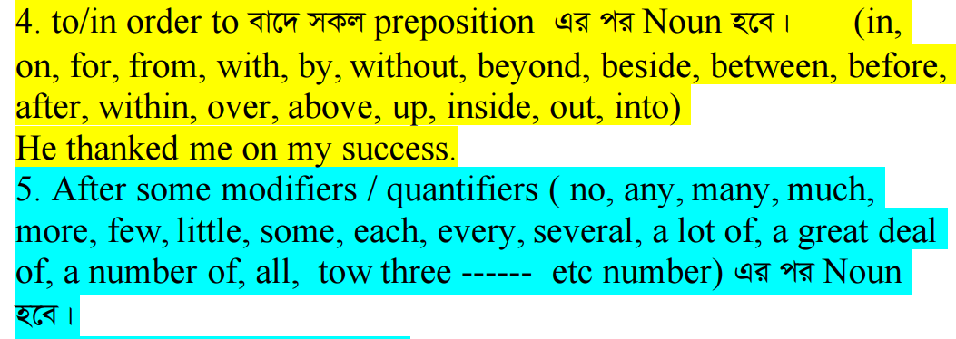

Slide 12
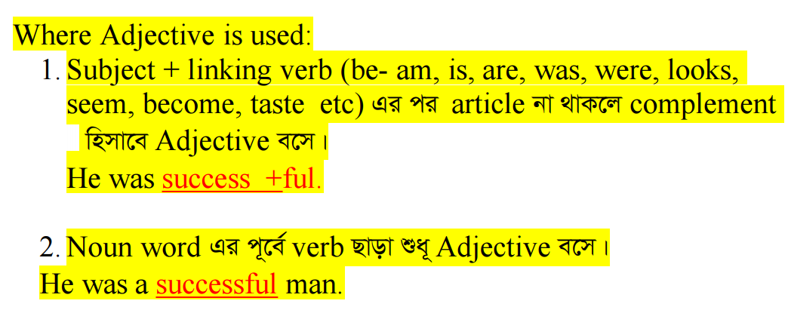

Slide 13
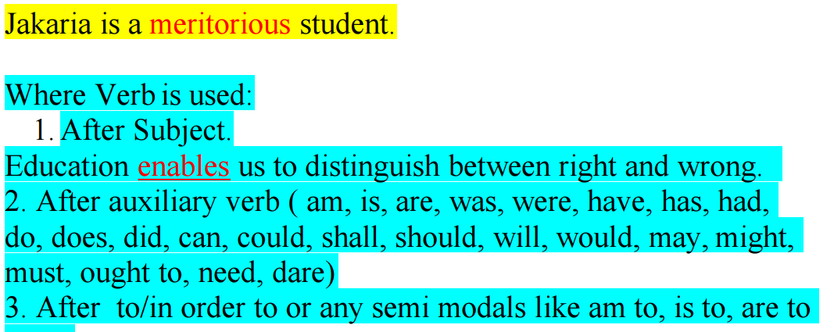

Slide 14
Let’s Finish Today.
Hope You All Enjoy the Class.
See You Tomorrow
And Thanks to ALL

