Slide 1
Welcome
You all to today’s lesson

Slide 2
আমার পরিচয়
শামীম মিয়া
ইবতেদায়ী শিক্ষক (বাংলা ও ইংরেজি)
০১৬ ২২ ৫৬৬ ৪৬৬

Slide 3
Introduction
Future lies in Present
Class Six
Myself
Shamim Miah
Ebtedai Teacher
Jalchatra Dakhil Madrasah
016 22 566 466

Slide 4
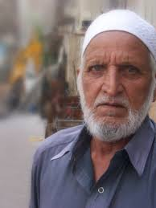
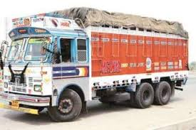
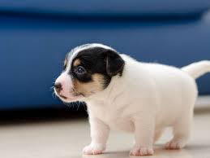
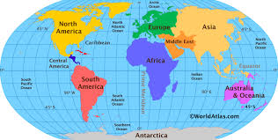
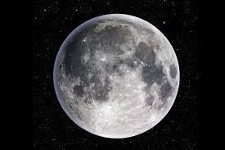
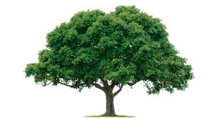
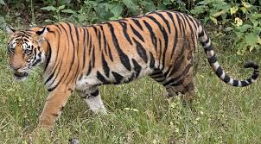
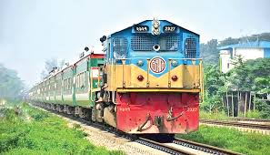
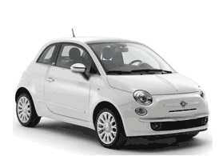
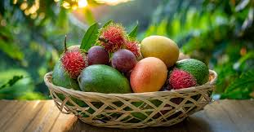
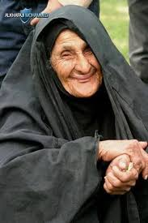
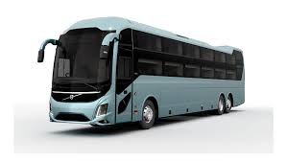
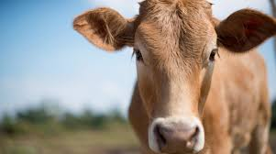

Slide 5
Introduction to the lesson

Slide 6
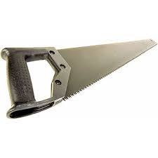

Slide 7
Noun
&
Its Classifications

Slide 8
Learning Outcomes-----
After completing the lesson, students are supposed to be able to
01. Discuss the definition of the NOUN
02. Identify the NOUNS and
03. Discuss the classifications of the NOUN

Slide 9
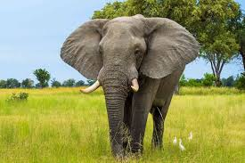
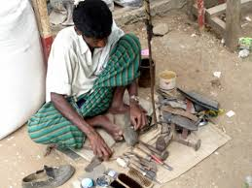
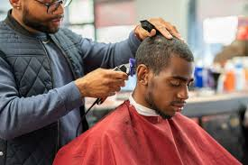
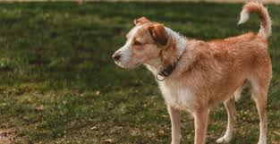
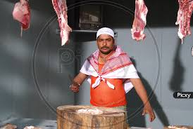
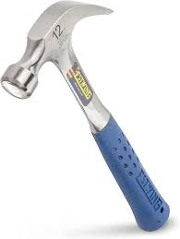
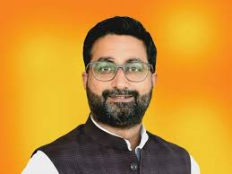
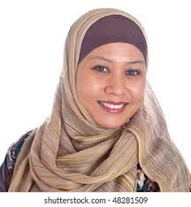
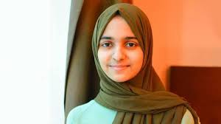
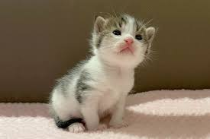
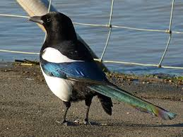
01. Man
02. Woman
03. Boy
04. Girl
05. Flag
06. Fruit
07. Bus
08. Dog
09. Book
10. Tree
11. Door
12. Bird
13. Cobbler
14. Barber
15.Ellaphant

Slide 10
Definition of NOUN
NOUN is a part of speech.
A noun is a word that names a person, place, thing, or idea.
02. NOUN is the naming word.

Slide 11
Pick out the NOUNS among the words below.
father, go, in, that, pick, alas! , moon , if, see, teacher, walk, out, Monika, than, Minto, be, kick, uncle, iron, she, naughty, happiness, truth, soon, leg, good, very, oxygen, wood, off, forest, pen, chair, cow, look, hardly, lion, owl, those, tall, feel, river, fall, crow,, hill, myself, fat, head, think, tomorrow, sight, of, as, Shima, country, because, false, kindness, Bravo! chemistry,

Slide 12
Classification of NOUN
NOUN
01. According to countability
02. According to Existence
01.Countable
02. Uncountable
01. Concrete
02. Astract

Slide 13
NOUN
01.. Proper
02. Common
03. Collective
04.Material &
05. Abstract
According to existence
01. Concrete
02. Abstract
01.Proper
01.Common
01.Collective
01.Material

Slide 14
Group Work
01. Write the name of each kind of NOUNS with minimum two example

Slide 15
Home Work
Writing minimum five examples with Bengali meaning of every sort of NOUN.

Slide 16
আজকের পাঠে অংশগ্রহণের জন্য
তোমাদের সকলকে

