Slide 1
Welcome

Slide 2
Syed Shakiruzzaman
Assistant Teacher of English
Pipayakandi Amanul Ulum Islamia Alim Madrdasah, Daudkandi , Cumilla
Class : Nine
Subject : English

Slide 3
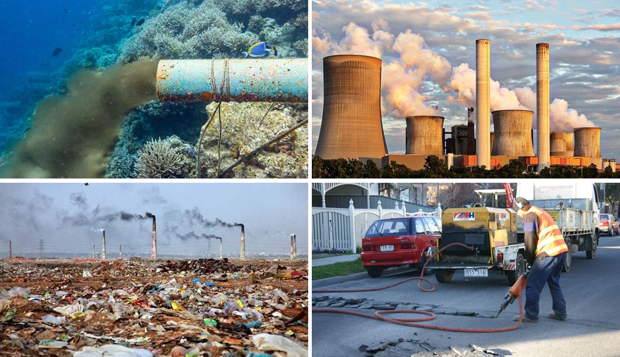

Slide 4
Environment Pollution

Slide 5
Environment pollution
Environment pollution is a complex and urgent global issue that threatens the health of our
planet and its inhabitants. It encompasses air pollution, water pollution, and soil pollution, each with its set of consequences. Air pollution, primarily caused by industrial activities and transportation, results in respiratory illnesses, cardiovascular problems, and environmental damage. Water pollution, often due to industrial discharges and inadequate waste management, endangers aquatic ecosystems and human health. Soil pollution, stemming from the use of chemicals and improper waste disposal, harms agriculture and food security. To combat environment pollution, concerted efforts are required at individual, community, and government levels. Reducing emissions from industries, promoting renewable energy sources, and implementing cleaner transportation options can alleviate air pollution. Proper waste disposal, wastewater treatment, and stricter regulations on chemical use are essential to tackle water pollution. Sustainable farming practices, reduced use of pesticides, and soil conservation techniques can mitigate soil pollution. Awareness and education play a crucial role in addressing pollution. By adopting eco-friendly lifestyles, conserving resources, and supporting policies that prioritize environmental protection, we can contribute to a cleaner, healthier planet. Pollution knows no borders, and it affects us all. It is our responsibility to take action and work together to ensure a sustainable and pollution-free future for generations to come.

Slide 6
→ Students will be able to say the meaning of the text
→ Students will be able to say the causes of the problems
→ Students will be able to say the solution of the problem

Slide 7
Word meaning
Environronment : পরিবেশ
Pollution : দূষণ
Damage : নষ্ট করা
Complex : জটিল
Urgent : জরুরী
Global : বিশ্ব
Planet : গ্রহ
Energy : শক্তি
Awaeness : সচেতনতা
Responsibility : দায়িত্ব
Priority : প্রাধান্য
Contribution : অবদান
Conversation : আলাপআলোচনা
Renerwable : নবায়নযোগ
Essential : প্রয়োজনীয়

Slide 8
Write a paragraph about Environment Pollution.

Slide 9
Have a nice day!
Thanks

