Slide 2
Introduction
Name : Fatema Akter
Designation : Lecturer in English
Khalna Islamia Fazil Madrasa
Patnitala, Naogaon.
Subject : English
Class: Six
Duration :45 minutes

Slide 3
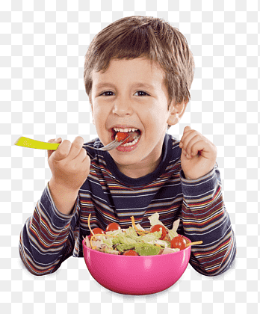
Look at the picture attentively Can you guess what are they doing ?

Slide 4
ACTION

Slide 5
Learning Outcome:
SS will be able to define Verb
SS will be able to classify Verb

Slide 6
Verb
A verb is a word that expresses an action .
A doing word is called a verb.
A verb is a word that shows action.
Example: Run, Walk,Swim,Eat,See
Rahim goes to school regularly.
I drink milk.
They are smart.

Slide 7
Single Task
Write down what is verb ?

Slide 8
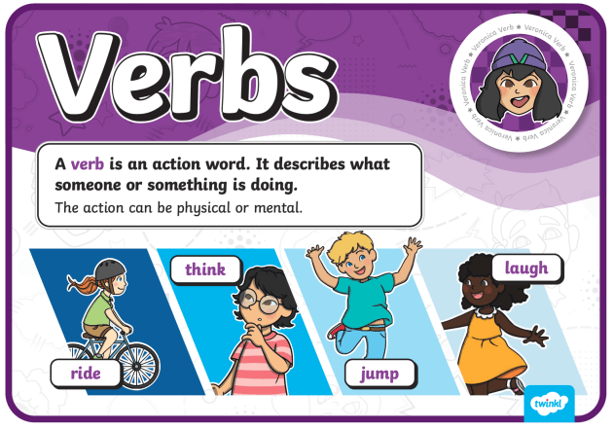
Let”s Match with our writing

Slide 9
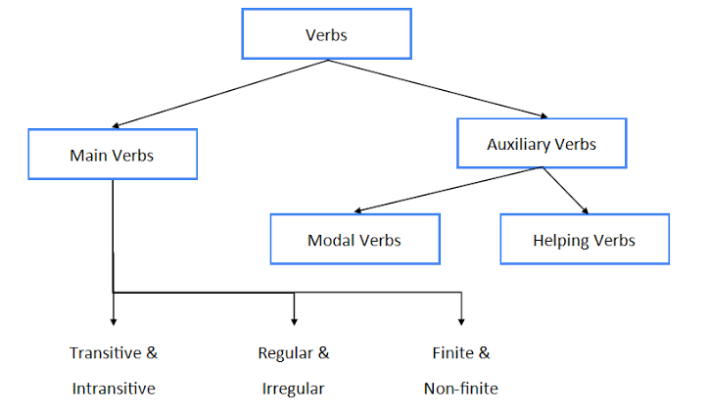
Classification of Verbs
Example of Verbs
Rahim goes to school.
I eat potato.
Rahim is going to school.
We were eating potatoes.
Goes
Eat
Is
were
Main Verb
Auxiliary Verb

Slide 10
Single Work Think a while and note down the types of verbs

Slide 11
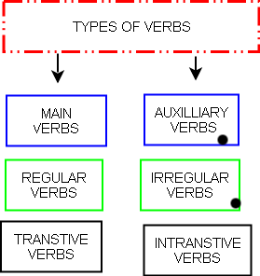
Let’s Find Answer

Slide 12
Work to be done at Home
WRITE DOWN THE DEFINITION & TYPES OF VERBS

Slide 13
And

