Slide 1
W
E
L
C
O
M
E

Slide 2
Teachers introduction
Rezvi Akter Tinny
Assisstant Teacher
Shorifabad Government primary school.
Louhojong , Munshiganj.

Slide 3
Lesson introduction
Class : One
Sub : English
Unit : 2
Lesson : 13
Session 01 : A,B
Page : 39

Slide 4
Learning outcomes
The students will be able to know-
1.1.1 recognize the sounds of the alphabet in familiar words
3.1.1 say proper sounds of the letters in familiar words.
4.1.1 read the pictures of familiar objects and events.

Slide 6
kite

Slide 7
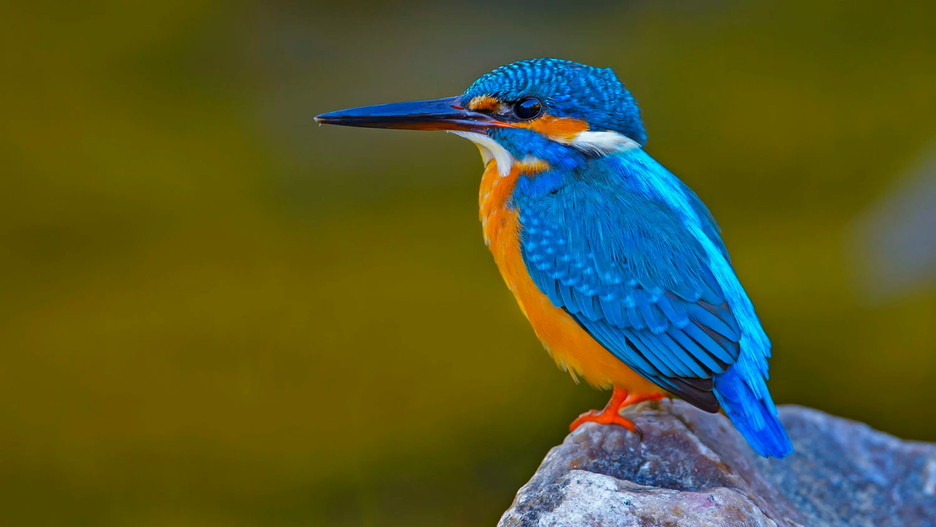
Kingfisher

Slide 8
Lotus

Slide 9
Leaf

Slide 10
Listen,say and read
Kite
K
Kingfisher
K

Slide 11
Listen,say and read
Lotus
l
L
leaf

Slide 12
Lotus
Leaf
Kite
Kingfisher
Notes:
Pair work

Slide 13
Individual assessment
Read and match the small and capital letters
l
K
L
k

Slide 14
Thank you

