Slide 1
WELCOME

Slide 2
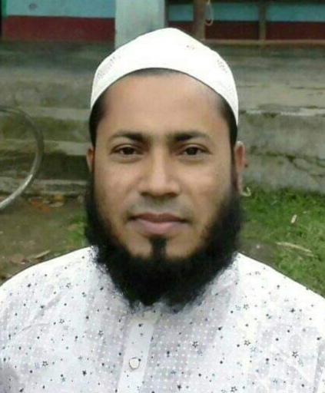
Teacher’s Identity
Shohel Miah
Assistant Teacher
Kongsherkul GPS,
Bhaluka, Mymensingh.
Mobile- 01612562053

Slide 3
LESSON INTRODUCTION
Class : Four
Subject : English
Unit : 39
Lesson : 1 (A, B, C)
Lesson Tittle : Occupations
Time: 40 minutes Date: 19.06.24

Slide 4
Learning Outcomes
Speaking:
1.1.1 Repeat after the teacher and say words, phrases
and sentences with proper sounds and stress.
3.1.1 To ask and answer simple WH question.
6.2.1 Talk about people, objects, event etc.
Reading:
1.4.1 Read word, phrases and sentences in the text.
1.5.1 Word, phrases and sentences in the text with proper pronunciation, stress and intonation
Writing:
3.1.1 Words, phrases and sentences using non-cursive capital and small letters.

Slide 5
1
What does your father do?
2
What does Your Mother do?

Slide 6
What is your Aim?
Farmer
Enginer
Driver
Police
Doctor
Teacher

Slide 7
Lesson Title
Occupations

Slide 8
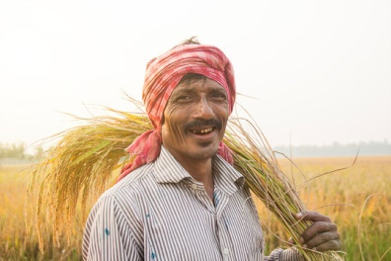
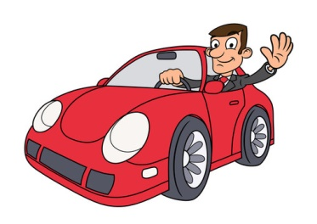
Different Types of Occupation
Farmer
Doctor
Driver

Slide 9
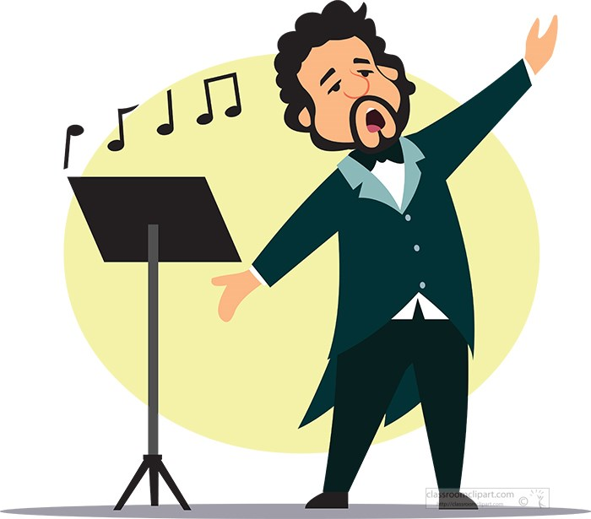
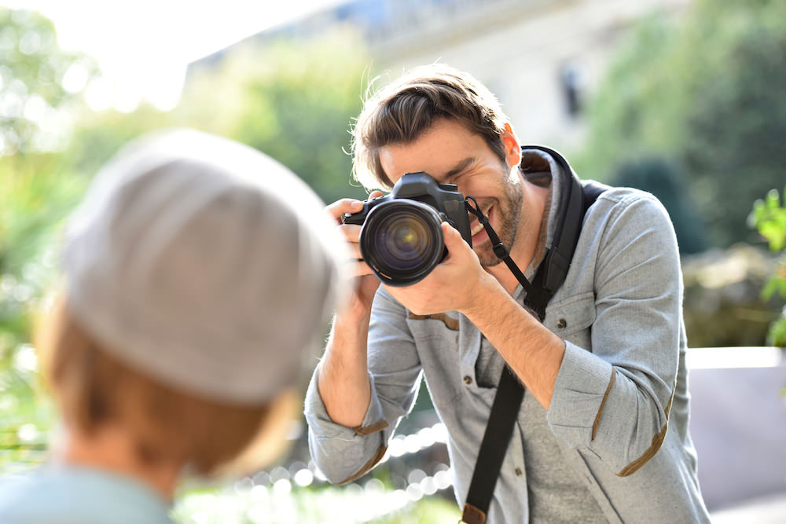
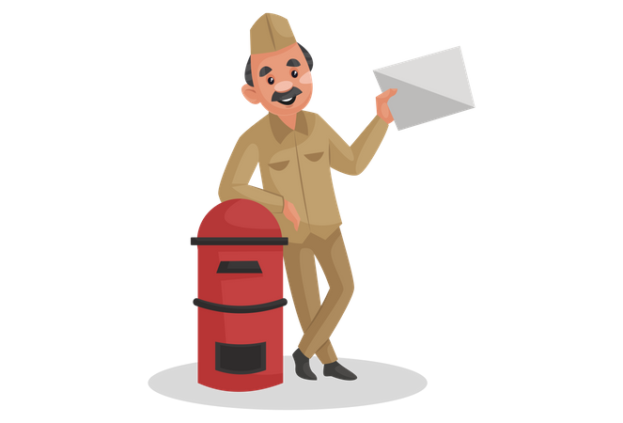
Different Types of Occupation
Singer
Photographer
Postman

Slide 10
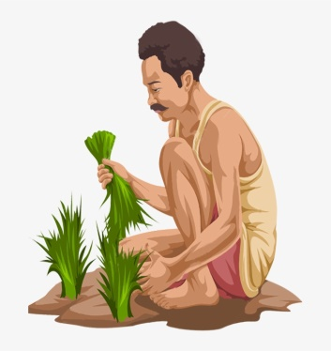
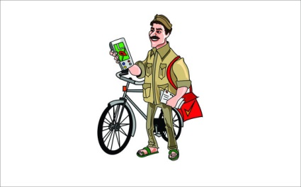
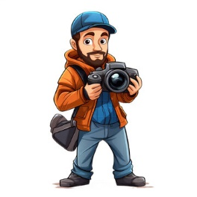
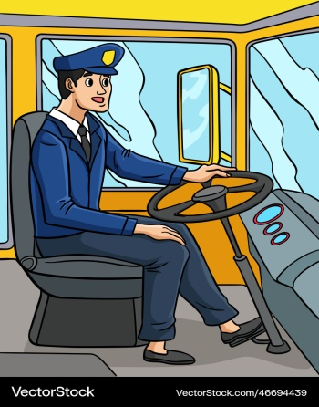
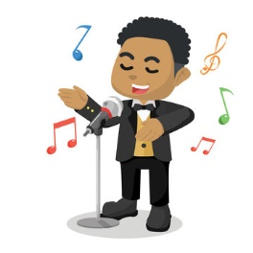
Picture and word matching
(Say and repeat)
Driver
Doctor
Postman
Farmer
Singer
Photographer

Slide 11
New Word & Word meaning
Singer : গায়ক/গায়িকা
Farmer : কৃষক
Driver : চালক
Photographer : আলোকচিত্রকর
Postman : ডাকপিয়ন
Doctor : ডাক্তার

Slide 12
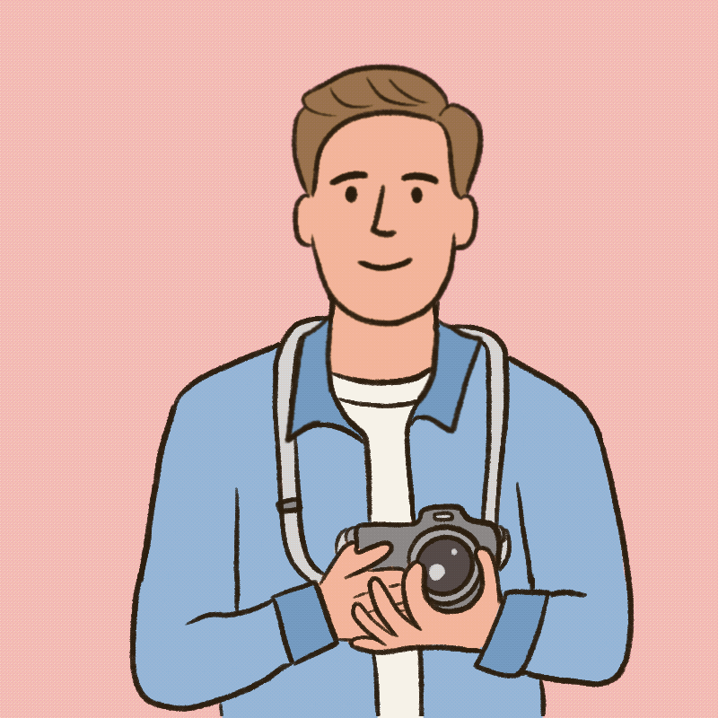
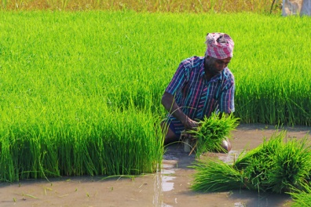
What do they do?
Photographer takes photo
Farmer grows food

Slide 13
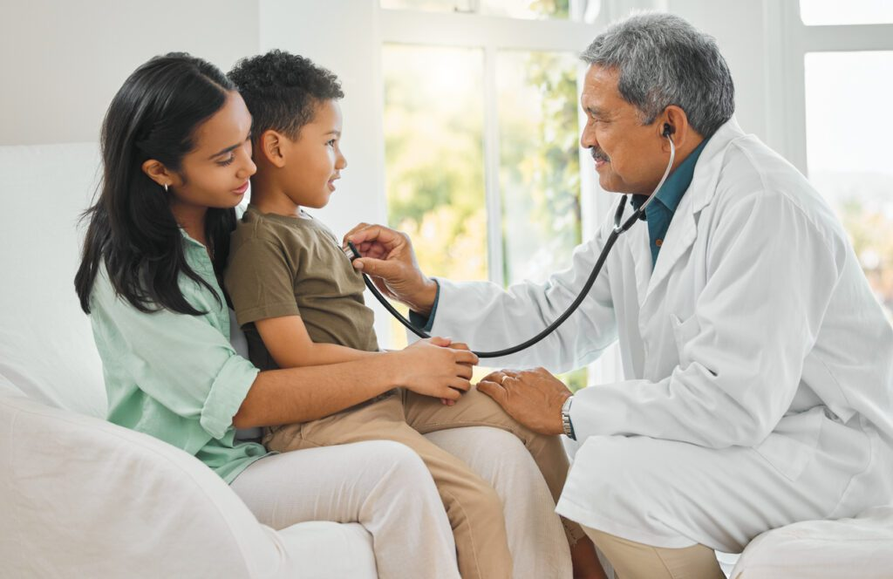
What do they do in Picture?
Doctor helps sick people
Postman brings letters to people

Slide 14
What do they do?
Driver drives car and bus
Singer sings songs

Slide 15
Group Work
Group A | Who grows food?
 | Who sings song?
Group B | Who helps sick people?
 | Who takes photos?
Group C | Who brings letters to people?
 | Who drives a car or a bus?

Slide 16
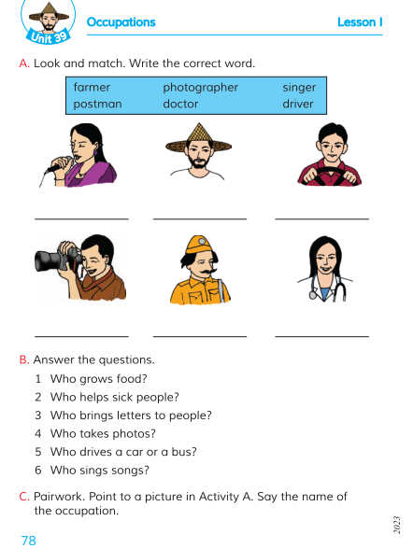
Open your book (Page no. 78)
Look and Match.
Write the correct word individually
(Using Non-cursive Capital & Small Letter)
Notes:
***Individual Work***

Slide 17
Assessment
Farmer
Photographer
Singer
Postman
Doctor
Driver

Slide 18
Summary And Feedback
Who grows food?
Farmar
Who helps sick people?
Doctor
Who brings letter?
Postman
Who takes photos?
Photographer
Who drives car or bus?
Driver
Who sings a songs?
Singer

Slide 19
Write Five sentences about your favorite occupation.

Slide 20
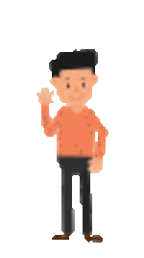
Thanks to All

