Slide 1
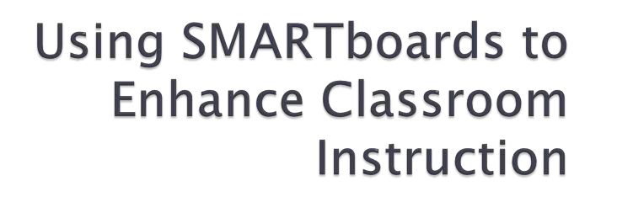


Slide 2


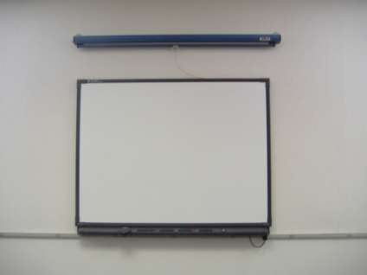
 A SMARTboard is a type of interactive whiteboard created by SMART Technologies.
 It provides touch control for computer applications.
 It gives the teacher a way to make their lessons interactive for the class.
Image provided by

Slide 3

 It was first developed in 1991 and there are
1.6 million used today.
 SMARTboards are today’s leading brand of interactive whiteboards.
 They are popular in the educational setting, along with the business world to enhance presentations.

Slide 4

 One way is using your finger on the touch sensitive screen to select or move an object.
 You can also use the SMART pens to write on the board or use the eraser to remove it.

Slide 5

 SMARTboards allow a teacher to turn their computer and projector into a powerful teaching tool.
 Teachers can engage their students and encourage participation.
 Provides a large display for a teacher to demonstrate how to do something

Slide 6
 You can save notes taken on the board to a computer file so that you can review them at a later time.
 There are many interactive games and lessons that you can use to engage your students.

Slide 7

 SMARTboards can also be great for distance learning opportunities in the classroom.
 Creates a way for two classrooms to connect with video conferencing.
 You can also take a class virtual field trip or complete a webquest to build student knowledge on a topic.

Slide 8

 I have taught second grade for several years and using a SMARTboard to manipulate Base Ten Blocks when demonstrating the concept of regrouping is wonderful!
 Students can come up and manipulate the blocks to show their understanding and they are all engaged and motivated to learn!

Slide 9

 SMARTboards can be expensive.
 Teacher training is needed.
 May be difficult for some students to reach the board.
 Lesson plan preparation time is increased.

Slide 10

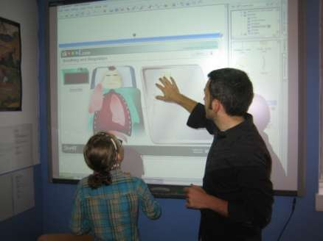
 Like anything new, it takes time to learn all the features and applications. With a little training and support, SMARTboards can be an amazing tool to have in the classroom that will engage your students and enhance their learning experiences.

