Slide 1
WELCOME

Slide 2
Presented By
EASMIN BITHI
Assistant Teacher
Rajnagar Purbanchal Govt. Primary School
Bauphal, Patuakhali

Slide 3
Learning Outcomes
Learning Outcomes
By the end of the lesson students will be able to
Listening:
3.2.1 Understand questions about family and friends.
3.4.1 Understand statements made by teacher and student.
Speaking:
1.1.1 Repeat after teacher and say words,phrases and sentences with proper
6.2.1 Talk about people,objects,events etc.
Reading:
1.7.1 Read short paragraphs,dialogues and simple letters.

Slide 4
Let’s Enjoy a Video

Slide 5
Lesson Direction
Sagar And His Family
Page : 30

Slide 6
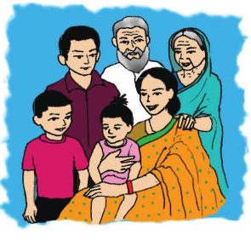
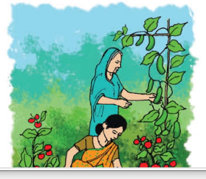
Sagar and His Family

Slide 7
LETS READ

Slide 8
Teacher’s Reading
Cross Reading
Students’ Silent Reading

Slide 9
WORD MEANING
Doctor ( চিকিৎসক ) : One who treats us
Homework ( বাড়ির কাজ ) : Do something at home
Pithas ( পিঠা ) : kind of cake
World ( পৃথিবী ) : Earth
Housewife ( গৃহিণী ) : A woman who works at home
Smart ( বুদ্ধিমান ) : very intelligent
Help ( সাহায্য করা ) : To assist someone

Slide 10
HOME TASK
Write a short composition about “Your Family”

Slide 11
That All for Today
THANK YOU !!
HAVE A GOOD DAY!!

