Slide 2
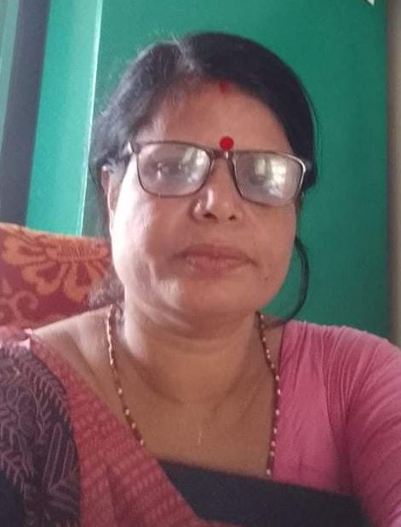
Teacher’s Introducing
Mira rani Sarkar,
H.M. Premnagor GPS,Rajnagor,Moulvibazar.
Class-2,Subject-English for today.

Slide 3
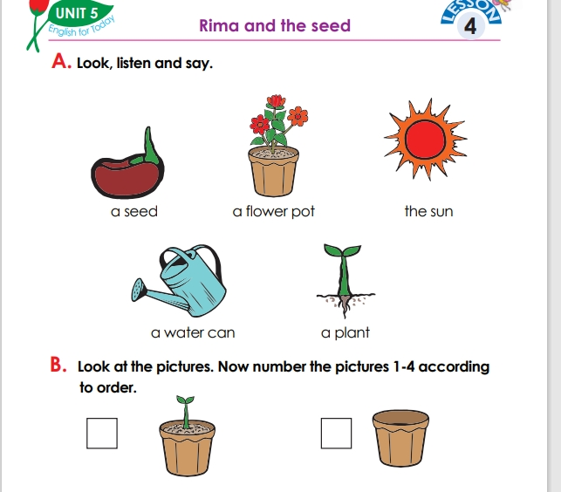

Slide 4
Attainable Competency
8.1Recognising and using words frequently used in the texts for participating
In everyday conversations’

Slide 5
Title declaration
Unite-5,Rima and the seed
Session-47,A,B
Page-49

Slide 6
WORD Meaning
Seed
A flower pot
sun
A water can
A plant

Slide 7
Group Work
Word Game on Board

Slide 8
Assessment learning
Play - yes/no

Slide 9
GOOD BYE

Slide 10
https://drive.google.com/file/d/1xxX0_5Qst0/view?

