Slide 1
Welcome

Slide 2
Unit 10
Lesson: 1-2
My Home District
Parts of a lesson: A (1st passage)
Teaching aid: Picture
Sara Sadia
Assistant Teacher
18 no. Modanpur Govt. Primary School
Bandar, Narayanganj.

Slide 4
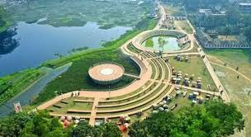
Mamun’s Home District
Kishoreganj

Slide 5
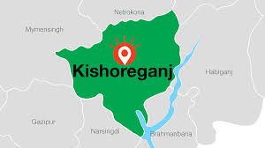
My Home District

Slide 6
Home District (n): নিজ জেলা
Headquarters (n): সদর দফতর
Municipality (n): পৌরসভা
Union (n): ইউনিয়ন
Village (n): গ্রাম
Old (adj): প্রাচীন
Landlord (n): জমিদার
Known (v): পরিচিত
Flow (v): প্রবাহিত হওয়া

Slide 8
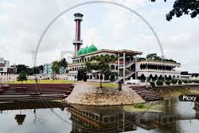
Brojakishore Pramanik
Narasunda Lake

Slide 9
Home District (n): নিজ জেলা
Headquarters (n): সদর দফতর
Municipality (n): পৌরসভা
Union (n): ইউনিয়ন
Village (n): গ্রাম
Old (adj): প্রাচীন
Landlord (n): জমিদার
Known (v): পরিচিত
Flow (v): প্রবাহিত হওয়া
The district that a person is from
The main or head office of an organisation
Towns that have local governments
An administrative unit
A place where rural people live in
Belonging to past times
A person who owns a large area of lands
Familiar to people
To move continuously in a current or stream

Slide 10
Group Work
Discuss about Kishoreganj District and write down about the district in one’s notebook

Slide 11
Individual Work
Kishoreganj
headquarters
landlord
municipalities
Narasunda
My home district is _________.
It is a district ______________.
The name Kishoreganj has comes from the old _________ Brojakishore Pramanik.
It has 8 ____________.
The river __________ flows through the town.

Slide 12
Checking Learning
Kishoreganj is an ancient city and district headquarter is about 145 km far away from Dhaka. There are 8 municipalities, 13 upazilas, 108 unions and 1,745 villages in this district. Narasunda river flows through kishoreganj. The name Kishoreganj comes from the name of an old landlord known as Brojakishore Pramanik or Nandakishore Pramanik. The area of Kishoreganj municipality is about 10 square kilometers.

Slide 13
Evaluation
Whose home district are we reading for ?
How many municiplities and unions are there in Kishoreganj district?
How the name Kishoreganj is known for?
Is it a district headquarter?

Slide 14
Home Work
Write five Sentences about your home district.

Slide 15
Thank You

