Slide 1
welcome

Slide 2
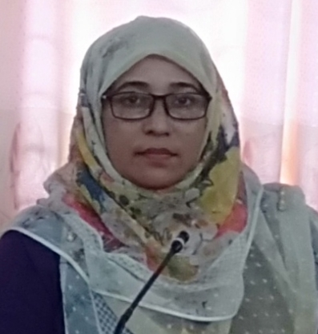
পরিচিতি
Subject – English
Unit _6/7/8
Class – Seven
Section – (A+B)
Date;-24/06/2024
Nilufar Yeasmin
Senior Teacher (ICT)
Garuria Secondary School
Email- yeasminnilu76@gmail.com
Contact No-01720592428

Slide 3
IDENTIFICATION
Nilufar Yeasmin
Assistant Teacher(ICT)
Garuria Secondary School
Bakergonj, Barishal.
E-mail:yeasminnilu76 @gmail.com
Contact No : 01720592428
English
Class : 6
Articles
Duration: 50 Minutes
Date: 24/06/2024

Slide 4
I met a young man while going to my school. The man was carrying a bag. He had apples in the bag. He gave an apple to a beggar. The beggar thanked him.

Slide 5
ARTICLE
Indefinite
Definite

Slide 6
LEARNING OUTCOMES
At the end of the lesson, students
will be able to…
call about article, name of articles,
identify articles.
use of articles in different ways.

Slide 7
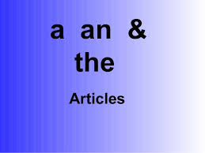
‘THE ADJECTIVES ‘A or AN AND THE’ ARE USUALLY CALLED ARTICLES’
Wren and Martin.
‘THE WORDS A, AN AND THE
ARE CALLED ARTICLES’
- Oxford Dictionary.

Slide 8
Definite Article: ‘The’ টি, টা, খানা, খানি
উৎপত্তি- That The
Indefinite Article: A, An- একটি
উৎপত্তি- One An, A

Slide 9
নদী, সাগর, দ্বীপপুঞ্জ
জাহাজাদী, গিরিপুঞ্জ
কোর্ট, সিনেট, সংবাদপত্র
তারিখ, পর্বতশ্রেণি, দিকের নাম
যত আছে খ্যাতধাম
চন্দ্র, সূর্য, গ্রহ, তারা
আরো যত বিশ্বধরায়
পৃথিবীতে অদ্বিতীয় যত
তার পূর্বে বসবে ‘The’
শাস্ত্রবিধি মত।
T
H
E

Slide 10
The Padma, the Meghna and the Jamuna
are the big rivers in Bangladesh.
The Pacific ocean is the longest of the world.
The Andamans and the Nikobars are in the
Indian ocean.
The great ship Titanic sailed from
Southampton to New York in 1912.
The volcanoes of Japan are very dangerous.
The Supreme Court, the High Court…..

Slide 11
The National Assembly of Bangladesh..
The Ittefaq, The Inqilab, the Prothom Alo, the Bangladesh Protidin, the New Age, The Bangladesh Observer, the New Nation, the Bangladesh Times etc.
The 26th March, the 16th December, the 21st February…..
The Himalayas mountain
The north-south, the east-west
The Taj Mahol, The National memorial
The moon, the sun, the earth, the Venus

Slide 12
Use of definite article - ‘the’
a class or group
proper names of Islands, mountains,
Countries(Contracted name e.g the U. S. A
The U.K, the U. A. E, /the Netherlands, the
Philippins etc), deserts, seas, Oceans, reasons, historical places, ship, Court, newspapers, holy books, parliament, stars, sun, moon, planet etc.

Slide 13
Use of Indefinite Article – ‘a’
‘O’ sound /wA/, /owa/ ; a one
‘U’ / ‘Eu’ sound /ju/, /u/ ; a University, a European, a union, a useful, a unique etc.
Countable noun; a cat, a girl, a bag
An example of a class

Slide 14
Use of Indefinite Article - ‘an’
Vowel beginning word ( a, e, i, o, u): an
apple, an egg, an inkpot, an owl, an orange, an umbrella etc.
Silent ‘h’ (adj/n): An honest, an hour,
an heir etc.
Words beginning with consonants
sounding vowel: An MP, an FRCS, an X-ray etc.

Slide 15
যেসব ক্ষেত্রে ‘a/an’ ব্যবহৃত হুয়না
Meals --( adjective before meals
‘a/an’ yes.)
Plural Noun
Uncountable Noun – advice, information,
News, baggage, luggage
Material Noun- water, milk, oil, ink, tea,
Hydrogen, paper etc.
Abstract Noun

Slide 16
যেসব ক্ষেত্রে ‘The’ ব্যবহৃত হুয়না
Proper Noun, Material Noun, Abstract Noun, Vocative case- Noun
Language, Lake, Bed, Hospital,
Allah, God, King, Queen, Lord, Maharaj
Parts of the body, Cloths, Home
Subject’s own father, mother, child
Day, month, Sports, meal, Diseases
Season, occasion/festival,
Road , Avenue, Square, park, Mosque, Church, Prison,

Slide 17
Dhaka is the capital of Bangladesh.
Gold is a precious metal.
Kindness is a great virtue.
Bangla is our mother tongue.
Lake Baikal, Lake Caspian are famous.
Allah is almighty. God is kind.
Queen Victoria died at 85.
King Hamlet was poisoned.
Raise your right hand.
Put off your shirt and pant.

Slide 18
Mahiya left home. Nijhum went home.
Convey my complements to mother.
Himel went to Dhaka with his father.
January is the first month of the year.
Friday is our holyday.
We like to play cricket/ football.
We have breakfast/ lunch/ dinner in time.
He died of cholera. She is suffering from cold- fever.
Summer is a hot but winter is cold.
We usually celebrate new year’s day.

Slide 19
He speaks the truth,
She tells a lie.
Do not make a noise.
He has gone out for a walk.
The work has come to an end.
She took a short sleep (a nap)
It is a sleep of the tongue or the pen.
He is in a temper.
The book costs fifty and a half taka.

