Slide 1
Subject English

Slide 2
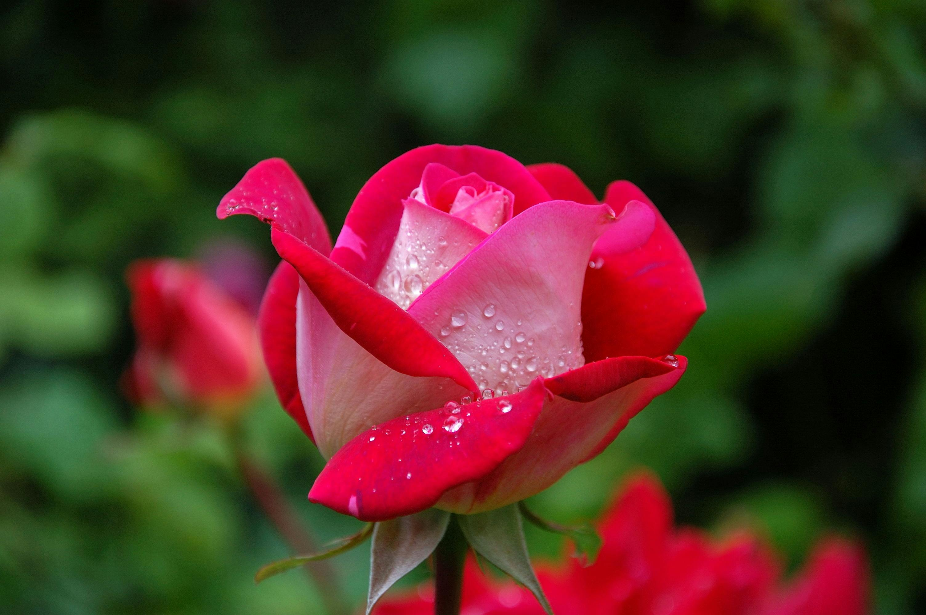
Welcome

Slide 3
INTRODUC OF TEACHER
MD. ZAKARIA HABIB
ASSESTANT TEACHER OF
RANIDIGHI GOVT PRIMARY SCHOOL
BIROL,DINAJPUR

Slide 4
Introduction of lesson
Class : Three
Subject: English
Unit: 6 Lesson: 1
Minites : 45
Date:05/o6/2004

Slide 5
Learning outcomes
Under Standing Simple text For Specific Imformation
They know about new words.
Using a arrange of words in day by day Communication.
Using part of speech correctly to Identify/refer to people object action.

Slide 6
Presentation of Session

Slide 7
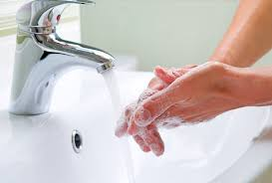
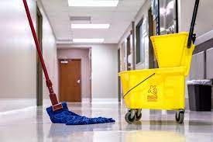

Slide 8
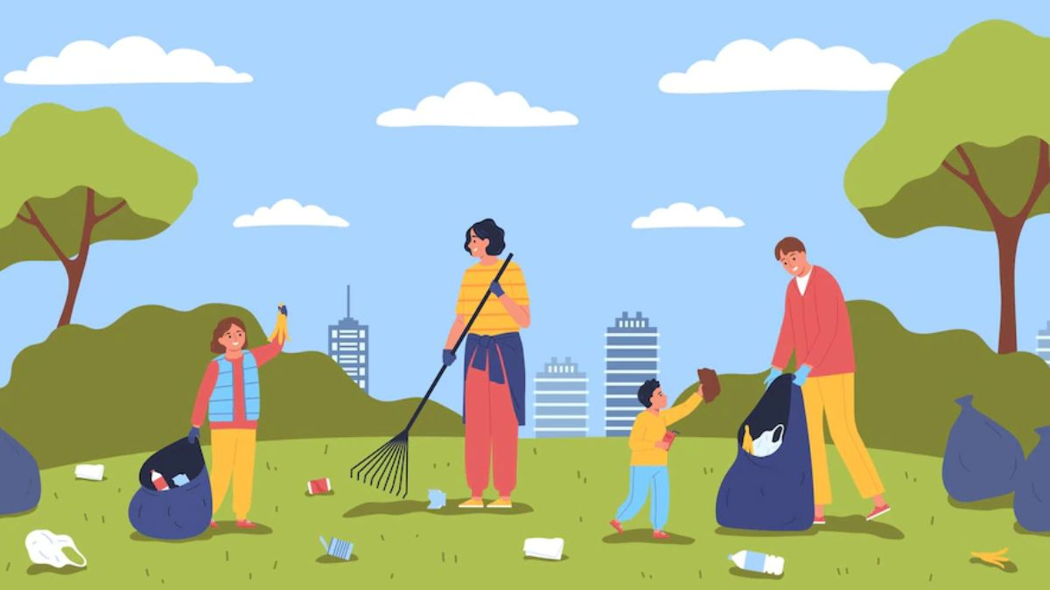
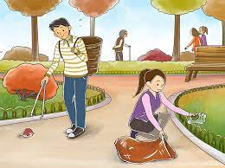

Slide 10
GOOD HABIT

Slide 12
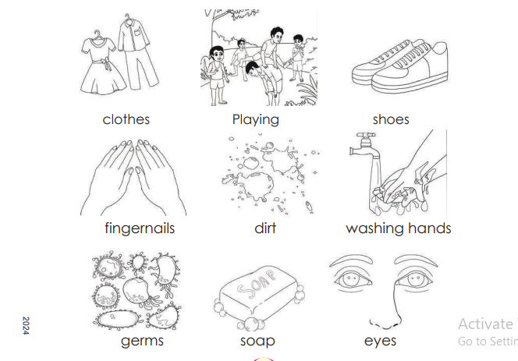
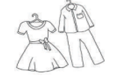
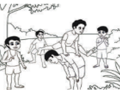
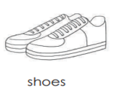
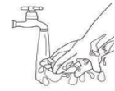
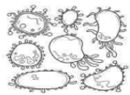
clothes
playing
shoe
Washing hands
fingernails
dirt
germ
soap
eyes

Slide 13
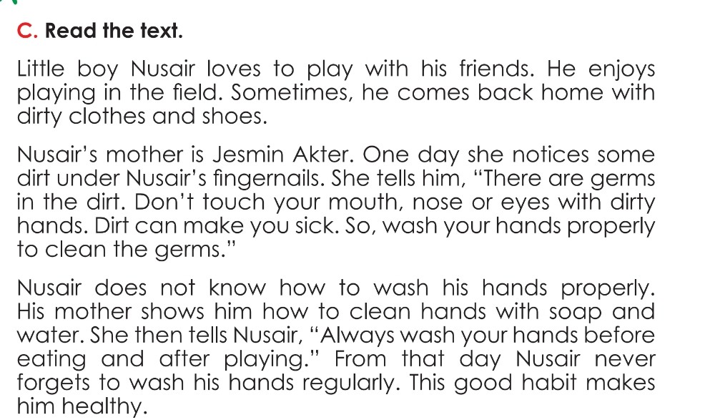

Slide 14
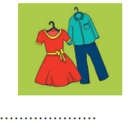
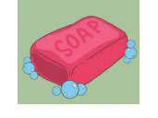
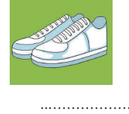
Sope
Shoe
Cloth
Nail
Dirt
Germ

Slide 15
Practice Activite
Open your book at page72
I reading aloud
Listen to me and follow

Slide 16
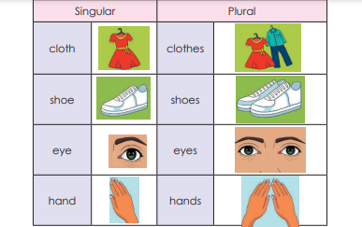

Slide 17
Feedback
Circle True or False for the Sentence below
a. Nusair loves to play along.
False
b.Nusair play in the field with his friends
True
c.He comes from the field with dirt.
True
d. Germs are found in dirt.
True
e.Nusair follows what his mother says .
True

Slide 18
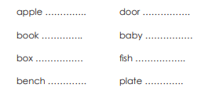
A
Group WORK
B
Group WORK
c
Group WORK
Write some plural.

Slide 19
Good habit
Wash hands
Eat healthfood
After toilet use shop
Drink pure water
Good habit
Washing Hand
Use sope
Clean fingernails
Drink pure water

Slide 20
Good Bye

