Slide 1
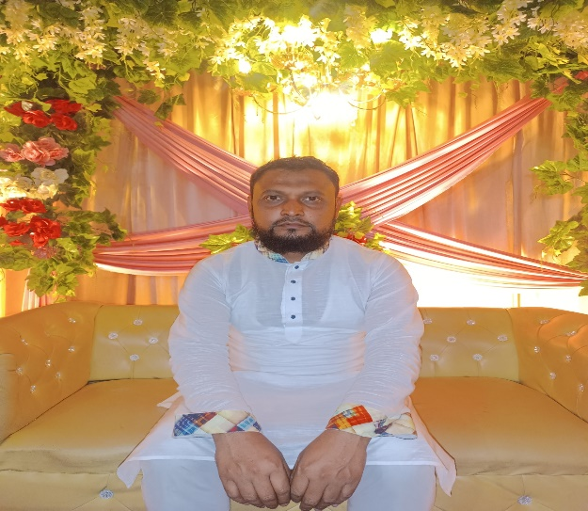
Welcome
To My Dream School
Kasba Govt. Girls High SchooL
Presentation On
Plan , Proposal And Budget to make My school as a smart school
Presentated by :
MD KHAIRUL ISLAM
Assistant Teacher
Kasba Govt. Girls High School

Slide 2
Introduction to my school:
School Name : Kasba Govt. Girls High School
Established In 1973
EIIN Number : 103338
Phone No : 029860785
Email : kgghsinfo1986@yahoo.com
Website : https://kgghs.edu.bd/ or
https://kasbagirls.gov.bd
Kasba,Brahmanbaria

Slide 3
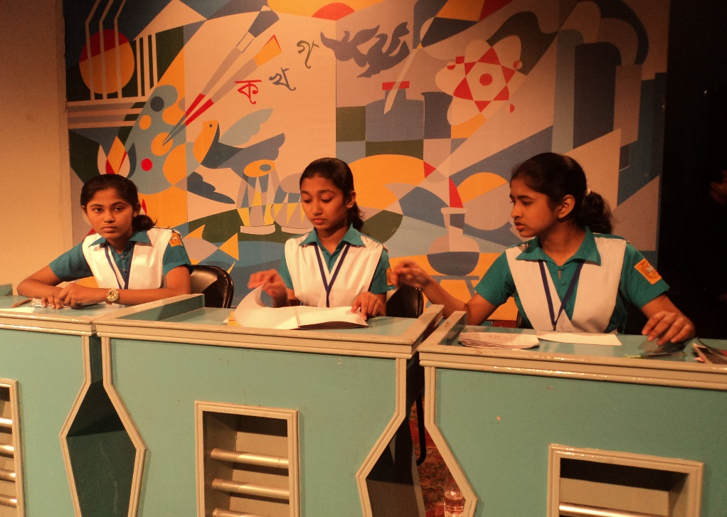
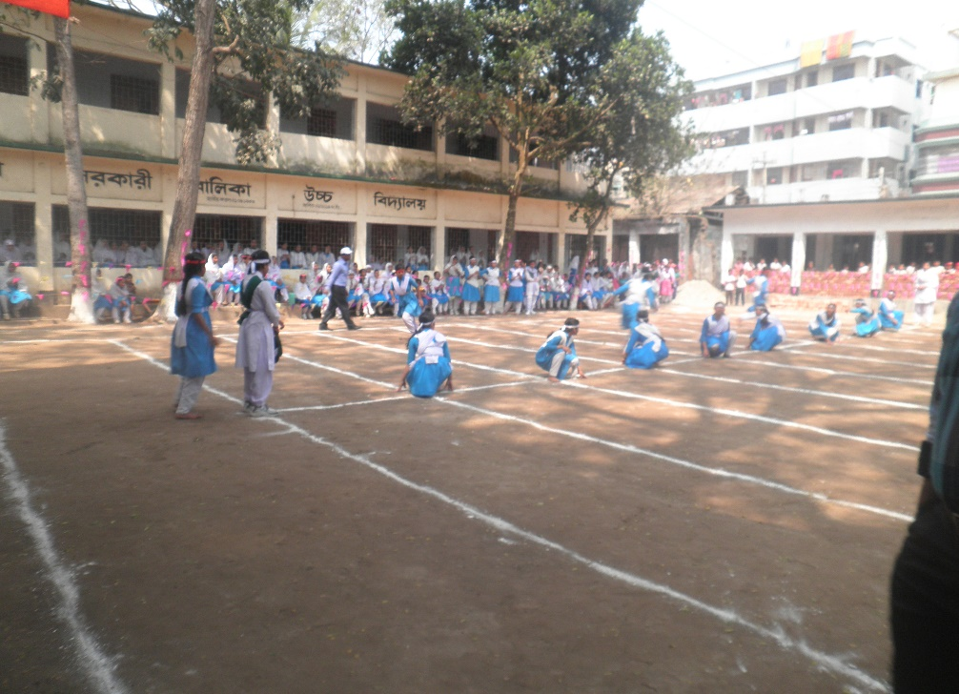
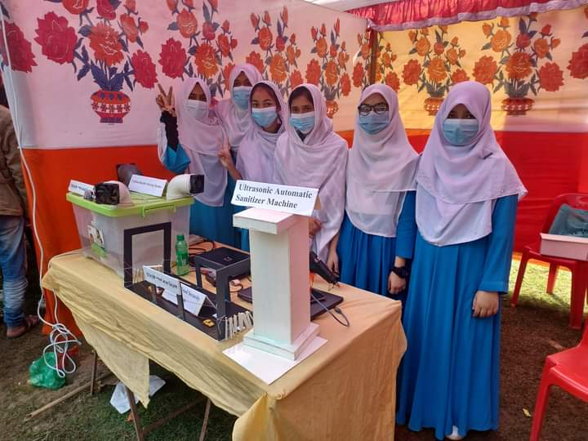
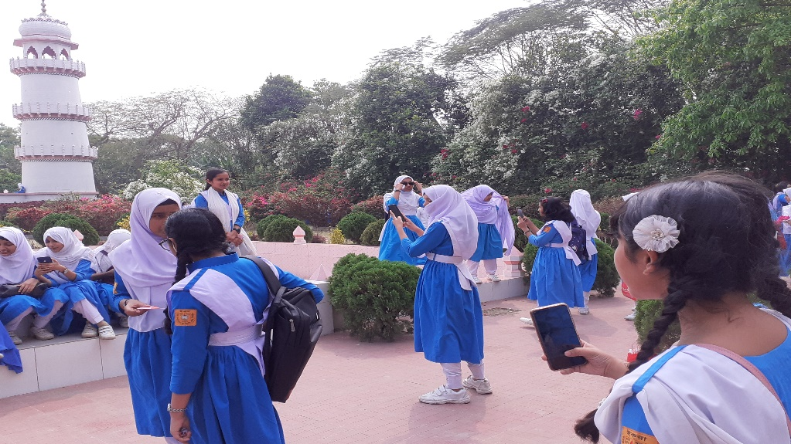
Cocurriculum Activities:
জাতীয় টেলিভিশন বিতর্ক
খো খো খেলা
বিজ্ঞান মেলা
তাজমহল পরিদর্শন

Slide 4
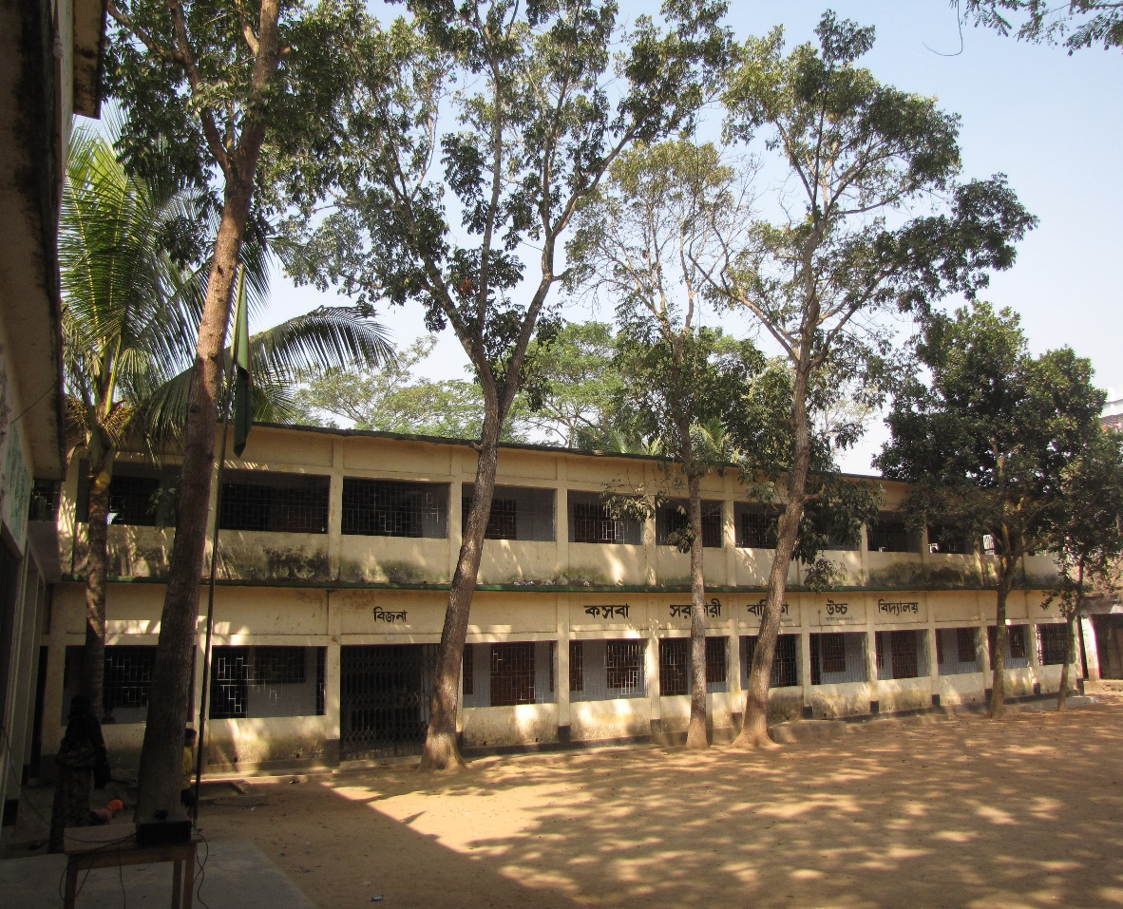
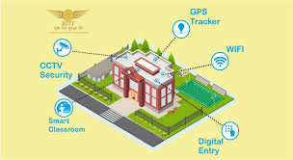
How to change the campus to create a smart school
Present Campus
Smart Campus

Slide 5
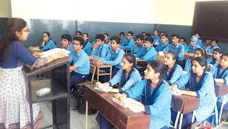
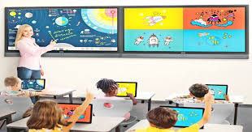
How to change the class room to create a smart school
Smart Board
White Board

Slide 6
How to change the library to create a smart school
Present Library
Future Library

Slide 7
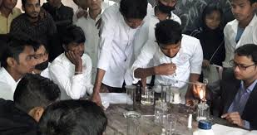
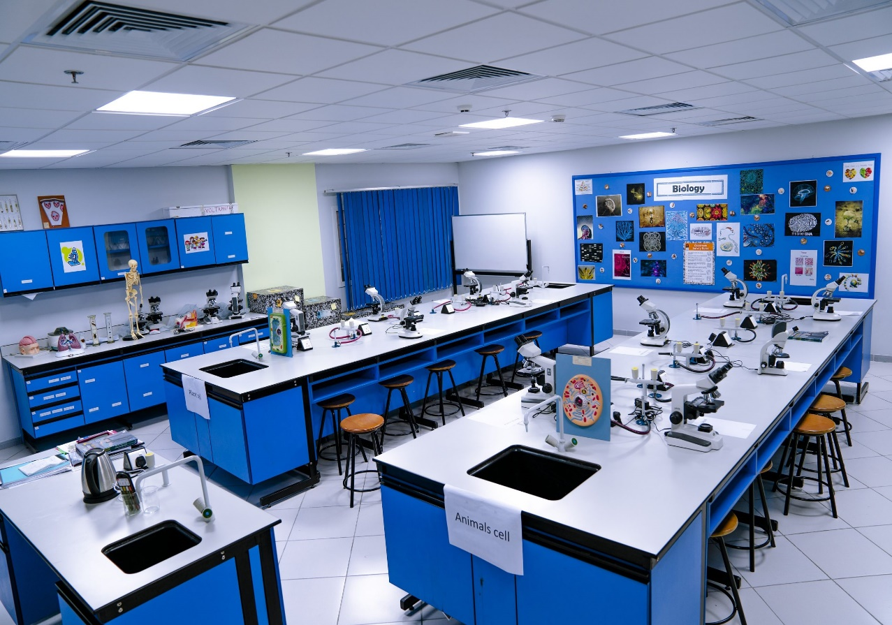
How to change the labratory to create a smart school
present
Future

Slide 8
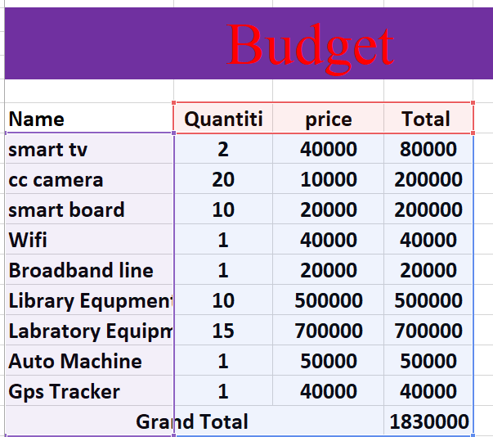
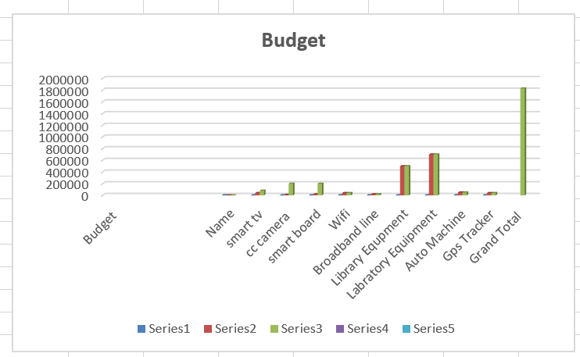
BUDGET

Slide 9
Plan implementation
Around three years
Head of the Institute & related committee
Government Budget and internal Budget

Slide 10
Thanks to all

