Slide 1
Welcome from
Todays Lesson

Slide 2
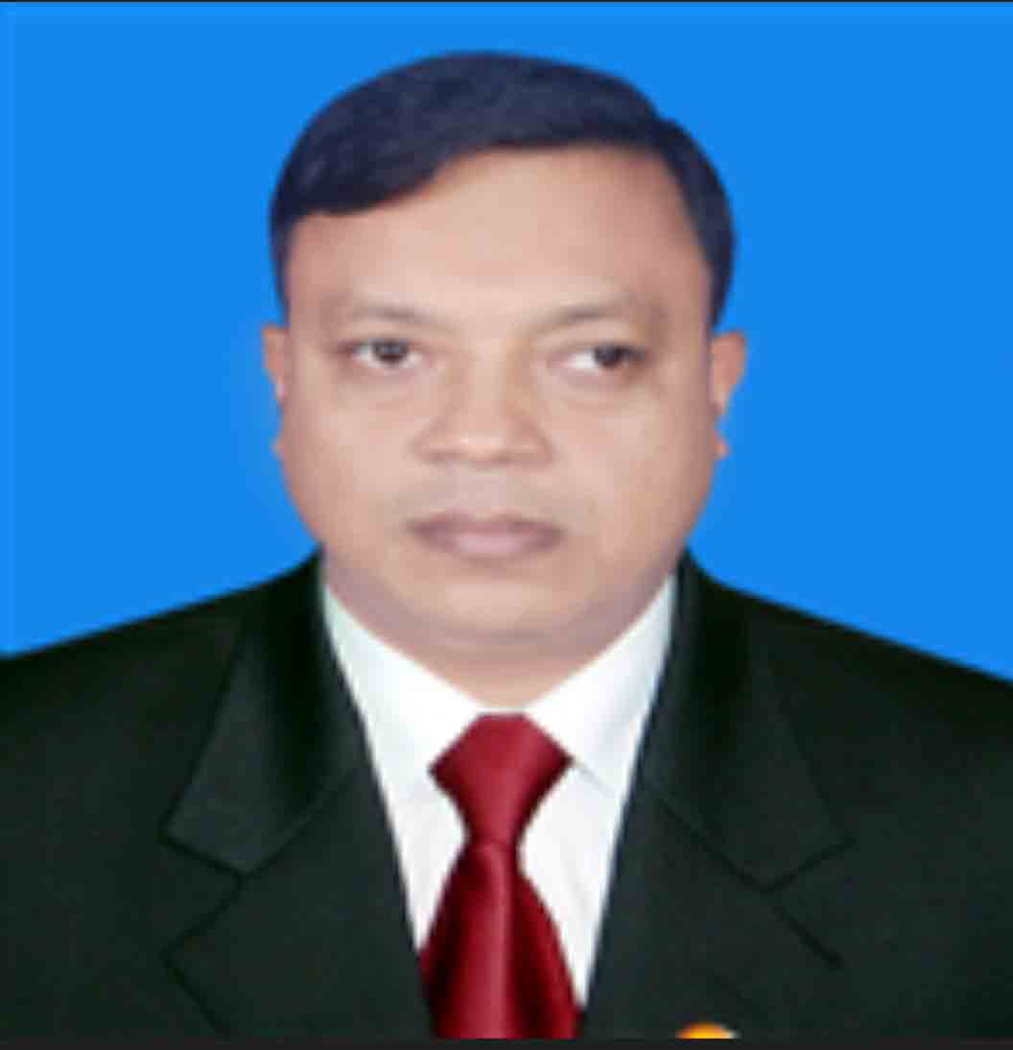
Identity
English For Today
Class : one.
Unit: 2
Lesson: 3
Lesson: cC dD.
Masiur Rahaman Kamal
Assistant Teacher
15 No. Tumchar Govt. Primary School
Gosairhat, Shariatpur.
masiurkm@gmail.com
Notes:
Teacher can hide this slide

Slide 3
Learning outcomes
By the end of the lesson, the students will be able to read c C d D.

Slide 4
Let’s enjoy a warmup song

Slide 5
Look at the picture
Say the names of the things that you see.
Talk to your partner.

Slide 6
Today`s topic
Unit: 2, Lesson: 3
Lesson: cC dD.

Slide 7
C
cat
Cat
c

Slide 8
Cow
cow
C
c

Slide 9
d
Dog
dog
D

Slide 10
duck
d
Duck
D

Slide 11
Pair Work.
Ask and answer.
1. What is this?
2. What is the first letter in the picture?

Slide 12
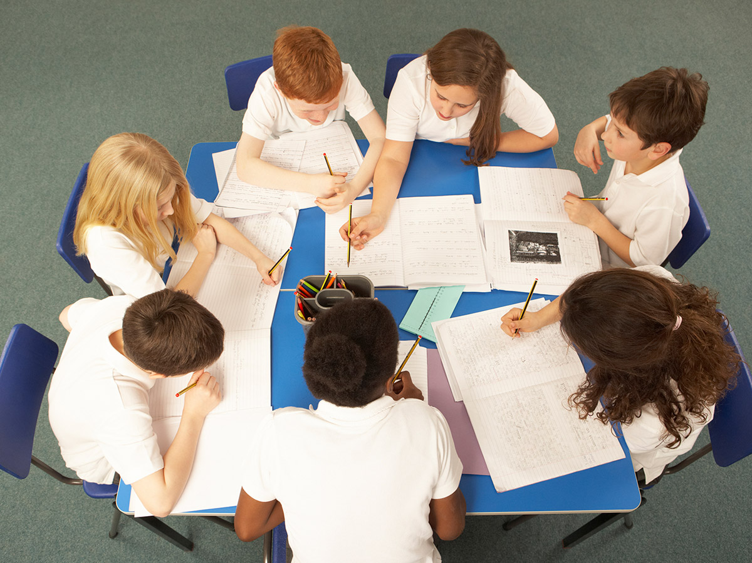
Group Works.
Match the pictures with the words.

Slide 13
Home work
Your will practice letter aA bB in your home.

Slide 14
Goodbye
See you

