Slide 2
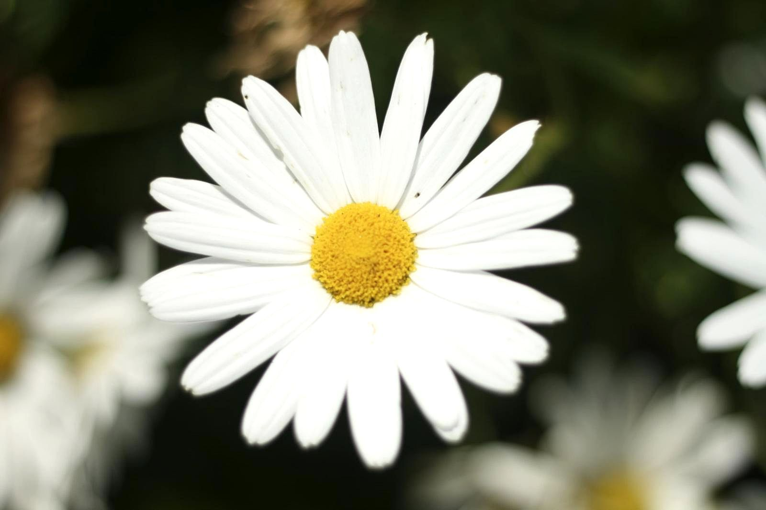
WELCOME

Slide 3
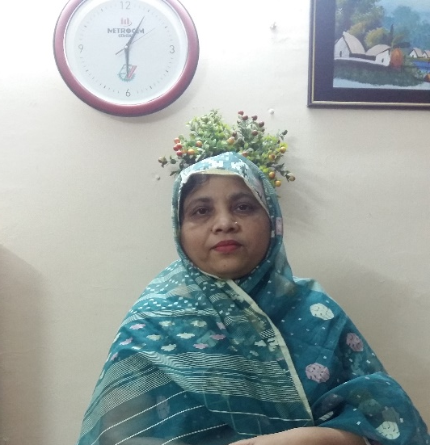
Introduction
Mukta mony
Head teacher
Atashia Government Primary School
Shibpur , Narsingdi.
Story: Why Does the Frog Croak?
Class: Five
Subject : English
Unit :25,Lesson-1 (What----- said.)
Time : 45 minutes
Date: --/--/2024
Page : 98

Slide 4
Learning Outcomes : Students will be able to –
Listening:
1.3.1 recognize which words in a sentence are stressed .
3.4.1 understand statement made by the teacher and student.
4.2.1 understand and enjoy simple stories.
Speaking :
1.1.1. say words, phrases, and sentences in the text with proper sound and stress.
1.1.2 say sentences with proper intonation.
Reading :
1.5.1 read words , phrases and sentences in the text with proper pronunciation , stress and intonation.
1.7.1 read paragraphs ,dialogues stories , letter and other texts.
7.1.1 recognize punctuation marks and read accordingly.

Slide 5
Let’s watch a video .Can you guess what may be our todays lesson ?

Slide 6
Our todays Topic
Story :
Why Does the Frog Croak ?

Slide 7
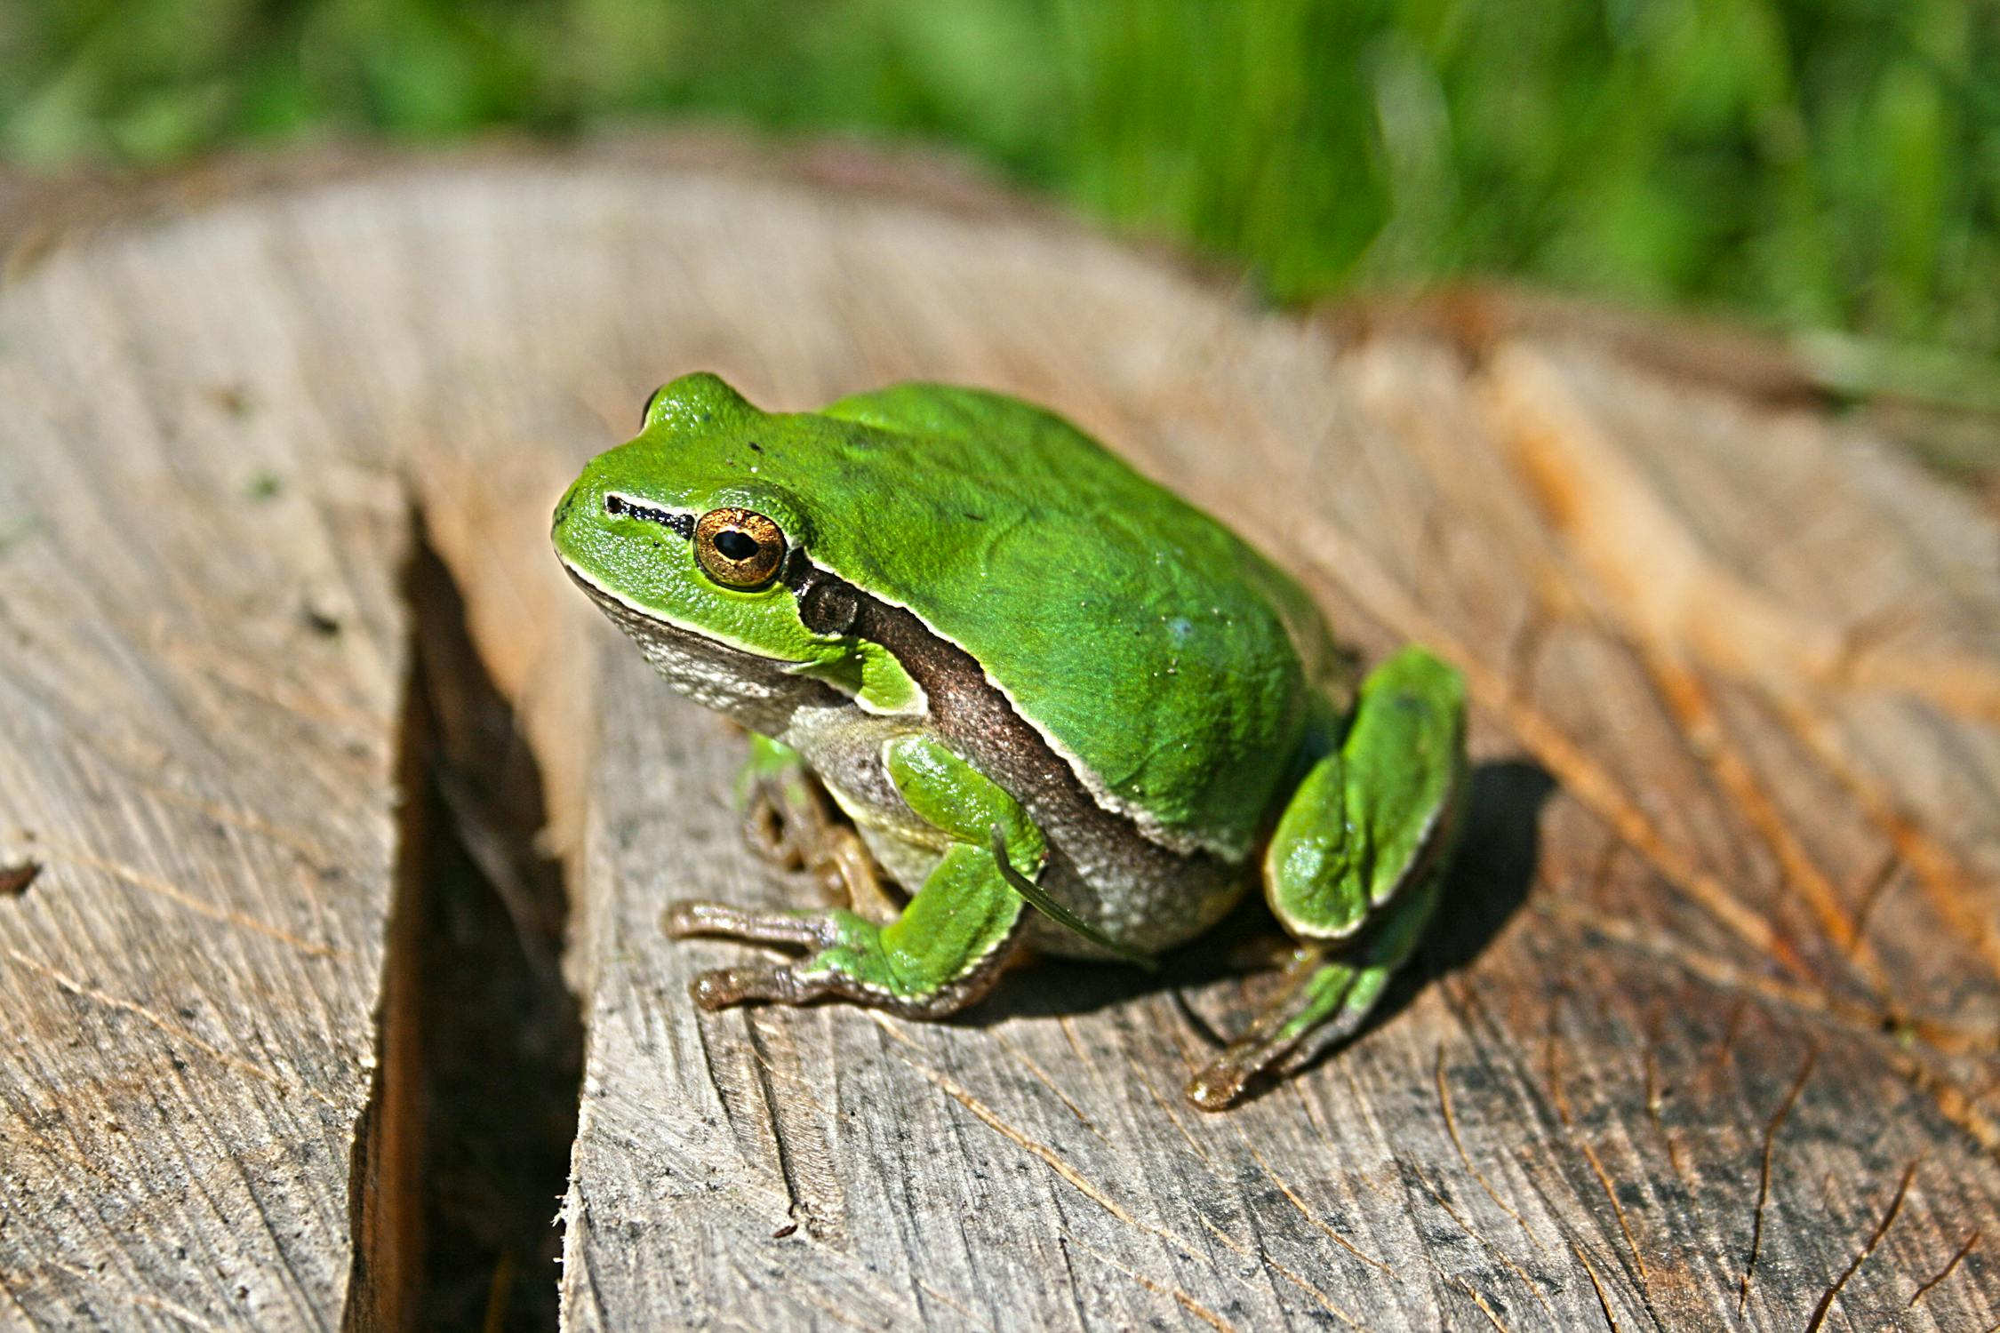

Slide 8
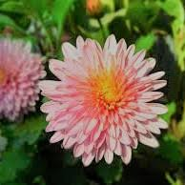
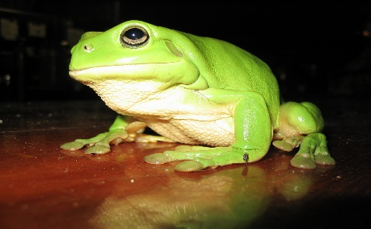
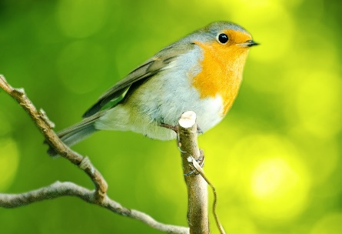
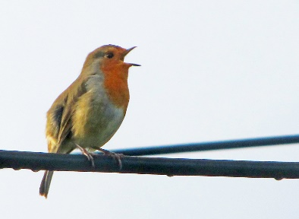
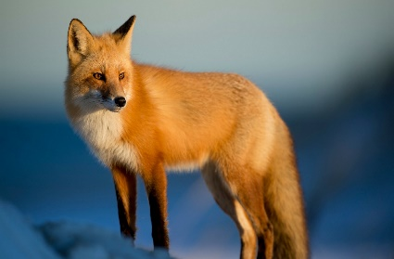
New words
Sound-শব্দ
Beautiful-সুন্দর
Bird-পাখি
Frog-ব্যাঙ
Sing-গান গাওয়া
Animal-প্রাণি

Slide 9
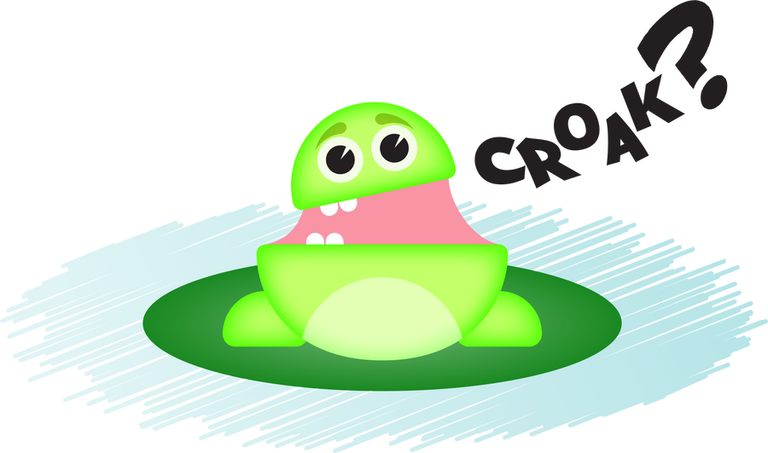
What sound does a frog make ? Croak , Croak !
It isn’t a beautiful sound.

Slide 10
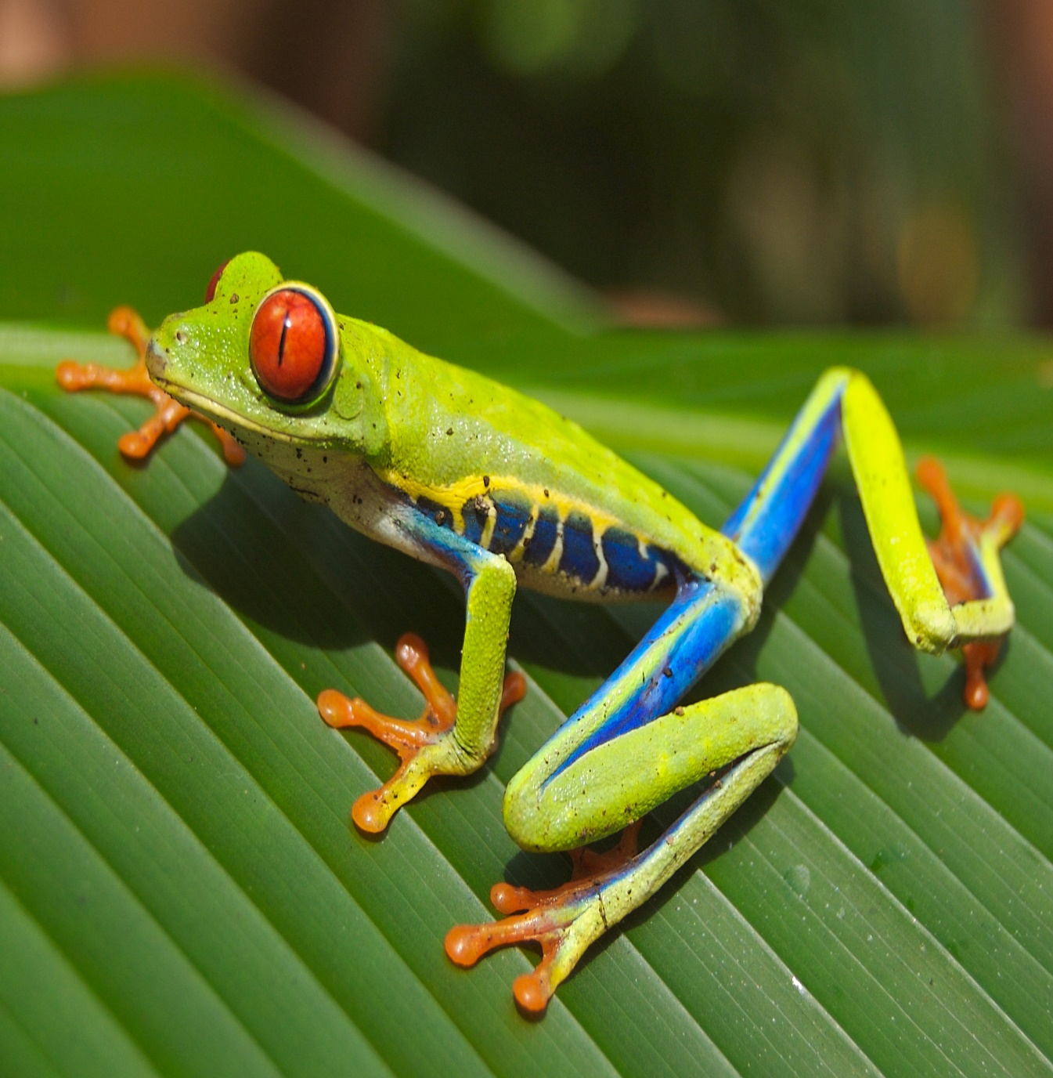
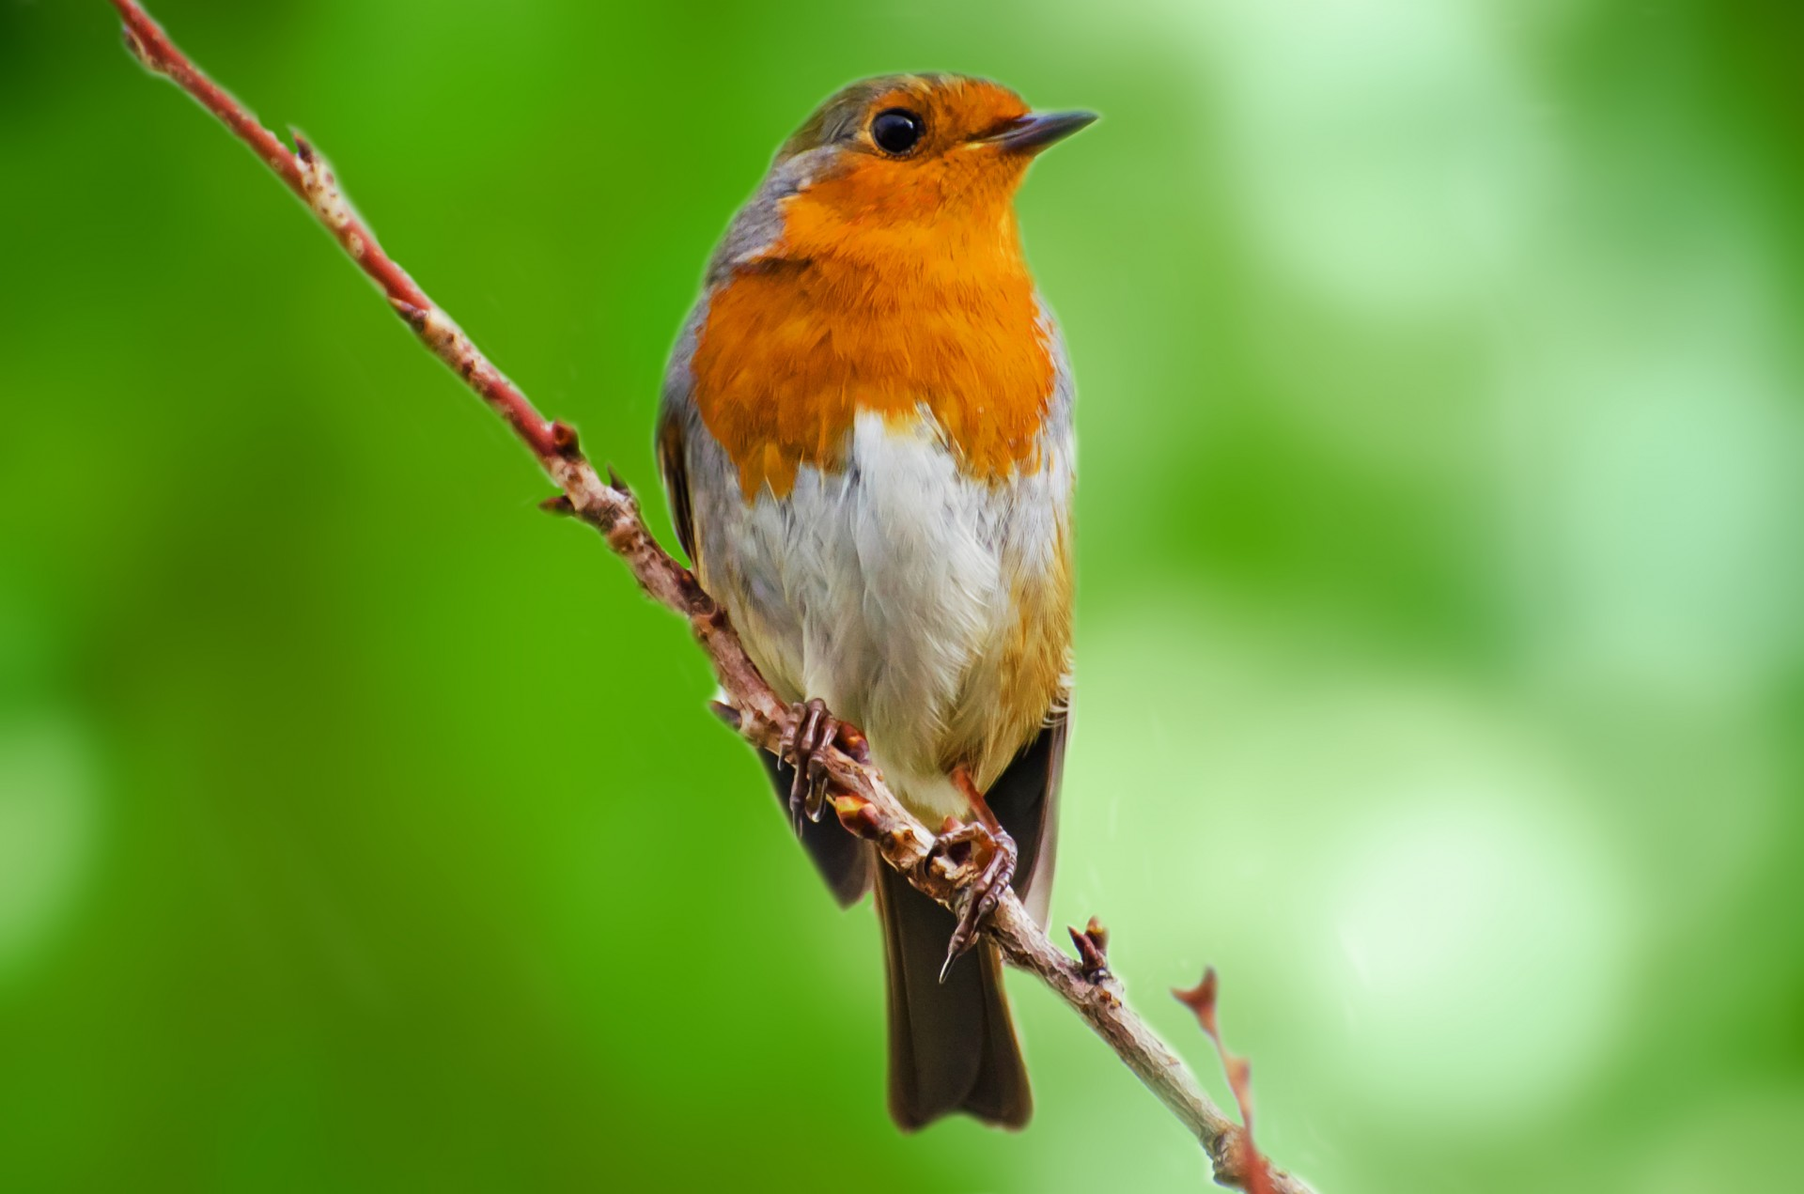
But ,a long time ago, frogs had beautiful voices. They could sing more beautiful than the birds.

Slide 11
This all changed because of one frog named Bluster
Bluster

Slide 12
Bluster had the most beautiful voice of all the animals. When he sang, all the other animals come to hear him. They enjoyed listening to him .”Please teach us how to sing !” the animals asked.

Slide 13
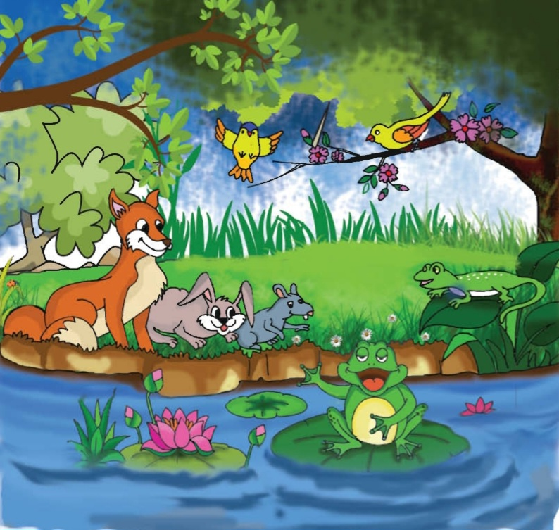
But Bluster always answered in the same way. “No , no.
My voice is mine . I can not share it, “ he said.

Slide 14
Open your book at page 98.
Model Reading
Individual Reading

Slide 15
One day one word
Please - দয়া করে।
Please, give me your book.

Slide 16
Complete the sentences:
1.The animals wanted the frog to share------
His food . b. his home.
his money. C. his voice.
2.Who can not share his voice-----
a . Fox b. bird
c. Bluster c . Rabbit

Slide 17
ASK AND ANSWER THE QUESTIONS.
What sound does the frog make ?
What is the name of the frog ?
Do you think this is a true story ?

Slide 18
Punctuation Marks
!
,
.
?
“ ”
Comma
Questions mark
Quotation marks
Full stop
Exclamation mark

Slide 19
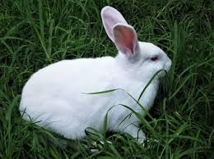
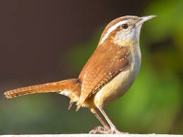
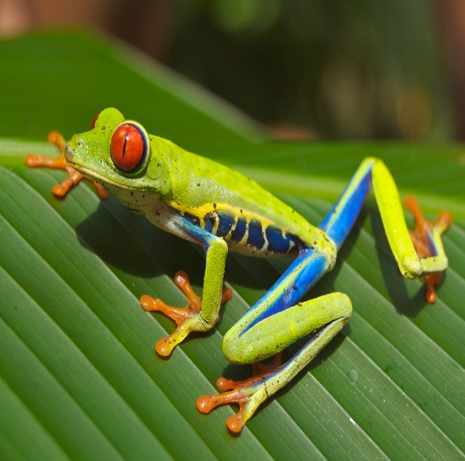
Write the name of the animals.
Group-B
Group-A

Slide 20
Home work
What is your favourite animal ? Why ? ( Or Your pet animal)
Write three sentences .

Slide 21
Good bye

