Slide 1
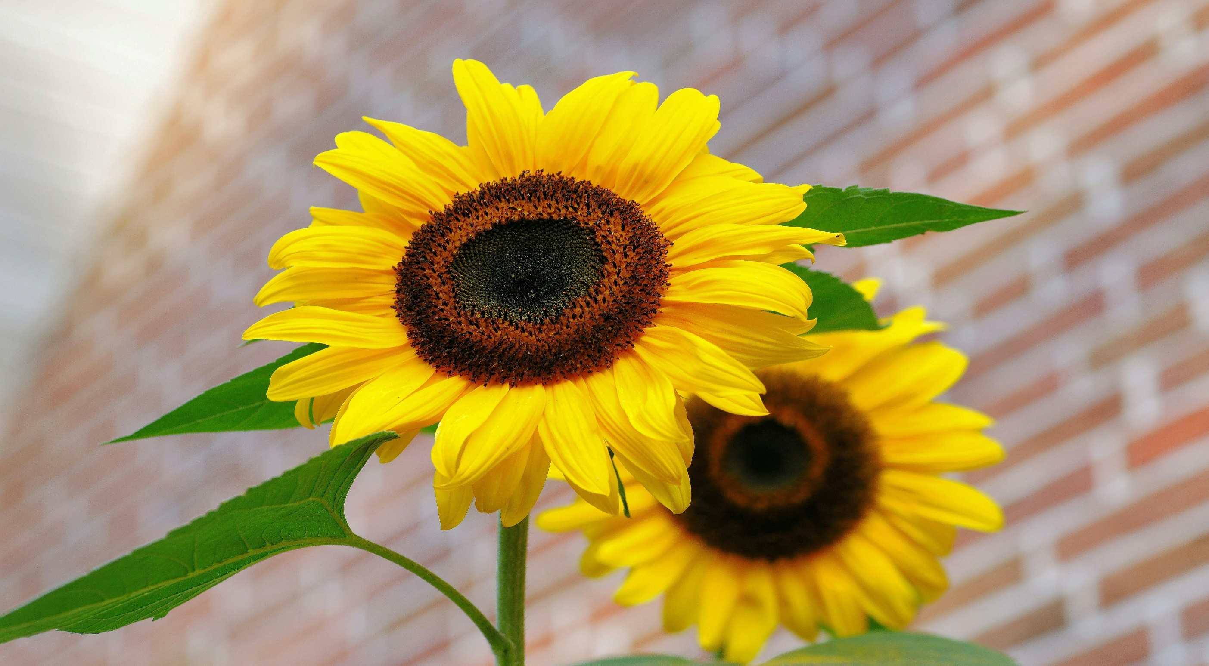
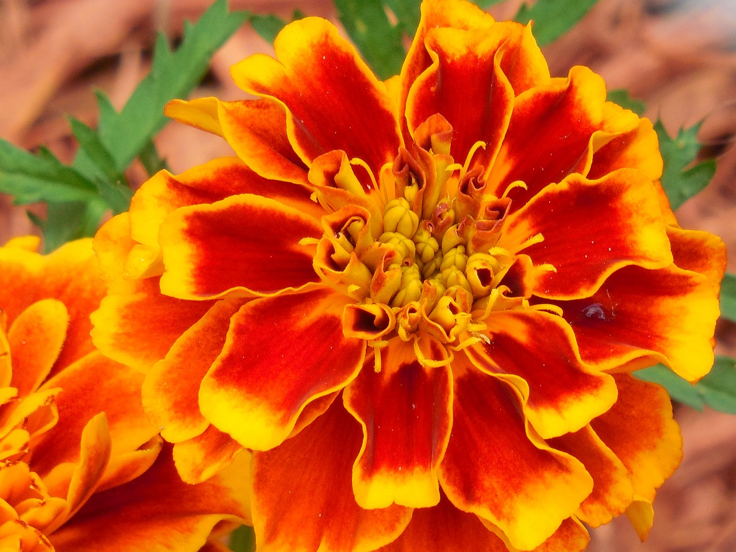
WELCOME

Slide 2
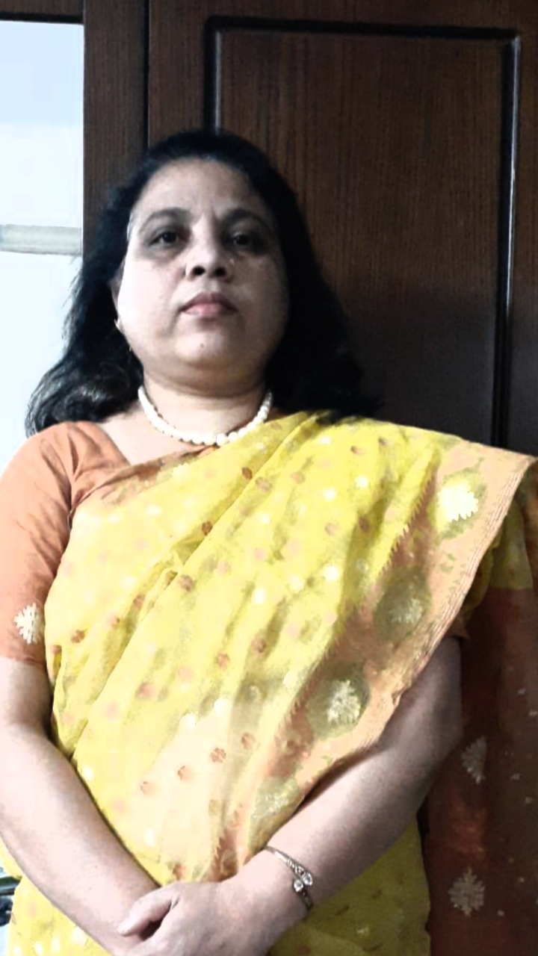
Muktamony
Head teacher
Atashia Government Primary School
Shibpur , Narsingdi

Slide 3
Lesson Identity
Lesson title- Story :The hare and the tortoise
Class - Five
Subject – English for today
Unit -14,
Lesson - 02( The hare ……the race . )
Time - 45 minutes
Date - --/--/2024
Page-55

Slide 4
Learning outcomes:
Students will be able to-
Listening:
1.3.1 recognize which words in a sentences are stressed.
4.2.1 understand and enjoy simple stories.
Speaking:
1.1.1 say words, phrases and sentences with proper sound and stress.
1.1.2 say sentences with proper intonation.
6.1.2 say what others are doing.
6.2.1 talk about people , objects , events etc.
Reading:
1.5.1 read words ,phrases and sentences in the text with proper pronunciation, stress and intonation.
1.7.1 read paragraphs, dialogues stories , letters and oter texts.
5.1.2 read silently with understanding stories.
7.1.1 recognize punctuation marks and read accordingly.

Slide 5
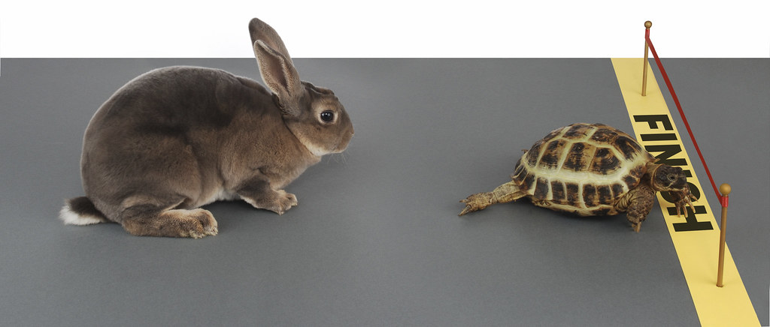
What can you see in the picture ?

Slide 6
The hare and the tortoise

Slide 7
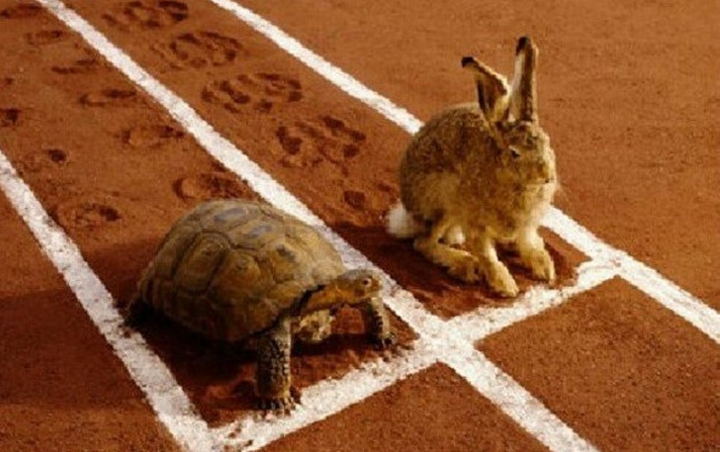
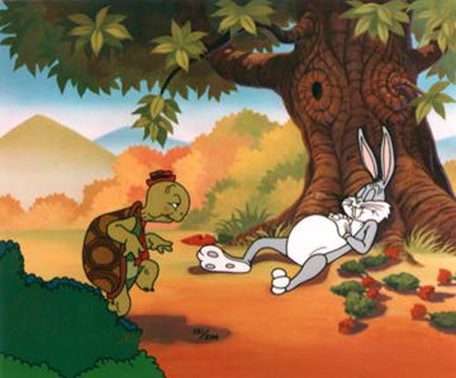
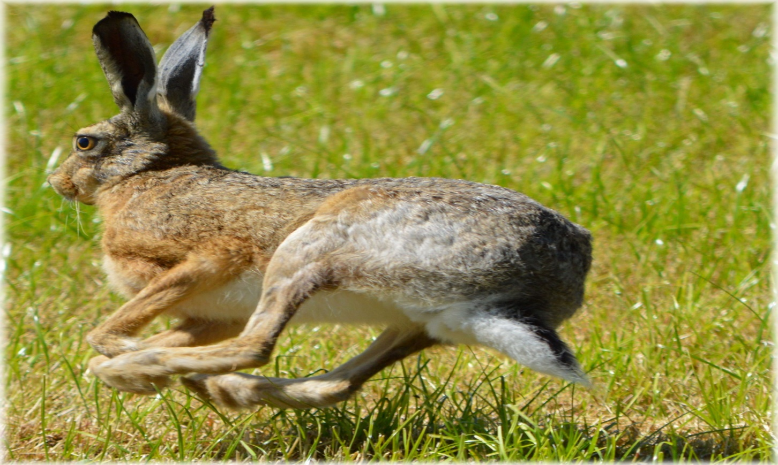

Slide 8
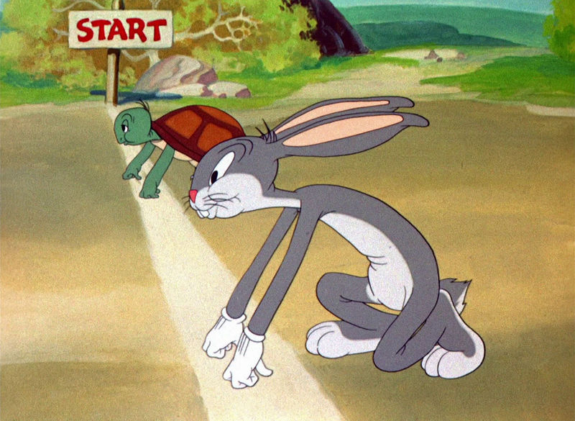
The hare stood beside the tortoise and the race began.

Slide 9
The hare ran quickly and in a few minutes the hare was out of site. The hare said to himself, “ The tortoise is very far behind. I can see the finish line. I have time for a nap !” Soon the hare was asleep under a tree next to the path.
The hare slept for an hour.

Slide 10
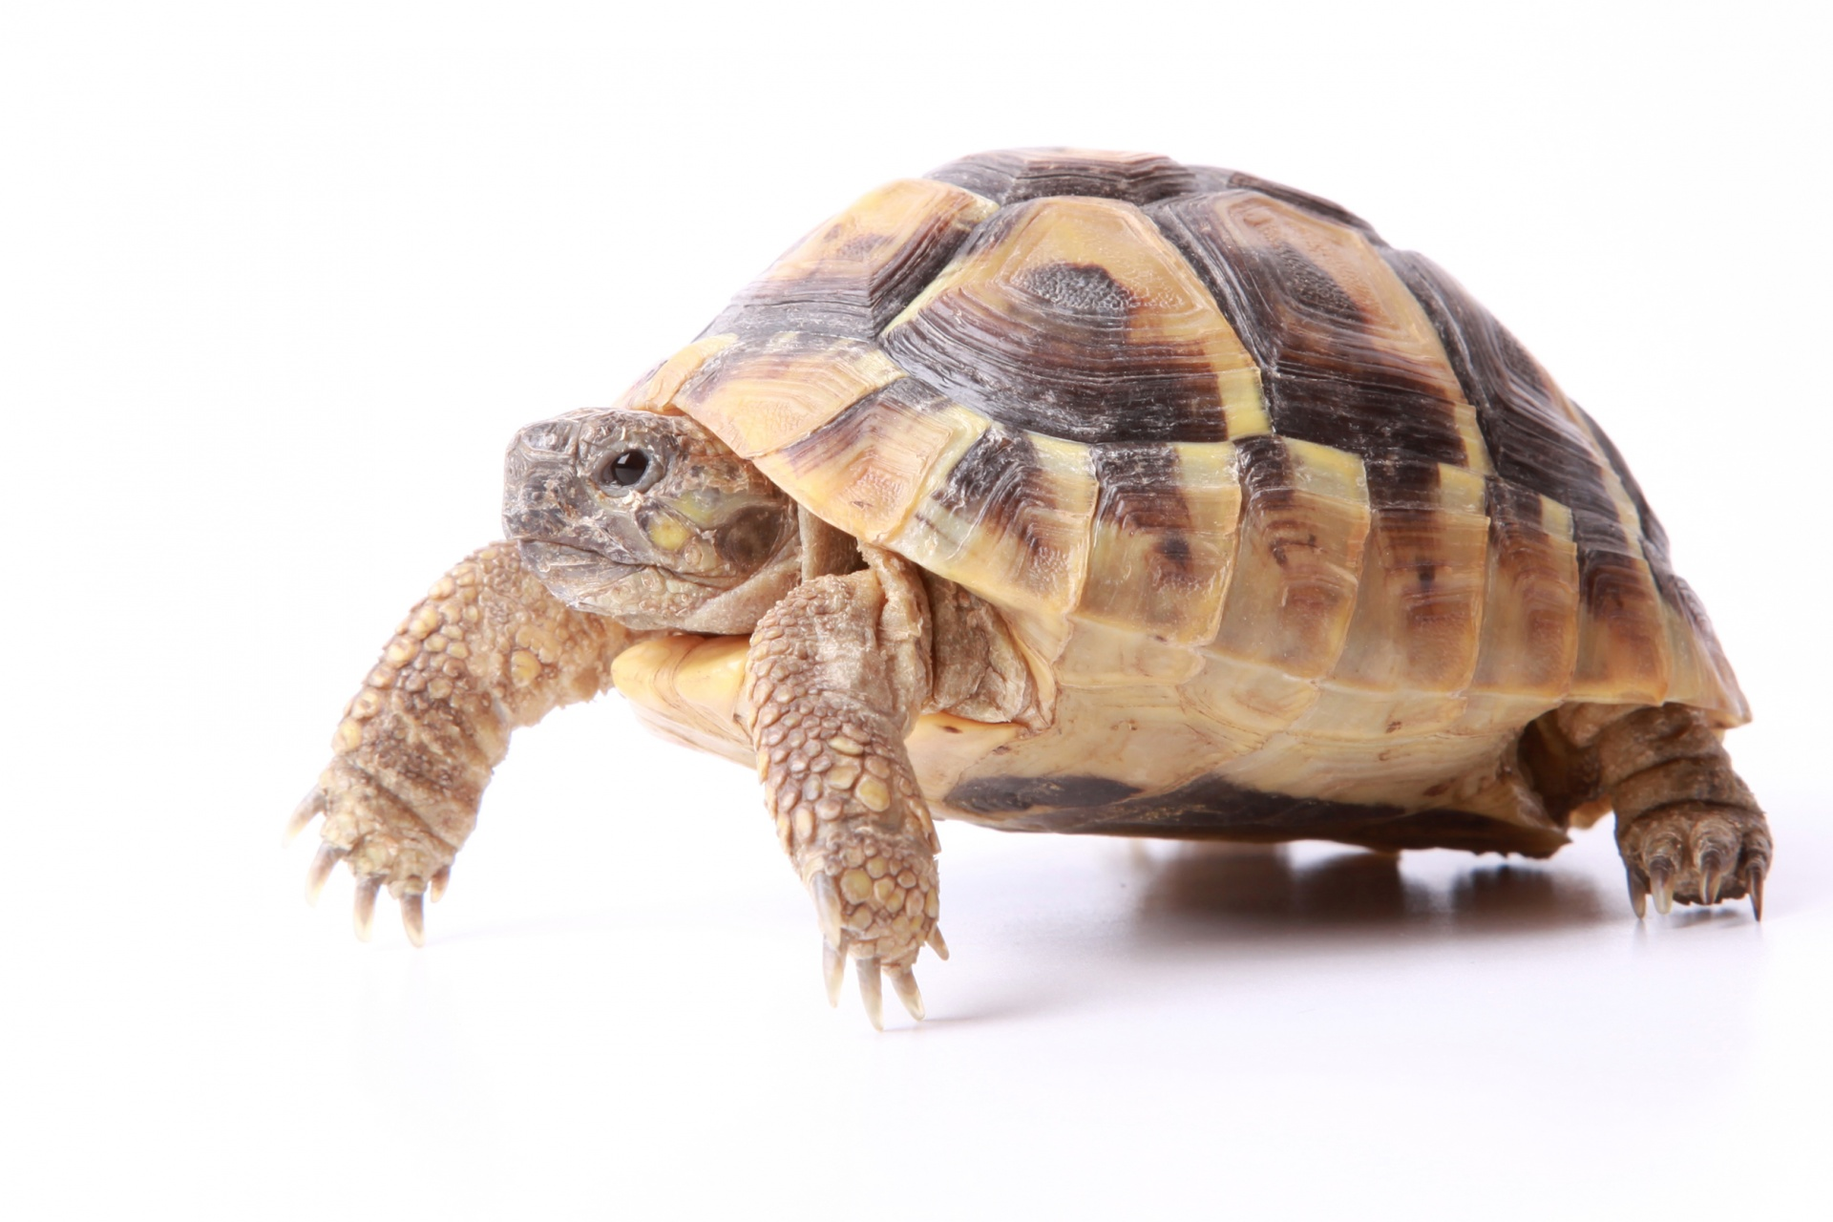
The tortoise walked steadily ,on and on. He didn’t stop. Soon he passed the sleeping hare.

Slide 11
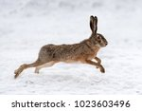
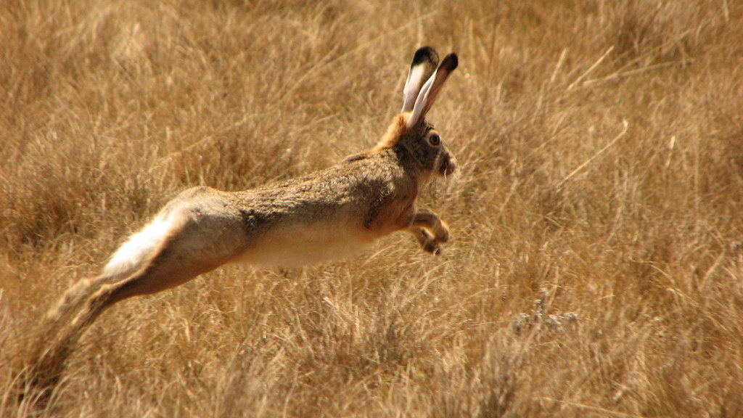
The hare ran as fast as he could, but it was too late.

Slide 12
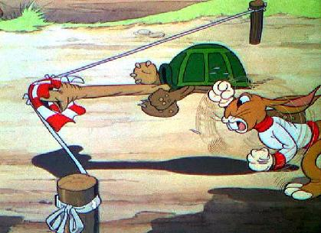
The tortoise crossed the finish line and won the competition!
The hare was furious.

Slide 13
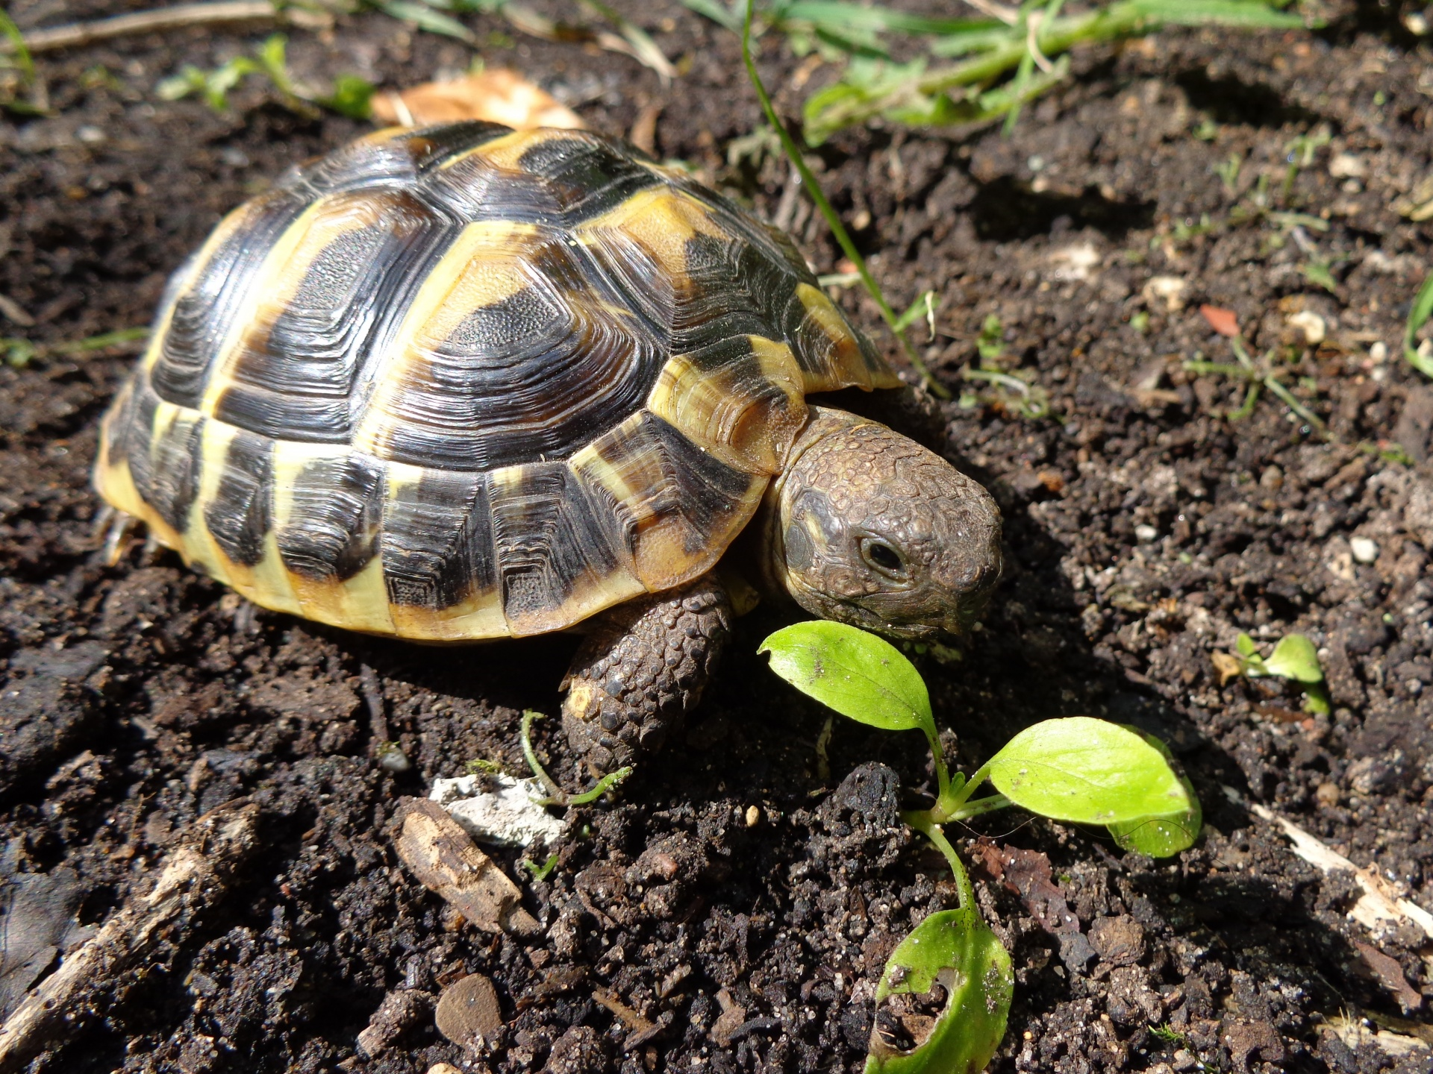
Then he said, “Slow but steady wins the race!”

Slide 14
One day one word
Believe- বিশ্বাস করা
He couldn’t believe his eyes!

Slide 15
New Words:
Agree- সম্মত হওয়া
Finish- শেষ
Beside- পাশে
Quickly- তাড়াতাড়ি
Steadily- ধীর স্থির
Competetion - প্রতিযোগিতা
Believe- বিশ্বাস করা
Almost- প্রায়
Furious- রাগান্বিত/ক্ষিপ্ত

Slide 16
Model reading

Slide 17
Ask and answer the questions-
1.Where did they start their race ?
Answer- They started their race next to a big tree .
2.How long did he sleep?
Answer- He slept for an hour.
3.When did the hare wake up ?
Answer – The hare woke up when the tortoise crossed the finish line .
4.Who won the race ?
Answer- The tortoise won the race .

Slide 18
C. Read the sentences. Which animal is each sentences about ?
Write T for Tortoise or H for Hare.
He is the fastest animal in the forest.--------H
He is the slowest animal in the forest.--------T
He took a nap during the race.-----------H
He crossed the finish line first. ---------T
He was angry at the end of the race.--------H

Slide 19
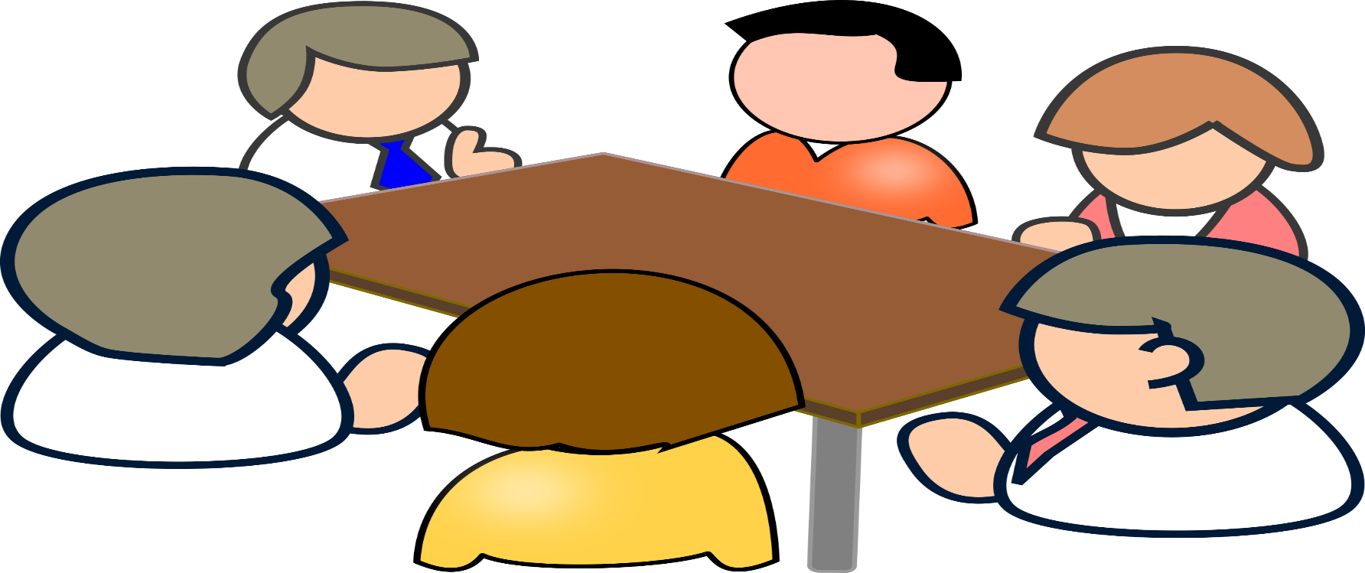
Group work
Group-A-- Hare
Write 5 sentences about hare.
Group-B--Tortoise
Write 5 sentences about tortoise .

Slide 20
Home work
1.What does “Slow but steady wins the race” mean ?

Slide 21
Thank you all.
Good Bye

