Slide 2
Welcome
Everybody

Slide 3
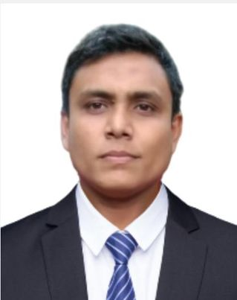
Teacher’s Identity
Mehedi Hasan Razib
Assistant Teacher
Charni lokkhi Govt. Primary school.
Kapasia, Gazipur.
Mob: 01914694764
Email: mhrazib735@gmail.com

Slide 4
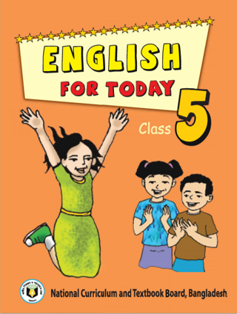
LESSON INTRODUCTION
Class : Five
Subject : English
Unit : 14
Lesson : 1
Lesson Title : The hare and tortoise
Page : 54
Date: /07/2024

Slide 5
Learning Outcomes
At the end of class, Students will be able to
Listening
1.3.1.recognize which words in a sentence are stressed.
4.2.1.understand & enjoy simple stories.
Speaking
1.1.1.say words, phrases & sentences with proper sounds & stress.
1.1.2.say sentences with proper sounds & intonation.
6.2.1 talk about people, objects, events, etc
Reading
1.5.1 read words, phrases and sentences in the text with proper pronunciation, stress and intonation.
1.7.1 read paragraphs, dialogues stories, letters and other texts.

Slide 6
Let’s watch a video

Slide 7
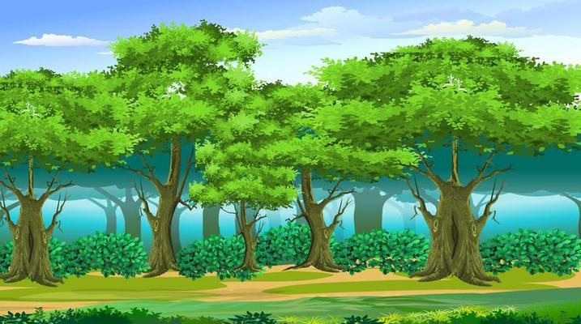
What do you see in the picture?
This is a forest.
Tortoise
Hare

Slide 8
Today’s lesson
Story:
The hare
and
the tortoise

Slide 9
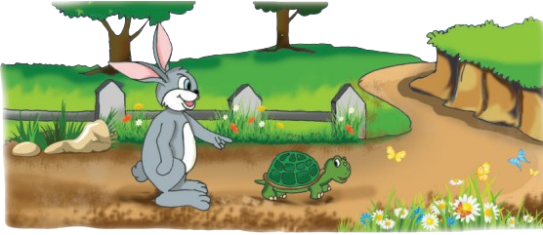
What do you see in the picture?
What can you see in the picture?
A hare and a tortoise
Who are there in the picture?
A hare and a tortoise
Where are they?
In a forest
What are they doing?
They are talking and walking.

Slide 10
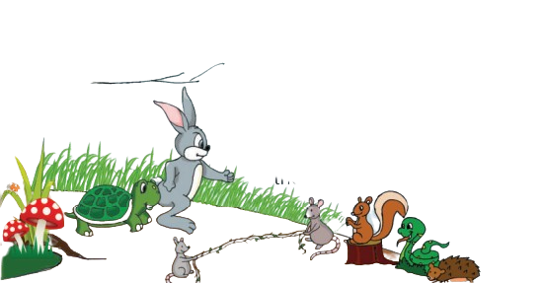
What do you see in the picture?
What are they doing?
They are beginning the race.
What are the other animals doing?
Watching the race.
Why are they holding the twig?
because the race will start here.

Slide 11
What do you see in the picture?
Where are the tortoise and the hare now?
in a race.
What is the hare doing?
taking rest
Why do you think the hare is taking rest?
Because the tortoise is far behind

Slide 12
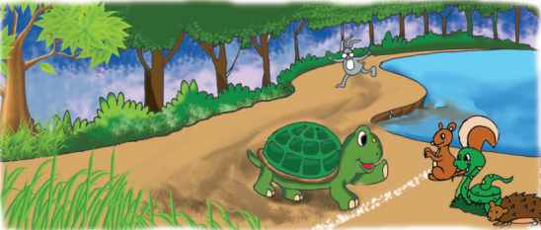
What do you see in the picture?
What can you see in the picture?
Final moment of the race.
Who won the competition?
the tortoise.
Why do you think the tortoise won the competition?
“Slow but steady wins the race”

Slide 13
Teacher’s reading
Open your text book at page no: 54
Everybody put on your finger on the text sima and listen to me attentively
One day, a hare was walking in the forest when he saw a tortoise. The hare was the fastest animal in the forest. The tortoise was the slowest animal in the forest. The hare called out to the tortoise, “Hurry up! You are so slow! Can’t you walk faster? Can’t you run?” A. Listen and read. The tortoise felt angry and said to the hare, “Why don’t we have a race? Maybe I can win!”
The hare laughed and laughed. “Sure! I will win!” the hare said. They agreed to start next to a big tree and finish at the river. Then they called their friends to watch. The hare stood beside the tortoise and the race began.

Slide 14
Teacher’s reading
Everybody put on your finger on the text sima and listen to me attentively
One day, a hare was walking in the forest when he saw a tortoise.
The hare was the fastest animal in the forest.
The tortoise was the slowest animal in the forest.
The hare called out to the tortoise, “Hurry up! You are so slow! Can’t you walk faster? Can’t you run?”
The tortoise felt angry and said to the hare, “Why don’t we have a race? Maybe I can win!”

Slide 15
Teacher’s reading
Everybody put on your finger on the text sima and listen to me attentively
The hare laughed and laughed. “Sure! I will win!” the hare said.
They agreed to start next to a big tree and finish at the river.
Then they called their friends to watch.
The hare stood beside the tortoise and the race began.

Slide 16
New words
slow
ধীর
race
দৌড় প্রতিযোগিতা
fast
দ্রুত
win
জয়লাভ করা
angry
রাগান্বিত
next to
সামনে
agree
রাজি হওয়া
beside
পাশে
watch
দেখা
furious
ক্রোধান্বিত

Slide 17
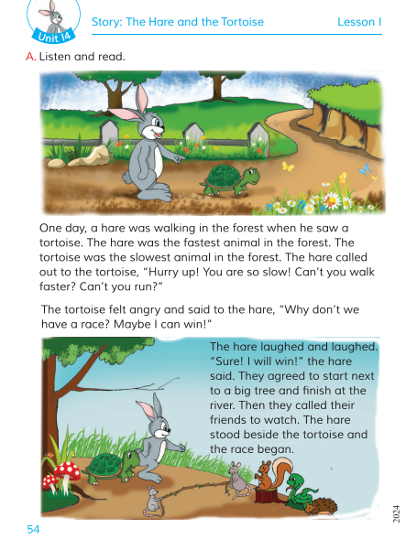
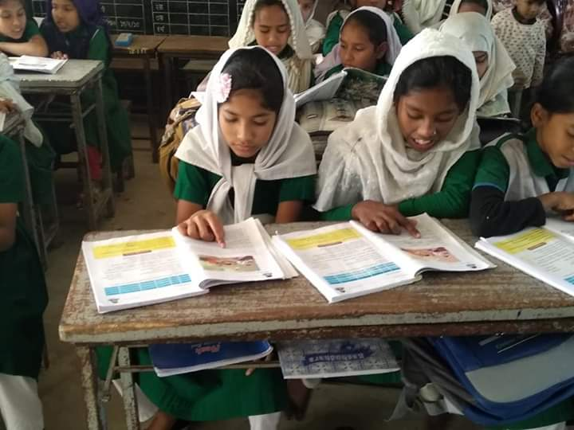
Pair work
Student Reading
Read the text attentively

Slide 18
Assessment
Read out the text.

Slide 19
Home work
Page- 54
Activity-A

Slide 20
Thank
You
All
See
You
Next
Class

