Slide 2

Welcome to all of you

Slide 3
Teacher Introduction
Md. Abu Hanif
Assistant Teacher (English)
Biara Marua Dakhil Madrasa
Kalihati, Tangail

Slide 4
Lesson Introduction
Class-Seven
Experience:-01
Competency No.03:- Ability to practise democratic norms in accordance with relevant social practices
Session No.:01
Duration :

Slide 5
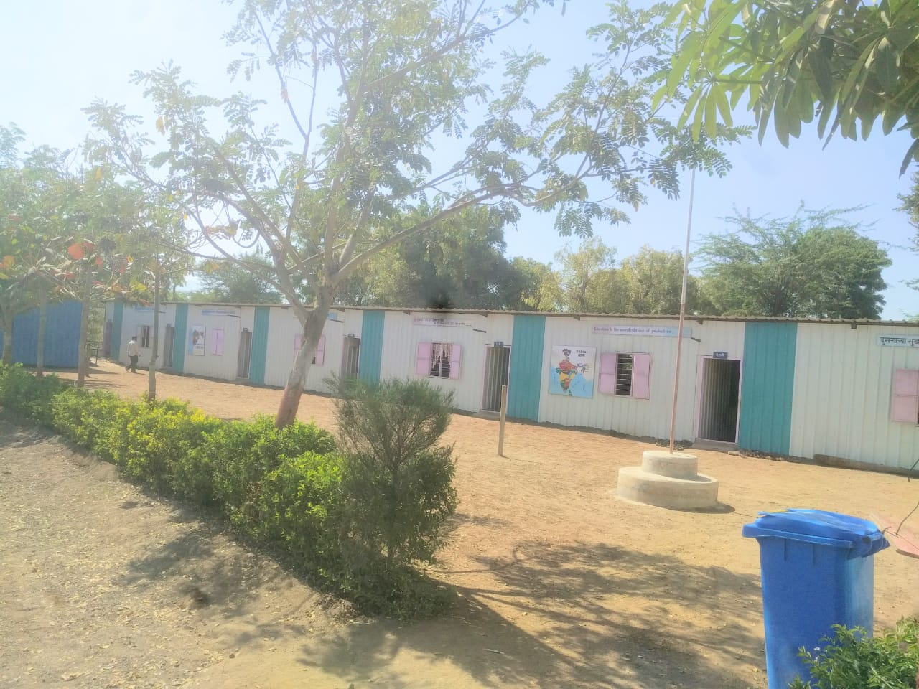
Look at the picture of a school . And write 5 sentences on what you love about this school in pairs/groups.

Slide 6
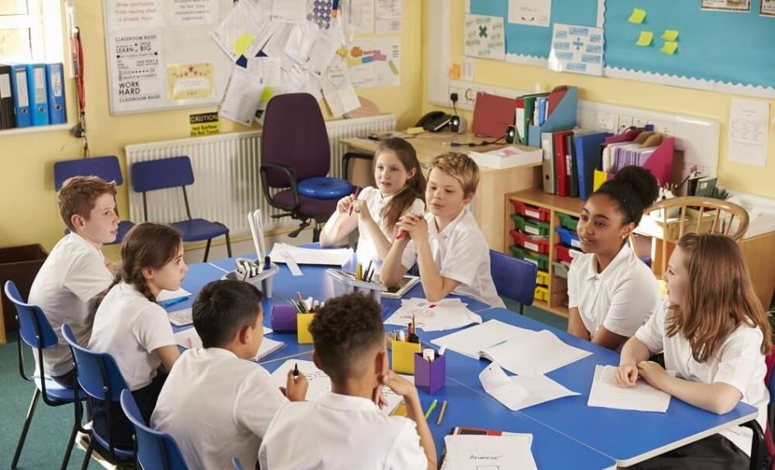
Group Work
1.2 Work in Pairs. Identify which of these facilities you have in your school. Tick under yes if you have the facilities and Tick under no if you do not have the facilities in your school. One is done for you.

Slide 7
Questions | Yes | No
1. Do you have a playground in your school? | √
2. Do you have a garden in your school?
3. Do you have a library in your school?
4.Do you have a canteen in your school?
5.Do you have a clean classrooms in your school?
6. Do you have a white/blackboard in the classroom?

Slide 8
Thank you all So So Much

