Slide 1




Welcome
To My
Articles
Class-2

Slide 2
Teacher’s Introduction
Md. Morsalin
Assistant English Teacher.
Paharipukur Dakhil madrasah

Slide 3
Outcome of the lesson
  After Completing the Lesson
  SS will be able to use Articles.
  SS will be able to make correct sentence.
  SS will be able to use correct articles.
  SS will be able to use a. an & the.

Slide 4
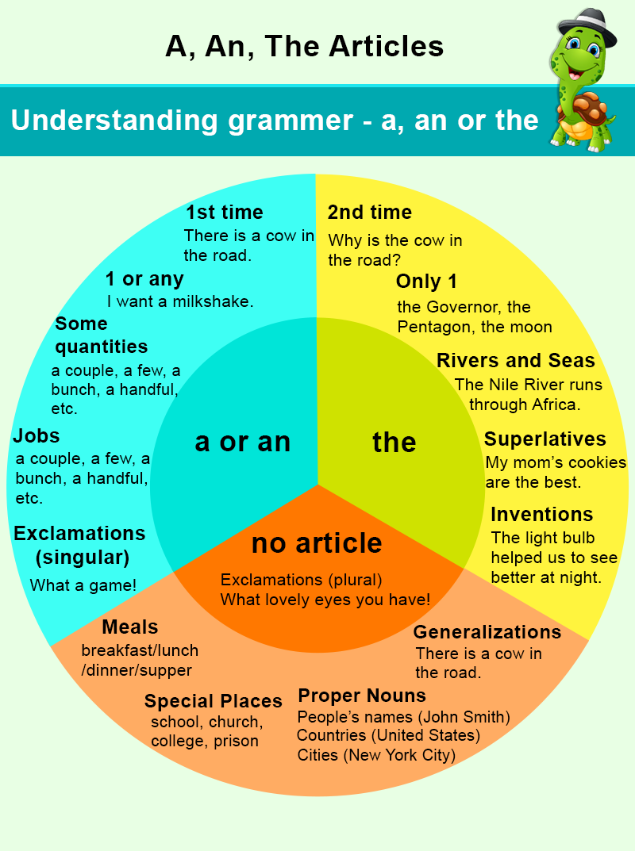

Slide 5


Slide 6
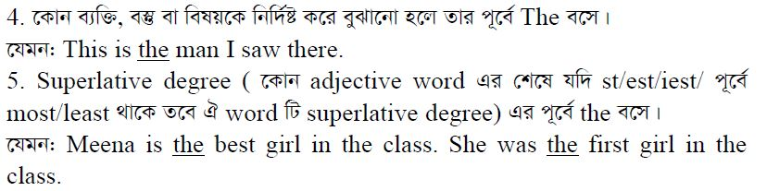

Slide 7
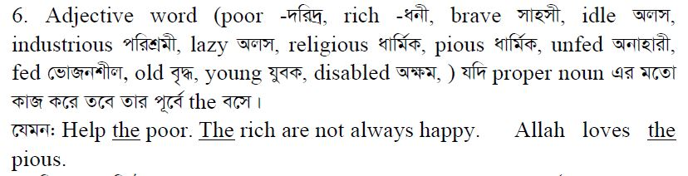

Slide 8
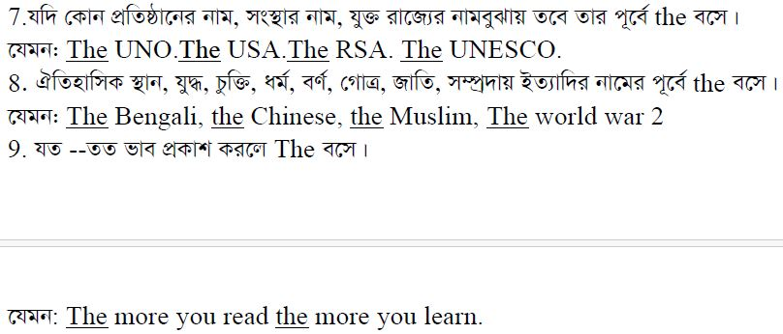

Slide 9
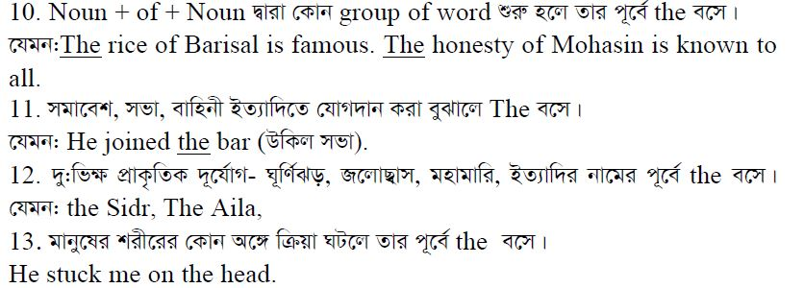

Slide 10
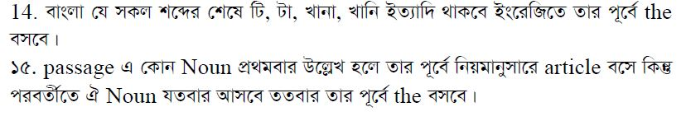

Slide 11
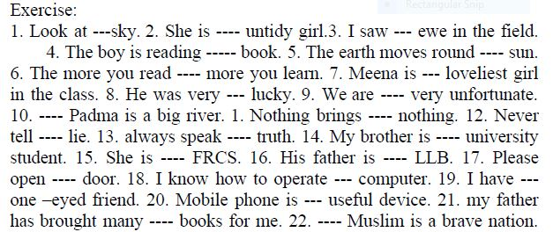

Slide 12
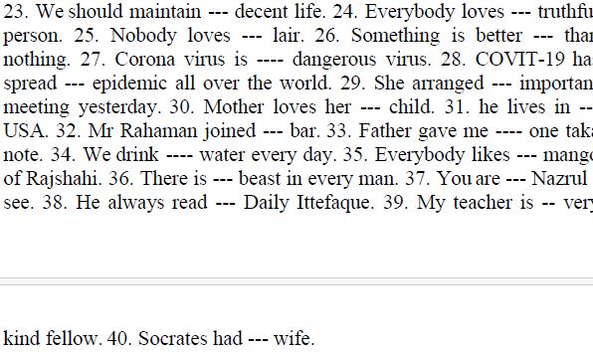

Slide 13
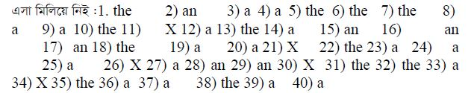

Slide 14
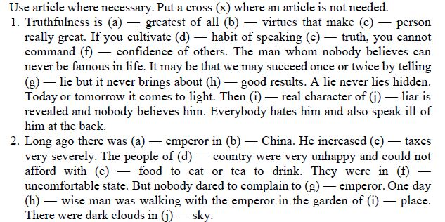

Slide 15

Let’s Finish Today.
Hope You All Enjoy the Class.
See You Tomorrow
And Thanks to ALL

