Slide 1

Welcome

Slide 2
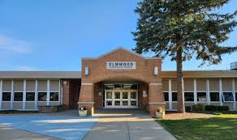
SALMA KHATUN
ASSISTANT TEACHER (ENGLISH)
KHATROPALA GIRLS’ DAKHIL MADRASHA
CLASS : CLASS SEVEN
SUBJECT: ENGLISH
EXPERIENCE :A DREAM SCHOOL
TIME: 45 MINUTES
DATE:18/5/24

Slide 3
LETS SEE A VIDEO
A DREAM SCHOOL

Slide 4
After finishing this experience students will be able to …… ………
Converse with other and share their opinion
Identify the similarities and dissimilarities.
  Share their dream and try to make it real .

Slide 5
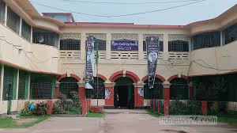

Do you like your school ? Why?
What do you have in your school ?

Slide 6

Identify the similarities and dissimilarities between the two school
Faria’s school
Raihan’s school

Slide 7
Identify the problems of your school in comparison to the story
Activity of group A
Facilities and problems of Faria’s school
The good things in your school
Activity of group B
Facilities and problems of Raihan’s school
What you need in your school

Slide 8
Home work
And write what should be improved upon or removed from your school to make your school a dream school .
Now produce a text on your dream school

Slide 9

THANK YOU

