Slide 1

Welcome

Slide 2
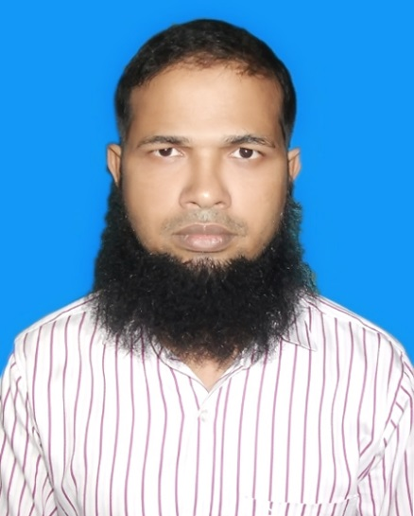
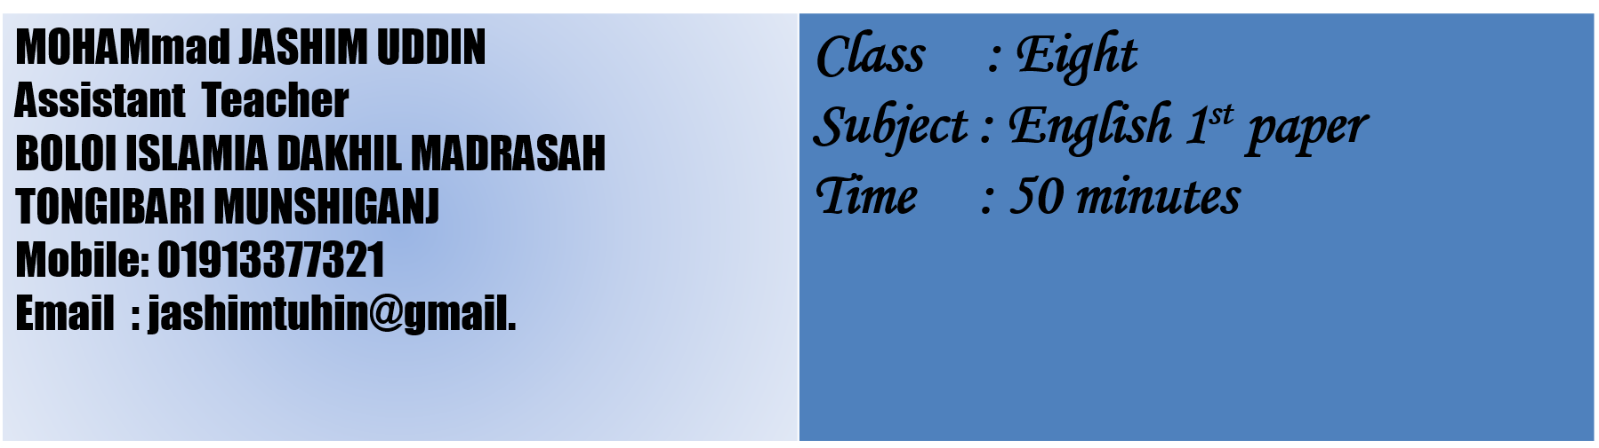
Introduction

Slide 3
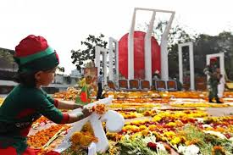
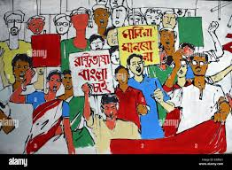
Look at the pictures

Slide 4
Let’s guess the text that we are going to read.
Yes. You are right. We are going to read about “Ekushe February /International Mother Language Day”

Slide 5
Learning outcome
After reading the text, students will be able:
To know The historical events
To know the importance of mother tongue.
To know about the multilingualism.
To know about global awareness.

Slide 6
21 February is a memorable day in our national history. We observe the day every year as international Mother Language Day. The day is a national holiday.
On this day, we pay tribute to the martyrs who laid down their lives to establish Bangla as a state language in undivided Pakistan in 1952. The struggle to achieve our language rights is known as the Language Movement. The seed of the Language Movement was sown on 21 March 1948 when Mohammad Ali Jinnah, the Governor General of Pakistan, declared in a public meeting in Dhaka that Urdu would be the only state language of Pakistan. The declaration raised a storm of protest all over the courtry. The protest continued non-stop, gathering momentum day by day. It turned into a movement and reached its climax in 1952. The government outlawed all sorts of public meetings and rallies to stop it.
The students of Dhaka University defined the law and brought out a peaceful protest procession on 21 February 1952. When the procession reached near Dhaka Medical College, the police opened fire on the students. killing Salam, Rafiq, Barkat, Safiur and Jabbar. As a result, there were mass protests all over the country and the government had to declare Bangla as a state language. This kindled the sparks of independence movement of Bangladesh.
Read the text silently

Slide 7
Individual work
(A) What is Ekushe February ?
(B) How is it observed in Bangladesh?
(C) Who were the martyrs?

Slide 8
ANSWER
(A) Ekushey February (21st February) is
International Mother Language Day, a global observance recognizing the sacrifice of Bangladeshi students who died in 1952 protesting to make Bengali a state language.
(B) People gather at the Shaheed Minar (Martyr's Monument) in Dhaka and its replicas to pay homage, placing flowers.It's also a national holiday, observed as "Shaheed Dibosh“. Morever there are patriotic songs (like "Amar Bhaier Rokte Rangano"), seminars, flag hoisting, and cultural programs.
(C) The most recognized martyrs (Shaheeds) are Salam, Jabbar, Rafiq, Barkat, and Shafiur Rahman, who died on that day or in subsequent protests.

Slide 9
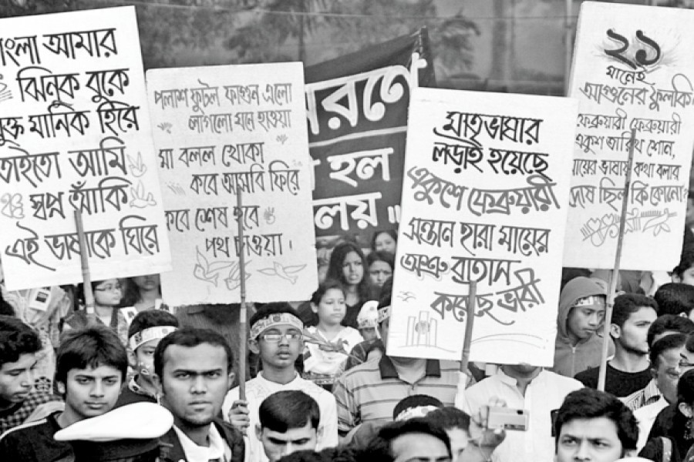
What happened on February 21, 1952?
Why did people protest when Urdu was declared the only state language of Pakistan?
Group work

Slide 10
Answer for Group work
Students at Dhaka university brought out a peaceful protest, and police opened fire, killing several students including Salam, Rafiq, Barkat, Shafiur and Jabbar.
The people of east pakistan praimarily spoke Bengali and protested against the imposition of another language due to cultural and languistic differences.

Slide 11
Assesment
Who declared 21st February as International Mother Language Day?
Why is 21 February significant for Bangladesh?
(c) What was the main demand of the Language Movement?
(d) Which phrase means a strong protest?

Slide 12
Answer of assesment
(a) UNESCO (United Nations Educational, Scientific and Cultural
Organization) declared February 21st as International Mother Language Day in 1999.
(b) February 21st is highly significant for Bangladesh as it commemorates the 1952 Bengali language movement.
(c) The main demand of the Language Movement (1948-1952) in East Pakistan (now Bangladesh) was for Bengali (Bangla) to be recognized as a state language of Pakistan, alongside Urdu.
(d) The phrase that means a strong protest is "a storm of protest".

Slide 13
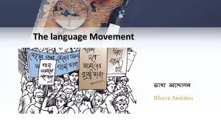
Homework
Who organized the movement for Bengali (Bangla) to become a state language, and what did they sacrifice?

Slide 14

THE END

