Slide 1


Slide 2
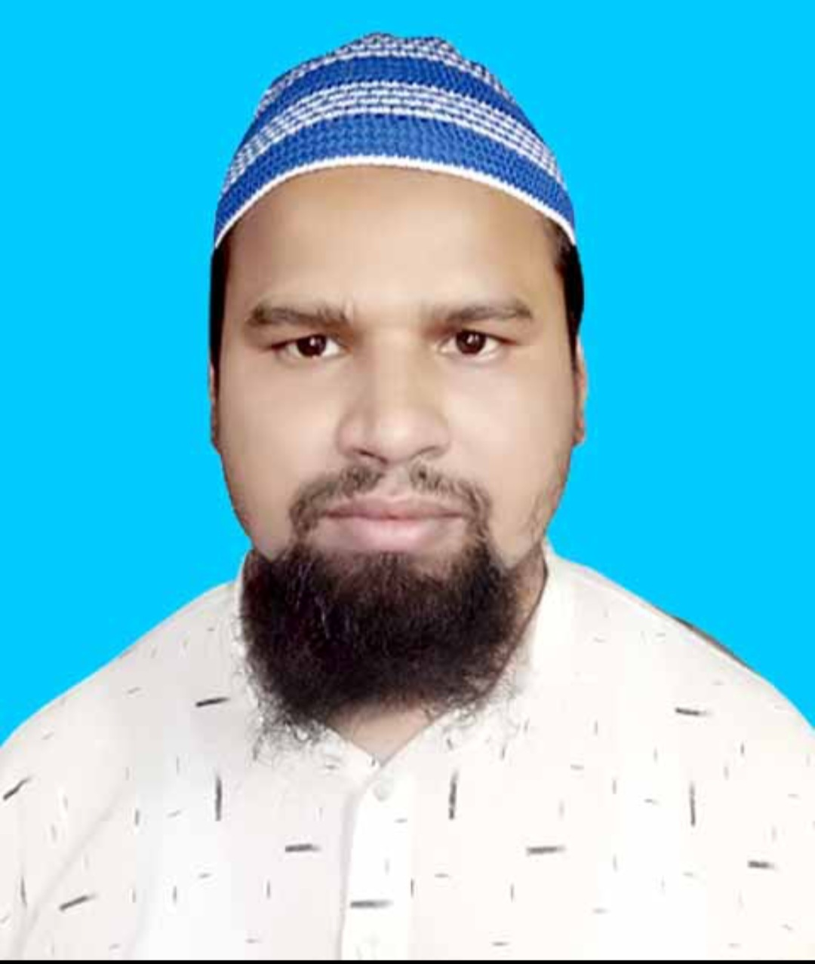
TEACHER’S IDENTITY
Md. Farid Uddin
Lecturer in English
Chipatali J.G.M Kamil (M.A) Madrasah
Hathazari, Chattogram
fariduddin111989@gmail.com
Exercise 2 Punctuation & Capitalization

Slide 3
Use capitals and punctuation marks where necessary in the following text.
Exercise: 28 i was born in a village near tangail a small river flows beside the village the villagers bathe in the river and catch fish how happy they are what they want is peace
Exercise: 29 did people use stamps in those days asked rafiq yes answered mr jamal the first stamps were used in 1840 are they easy to get now asked rafiq they are very difficult to get his uncle replied
Exercise: 30 after supper when I began to set out lucy trembled in fear and said alfred dear are you quite sure that the letter really came from your chief I laughed told her not to be afraid and hurried out of the room and walked down the street.

Slide 4
Answer:28 I was born in a village near Tangail. A small river flows beside the village. The villagers bathe in the river and catch fish. How happy they are! What they want is peace.
Answer: 29 “Did people use stamps in those days?” asked Rafiq. “Yes,” answered Mr. Jamal. “The first stamps were used in 1840.” “Are they easy to get now?” asked Rafiq. “They are very difficult to get,” his uncle replied.
Answer: 30 After supper when I began to set out, Lucy trembled in fear and said, “Alfred dear, are you quite sure that the letter really came from your chief”?” I laughed, told her not to be afraid and hurried out of the room and walked down the street.

Slide 5
Exercise: 31 the man said to me where are you going i am going to school said i did you go to school yesterday no i replied why didn’t you go i was very busy said i
Exercise: 32 the teacher said to the boy where are you going now i am going to school said the boy did you go to school yesterday no the boy replied why did you not go i was suffering from fever said the boy
Exercise: 33 robert bruce the king of scotland was defeated at a war and failed to regain his country’s freedom several times naturally he was in a very dejected mood sitting in his hide out he lost himself in deep thought.

Slide 6
Answer:31 The man said to me, “Where are you going?” “I am going to school.” said I. “Did you go to school yesterday?” “No,” I replied. “Why didn’t you go?” “I was very busy.” said I.
Answer:32 The teacher said to the boy, “Where are you going now?” “I am going to school,” said the boy. “Did you go to school yesterday?” “No,” the boy replied. “Why did you not go?” “I was suffering from fever,” said the boy.
Answer: 33 Robert Bruce, the king of Scotland, was defeated at a war and failed to regain his country’s freedom several times. Naturally he was in a very dejected mood. Sitting in his hide out, he lost himself in deep thought.

Slide 7
Exercise: 34 the king said what harm did I do then that you should seek to take my life with your own hand you killed my father and my two brothers the young man replied.
Exercise: 35 why are you going to barisal said father i want to buy some important books said saad do you need money yes father don’t go alone as time is not going well.
Exercise: 36 once my mother said to me who came to you my friend Rafiq mom she asked what did he want i said his mother is ill he needs some money i have given him five hundred taka my mother said wonderful.

Slide 8
Answer: 34 The King said, “What harm did I do then that you should seek to take my life with your own hand?” “You killed my father and my two brothers,” the young man replied.
Answer: 35 “Why are you going to Barisal?” said father. “I want to buy some important books,” said Saad. “Do you need money?” “Yes, father.” “Don’t go alone as time is not going well.”
Answer: 36 Once my mother said to me, “Who came to you?” “My mother friend Rafiq, Mom.” She said, “What did he want?” I said, “His mother is ill. He needs some money. I have given him five hundred taka.” My mother said, “Wonderful!”

Slide 9
Exercise: 37 bangladesh is a small country with a population of about sixteen crores she can hardly make headway so we should work hard to keep pace with the rest of the world
Exercise: 38 is there anybody here who has ever crossed a river by a boat i have teacher i clearly remember what happened in that journey said Jamal.

Slide 10
Answer: 37 Bangladesh is a small country. With a population of about sixteen crores, she can hardly make headway. So, we should work hard to keep pace with the rest of the world.
Answer: 38 “Is there any anybody here who has ever crossed a river by a boat?” “I have, teacher. I clearly remember what happened in that Journey,” said Jamal.

Slide 11
Exercise: 39. why are you going to barishal said father i want to buy some important books said saad do you need money yes father dont go alone as time is not going well
Exercise : 40. would you please tell me one reason of air pollution yes the smoke from our household activities vehicles factories ete is mainly causing air pollution
Exercise : 41 arent you going to have any said I no i never eat asparagus I know there are people who dont like them the fact is that you ruin your palate by all the meat you eat she said

Slide 12
Answer: 39 “Why are you going to Barishal?” said father. “I want to buy some important books,” said Saad. “Do you need money?” “Yes, father.” “Don’t go alone as time is not going well.”
Answer: 40 “Would you please tell me one reason of air pollution?” “Yes, the smoke from our household activities, vehicles, factories etc. is mainly causing air pollution.”
Answer: 41. “Aren’t you going to have any?” said I. “No, I never eat asparagus.” “I know there are people who don’t like them. The fact is that you ruin your palate by all the meat you eat,” she said.

Slide 13
Exercise: 42. hello old lady what are you doing said the princess i am spinning a yarn around the spindle replied the old woman
Exercise : 43. my dear mother your letter is just to hand it seems to me that you are anxious for me but you need not think about me
Exercise : 44. is there anybody here who has ever crossed a river by a boat is have teacher i clearly remember what happened in that journey said jamal

Slide 14
Answer: 42. “Hello, old lady, what are you doing?” said the Princess. “I am spinning a yarn around the spindle.” replied the old woman.
Answer: 43. My dear Mother, your letter is just to hand. It seems to me that you are anxious for me, but you need not think about me.
Answer: 44. “Is there anybody here who has ever crossed a river by a boat?” “I have, teacher. I clearly remember what happened in that journey,” said Jamal.

Slide 15
Exercise:45. how is your father bilkis said mr rahman he is very well thank you bilkis replied i am glad to here that he is in good health said mr rahman
Exercise:46. the teacher said to the girl do you think that honesty is the best policy yes sir i think so said the girl then learn to be hones from your childhood thank you sir said the girl may allah bless you said the teacher.
Exercise:47. do not worry about a few mistakes said the teacher you can learn a lot through your mistakes do we learn from our mistakes asked the boy.

Slide 16
Answer: 45. “How is your father, Bilkis?” said Mr. Rahman. “He is very well. Thank you.” Bilkis replied. “I am glad to hear that he is in good health,” said Mr. Rahman
Answer: 46. The teacher said to the girl. “Do you think that honesty is the best policy?” “Yes, sir, I think so.” said the girl. “Then learn to be honest from your childhood.” “Thank you, sir.” said the girl. “May Allah bless you.” said the teacher.
Answer: 47. “Do not worry about a few mistakes,” said the teacher. “You can learn a lot through your mistakes.” “Do we learn from our mistakes?” asked the boy.

Slide 17
Exercise: 48. have you heard the name of alexander asked mr ahmed no sir razu replied how strange It is said he will you tell me about alexander please well he was the great king of mecedonia
Exercise: 49. go to bed now mother said you can complete your assignment in the morning no mom ill finish it now
Exercise: 50. stop you are eating all our bread shouted the two rats i am doing my best but I have told you that its difficult said the monkey give us that little Piece said the rats this is My piece havent i laboured a lot for you replied the Monkey how foolish we are believing you said the two rats

Slide 18
Answer: 48. “Have you heard the name of Alexander?” asked Mr. Ahmed. “No, sir,” Raju replied. “How strange it is!” said he. “Will you tell me about Alexander, please?” “Well, he was the great king of Macedonia.”
Answer: 49. “Go to bed now.” mother said. “You can complete your assignment in the morning.” “No mom. I’ll finish it now.”
Answer: 50. “Stop! You are eating all our bread,” shouted the two rats. “I am doing my best. but I have told you that it’s difficult,” said the monkey. “Give us that little piece,” said the rats. “This is my piece. Haven’t I laboured a lot for you?” replied the monkey. “How foolish we are believing you!” said the two rats.

Slide 19


