Slide 1



Slide 2
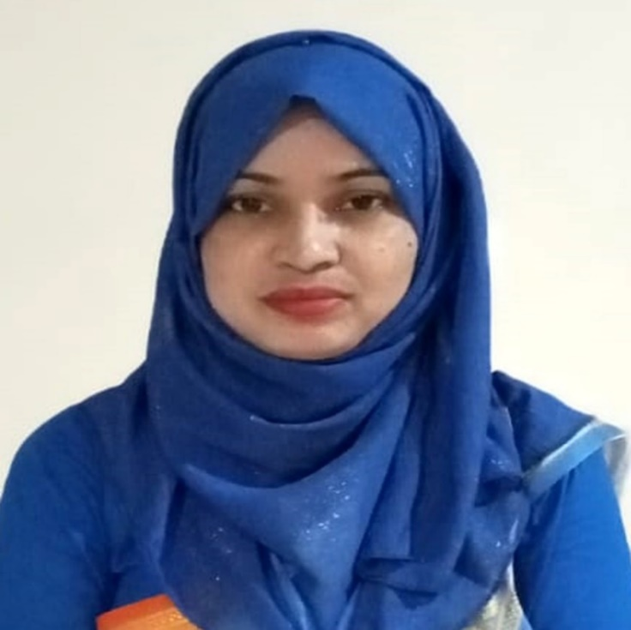
Conduct By
MUNZILA AKTER
Instructor (English)
Madaripur Govt. T.S.C
Madaripur.
2

Slide 3
Lesson Identity
Subject
English For Today
Class –Ten
Time -45 mins
Unit-2
Topic: Climate Change
Lesson-1
3

Slide 4
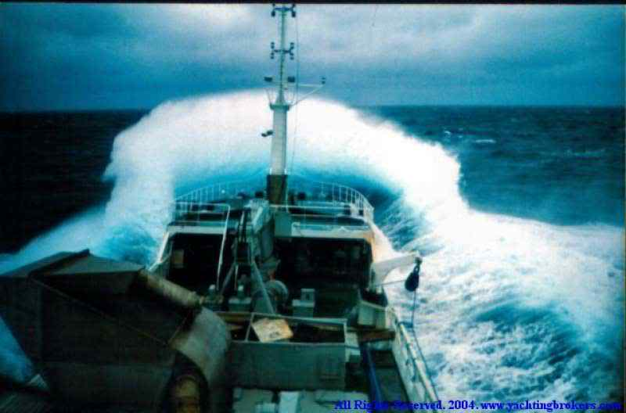
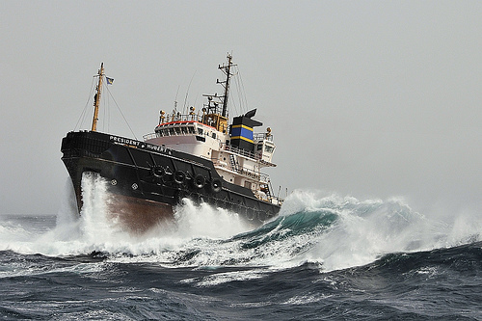

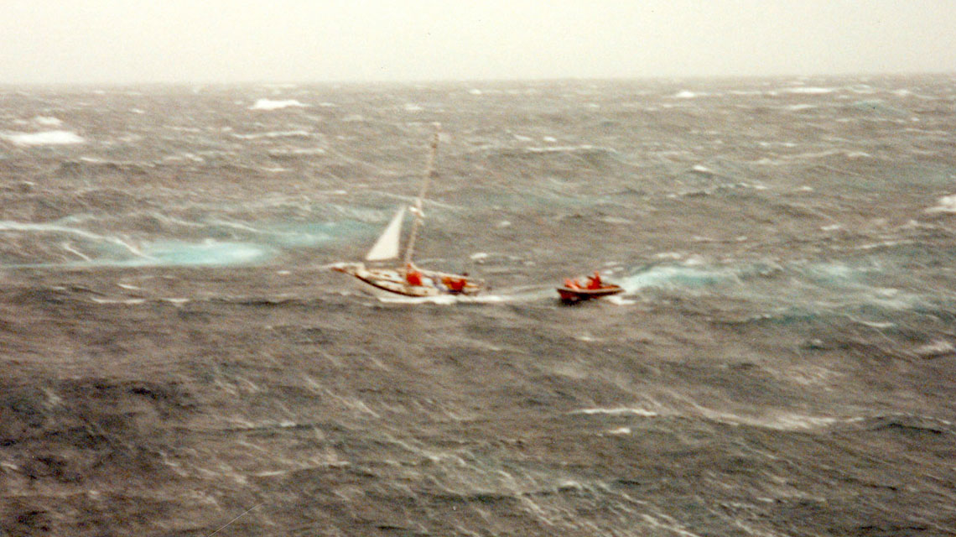
Look at these pictures.
4

Slide 5
Our today’s lesson is-
The Greed of the Mighty Rivers
Unit-Two, Lesson -one
5

Slide 6

Learning Outcomes
After we have studied this lesson, students will be able to---
Ask and answer questions
Demonstrate understanding and summarize texts
Take part in debate on given topic.
Write slogans for poster
6

Slide 7
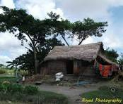
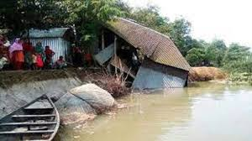
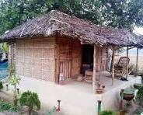
Meherjan house
7

Slide 8
a) What do you know about rough weather?
b) What did property loss to river the Jamuna?
c) What do you know about Meherjan’s family?
d) What is river erosion?
8

Slide 9

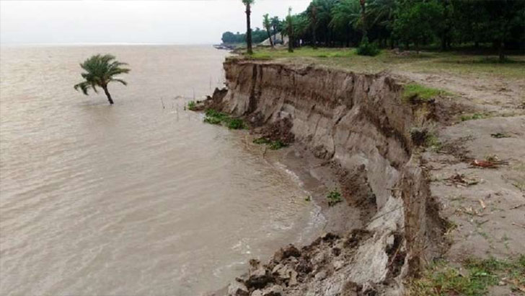
Dear students, read the text silently.
The Greed of the Mighty Rivers
9

Slide 10
Meherjan lives in a slum on the Sirajgonj Town Protection Embankment. The whispering wind from the river Jamuna makes the fire unsteady. The dancing flames remind Meherjan of the turmoil in her life.
Not long ago Meherjan had everything-a family, arable land and cattle. The erosion of the Jamuna gradually consumed all her land It property. finally claimed her only shelter during the last monsoon. It took the river only a day to devour Meher's house, trees, vegetable garden and the bamboo bush. She had a happy family once.
10

Slide 11
Over the years, she lost her husband and her family to diseases that cruel hunger and poverty brought to the family. Now, she is the only one left to live on with the loss and the pain. The greedy Jamuna has shattered her dreams and happiness.
There are thousand others waiting to share the same fate like Meherjan. Bangladesh is a land of rivers, some of whose banks overflow or erode during monsoon. Erosion is a harsh reality for the people living along the river banks. During each monsoon many more villages are threatened by the mighty rivers like the Jamuna, the Padma and the Meghna.
11

Slide 12
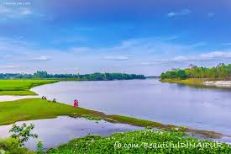
New Vocabularies
Word Meaning
ঢেউ
Wave
অর্থ
1
জাহাজ
Ship
অর্থ
2
নদী
River
অর্থ
3
12

Slide 13

Home Work
Debate: Form two groups of ¾. Decide which group will speak against the motion given below. In your group, first discuss and note down points to oppose the motion. Then select the speakers from each group to start the debate.
Motion: Humans can’t do anything to control the course of time
13

Slide 14

14

