Slide 1


Slide 2
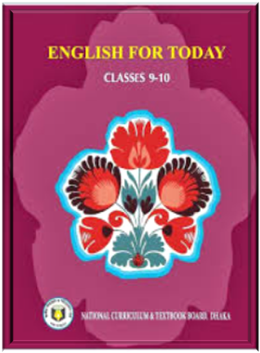
Presenter
MUNZILA AKTER
Instructor(English)
Madaripur Govt. T.S.C
Madaripur.
Subject
English For Today
Class–Ten
Time-45 mins

Slide 3
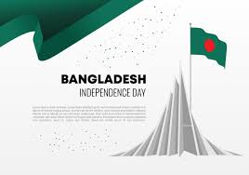
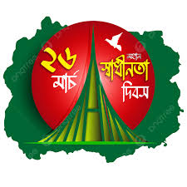

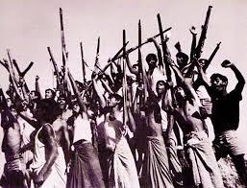

Slide 4
Today we will learn about-
Independence Day
Unit-Four, Lesson-Five

Slide 5
After we have studied this ,we will be able to learn-
1
Talk about events and festivals.
2
Ask and questions.
3
Give opinions in a logical sequence
4
Infer meaning from the context

Slide 6
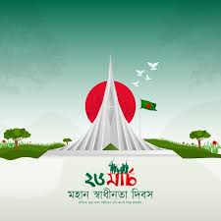
Look at the picture and answer the questions about it.
What do you see in the picture?
Where is it situated?
Why was it built?

Slide 7
Read the Text carefully
26 March, our Independence Day, is the one of the most important state festival. The day is celebrated every year in the country with great enthusiasm and fervour. It is a national holiday. All offices, educational institutions, shops and factories remain closed on this day. The day begins with a 31 gun salute.
Early in the morning the President and the Prime Minister, on behalf of the nation place floral wreaths at the National Mausoleum at Savar. Then other leaders, political parties, diplomats, social and cultural organisations, educational institutions and freedom fighters pay homage to the martyrs. People from all walks of life also go there in rallies and processions. There are many cultural programmes throughout the day, highlighting the heroic struggle and sacrifice in 1971.

Slide 8
Read the Text carefully
In Bangabandhu National Stadium, school children, scouts and girl guides take part in various displays to entertain thousands of spectators. Educational institutions also organise their individual programmes. Sports meets and tournaments are also organised on the day, including the exciting boat race in Buriganga.
In the evening, all major public buildings are illuminated with colourful lights. Bangla Academy, Bangladesh Shilpakala Academy and other socio-cultural organisations hold cultural functions. Similar functions are also arranged in other places in the country.

Slide 9
Match the word with their meanings
Fervour
Alike
Displays
Spectator
Act of performing skills.
In a similar way.
A strng feeling of excitement.
A person who is watching an event.

Slide 10
Lets match the word with their meaning
Fervour
A strng feeling of excitement.
Alike
In a similar way.

Slide 11
Lets match the word with their meaning
Displays
Act of performing skills.
Spectator
A person who is watching an event.

Slide 12
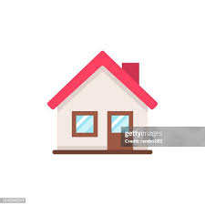
Home Work
Write in brief, how you have celebrated this year’s “Independence Day”.

Slide 13


