Slide 1


WELCOME

Slide 2
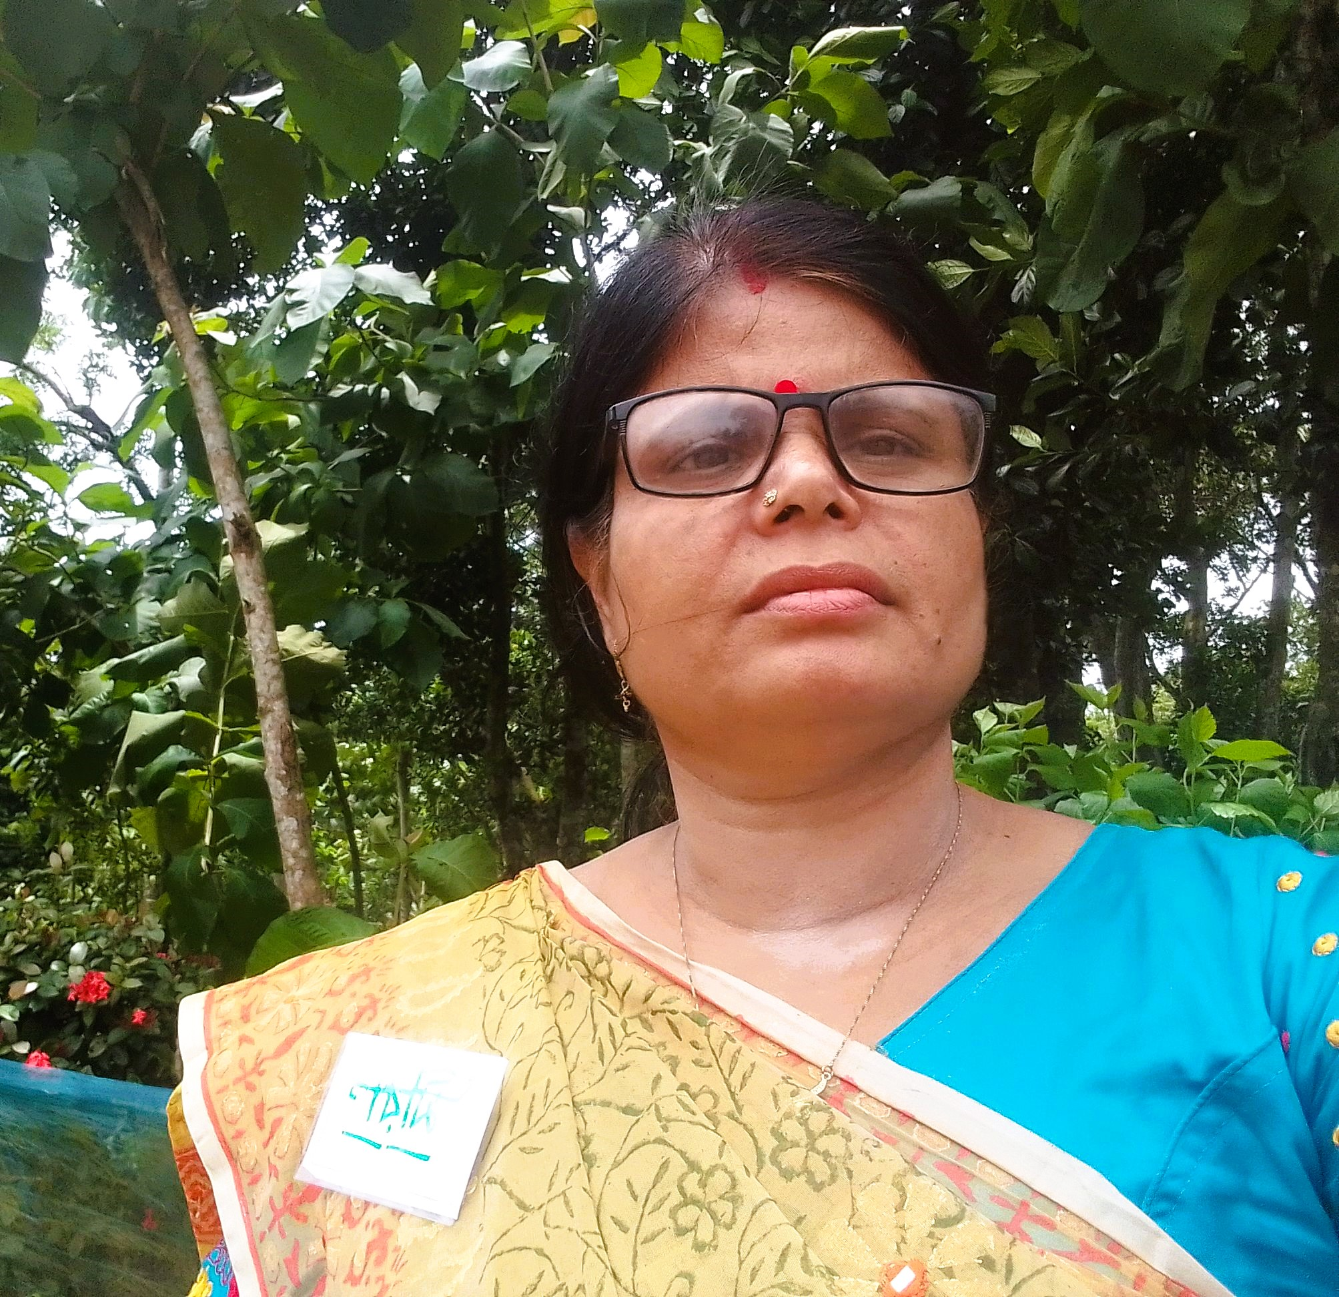

I am

Slide 3
WARM UP

Slide 4
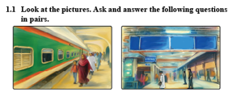
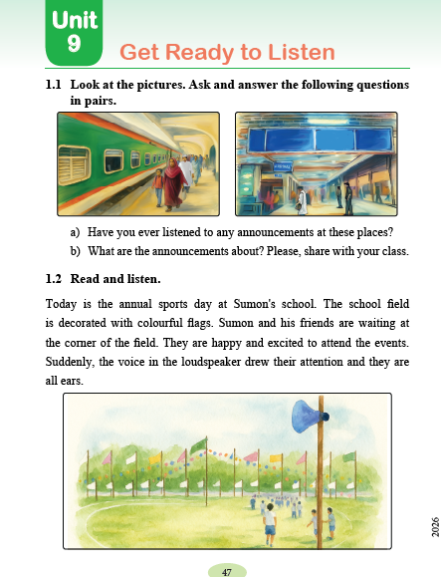
Let’s to see a picture.

Slide 5


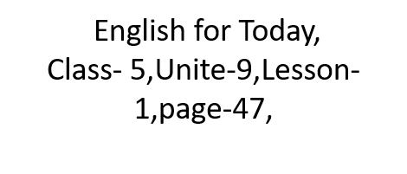

Slide 6


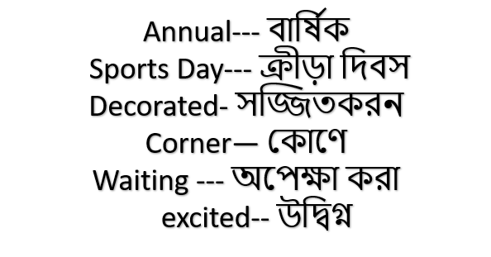

Slide 7
Open your book at page 47.

Slide 8
Say the words meaning

Slide 9

Annual-
Sports –
Flag—
Decorated—
Excited--

Slide 10
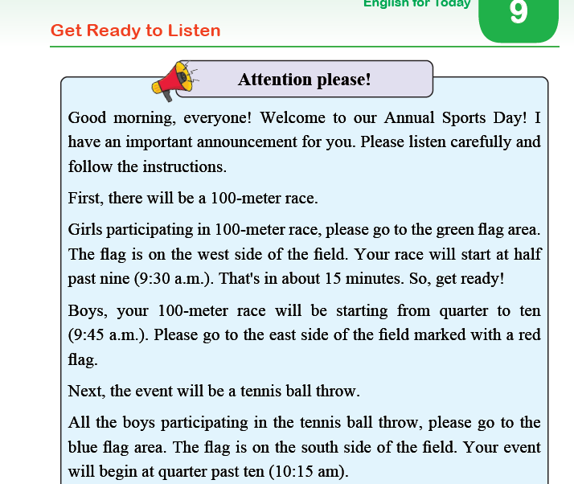

Slide 11
THANK YOU, Good BYE.

