Slide 1
Welcome

Slide 2
Teacher Identity:
Md. Gausul Haque
Senior Teacher
Kalikapur Chowkuni High School, koyra, Khulna

Slide 3
Class: Seven
Sub: English 2nd paper
Time: 45 minutes

Slide 4
Objectives
By the end of the lesson------
TO KNOW THE DEFINITION OF GENDER
TO CLASSIFY OF GENDER
TO IDENTIFY OF GENDER

Slide 5
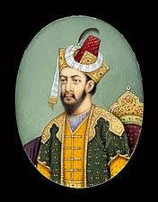
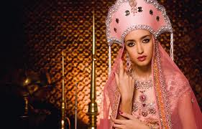
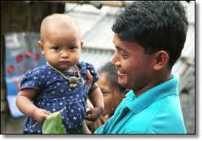
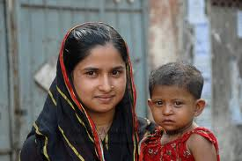
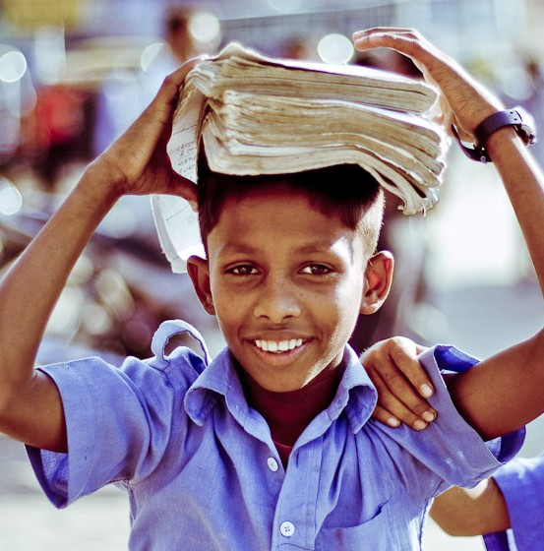
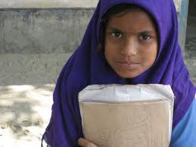
Current page-1

Slide 6
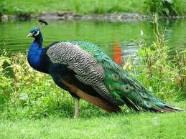
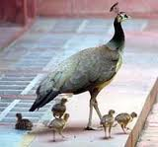
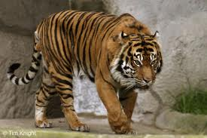
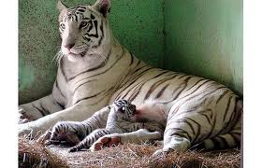
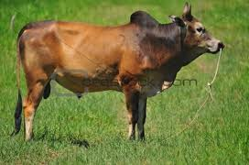
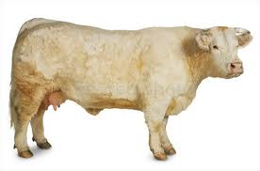
What is this?

Slide 7
Our Today’s lesson is -
Gender and it’s Classifications.

Slide 8
When a word denotes a male or female or both male and female or a thing without life is called a gender.

Slide 9
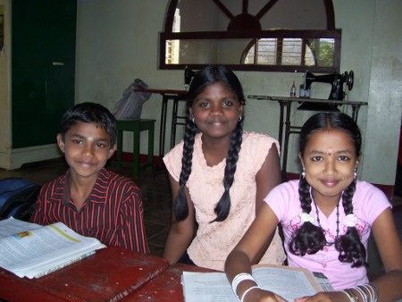
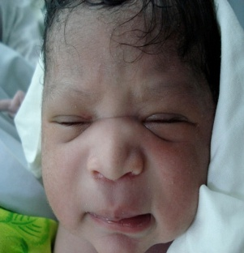
Classifications of Gender
Baby
Girl
Boy
Table

Slide 10
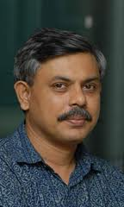
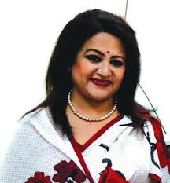

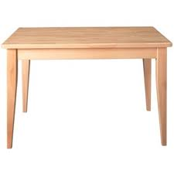
Table is a word that thing without life, so Table =
Nuter Gender
Baby is a both male or female word ,so baby =
Common Gender
Father is a male word, so Father =
Masquline Gender
Mother is a female word, so Mother =
Feminine Gender

Slide 11
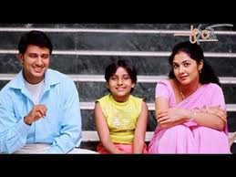
Indivisual Work
How many Gender have in this picture?

Slide 12
Evaluation
What is Gender?
How many kinds of Gender?
What kind of Gender is Friends?

Slide 13
Home Work
Write down the oposite Gender
of the followings word by own word.

Slide 14
Thank You All

