Slide 1

Notes:
Please follow the instructions here.

Slide 2
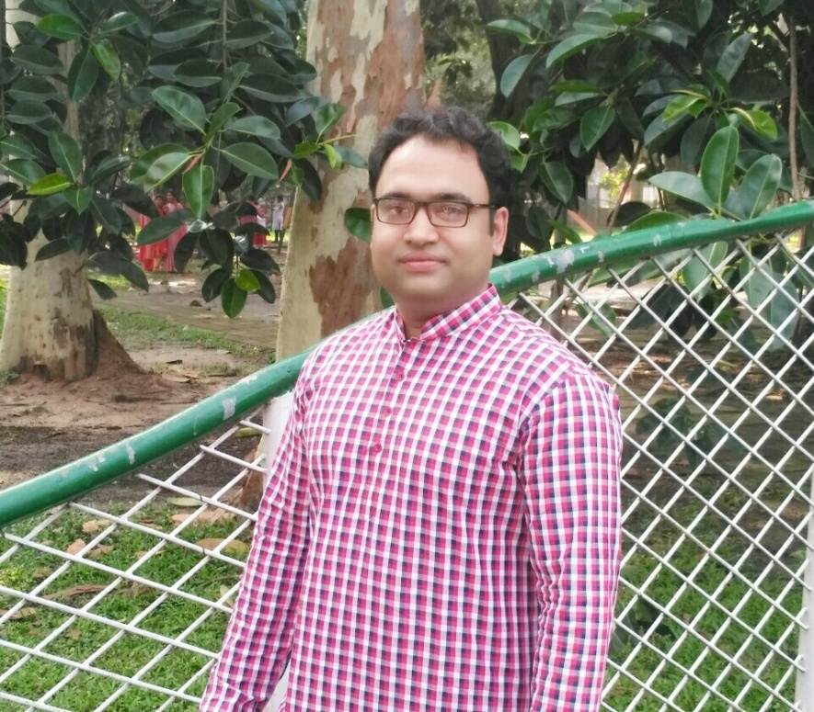
Welcome
Notes:
Welcome slide

Slide 3
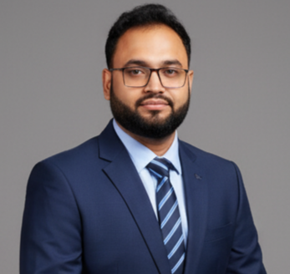
Introduction
Serazul Islam
B.A. Hons. In English M.A
English Teacher
Abdul Gafur Memorial Secondary High School
Jashore Sadar, Jashore.
Presentation made for
Class: vi to xii
Notes:
Introduction of the teacher & class.

Slide 4
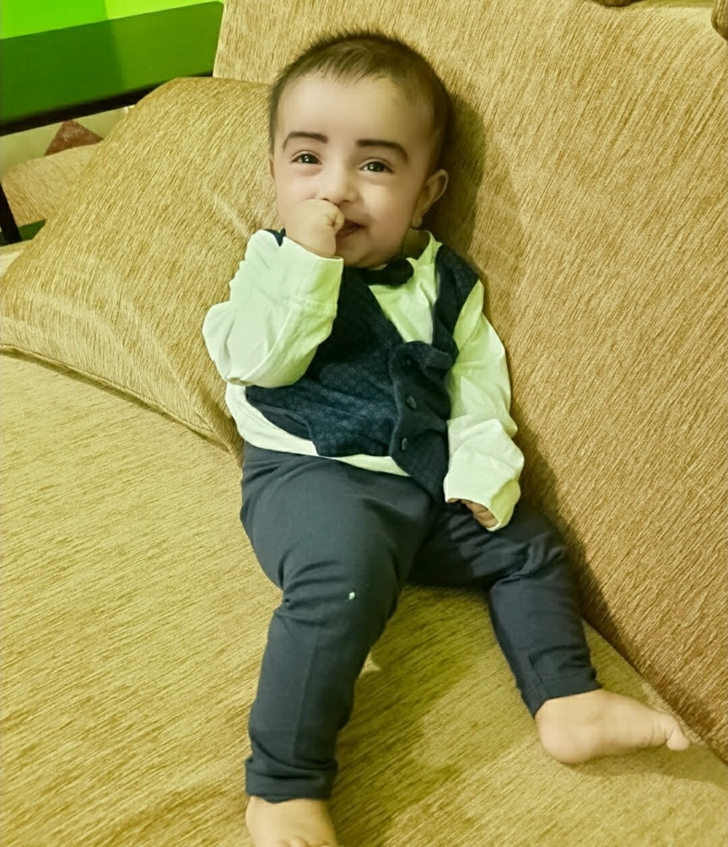
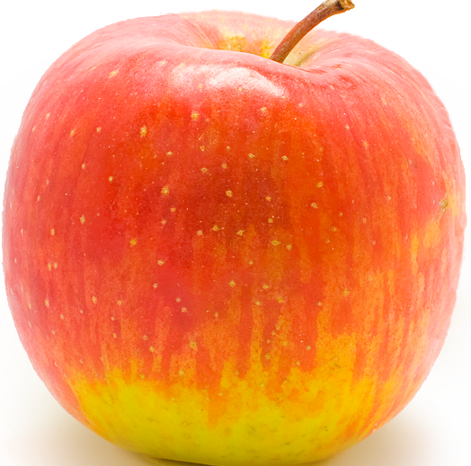
Raiyan eats an apple.
An apple is eaten by Raiyan.
An apple
Raiyan
An apple
Raiyan
Notes:
Suspension 1 to lead the lesson.

Slide 5
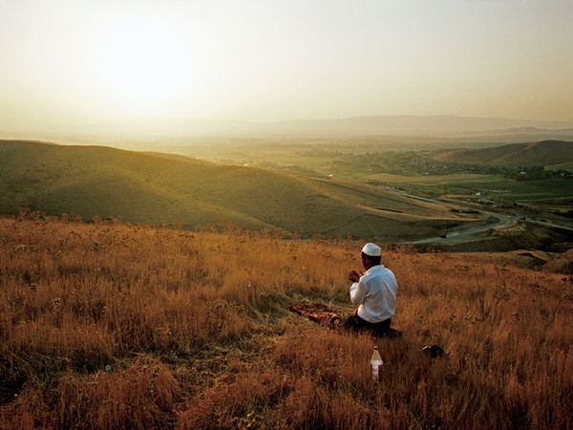
I say my prayer regularly.
My prayer
is said
by me
regularly.
What is it related to?
Notes:
Suspension 2 to lead the lesson.

Slide 6
Voice change
Let us discuss about voice
change in our today’s class.
Notes:
Lesson declaration

Slide 7
Learning outcomes
After studied this lesson, we will be able to---
identify the definition of voice
identify the classification of voice
identify the structure s of active and passive voice
change voice from active to passive
Notes:
Basic rules of voice change will be taught from this content.

Slide 8
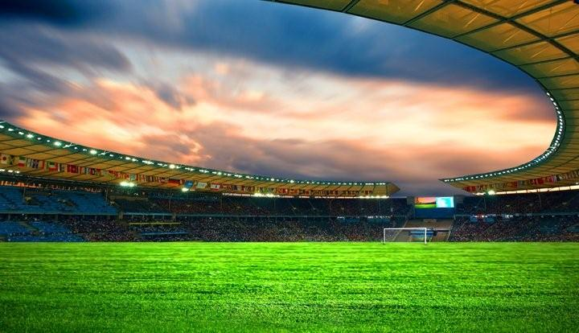
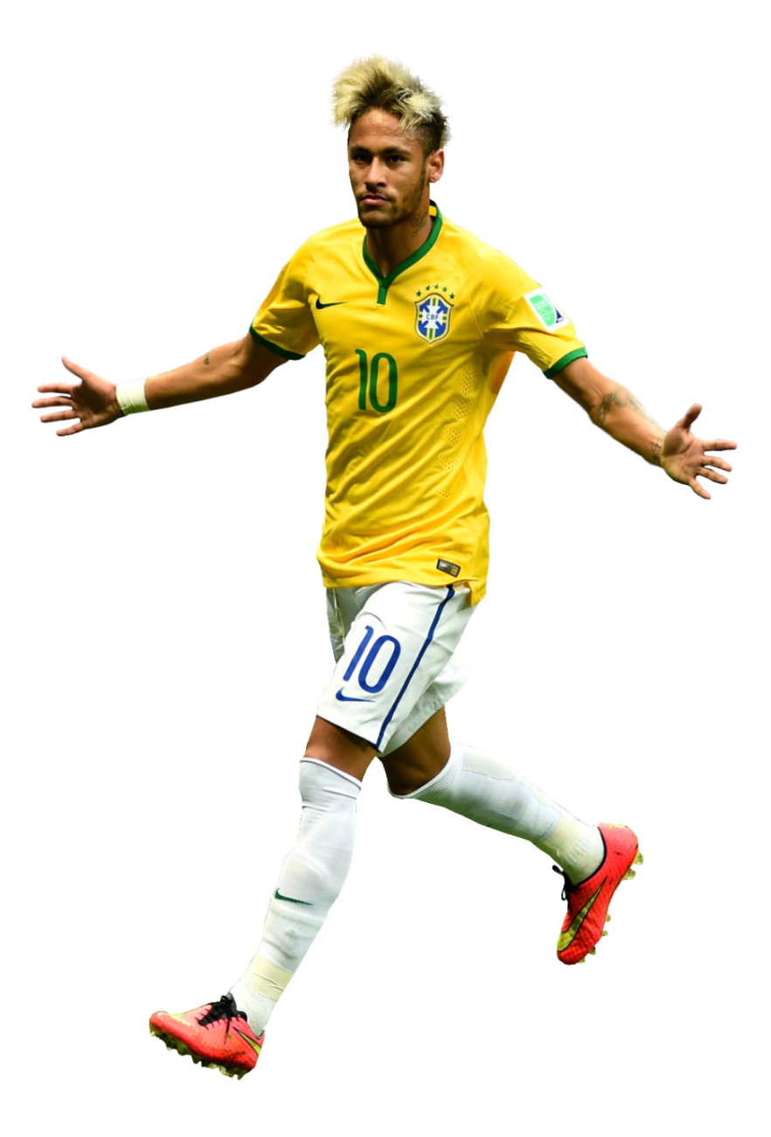

What is voice?
So, Voice is a formation of verb by which subject
does something itself or something is done by subject.
Neymar plays football.
Football is played by Neymar.
Notes:
Delimitation of the voice

Slide 9
Voice is classified into two kinds
Active voice
Passive voice
When the subject does
something itself.
When something is
done by the subject.
Notes:
Classification of voice is focused in this slide.

Slide 10
Quasi-Passive
When the subject does not do
something itself.
The verb remains active
Example: Honey tastes sweet

Slide 11

Active voice
Structure:
Subject
+
Verb transitive
+
object
He reads a book.
Verb
transitive
Subject
object
Notes:
Formation of active voice with example.

Slide 12
Passive voice
Subject of object
object of subject
+
To be verb
+
v₃
+
by/to/for
+
The book is read by him.
Subject of object
To beV
V₃
by
Object of subject
He reads the book.
Subject
Verb transitive
object
Notes:
Formation of passive voice with example.

Slide 13
AT
‘surprised, annoyed, shocked, alarmed, disappointed, displeased, distressed, astonished, laughed
Example:
Active: His behavior annoyed me.
Passive: I was annoyed at his behavior.
TO
‘married, known, obliged’
Example:
Active: Karan married Bipasha.
Passive: Bipasha was married to Karan.
WITH
‘pleased, disgusted, impressed, charmed, etc.
Example:
Active: Her performance impressed us.
Passive: We were impressed with her performance.
IN
‘interested, consisted, absorbed, contained, etc.’
Example:
Active: This topic might interest students.
Passive: Students might be interested in this topic

Slide 14
List of some subjects and their objects
Subject | object
I | me
We | us
You | you
They | them
He | him
She | her
Rahim/Karim | Rahim/Karim
The pen | the pen
Animals | animals
Notes:
Basic of all grammar items.

Slide 15
To be verbs of passive voice
If the active voice is- | Auxiliary of passive voice will be--
No aux V | am/is/are/was/were
Have/has/had | been
V+ing | being
Modal aux. Verb | be
Notes:
Fundamental items of voice change.

Slide 16
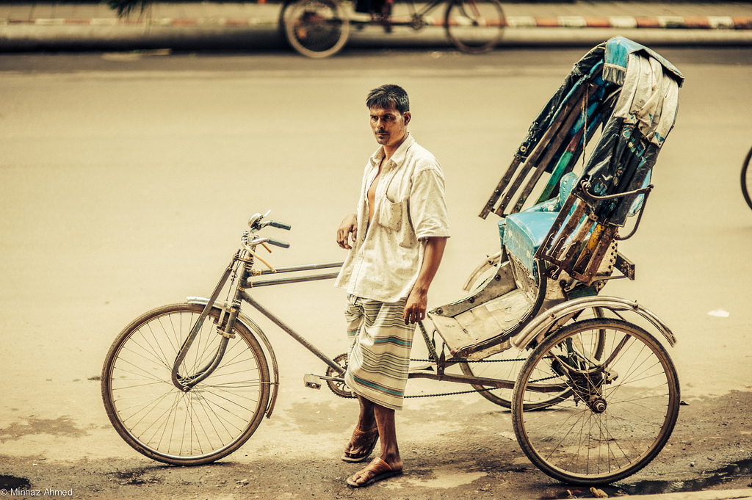
Active to passive
Assertive sentence.
He pulls a rickshaw (make it passive).
A rickshaw is pulled by him.
We should respect a rickshaw puller (Make it passive)
A rickshaw puller should be respected by us.
Notes:
How to change from active to passive shown here.

Slide 17
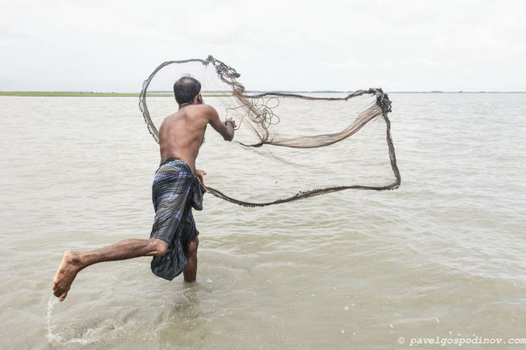
The fisherman is catching fish. (Make it passive)
Fish is being caught by the fisherman.
Notes:
Practice on changing into passive from present continuous tense.

Slide 18
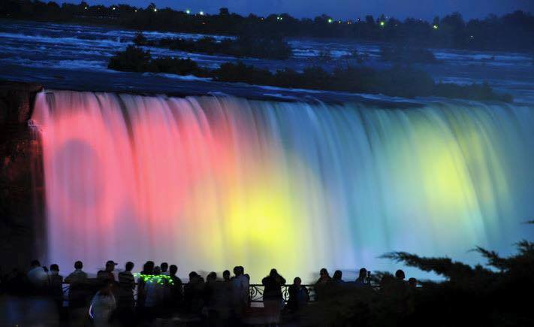
Activities
Transform the sentences into passive voice
I visited the Nayagra waterfall last year.
Many people enjoy the waterfall all the year round.
The waterfall makes a beautiful view.
You may enjoy it if you want.
I will visit it again.
Notes:
Class work according to previous slides.

Slide 19
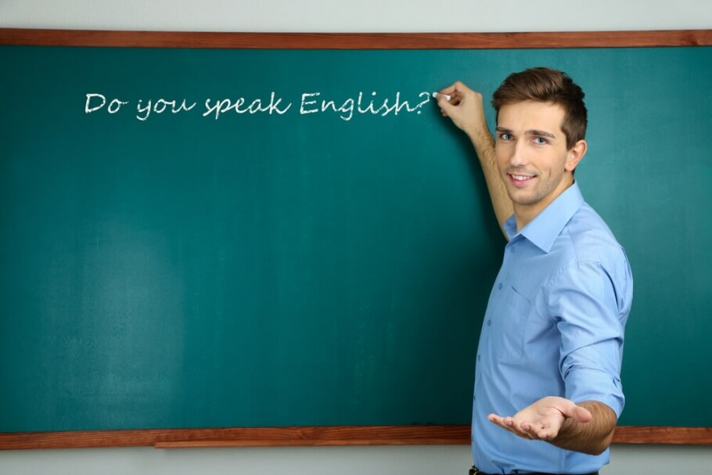
Let us know the voice change of double object.
He teaches us English.
Sub
Verb transitive
Obj
Obj
(us) = indirect object
Double object
(English) = direct object
Note: You can use any object as the subject of passive voice.
Notes:
Indirect object we mean man/woman that sit before direct object. Direct object we mean other than man/woman (object)

Slide 20
Let’s practice
He teaches us English.
We are taught English by him.
English is taught us by him.
Now try to change it into passive voice.
He gave me a book.
I taught him a lesson.
They feed me fruits.
We made him captain.
She informed me this.
Notes:
Practice on double object.

Slide 21
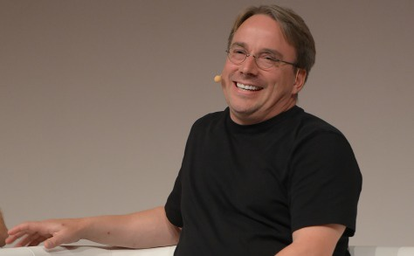
Passive voice of silent infinitive
I told him do this.
Sometime Infinitive remains silent in the active voice
He was told to do this by me.
Infinitive must be shown in
the passive voice
Notes:
How to change into passive voice from silent infinitive.

Slide 22
Class activities
Change the active voice into passive voice.
He advised me tell the truth.
They elected him go there.
He ordered Rahim solve it.
The bird made the wind blow.
The teacher told him do the sum.
Notes:
Practice or evaluation.

Slide 23
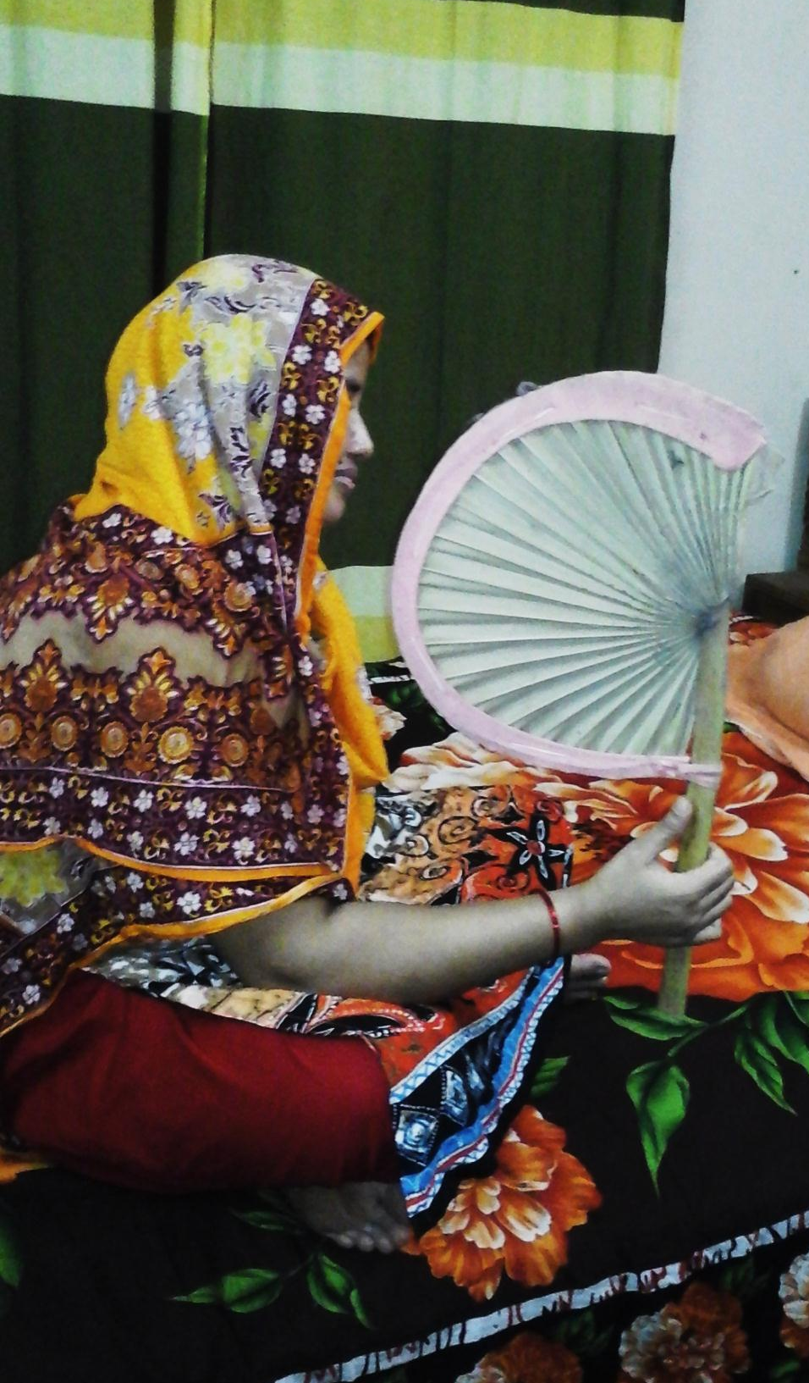
Exception-1
If the active voice is with reflexive pronoun--
Subject + auxiliary verb + v₃ +by + reflexive pronoun
She fans herself.
She is fanned by herself.
He killed himself.
He was killed by himself.
Note: If there is reflexive pronoun as object of the sentence, subject and object will not be changed to make it passive.
Notes:
How to change into passive from reflexive pronoun.

Slide 24

Exception-2
If the active voice is with quasi-passive verb-
Subject + auxiliary verb + v₃ +adjective
The rose smells sweet.
The rose is smelt sweet.
The sight looks charming.
The sight is looked charming.
Note: If there is an adjective after the verb of the sentence, subject and adjective will not be changed in the passive voice
Notes:
How to change into passive with quasi-passive active voice.

Slide 25
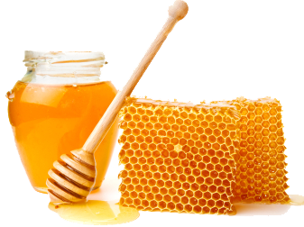

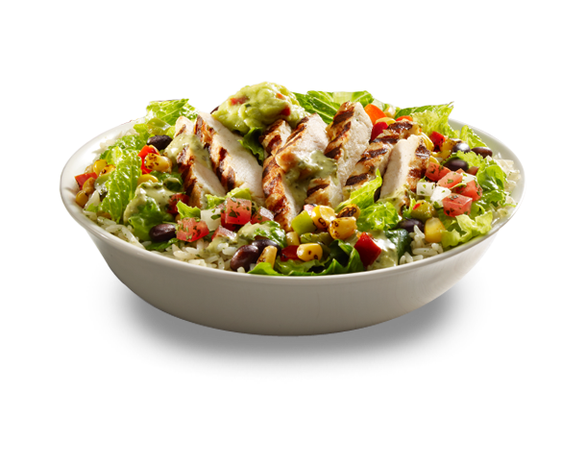
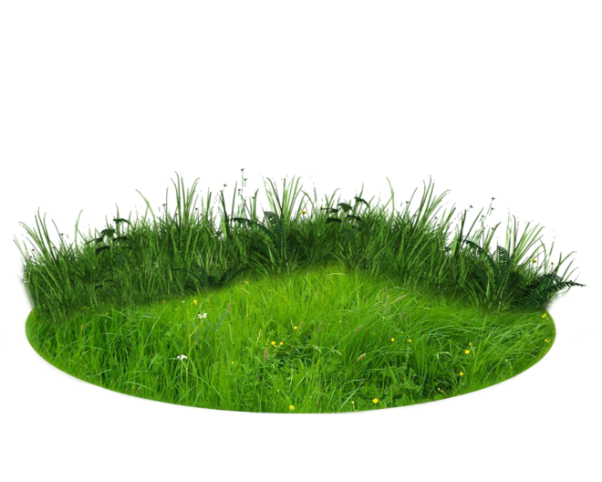
Class activities
Change the active voice into passive voice.
Honey tastes sweet.
The pill tastes bitter.
The food looks delicious.
The man seems strong.
The sky appears blue.
Notes:
Evaluation/Practice.

Slide 26
Gerund Combinations advise/ propose/recommend/suggest+gerund+object থাকলে , অথবা agree, be anxious, arrange, determine, be determined, decide, demand+ infinite + object থাকলে
Passive= Subject + main verb+that+next obj of gerund+should be+V3 of gerund
Example= He wanted playing football.
Passive= He wanted that football should be played.

Slide 27
Converting infinitive into Passive
Passive= Subject +main verb+infinitive next object+to be+infinitive V3.
Example: He wants someone to take camera
Passive=He wants camera to be taken

Slide 28
Interrogative Sentence
Passive: WH +to be verb+object(if)+V3+by+subject(if)
Who= By/To whom
Whom= Who
Ex: Who knows you?
Passive:To whom are you known?

Slide 29
Imperative Sentence
(verb/ let দিয়ে শুরু হয়)
Passive: Let+object+be+v3+by+subject
Ex: Do it.
Passive: Let it be done.
Please/kindly থাকলে- You are requested to+ বাকি অংশ।
Object না থাকলে- You are + related verb+ to+বাকি অংশ

Slide 30
Some important voice changing:
1. Mr. Seraz teaches us English.
2.Jerry did for me the unnecessary things.
3. They were flying kites.
4. We had dug the canal.
5. We will have finished the work.
6. I can do the sum.
7. He killed himself .
8. she hurt herself.
9. You must do the work.
10. We ought to obey our parents.
11. They are going to open a bank.
12. Do not play football at noon.
13.Let him write a letter.
14. Never tell a lie.
15. Buy me a shirt.
16.Did you play football?
17. Is he reading a book?
18. who is calling me ?
19.who will help you?
20. who has broken the glasses?
21. Whom is he teaching English?
22.whom has he beaten?
23.what do you want?
24 what has he done?
25. I saw him reading a book.
26. Mr. Mazhar teaches us English.
27. I gave him a book.
28. We made him captain.
29. He called it laurel.
30.She killed herself .
31.The track ran over the boy.
32.He laughed at the old man.
33.She looks after the orphans.
34.He told me that he had done the work.
35.They searched his house and found a number of stolen articles.
36. I know that he did the work.
37 People say that the lion is the king of beast.
38. Five men were arrested and one fined.
39. She ran a race.
40. Honey tastes sweet
41.Rice sells cheap.
42. The rose smells sweet.
43.The bed feels soft.
44. The books read well.
45. The house is building.
46. The cow is milking.
47. The drums are beating.
48. Miss Mina wants someone to take photographs.
49. Mr. Seraz wants him to write the letter.

Slide 31
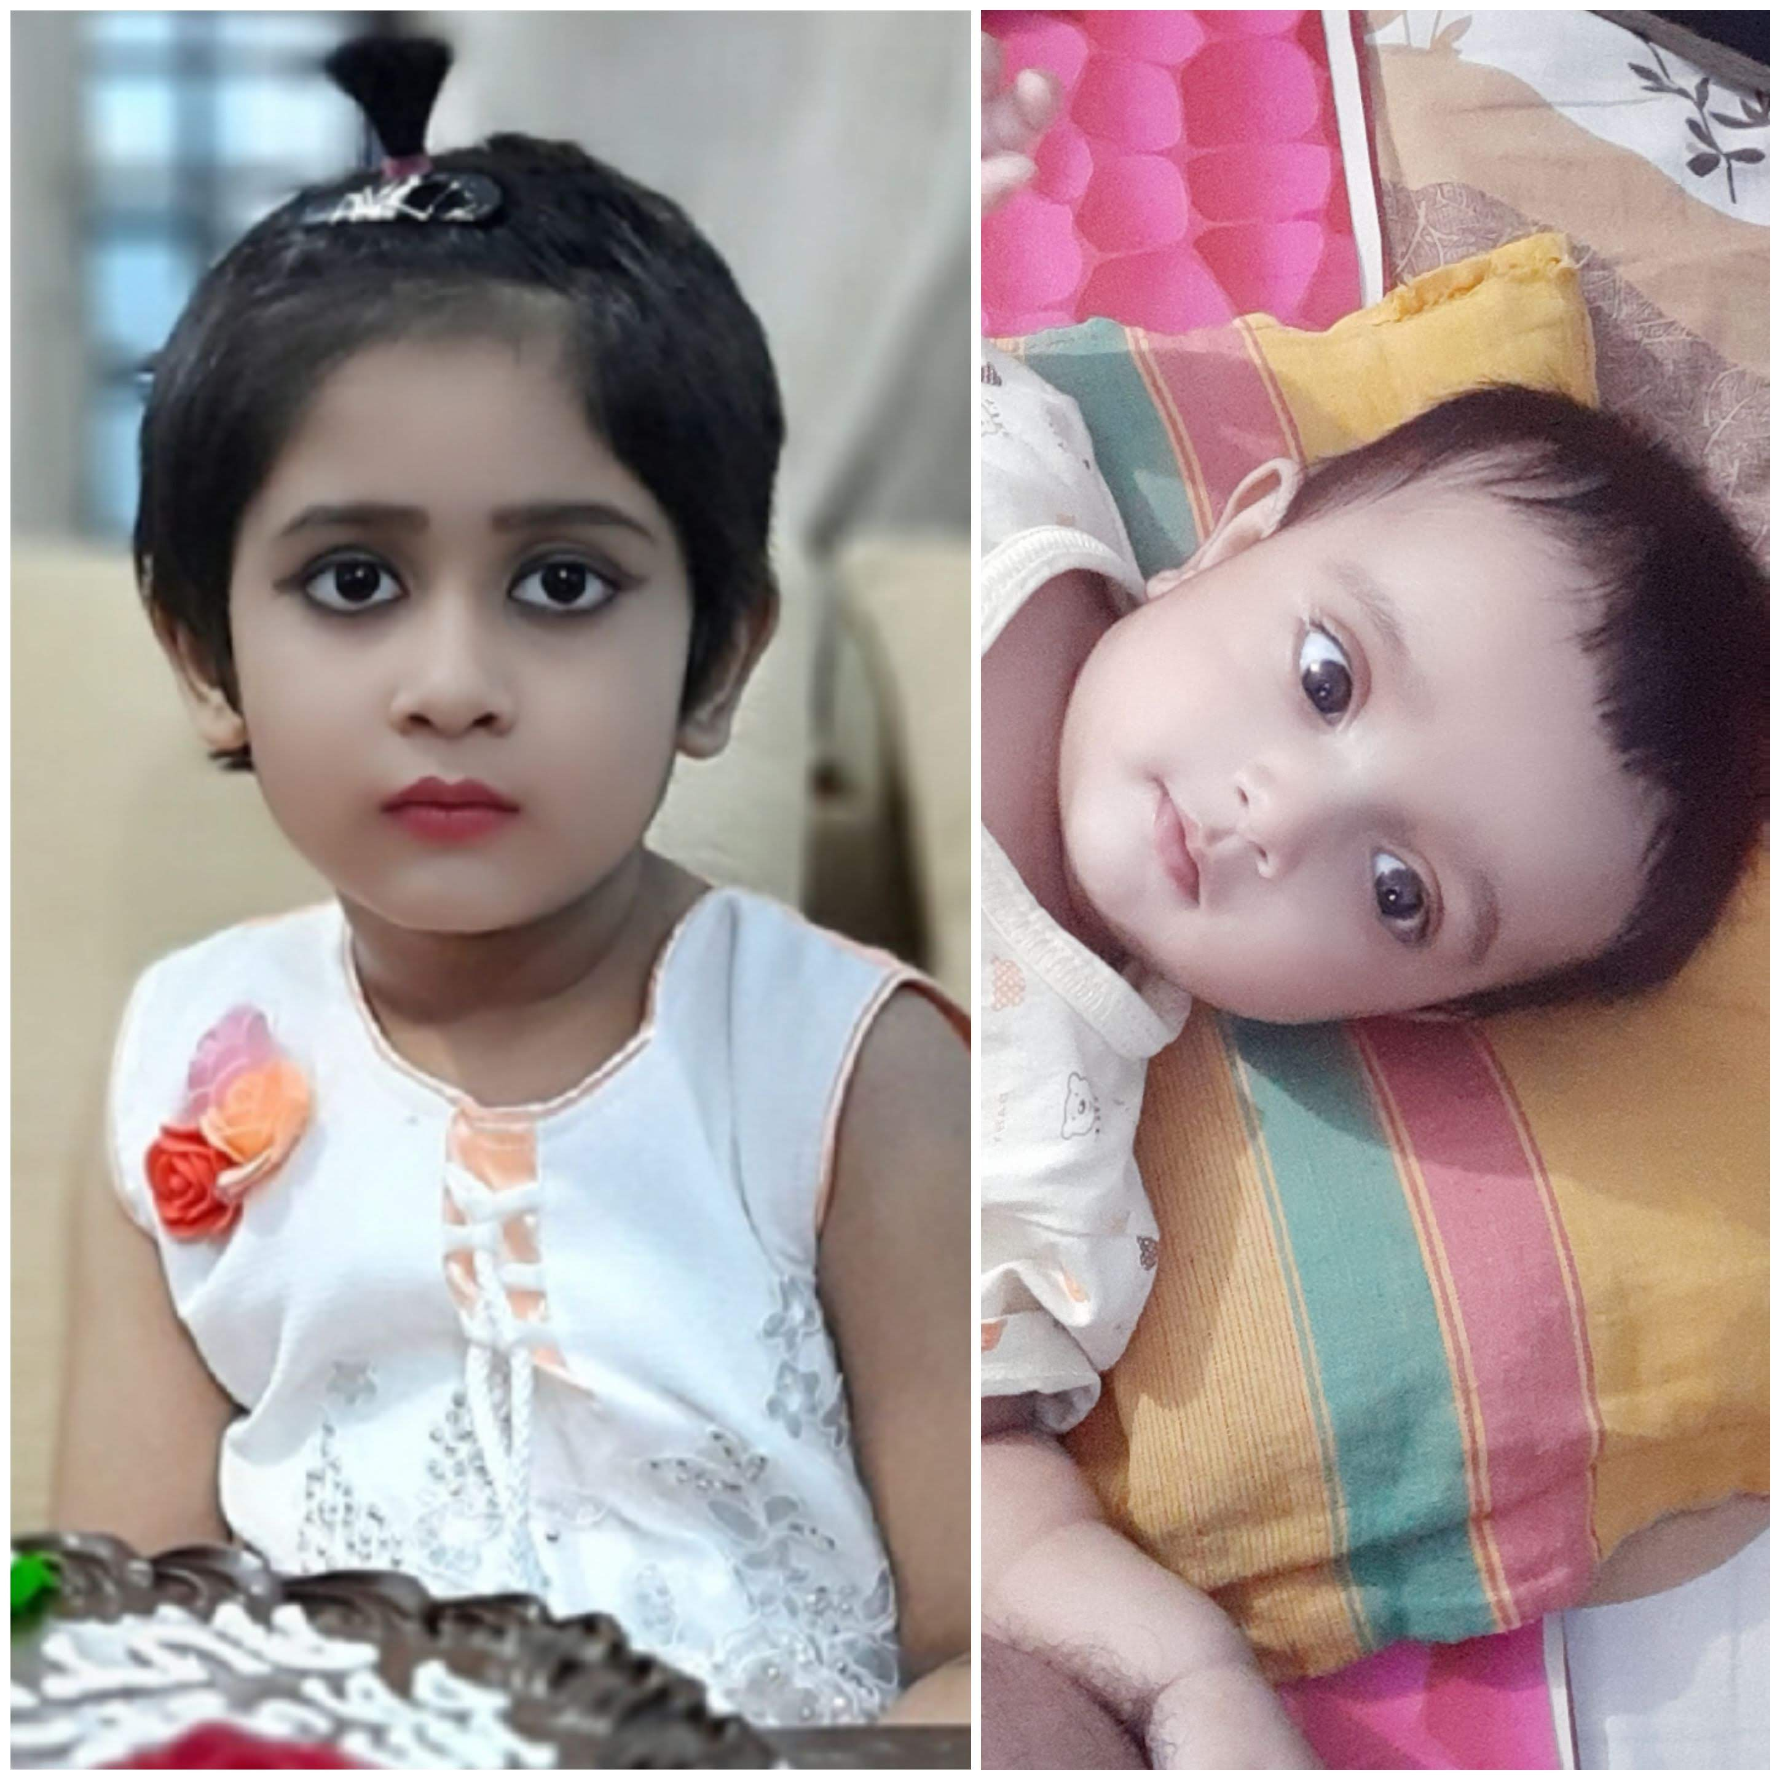
See you again.
Notes:
Ending slide.

Slide 32
Extra Exercise
1. a._ Pen.b._ apple. c._elephant.d._ orange. e._ umbrella. f._ ox. g. _pen. h. _ book. i. _ mango. j. _ shirt. k. _ chair.
2. _ hour. b. _ hotel. c. _ honest man. d. _ honourable man. e. _ heir. f. _ hunter. g. _ horse. h. _ hill. i. _ house.
3. a. _ university. b. _ European. c. _ unique case .d. _ useful thing. e. _ one eyed man. f. _ one taka note.
4. a. _ MA. b. _ Mp. c. _MBBS. d. _ LLB. e. _ FRCS.f. _ B.A.
5.a. A cow is _ domestic animal. b. A dog is _ faithful animal .
6. a. You are _ Nazrul I see. b. He thinks he is _ Alexandar Pop.
7. a. I have _ pen. b. He is _ honest man.
8. a. Monika is _ best girl in the class. b. Dhaka is _ oldest city. c. she is _ most beautiful girl. d. Mr. mazhar is _ best boy.
9.a. He bought _ lot of fruits. b. There is _ little water in the glass.c. Mr. Mazhar earned _ great deal of money.d. The king live _ great many years.
10.a. He went _ fishing.
11. a. He is in _ temper. b. He has got _ headhache. c. I have _ cold.
12.a. What _ pity ! b. What _ beautiful girl ! c. What _ nice bird it is ! d. What _ awful remark.
13.a._ Mitu called me.[unknown person]
b._ Mrs. Mahinur akter came to see you. [unknown]
c. _ Ruplal came here to collect rubbish. [unknown person]
14.a._ B.D.O. b._ SDO. c._D.M. d. _ B.A. e._ M.A. f._ ewe.
g._union. h._ European. i._ university. j. _umbrella. k. _ unique event. l. _ uniform speed.m._ one-eyed man. n._ one-act play.o. _opinion. p._ historical play. q. _ honest man.
15.a.Look at _ girl.b._ book is mine.c._ tree is an oak.d. _ girl with the white shari is my beloved.e. _ pen wich I bought yesterday is fine.f._ cow is a useful animal.g._ rose is the queen of flower.h._ banyan is a kind of big tree.i._sun shines in the sky.j._ earth moves round the sun.k._English are industrious.l._ Bangalees are intelligent but idle.m. who is_first boy?n._ 26th March is our independent day.o._ Bible,_ Quran,_ Gita.
p._ Jugantar, _ Ittefaque.q._ padma express, _ jamuna express.r._Padma,_ Meghna,s. _ Arabian sea.t._ Atlantic ocean, _ Indian, _ Pacific ocean.u._north,_south.v._poor are unhappy.w._rich are happy.x._virtuous are happy.y._sooner,_better.z._more,_merrier.
z._more we have, _more we want.

