Slide 1
English Grammar
NOUN CLASSIFICATION
English Grammar • Noun Classification

Slide 2

Md. Burhane Sultan
Assistant teacher • Mathematic
H.V.S Hazi Nur Uddin Dakhil Madrasa
Mobile - 01715509603
English Grammar • Noun Classification

Slide 3
English Grammar
নামের শ্রেণিবিভাগ
NOUN CLASSIFICATION
A noun is a word that names a person, place, animal, thing, idea, or quality.
English Grammar • Noun Classification

Slide 4

1. PROPER NOUN
Proper Noun (নির্দিষ্ট নামবাচক বিশেষ্য)
A specific name of a person, place, organization, etc.
Examples: Rahim, Bangladesh, Dhaka, Padma
English Grammar • Noun Classification

Slide 5
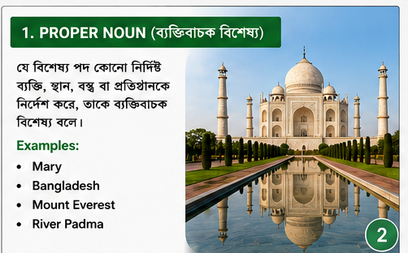
2. COMMON NOUN
Common Noun (জাতিবাচক বিশেষ্য)
A general name for a person, place, animal, or thing.
Examples: boy, city, teacher, book, river
English Grammar • Noun Classification

Slide 6
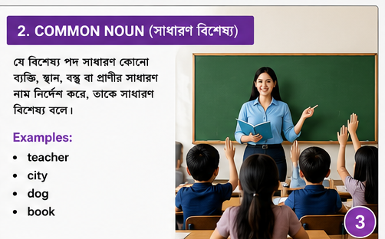
3. CONCRETE NOUN
Concrete Noun (বস্তুবাচক বিশেষ্য)
Something that can be experienced through the senses.
Examples: apple, chair, flower, music, house
English Grammar • Noun Classification

Slide 7
4. ABSTRACT NOUN
Abstract Noun (ভাববাচক বিশেষ্য)
A quality, feeling, idea, or state that cannot be physically touched.
Examples: honesty, love, courage, freedom, happiness
English Grammar • Noun Classification

Slide 8
5. COLLECTIVE NOUN
Collective Noun (সমষ্টিবাচক বিশেষ্য)
A noun that refers to a group as one unit.
Examples: team, class, family, flock, committee
English Grammar • Noun Classification

Slide 9
6. COUNTABLE NOUN
Countable Noun (গণনাযোগ্য বিশেষ্য)
Nouns that can be counted and have singular/plural forms.
Examples: one pen → two pens; one child → three children
English Grammar • Noun Classification

Slide 10
7. UNCOUNTABLE NOUN
Uncountable / Mass Noun (অগণনাযোগ্য বিশেষ্য)
Nouns that are not normally counted individually.
Examples: water, rice, sugar, information, furniture
English Grammar • Noun Classification

Slide 11
8. COMPOUND NOUN
Compound Noun (যৌগিক বিশেষ্য)
A noun made from two or more words.
Examples: toothbrush, classroom, bus stop, mother-in-law
English Grammar • Noun Classification

Slide 12
QUICK REVIEW
এক নজরে Noun Classification
Proper → নির্দিষ্ট নাম
Common → সাধারণ নাম
Concrete → ইন্দ্রিয়গ্রাহ্য বস্তু
Abstract → ভাব/গুণ
Collective → সমষ্টি
Countable → গণনা করা যায়
Uncountable → সাধারণত গণনা করা যায় না
Compound → একাধিক শব্দে গঠিত
English Grammar • Noun Classification

Slide 13
PRACTICE
Identify the type of noun
1. Bangladesh
2. teacher
3. honesty
4. team
5. water
6. toothbrush
7. books
8. flower
Try to identify each noun before checking the answers!
English Grammar • Noun Classification

Slide 14
ANSWER KEY
Practice Answers
1. Bangladesh — Proper Noun
2. teacher — Common Noun
3. honesty — Abstract Noun
4. team — Collective Noun
5. water — Uncountable Noun
6. toothbrush — Compound Noun
7. books — Countable Noun
8. flower — Concrete Noun
English Grammar • Noun Classification

Slide 15
The End
English Grammar • Noun Classification

