Slide 1


Slide 2
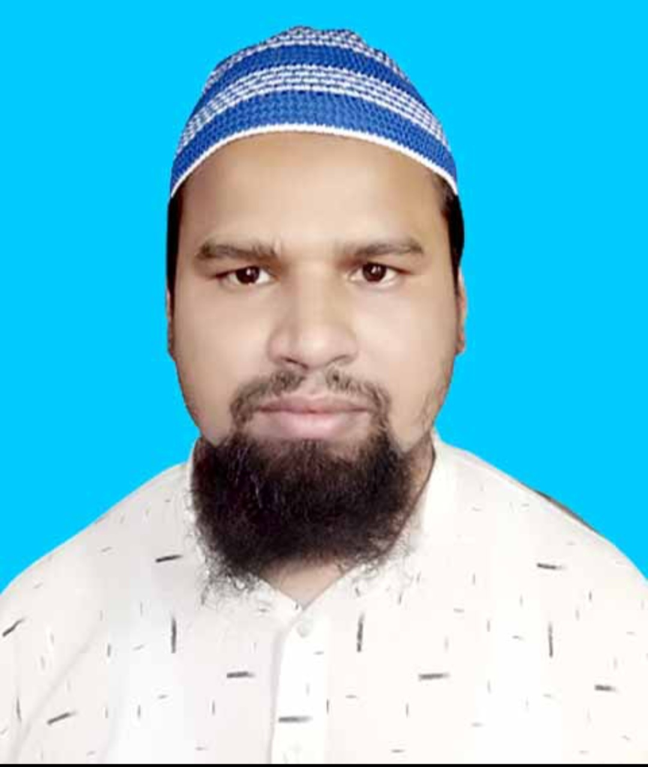
TEACHER’S IDENTITY
Md. Farid Uddin
Lecturer in English
Chipatali J.G.M Kamil (M.A) Madrasah
Hathazari, Chattogram
fariduddin111989@gmail.com
Punctuation & Capitalization Part-3
(Exercise For Practice)

Slide 3
Use capitals and punctuation marks where necessary in the following text.
Exercise: 01 arent you going to have any said i no i never eat asparagus i know there are people who dont like them the fact is that you ruin your palate by all the meat you eat she said.
Exercise: 02 the teacher said to the girl do you think that honesty is the best policy yes sir i think so said the girl then learn to be honest from your childhood thank you sir said the girl may allah to bless you said the teacher
Exercise: 03 do not worry about a few mistakes said the teacher you can learn a lot through your mistakes do we learn from our mistakes asked the boy.

Slide 4
Answer: 1 “Aren’t you going to have any?” said I. “No, I never eat asparagus.” “I know there are people who don’t like them. The fact is that you ruin your palate by all the meat you eat,” she said.
Answer: 2 The teacher said to the girl, “Do you think that honesty is the best policy?” “Yes, sir, think so,” said the girl. “Then learn to be honest from your childhood.” “Thank you sir,” said the girl. “May Allah bless you,” said the teacher.
Answer: 3 “Do not worry about a few mistakes,” said the teacher, “you can learn a lot through your mistakes.” “Do we learn from our mistakes?” asked the boy.

Slide 5
Exercise: 04 how is your father bilkis said mr rahman he is very well thank you bilkis replied i am glad to hear that he is in good health said mr rahman
Exercise: 05 hello old lady what are you doing said the princess i am spinning a yarn around the spindle replied the old woman.
Exercise: 06 would you please tell me one reason of air pollution yes the smoke from our household activities vehicles factories etc is mainly causing air pollution

Slide 6
Answer: 4 “How is your father, Bilkis?” said Mr. Rahman. “He is very well. Thank you.” Bilkis replied. “I am glad to hear that he is in good health,” said Mr. Rahman.
Answer: 5 “Hello, old lady, what are you doing?” said the Princess. “I am spinning a yarn around the spindle,” replied the old woman.
Answer: 6 “Would you please tell me one reason of air pollution?” “Yes, the smoke from our household activities, vehicles, factories etc. is mainly causing air pollution.

Slide 7
Exercise: 07 have you heard the name of alexander asked mr ahmed no sir razu replied how strange it is said he will you tell me about alexander please well he was the great king of macedonia
Exercise: 08 go to bed now mother said you can complete your assignment in the morning no mom ill finish it now
Exercise: 09 why ard you late always try to attend the class regularly yes sir the student said to the teacher

Slide 8
Answer: 7 “Have you heard the name of Alexander?” asked Mr. Ahmed. “No sir.” Razu replied. “How strange it is!” said he. “Will you tell me about Alexander, please?” “Well, he was the great king of Macedonia.”
Answer: 8 “Go to bed now,” Mother said. “You can complete your assignment in the morning. “No, Mom! I’ll finish it now.”
Answer: 9 “Why are you late? Always try to attend the class regularly.” “Yes sir,” the student said to the teacher.

Slide 9
Exercise: 10 zaman can you tell me what i am teaching the teacher asked im sorry sir i can’t follow replied zaman you can’t because you are not attentive the teacher said
Exercise: 11 don’t you have any relative here to stay with no sir so i need a transfer certificate to be admitted there
Exercise: 12 do you know me yes i know you from my childhood whats your name my name is sumon thank you a lot said mr jamal

Slide 10
Answer: 10 “Zaman, can you tell me what I am teaching?” the teacher asked. “I’m sorry sir. I can’t follow,” replied Zaman. “You can’t because you are not attentive,” the teacher said.
Answer: 11 “Don’t you have any relative here to stay with?” “No, sir. So, I need a transfer certificate to be admitted there.”
Answer: 12 “Do you know me?” “Yes, I know you from my childhood.” “What’s your name?” “My name is Sumon.” “Thank you a lot.” said Mr. Jamal.

Slide 11
Exercise: 13 stop you are eating all our bread shouted the two rats I m not doing My best but I have told you. that its difficult said the monkey give us that little Piece said the rats this is My Piece havent I laboured a lot for you replied the Monkey how foolish we are believing you said the two rats
Exercise: 14 whats your programme after the examination asked ratul nabil said i havent yet decided can you suggest any lets go on a picnic said ratul what an excellent idea
Exercise: 15 in a certain school a student, once found a one hundred taka note in the play ground he took it to his teacher what shall i do with it asked the teacher

Slide 12
Answer: 13 “Stop! You are eating all our bread,” shouted the two rats. “I’m doing my best, but I have told you that it’s difficult,” said the monkey. “Give us that little piece.” said the rats. “This is my piece. Haven’t I laboured a lot for you?” replied the Monkey..”How foolish we are believing you!” said the two rats.
Answer: 14 “What’s your programme after the examination?” asked Ratul. Nabil said, “I haven’t yet decided, Can you suggest any?” “Let’s go on a picnic,” said Ratul. “What an excellent idea!”
Answer: 15 In a certain school a student once found a one hundred taka note in the play ground. He took it to his teacher. “What shall I do with it?” asked the teacher.

Slide 13
Exercise: 16 the teacher said to me dont you like to practise english its an important subject and you should be more careful about it
Exercise: 17 how daring you are to wake me up the lion roared i shall kill you for that please let me go the mouse cried i did not mean to wake you up
Exercise: 18 my sons listen to me said rahman an old farmer a great treasure lies hidden in the land there i am going to leave it for you the sons asked how shall we find it

Slide 14
Answer: 16 The teacher said to me, “Don’t you like to practise English? It’s an important subject and you should be more careful about it.”
Answer: 17 “How daring you are to wake me up?” the lion roared. “I shall kill you for that.” “Please, let me go”, the mouse cried.” I did not mean to wake you up.”
Answer: 18 “My sons, listen to me,” said Rahman, an old farmer. “A great treasure lies hidden in the land there. I am going to leave it for you.” The sons asked, “How shall we find it?”

Slide 15
Exercise: 19 why don’t you attend classes regularly the teacher said to the boy you cannot expect good résult unless you attend classes be regular in class.
Exercise: 20 oh my lord please dont kill the child said the first woman to the king solomon let her have it king solomon said to them now everything is clear to me pointing the first woman he said to the servant give her the child she is the mother of the baby.
Exercise: 21 thomas alva edison a great scientist was born in 1847 in ohio america as a little boy he was very inquisitive he always wanted to know how things were done very early in life he showed that he was full of curiosity a quality which is so important to inventors.

Slide 16
Answer : 19 Why don’t you attend classes regularly?” the teacher said to the boy. “You can’t expect good result unless you attend classes. Be regular in class.”
Answer: 20 “Oh my lord! Please don’t kill the child,” said the first woman to the king Solomon. “Let her have it,” King Solomon said to them. “Now everything is clear to me.” Pointing the first woman he said to the servant, “Give her the child. She is the mother of the baby.”
Answer: 21 Thomas Alva Edison, a great scientist was born in 1847 in Ohio, America. As a little boy he was very inquisitive. He always wanted to know how things were done. Very early in life he showed that he was full of curiosity, a quality which is so important to inventors.

Slide 17
Exercise: 22 why are you putting up the food in your pocket why don’t you eat asked the noble man i am doing the right thing replied sheikh saadi
Exercise: 23 the lion roared how dare you wake me up ill kill you the mouse cried please let me go i didn’t mean to wake you up
Exercise: 24 who are jolly those who have. sound health are jolly sound mind lies in sound body minds become jolly when our life is filled with pleasure.

Slide 18
Answer:22 “Why are you putting up the food in your pocket? Why don’t you eat?” asked the noble man. “I am doing the right thing”, replied Sheikh Saadi.
Answer: 23 The lion roared, “How dare you wake me up? I’ll kill you.” The mouse cried, ” Please, let me go. I didn’t mean to wake you up.”
Answer:24 Who are jolly? Those who have sound health are jolly. Sound mind lies in sound body. Minds become jolly when our life is filled with pleasure.

Slide 19
Exercise: 25 my dear mother your letter is just to hand it seems to me that you are anxious for me why you need not think about me
Exercise: 26 give me a few grains of corns i am dying of hunger said the grasshopper but what did you do in the summer didn’t you store any grain the ant remarked to i was too busy in singing.
Exercise: 27 are you ill he said coldly no i said then why are you sitting when all others are working go out at once and give them a hand

Slide 20
Answer:25 My dear mother, your letter is just to hand. It seems to me that you are anxious for me. Why? You need not think about me.
Answer:26 “Give me a few grains of corns. I am dying of hunger,” said the grasshopper. “But what did you do in the summer? Didn’t you store any grain?” the ant remarked to. “I was too busy in singing.”
Answer:27 “Are you ill?” he said coldly. “No”, I said. “Then why are you sitting when all others are working? Go out at once and give them a hand.

Slide 21


