Slide 1



Slide 2
IDENTITY
Md. Farid Uddin
Lecturer in English
Chipatali Jamia Gausia Muinia Kamil (M.A) Madrasah
Hathazari, Chattogram

Slide 3

Let’s See Some Pictures!

Slide 4
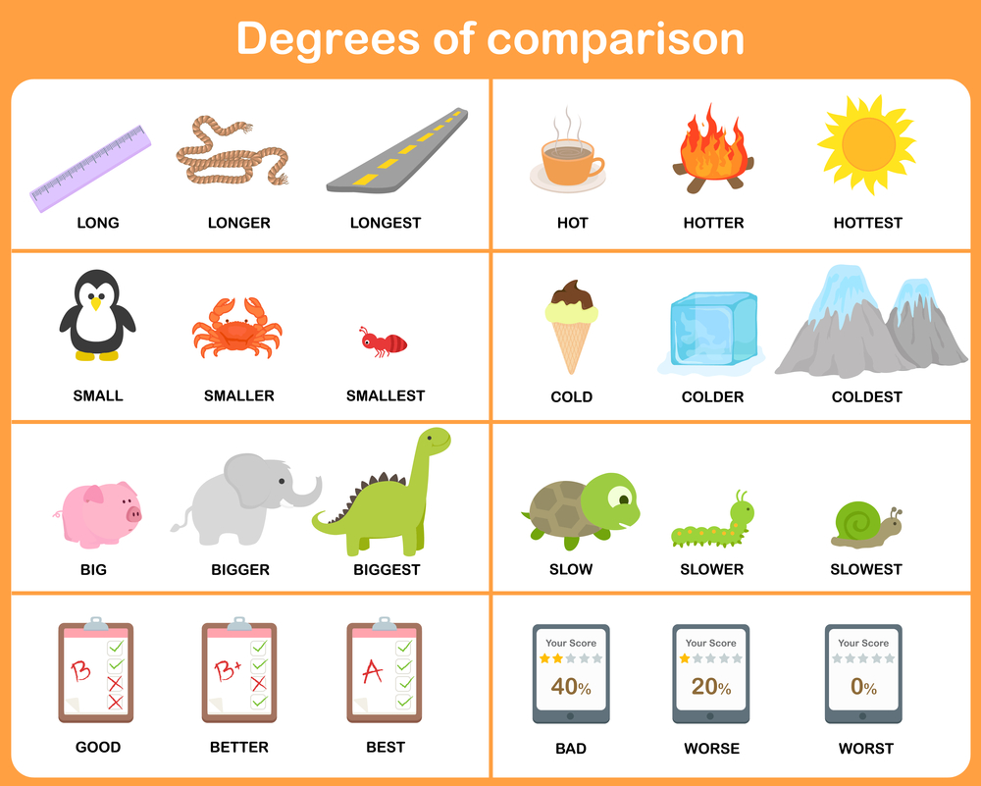
What do you see in these pictures?

Slide 5

Let’s enjoy a video!

Slide 6
Comparison of Adjectives (Degree)

Slide 7
Degree কাকে বলে ও কত প্রকার
Comparison of adjectives বা Degree বলতে adjective-এর বিভিন্ন রূপকে বোঝায়।
Comparison of adjectives or Degree refers to different forms of the adjective.
It is divided into three types:

Slide 8
Positive Degree
Comparative Degree
Superlative Degree

Slide 9
Positive Degree:
একটি sentence-এ noun বা pronoun-এর গুণ, দোষ, অবস্থা প্রভৃতি বোঝাতে adjective-এর যে রূপ ব্যবহৃত হয় তাকে Positive Degree বলে।
The form of an adjective which depicts a noun or pronoun’s quality, flaw or state is called Positive degree.
Example:
He is a talented writer.

Slide 10
Comparative Degree:
দুটি noun বা pronoun-এর গুণ, দোষ, অবস্থা প্রভৃতির তুলনা করতে adjective-এর যে রূপ ব্যবহৃত হয় তাকে Comparative Degree বলে।
The form of adjective which compares two nouns’ or pronouns’ quality, flaw or state is called Comparative degree.
Example:
Arisha is taller than Trina.

Slide 11
Superlative Degree:
Adjective-এর যে রূপটি অনেকের মধ্যে তুলনা করতে ব্যবহৃত হয় তাকে Superlative Degree বলে।
The form of an adjective which is used to compare among many is called Superlative Degree.
Example:
Shahab is the best player on the cricket team.

Slide 12
Change of Degrees:
Superlative Degree into Positive Degree
Rules of changing Superlative Degree into Positive Degree

Slide 13
Rule 1:
No other+ sentence-এ প্রদত্ত Superlative-এর পরের অংশ+verb+so/as+ Superlative degree-এর positive form+ as+ প্রদত্ত sentence-এর subject.
No other+ the latter part of the given Superlative in the sentence+ verb+ so/as +a positive form of the Superlative degree+ as+ given sentence’s subject.
Superlative: Saira is the tallest girl in the class.
Positive: No other girl is as tall as Saira.

Slide 14
Rule 2:
Rule of changing Superlative Degree having one of the, all other, many other, most other, very few, few other, into Positive Degree:
Very few+ sentence-এ প্রদত্ত Superlative-এর পরের অংশ+ verb-এর plural form+ so/as+ Superlative degree-এর positive form+ as+ প্রদত্ত sentence-এর subject.
Very few+ the latter part of the given Superlative in the sentence+ verb’s plural form+ so/as+ a positive form of the Superlative degree+ as+ given sentence’s subject.
Superlative: Sohana is one of the best students in her class.
Positive: Very few students in Sohana’s class are as good as her.

Slide 15
Comparative Degree
into Positive Degree
Rule 1:
Rule of changing Comparative Degree having than any other/ all other, into Positive Degree:
No other+ any other/ all other-এর পরের অংশ+ verb+so/as+ Comparative degree-এর positive form+ as+ মূল sentence-এর subject.
No other+ the latter part of any other/ all other in the sentence+ verb+so/as+ a positive form of the Comparative degree+ given sentence’s subject.
Comparative: Ahan is better than any other debater in the debate club.
Positive: No other debater in the debate club is as good as Ahan.

Slide 16
Rule 2:
Rule of changing Comparative Degree having than, into Positive Degree:
বাক্যে Than-এর পরের অংশ + verb+ not+ so/as+ Comparative degree-এর Positive রূপ+ as+ মূল sentence-এর subject.
The latter part of than in the sentence+ verb+ not+ so/as+ Comparative degree’s positive form+ as+ given sentence’s subject.
Comparative: Ahan is stronger than Rihan.
Positive: Rihan is not as strong as Ahan.

Slide 17
Rule 3:
Rule of changing Comparative Degree having than most other/ than few other, into Positive Degree:
Very few+ Sentence-এ most other/few other-এর পরের অংশ+verb-এর plural form+ so/as+ Comparative degree-এর Positive রূপ+ as+ মূল sentence-এর subject.
Very few+ The latter part of most other/few other in the sentence+ verb’s plural form+ so/as+ Comparative degree’s positive form+ as+ given sentence’s subject.
Comparative: Adil is more intelligent than most other students in the academy.
Positive: Very few students in the academy are as intelligent as Adil.

Slide 18
Rule 4:
Rule of changing Comparative Degree having No less/ not less, into Positive Degree:
No less/ not less উঠে গিয়ে সে স্থানে ‍as বসে এবং than উঠে গিয়ে সে স্থানে as বসে, বাক্যের বাকি সবকিছু অপরিবর্তিত থাকে।
‘As’ is placed in the places of “No less/ not less” and “than”, other things remain unchanged in the sentence.
Comparative: Karim is no less active than Rahim.
Positive: Karim as active as Rahim.

Slide 19
Rule 5:
Rule of changing Comparative Degree having No sooner had…. than, into Positive Degree:
No sooner had উঠে গিয়ে as soon as+ subject+ verb-এর past form+ than-এর পূর্বের অংশ+ than উঠে গিয়ে কমা বসে+ বাক্যের বাকি অংশ।
As soon as is placed in the place of No sooner had+ subject+ verb’s past form+ former part of than+ a comma (,) is placed in the place of than+ rest of the sentence.
Comparative: No sooner had he listened to it than he started laughing.
Positive: As soon as he listened to it, he started laughing.

Slide 20
Do Yourself:
Platinum is the most expensive of all the metals. (Positive degree)
Ravi is smarter than Raju. (Positive degree)
Russia has a larger area than Canada. (Positive degree)
Sana is the most intelligent girl in the class. (Positive degree)
Very few students in the class are as diligent as Rina. (Superlative degree)
Ramesh is the most athletic of all the boys. (Positive degree)

Slide 21
Solutions for Do Yourself:
No other metal is as expensive as Platinum.
Raju is not as smart as Ravi.
Canada’s area is not as large as Russia’s.
No other girl in the class is as intelligent as Sana.
Rina is one of the most diligent students in the class.
No other boy is as athletic as Ramesh.

Slide 22
Gold is the most expensive of all the metals. (Positive degree)
Ramu is stronger than Shamu. (Positive degree)
China has a higher population than India. (Positive degree)
Riya is the laziest girl in the class. (Positive degree)
Minu is the sweetest girl in the class. (Positive degree)
Uday is the heaviest of all the boys. (Positive degree)
Answers
No other metal is as expensive as gold.
Shamu is not as strong as Ramu.
No other girl in the class is as lazy as Riya.
No one in the class is as sweet as Minu.
The other knife is sharper than this one.
No other boy is as heavy as Uday.

Slide 23

To be continued..

