Slide 1


Slide 2
IDENTITY
Md. Farid Uddin
Lecturer in English
Chipatali Jamia Gausia Muinia Kamil (M.A) Madrasah
Hathazari, Chattogram

Slide 3

Let’s See Some Pictures!

Slide 4
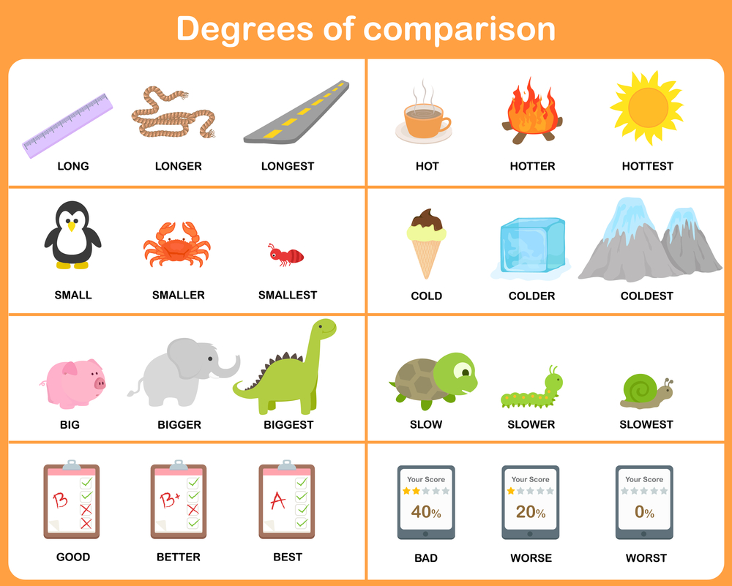
What do you see in these pictures?

Slide 5

Let’s enjoy a video!

Slide 6
Comparison of Adjectives (Degree)
Superlative Degree into Comparative Degree Part -2

Slide 7
Rule 1:
Subject+ verb+ Superlative-এর Comparative রূপ+ than any other+ বাক্যের বাকি অংশ।
Subject+ verb+ Superlative degree’s Comparative form+ than any other+ rest of the sentence.
Superlative: She is the most active member of the group.
Comparative: She is more active than any other member of the group.

Slide 8
Note: যদি of all থাকে, of all-এর বদলে than all other বসে।
If there is “of all” than all other is placed in the place of “All of”.
Superlative: He is the most honest of all men.
Comparative: He is more honest than all other man.

Slide 9
Rule 2:
Rule of changing Superlative Degree having one of the, into Comparative degree:
Subject+ verb+ Superlative-এর Comparative রূপ+ than most other+ বাক্যের বাকি অংশ।
Subject+ verb+ Superlative’s comparative form+ than most other+ rest of the sentence.
Superlative: Sohana is one of the most brilliant students in the class.
Comparative: Sohana is more brilliant than most other students in the class.

Slide 10
Positive Degree into Comparative Degree
Rule 1:
Rule of changing Positive Degree having no other, into Comparative degree:
মূল বাক্যের শেষের subject+ Positive degree-এর Comparative degree+ than any other+ No other-এর পর থেকে verb-আগে পর্যন্ত।
subject situated at theMain sentence’s last+ Positive degree’s Comparative form+ than any other+ latter part of “No other” up to the verb.
Positive: No other student in the class is as brilliant as him.
Comparative: He is more brilliant than most other student in the class.

Slide 11
Rule 2:
Rule of changing Positive Degree having very few, into Comparative degree:
মূল বাক্যের শেষের subject+ verb + Positive degree-এর Comparative degree + than most other+ very few-এর পর থেকে verb-আগে পর্যন্ত।
Main sentence’s subject situated at the last+ verb+ Positive degree’s Comparative form+ than most other+ latter part of “Very few” up to the verb.
Positive: Very few men are as honest as Mr. Abu Taleb.
Comparative: Mr. Abu Taleb is more honest than most other men.

Slide 12
Rule 3:
Rule of changing Positive Degree having As….as, into Comparative degree:
মূল বাক্যের শেষের subject+ verb+ not+ Positive degree-এর Comparative degree+ than+ মূল বাক্যের প্রথম subject।
Main sentence’s subject situated at the last+ verb+ not+ Positive degree’s Comparative form+ than+ Main sentence’s first subject.
Positive: She is as honest as her sister.
Comparative: Her sister is not more honest than her.

Slide 13
Comparative Degree into Superlative Degree
Rule 1:
Subject+ verb+ the+ Comparative-এর Superlative রূপ+ বাক্যে other-এর পরের অংশ।
Subject+ verb+ the+ Comparative’s Superlative form+ latter part of other in the sentence.
Comparative: He is more brilliant than any other student in the class.
Superlative: He is the most brilliant student in the class.

Slide 14
Note: any other-এর পরিবর্তে of all থাকলে, Superlative-এর পরে of all বসে।
Comparative: He is more brilliant than of all students.
Superlative: He is the most brilliant of all students.

Slide 15
Rule 2:
Rule of changing Comparative degree having than most other/ than few other, into Superlative degree:
Subject+ verb+ one of the+ Comparative-এর Superlative রূপ+ বাক্যে most other/few other-এর পরের অংশ।
Subject+ verb+ one of the+ Comparative’s Superlative form+ latter part of most other/ few other in the sentence.
Comparative: Arif is stronger than most other boys on the team.
Superlative: Arif one of the strongest boys on the team.

Slide 16
Positive Degree into Superlative Degree
Rule 1:
Rule of changing Positive degree having no other, into Superlative degree:
মূল বাক্যের শেষের subject+ verb+ the+ Positive-এর Superlative রূপ+ no other-এর পের থেকে verb-এর মাঝের অংশ।
Main sentence’s subject situated at the last+ verb+ the+ Positive degree’s Superlative form+ the part of the sentence between No other and the verb.
Positive: No other student in the class is as brilliant as Adil.
Superlative: Adil is the most brilliant student in the class.

Slide 17
Rule 2:
Rule of changing Positive degree having very few, into Superlative degree:
মূল বাক্যের শেষের subject+ verb+ one of the+ Positive-এর Superlative রূপ+ very few -এর পের থেকে verb-এর মাঝের অংশ।
Main sentence’s subject situated at the last+ verb+ one of the+ Positive degree’s Superlative form+ the part of the sentence between Very few and the verb.
Positive: Very few students in the class is as brilliant as Sohana.
Superlative: Sohana is one of the most brilliant students in the class.

Slide 18
A: Positive to Comparative:
1. Positive – He is as brave as a lion.
2. Positive – I am as weak as a child.
3. Positive – He is not so tall as Joe.
4. Positive – Meena is as good as Tina.
5. Positive – Rohit is as dull as Mohan.
6. Positive – Steve is as intelligent as Mitchel.
7. Positive – My brother is not so much popular as I am.
8. Positive – They were not so poor as we were.
9. Positive – You are not so thin as Peter.
10. Positive – Mr. Mukherjee is as wise as Mr. Sen.

Slide 19
Probable Answer
A lion is not braver than he.
A child is not weaker than I.
Joe is taller than he.
Tina is not so good Meena.
Mohan is not duller than Rohit.
Mitchel is not more intelligent than Steve.
I am more popular than my brother.
We were poorer than they.
Peter is fatter than you.
Mr. Sen is not wiser than Mr. Mukherjee.

Slide 20
Do Yourself:
Platinum is the most expensive of all the metals. (Positive degree)
Ravi is smarter than Raju. (Positive degree)
Russia has a larger area than Canada. (Positive degree)
Sana is the most intelligent girl in the class. (Positive degree)
Very few students in the class are as diligent as Rina. (Superlative degree)
Ramesh is the most athletic of all the boys. (Positive degree)

Slide 21
Solutions for Do Yourself:
No other metal is as expensive as Platinum.
Raju is not as smart as Ravi.
Canada’s area is not as large as Russia’s.
No other girl in the class is as intelligent as Sana.
Rina is one of the most diligent students in the class.
No other boy is as athletic as Ramesh.

Slide 22
Gold is the most expensive of all the metals. (Positive degree)
Ramu is stronger than Shamu. (Positive degree)
China has a higher population than India. (Positive degree)
Riya is the laziest girl in the class. (Positive degree)
Minu is the sweetest girl in the class. (Positive degree)
Uday is the heaviest of all the boys. (Positive degree)
Answers
No other metal is as expensive as gold.
Shamu is not as strong as Ramu.
No other girl in the class is as lazy as Riya.
No one in the class is as sweet as Minu.
The other knife is sharper than this one.
No other boy is as heavy as Uday.

Slide 23

To be continued..

