Slide 1

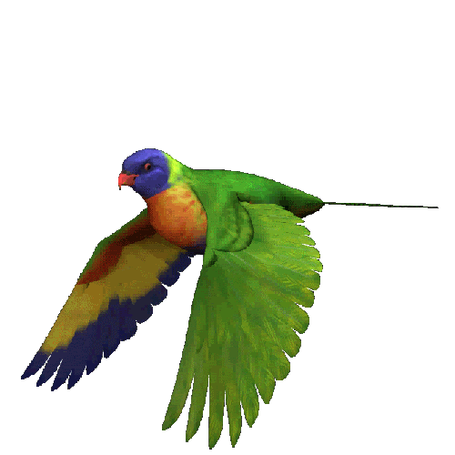
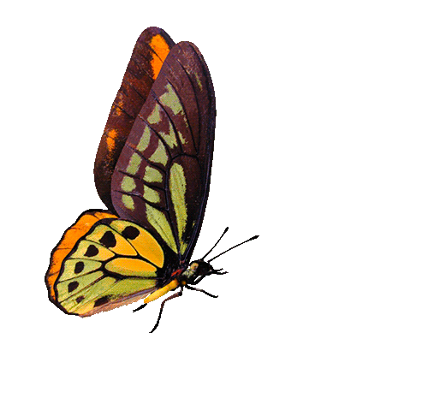
Welcome to all in my multimedia class
“English For Today”
Rajib Dutta. Bhingrol gps. Ctg.

Slide 2




Presented By
Rajib Dutta
Assistant teacher
Bhingrol Govt.Primary School
Anowara, Chottogram
Email: rajibduttaat@gmail.com
Rajib Dutta. Bhingrol gps. Ctg.

Slide 3

COLOURS
Unit-16
Section A
Page- 33
Lesson’s Identity
Lessons-4-6
Rajib Dutta. Bhingrol gps. Ctg.

Slide 4
By the end of the lesson students will be able to -
L: 1.1.1 Become familiar with English sounds by listening to common English word.
S: 1.1.1 repeat after the teacher simple words and phrases with proper sounds and stress.
S: 1.1.2 say words and phrases sentences with the help of visual clues and simple sentences.
R:1.4.1 read words and phrases with the of visual clues (about 3 new words)and simple sentences.
Learning outcomes:
Rajib Dutta. Bhingrol gps. Ctg.

Slide 5

What can you see?
Think and tell me.
Look at the picture
Rainbow.
7 Colours
How many colours are there in Rainbow?
Rajib Dutta. Bhingrol gps. Ctg.

Slide 6
Everybody listen the rhyme carefully
Let’s watch a video
https://youtu.be/NfeZXQbkRYk
Rajib Dutta. Bhingrol gps. Ctg.

Slide 7

Today’s lesson is-----
Lesson declaration
COLOURS
Rajib Dutta. Bhingrol gps. Ctg.

Slide 8
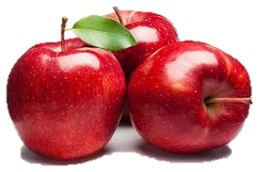
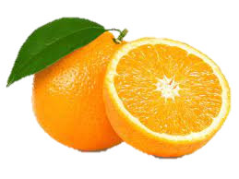
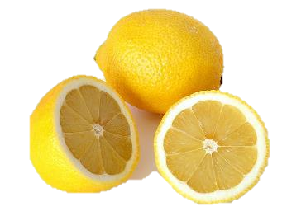
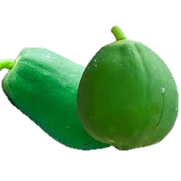
What colour is these?
Look, listen and say.
Red
Orange
Yellow
Green
Rajib Dutta. Bhingrol gps. Ctg.

Slide 9
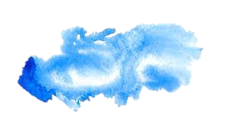
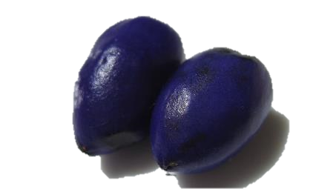
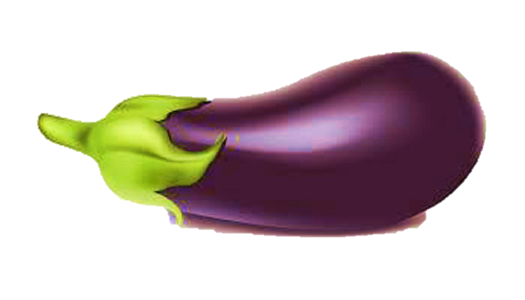
What colour is these?
Look, listen and say.
Blue
Indigo
Violet
Rajib Dutta. Bhingrol gps. Ctg.

Slide 10
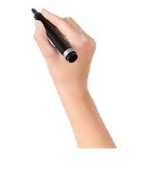
Look and say the colours name.
Red
Orange
What colour is it?
What colour is it?
Rajib Dutta. Bhingrol gps. Ctg.

Slide 11
Look and say the colour name.
Yellow
Green
What colour is it?
What colour is it?
Rajib Dutta. Bhingrol gps. Ctg.

Slide 12
Look and say the colours name.
Blue
Indigo
What colour is it?
What colour is it?
Rajib Dutta. Bhingrol gps. Ctg.

Slide 13
Look and say the colour name
Violet
What colour is it?
Rajib Dutta. Bhingrol gps. Ctg.

Slide 14
Now you will tell yourself.
red
orange
yellow
green
blue
violet
indigo
Rajib Dutta. Bhingrol gps. Ctg.

Slide 15
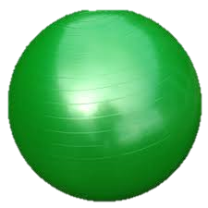




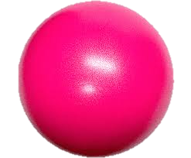
Find out the green ball
Find out the red ball
Individual Work
Rajib Dutta. Bhingrol gps. Ctg.

Slide 16
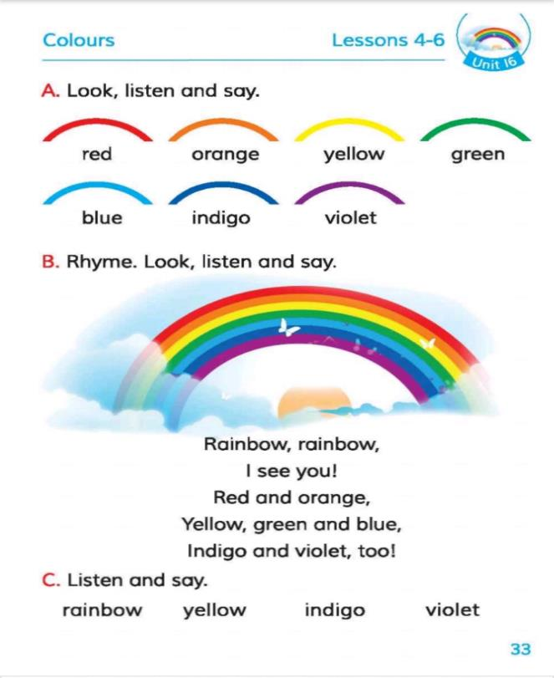


Open your book
Page no- 33
Activity-A
Connect With Studybook
Rajib Dutta. Bhingrol gps. Ctg.

Slide 17



Lets play a colour game.
Pair work
What colour ball did he throw?
What colour ball did he get?
What colour ball did he throw?
Only for classroom
Rajib Dutta. Bhingrol gps. Ctg.

Slide 18
Match the pictures with the colours name.
violet
Evaluation
blue
orange
yellow
Rajib Dutta. Bhingrol gps. Ctg.

Slide 19




Write the colour’s name below the pictures.
Evaluation
________________
________________
________________
________________
Rajib Dutta. Bhingrol gps. Ctg.

Slide 20


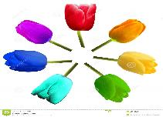
Home work
Draw a picture of Rainbow with 7 colours.
Rajib Dutta. Bhingrol gps. Ctg.

Slide 21


Good bye every one
Thanks to all
See you again…
Rajib Dutta. Bhingrol gps. Ctg.

