Slide 1


Slide 2



Introduction
Ayesha Siddiqua
Head Teacher
Rampur GPS
Laksam,Cumilla
Class : One
Sub : English
Unit : 2
Lesson : 12
Topics : Numbers Page (37-38)
Time : 30 minutes

Slide 3
LEARNING OUTCOMES
After finishing the lesson students will be able to-
4.1.4 read aloud cardinal numbers in figures properly

Slide 4
“Let’s listen to a song (Number song).
[1, 2, 3, 4, 5
Count the fish from 1 to 5.
6, 7, 8, 9, 10
Count the fish from 1 to 10!]

Slide 5

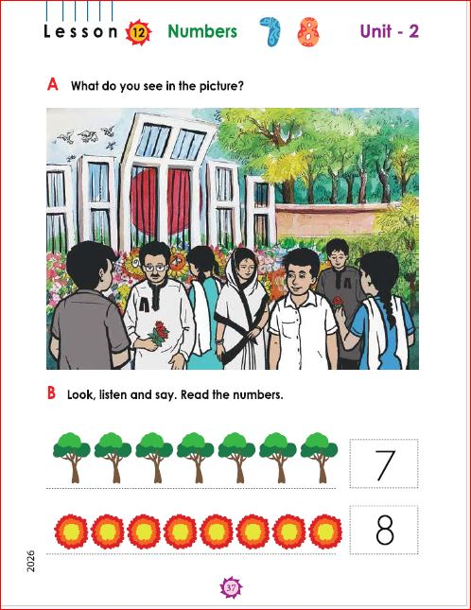

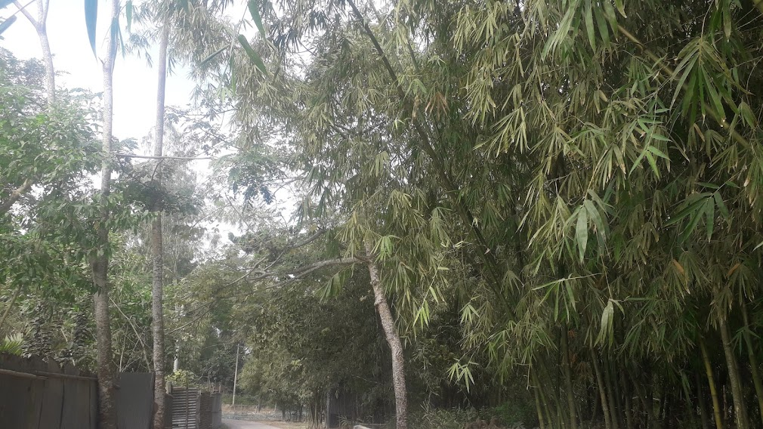
Look at the pictures with great attention:

Slide 6
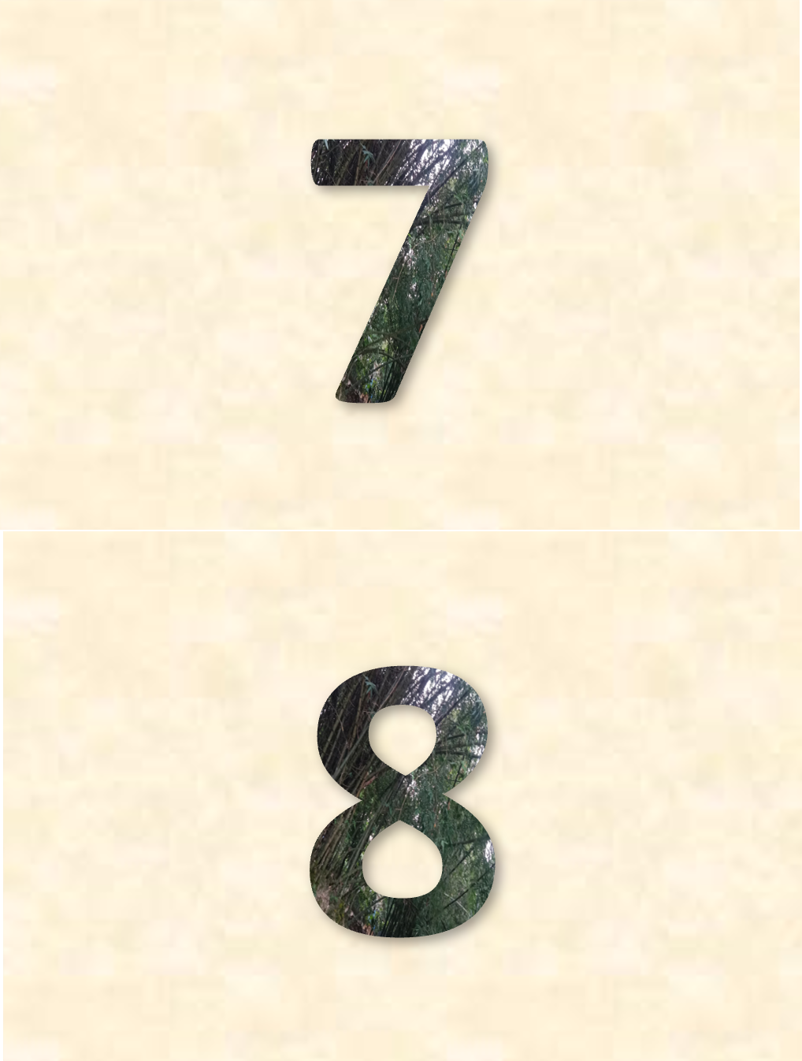
“Today we are going to learn how to count and read the numbers of 1and 2.”
The topic is “Numbers” 7 & 8

Slide 7
Review of the previous session:
Ask ss altogether, “What did we learn yesterday?”
[Showing the letters/writing the letters
(iI, jJ) on board]
Ask a student randomly,
“What is the letter can you see?” Possible answer should be iI, jJ.

Slide 8
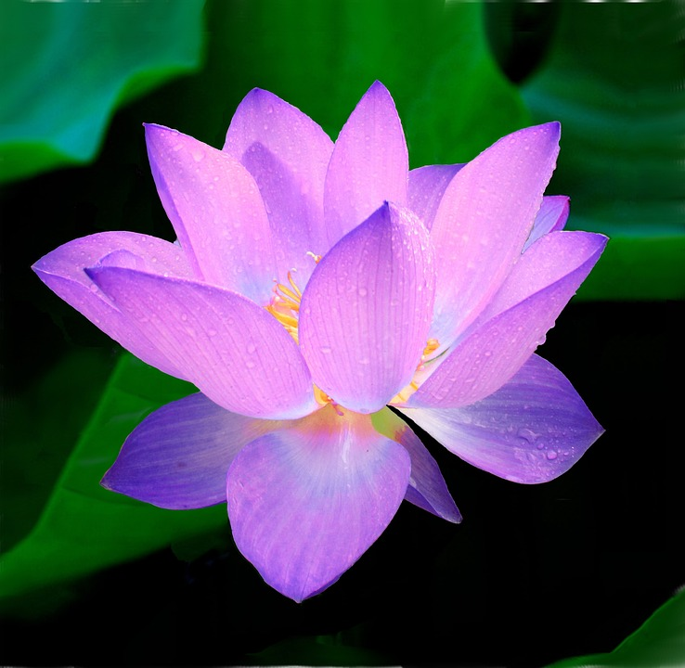
Count the pictures
7
8

Slide 9
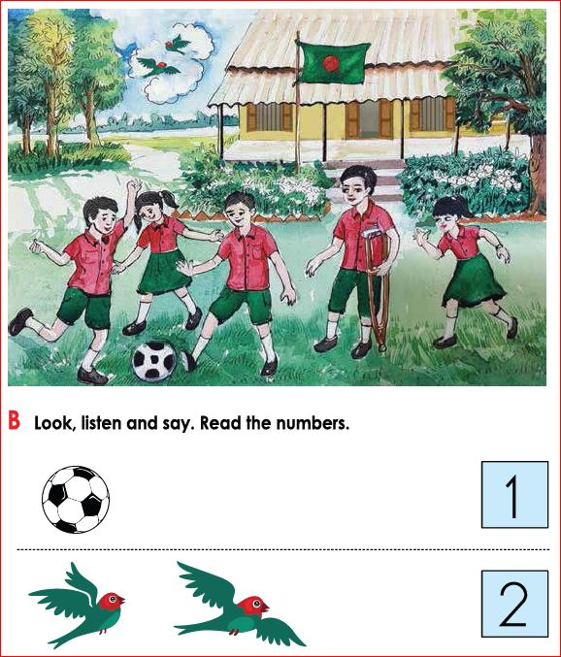
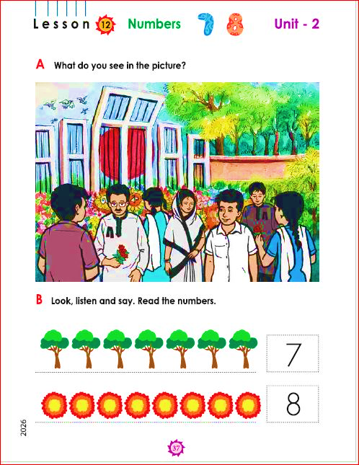

Slide 10


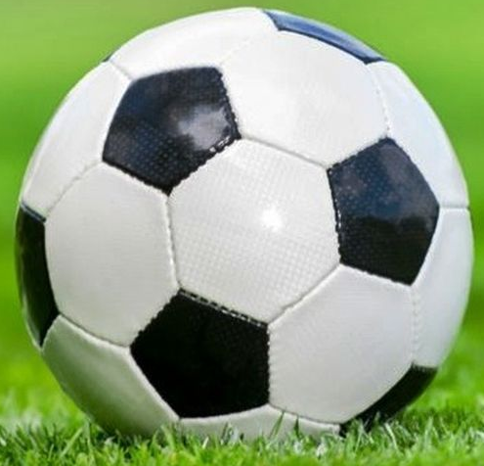
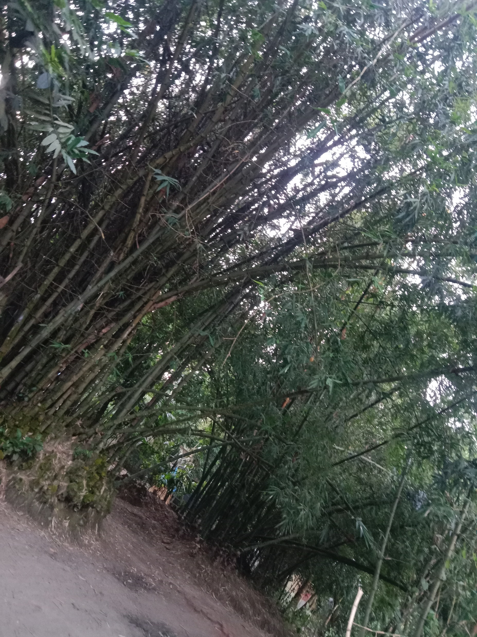
Group work
7
Read the number.
8
Read the number.
How many umbrellas are there?
How many balls are there?

Slide 11
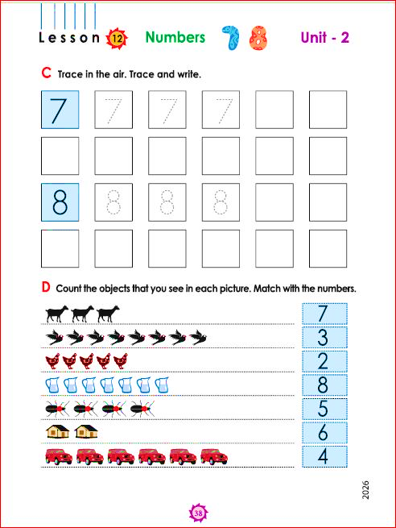

Slide 12


Pair work
Write down 1, 2, 3, 4, 5, 6, 7 & 8

Slide 13

Read out with me
7
Seven
8
Eight

Slide 14

Open your book
Page 32, 33
English for Today

Slide 15
Individual work
Match the pictures with words
Seven
One
Eight
Four

Slide 17
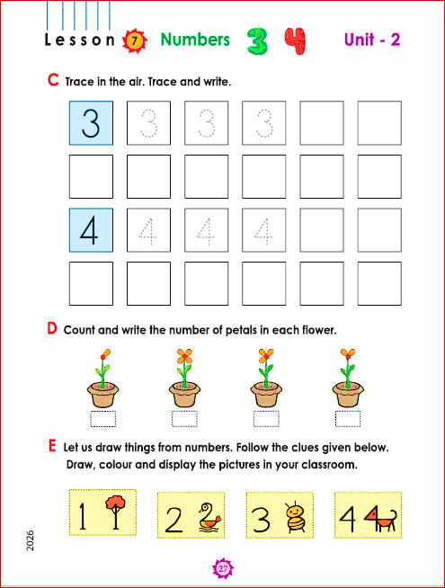




Slide 18
Assessment Indicators-42
Domain | Indicators
Knowledge | 1. S traces the cardinal number (1, 2, 3, 4, 5, 6, 7, and 8) neatly and legibly.
Skill | 2. S writes the cardinal number (1, 2, 3, 4, 5, 6, 7, and 8) neatly and legibly.
Attitude and values | 3. S feels confident to write the number (1, 2, 3, 4, 5, 6, 7, and 8) appropriately.

Slide 19
Feedback
Help the students who can’t read & write 1, 2, 3, 4, 5, 6, 7 & 8 properly

Slide 20
Homework
Write
5, 6, 7 and 8

Slide 21


