Slide 1
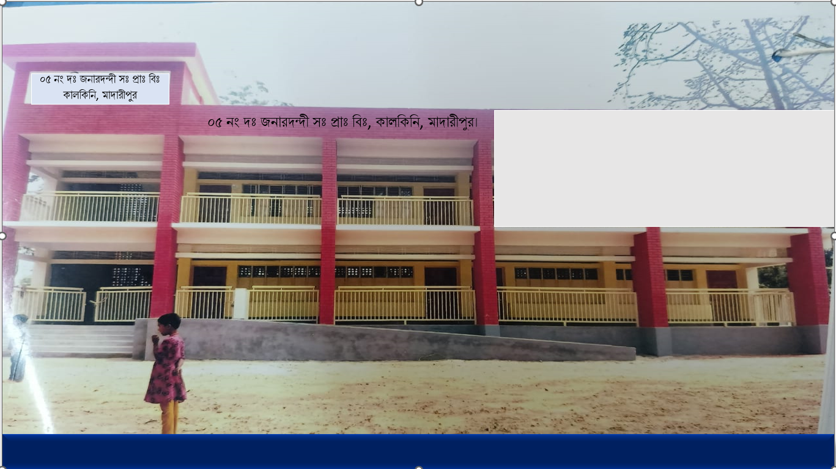
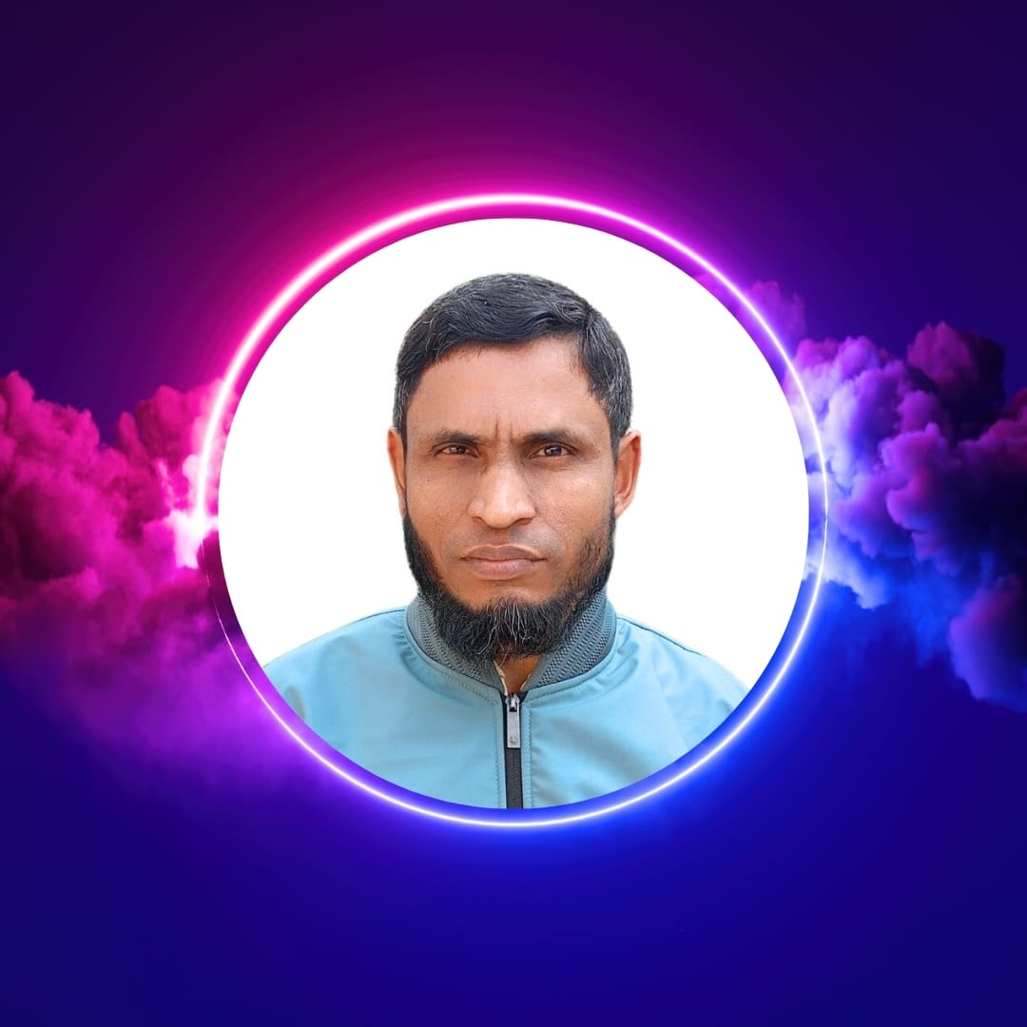
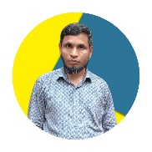
WEL COME
Class - Four
Subject - English
Unit - 5
I want
to join
English class
*05 No South Jonardondi GPS* * Kalkini, Madaripur. *

Slide 2
Introducing
Belayet Hossain
Assistant Teacher
05 No South Jonardondi GPS
Kalkini, Madaripur.
Gmail : belayet01715205765@gmail.com

Slide 3

INTRODUCING
Class : Four
Subject : English
Unit : 5
The Little Doctor
Activity : 1.1, 1.2
Page : 12,13.
Time : 45 minutes

Slide 4
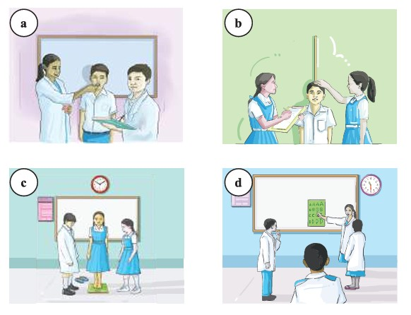
Can you guess what is our today's lesson?
What is the relationship between them?

Slide 5
Today's Our Lesson
The Little Doctor
Unit - 5.
1.1, 1.2

Slide 6
Learning Outcomes
Students will be able to:-
Listening:-
4.3.1 - enjoy and understand simple stories.
Speaking:-
3.1.1 - ask and answer Wh questions.
Reading:-
5.1.1 - read simple paragraphs.
Writing:-
8.1.3 - write sentence from the text book or model.
10.1.1 - write short and simple paragraphs answering a
set of questions.

Slide 7
Who can you see in the picture?
New Words
Doctor
Who treatment patient.
Aliya is a student of class four. She is one of the little doctors of her school. A little doctor works for the physical wellbeing of students. She visits the classes and takes measurement Of the height, weight and temperature of students. She helps to distribute deworming tablets and vitamin capsules among the students. She suggests the students to take the deworming tablets after a meal. She asks them to drink safe water. She also asks the students to wash hands before taking food. Aliya keeps the health records of the students. When a student feels sick or gets hurt, she responds quickly with a first aid box. She also informs teachers in case of an emergency. Aliya enjoys her work as little doctor.

Slide 8
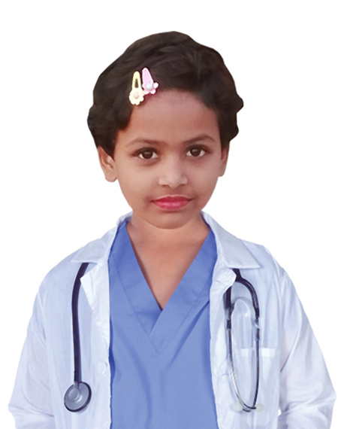
The Little Doctor
Aliya is a student of class four. She is one of the little doctors of her school. A little doctor works for the physical wellbeing of students. She visits the classes and takes measurement Of the height, weight and temperature of students. She helps to distribute deworming tablets and vitamin capsules among the students.

Slide 9
The Little Doctor
She suggests the students to take the deworming tablets after a meal. She asks them to drink safe water. She also asks the students to wash hands before taking food. Aliya keeps the health records of the students. When a student feels sick or gets hurt, she responds quickly with a first aid box. She also informs teachers in case of an emergency. Aliya enjoys her work as little doctor.

Slide 10
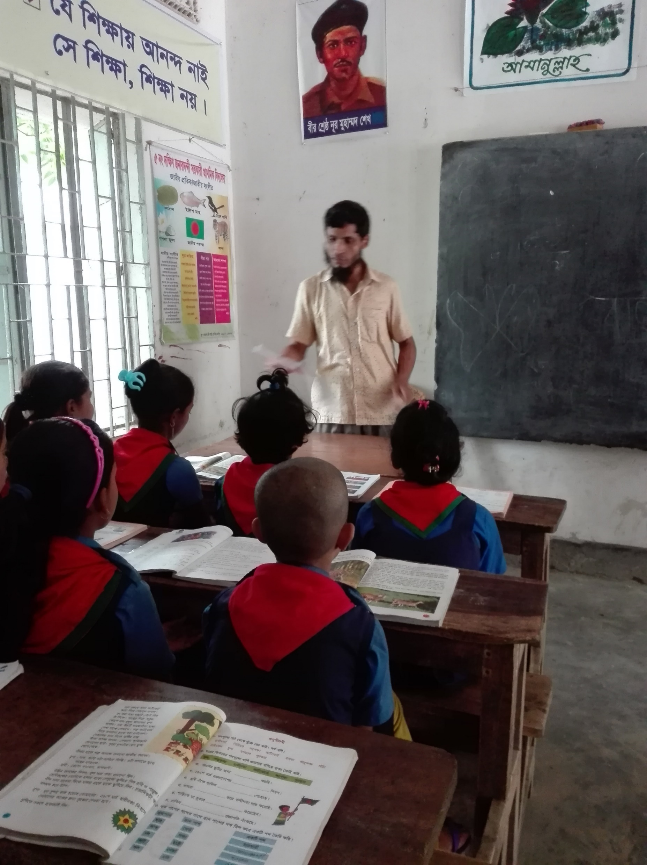
Teacher’s reading

Slide 11
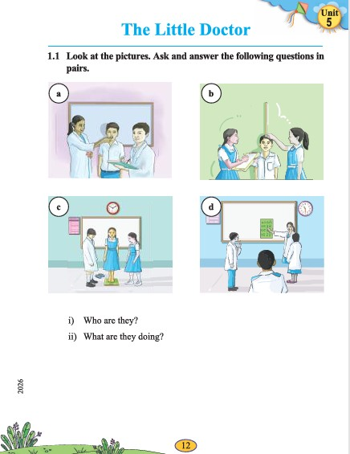
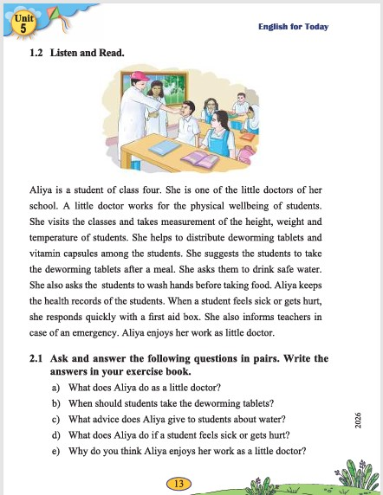
Open your English book at page- 12 & 13.

Slide 12
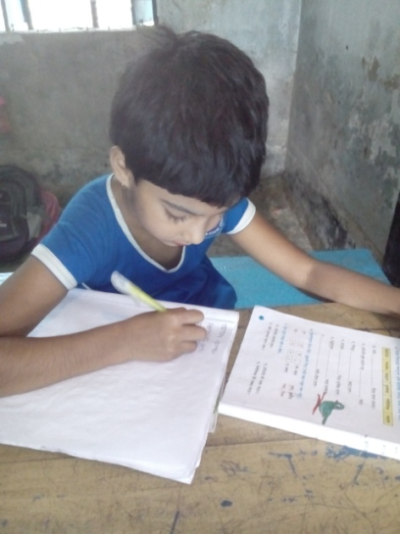
Individual Work
Make sentence by the words:
Class
Four
Weight

Slide 13
Aliya is a student of class four. She is one of the little doctors of her school. A little doctor works for the physical wellbeing of students. She visits the classes and takes measurement Of the height, weight and temperature of students. She helps to distribute deworming tablets and vitamin capsules among the students. She suggests the students to take the deworming tablets after a meal. She asks them to drink safe water. She also asks the students to wash hands before taking food. Aliya keeps the health records of the students. When a student feels sick or gets hurt, she responds quickly with a first aid box. She also informs teachers in case of an emergency. Aliya enjoys her work as little doctor.
Who is a student of class four?
What is she?
What does a little doctor do?
When does the students take the deworming tablets take?
What does Aliya do?
Answer
Please click answer button for answer
Answer
Pair Work
Answer
Time: 5 minute's
Answer
Answer

Slide 14
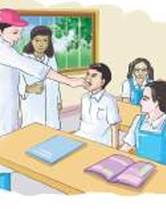
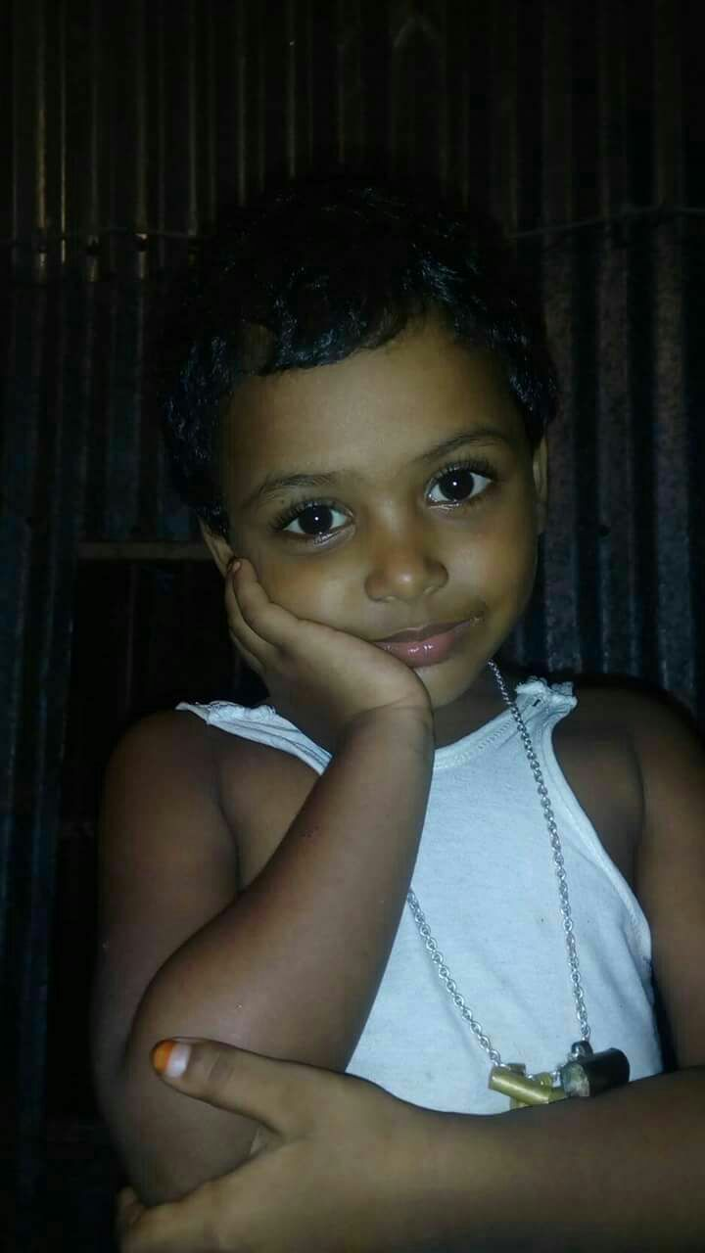
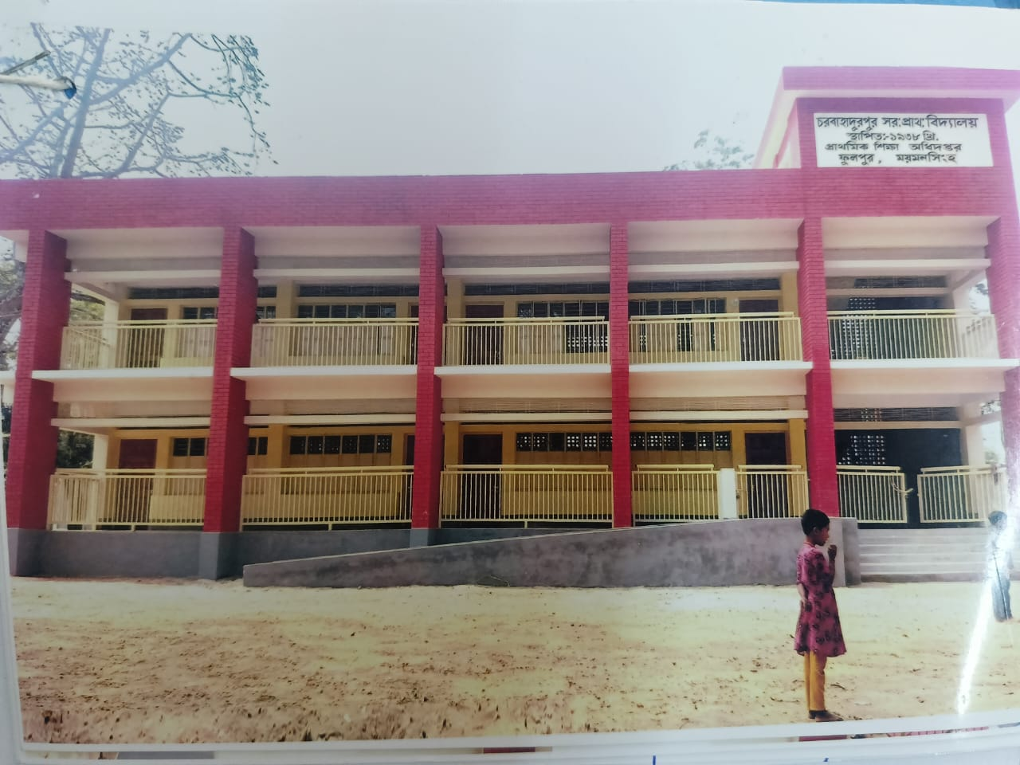
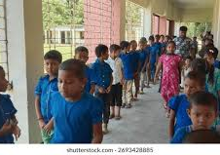
Group Work
Time: 10 minute's
Talk about Uses of Assembly

Slide 15
Individual Work
Read the sentences. Write T for True and F for False.
Aliya is a students of class Five.____
She is one of the little doctors of her school. ____
She helps to distribute deworming tablets._____
She asks them to drink safe water..____
Aliya enjoys her work as large doctor.____
F
T
T
T
F

Slide 16
Pair Work
Ask and answer.
What is the story about?
What does Aliya do as a little doctor?
When should students take the deworming tablets?
What advice does Aliya give to students about water?
What does Aliya do if a student feels sick or gets hurt?

Slide 17
Evaluation
Look attentively. Now we play a game. Everybody close your eyes.
Which word is missing?
Open your eyes.
Student
Doctor
Sick

Slide 18
Evaluation
Write three activities students as a little doctor.

Slide 19
Thanks to All

