Slide 1
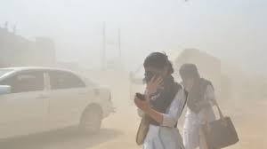
Welcome the students

Slide 2
Md. Siddique Ali
ICT teacher
Durgapur Dakhil Madrasha
Kumarkhali, Kushtia.
Mobile-01716351307.
siddiqueali03@gmail.com

Slide 3
Class nine
Subject : English 1st paper
Unit- 1
Lesson- 2

Slide 4
Learning outcomes
After the students have studied this lesson , they will able to
Summarize texts.
Ask and answer questions.
Identify the problems and solve it.
Do a project work.

Slide 5
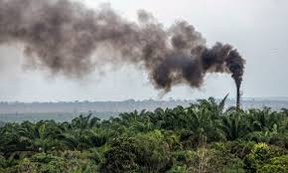
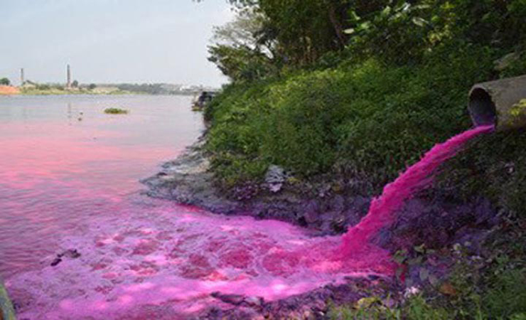
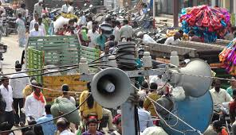
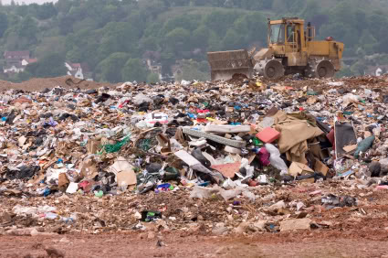
Let’s watch some pictures

Slide 6
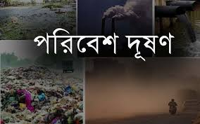
Today’s topic is environmental pollution

Slide 7
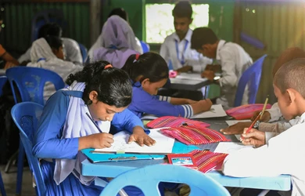
Silent reading

Slide 8
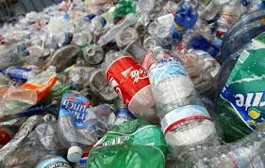
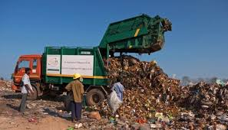
Now memorize the word meaning
Pollution-
-To make something ugly
Wastes-
-Garbage's

Slide 9
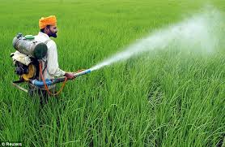
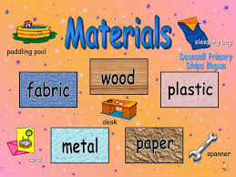
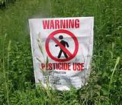
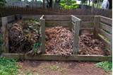
Toxic-
-Poison
Materials-
-Things
Pesticides-
-to use killing germs in farmland
Compost-
-Natural fertilizer

Slide 10
Fill in the gap with the clues
burning
brick
ten
fuel
reuse
jute
Recycle
Pollution | CAUSES | suggestions
Air pollution | 1.Toxic smokes from …………..…..plants 2.Smoke from the……………..fields | 1. Don’t drive motorcars which are older than………..years
 |  | Use CNG or LP gas as car……………………
Soil pollution.. | Industrial wastes not……………properly Use of……………shopping bag | 1………..……paper , plastics and other materials

Slide 11
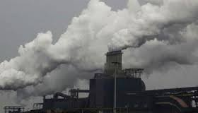
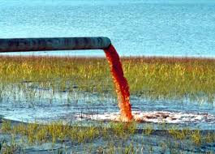
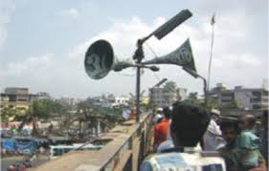
Presentation
Air pollution
Water pollution
Soil pollution
Sound pollution

Slide 12

Single work
1
How many pollutions have you seen just now?
Do you know about any more pollution ? If know write a summery on it basis on text.

Slide 13
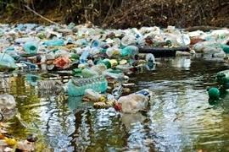
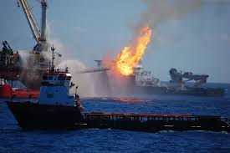
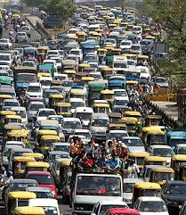
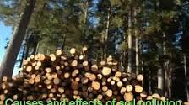

Slide 14
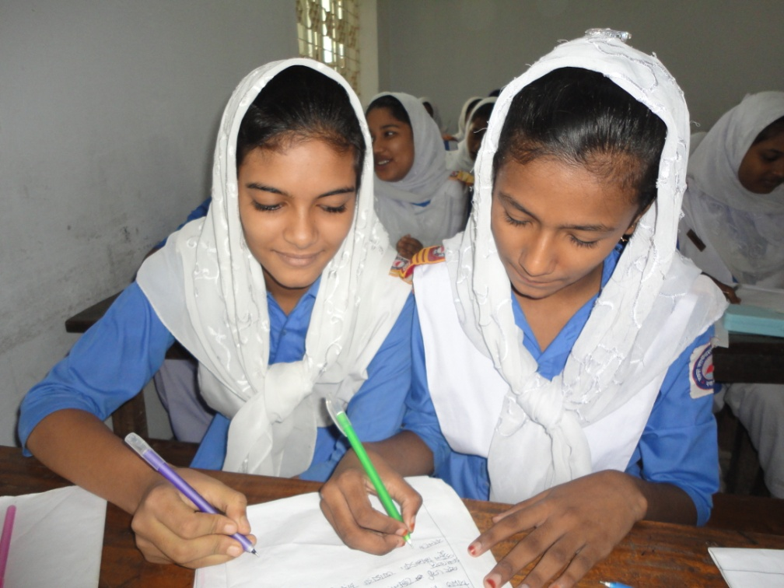
Pair work:
Ask and answer questions basis on those pictures we have seen just now . Show the causes at least 3 items.

Slide 15
Check your justification.
There are many causes of environmental pollution. Such as :
Industrial plants , brick kilns, old vehicles ,dust from roads and construction sites are some of the major sources of air pollution.
Throwing away a toxic substance on water sources, Throwing away industrial wastes in river or lakes are some of the major sources of water pollution.
Throwing away polythene, agricultural pesticides , fertilizers, fuel leakages, are some of the major sources of soil pollution.

Slide 16
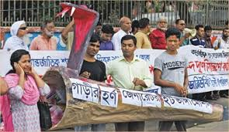
What can we do to prevent environmental pollution?
Campaign
Stop cutting trees

Slide 17


Plant tree

Slide 18

Group work
Group A
Group B
How can you prevent pollution?
Write 4 types of pollution causes

Slide 19
Evolution
1.Why should we prevent pollution?
2.What kinds of problem do it create ?
3.What is the acute problem in our country?

Slide 20
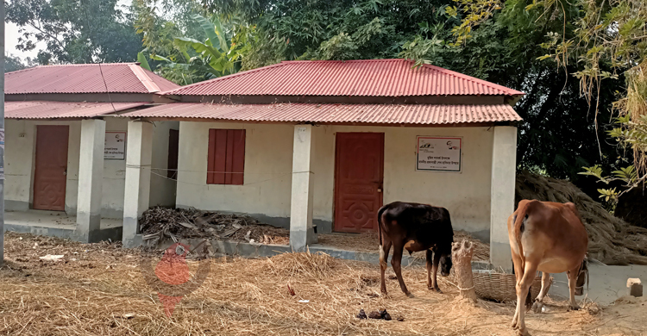
Home work
You all will write a short essay on ”Environmental pollution in your area.”

Slide 21
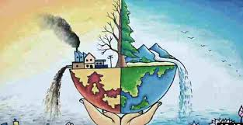
Thank you all.

