Slide 1

Welcome

Slide 2


Introduction
Name: Nironjon Roy
Name of the post: Assistant teacher (English)
Name of the institution: Nutan Bandar Benghari High School
Fultolahat ,Boda,Panchagarh

Slide 3

Class: Ten
Subject: English
Unit Four: Events and Festivals
Name of the lesson: International Mother Language Day

Slide 4


Learning outcomes
After we have studied this unit, we will be able to
Talk about events festivals
Ask and answer questions and give opinions a logical sequence
Infer meaning from the context.

Slide 5
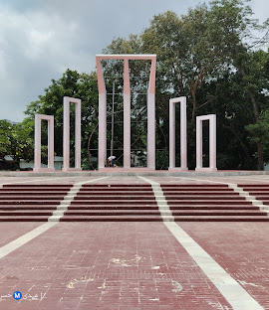
A Look at the picture and talk about it.
What’s the picture about?
What’s the place in the picture?
Why was it built?

Slide 6
So, today’s topic is International Mother Language Day.

Slide 7

Now open your textbook and go to page number 42.

Slide 8

Important vocabularies
Tribute = respect
Laid down = sacrifice
Climax = the highest point
Turned into = form a shape

Slide 9
Read the text silently for 5 minutes.

Slide 10
C Complete the chart individually.
Time | What happened
1947
1948
1952

Slide 11
C Evaluation
Time | What happened
1947 | Divided Pakistan and India
1948 | The seed of the Language Movement was sown.
1952 | Our Language Movement happened.

Slide 12

D. Answer these questions in pair.
Why do we observe 21 February as the International Mother Language Day?
What happened when Urdu was declared as the only state language of Pakistan?
Who defied the law and brought out a peaceful protest procession?

Slide 13
Evaluation
1. Answer: We observe it as International Mother Language Day because UNESCO has declared it as International Mother Language Day.
2. Answer: The declaration raised a storm of protest all over country when Urdu was declared the only state language of Pakistan.
o
3. Answer: The students of Dhaka University defied the law and brought a peaceful protest procession.

Slide 14


Homework
Describe a traditional festival that you celebrate every year.

Slide 15


Thank you so much.

