Slide 1

Teaching Speaking; Techniques of Practicing Speaking in Classroom & Demonstration
Presented By
Maruf Sakil
Assistant Teacher
Nadmula Secondary School
Bhandaria, Pirojpur

Slide 2
Let’s exchange ideas on today’s Topic…….
For Example; Word Game;

Slide 3
How can Listening help Speaking?
To improve pronunciation
To enhance vocabulary & grammar
To imitate some expressions
To improve comprehension
To boost confidence

Slide 5
Speaking Techniques
Making Imperatives
Making Question
Games
Role- Plays
Group Discussion
Debates
Storytelling
Presentation
Use of Technology
Real World Scenario

Slide 6


Commanding
Questioning
100 Questions
https://www.youtube.com/watch?v=uPACgfqVVy4

Slide 7

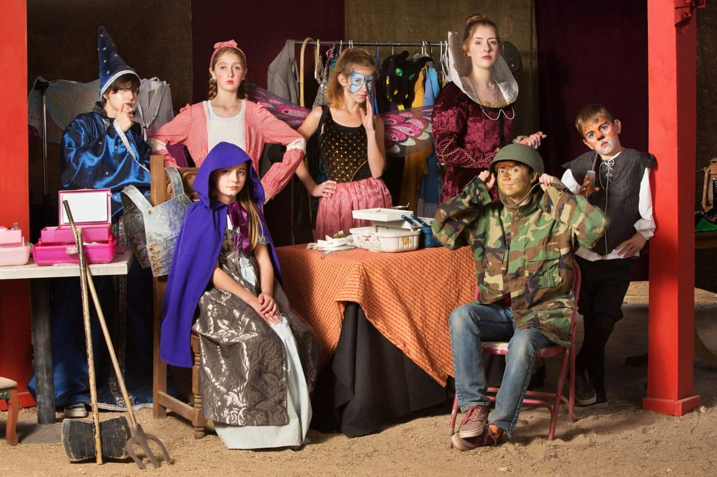
https://www.youtube.com/watch?v=1wPxF8C6tYM
Role- Plays
Language Games
https://www.youtube.com/watch?v=awbVzXKr5co

Slide 8
Situational Conversation Topic
Between a Teacher and the Principal/ Superintendent on opening language club;
Friends at a restaurant;
Among Teachers about speaking practice in classroom;
Talking about Hobbies & Interest
About Foods
Book Reviews among Colleagues

Slide 9


https://www.youtube.com/watch?v=1TSkkxu8on0
Debates
Group Discussion

Slide 10


https://www.youtube.com/watch?v=1TSkkxu8on0
Storytelling
Presentation

Slide 11
Storytelling
There was a rumor in my village………………..
I have a dream project……………………..
One of the memories of life is………………
Beside teaching , I want to run a business………….
I would like to share my experience on…………..

Slide 12
Use of Technology
Language Exchange apps (https://preply.com/en/blog/language-exchange-app/)
Computer-assisted language learning- https://woulibrary.wou.edu.my/weko/eed502/computerassisted_instruction_cai.html

Slide 13
Post Speaking
Recordings
Peer Feedback
Self Assessment

Slide 14
Thank You Everybody
The End

