Slide 1
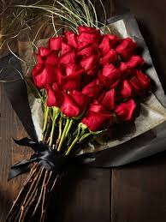
Welcome to today’s class, everyone.

Slide 2
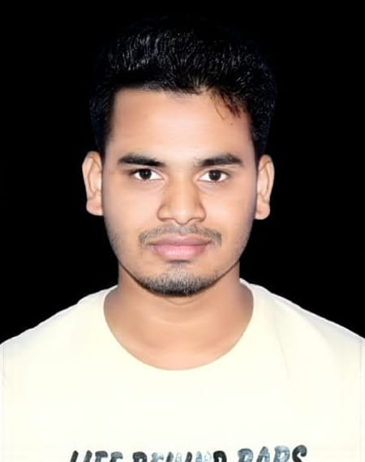
First, let me introduce myself as your teacher.
Name: Sm Riazul islam
Designation: Assistant teacher(ICT)
Sayedergaon secondary school.
Muladi,Barishal

Slide 3
Today, we are going to learn about Tense.
Do you know what is meant by tense?
In simple words, the time of performing an action is called Tense.
Can anyone tell me how many types of tense there are and what they are?

