Slide 1

WELCOME

Slide 2
INTRODUCTION
Teacher Introduction
Lesson Introduction
Name: Mst. Jakia Pervin
Designation: Ebtedayee Junior Teacher
Institute: Paikpara Asgar Ahamad Dakhil Madrasah
Chunarughat, Hobiganj
01741457566
Class: Eight
Subject: English
Unit: Three
Lesson: Three(Hygiene)
Date: 24-06-2026

Slide 3
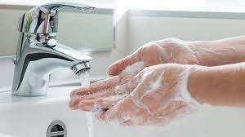
Look At the Picture

Slide 4
Learning Outcome
After we have studied this unit, we will be able to
  Why health is essential for us?
  How many times should we brush our teeth a day?
  What kind of water should we drink?

Slide 5
Hygiene
The word hygiene means the practice of keeping ourselves clean. Hygiene is thought to be next to godliness. Nobody likes an unclean person. So, we must follow the rules of hygiene.
Finally, we should keep our surroundings and environment clean.

Slide 6
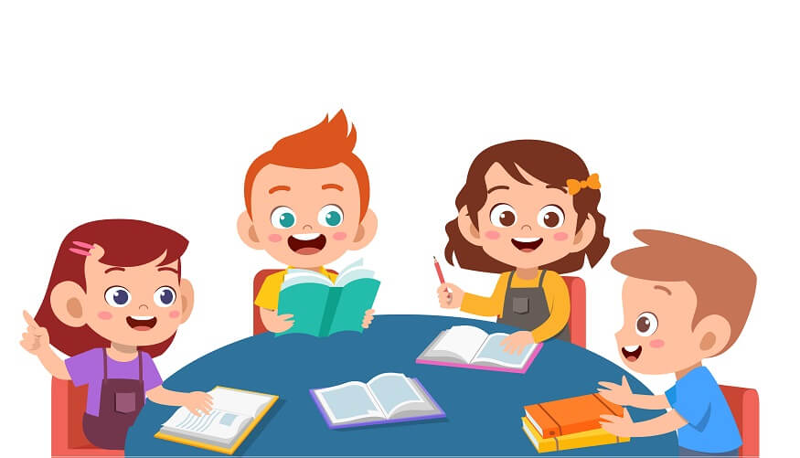
Work in group
Make a list of five things that you do daily to maintain personal hygiene. Share with other group, make a poster and display it to the class.

Slide 7
Home Work
Read the following statements and say if they are True or False. If False, give the correct information:
Cleanliness is a part of good health.
Cleanliness is very important for mental health.
We need to wear socks and shoes to look smart.
We must keep ourselves clean.

Slide 8
Thank You

