Slide 1
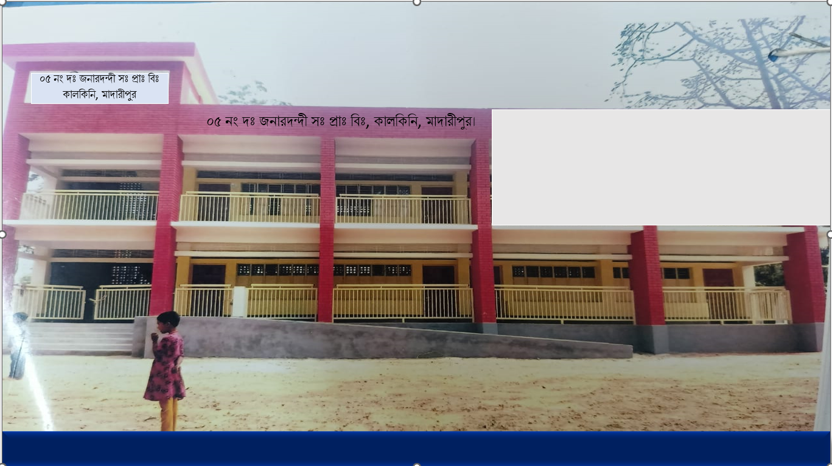
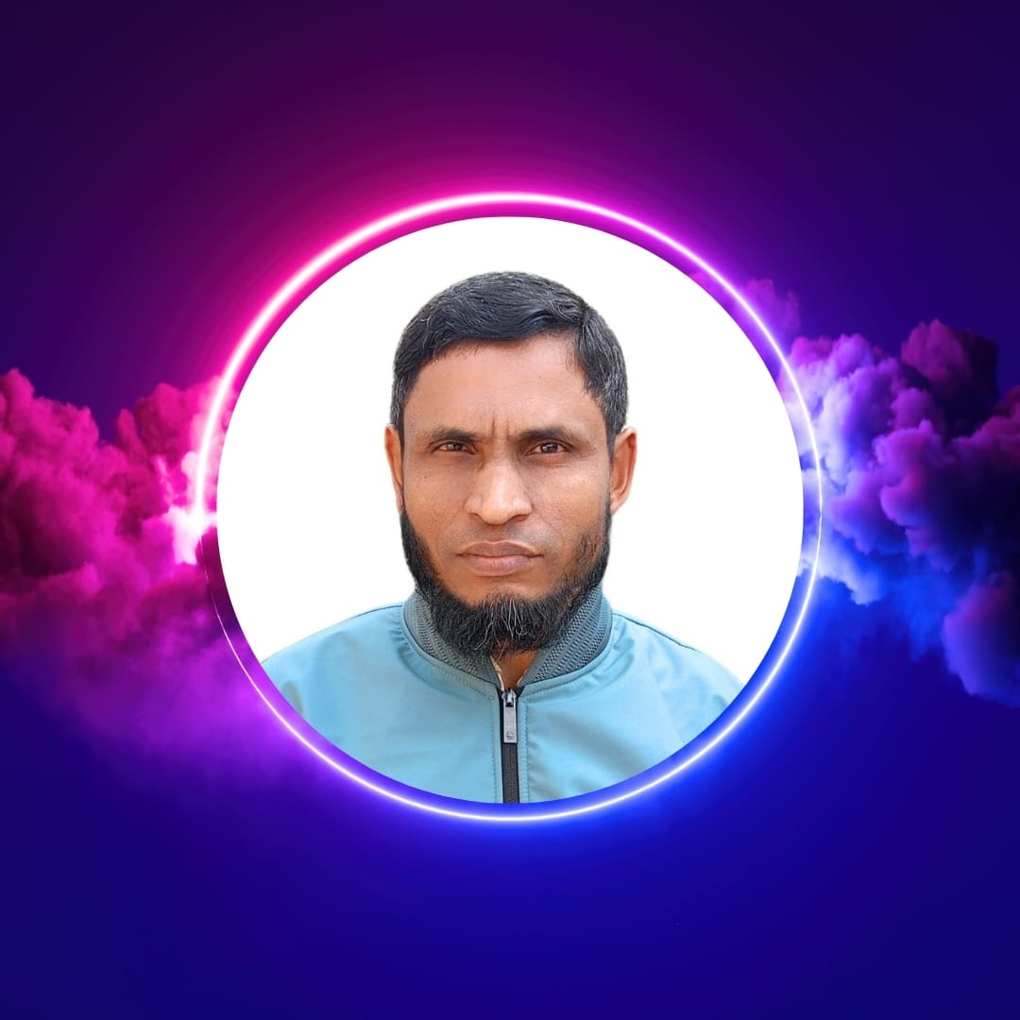


WEL COME
Class - Four
Subject - English
Unit - 9
I want
to join
English class
*05 No South Jonardondi GPS* * Kalkini, Madaripur. *

Slide 2
Introducing
Belayet Hossain
Assistant Teacher
05 No South Jonardondi GPS
Kalkini, Madaripur.
Gmail : belayet01715205765@gmail.com

Slide 3
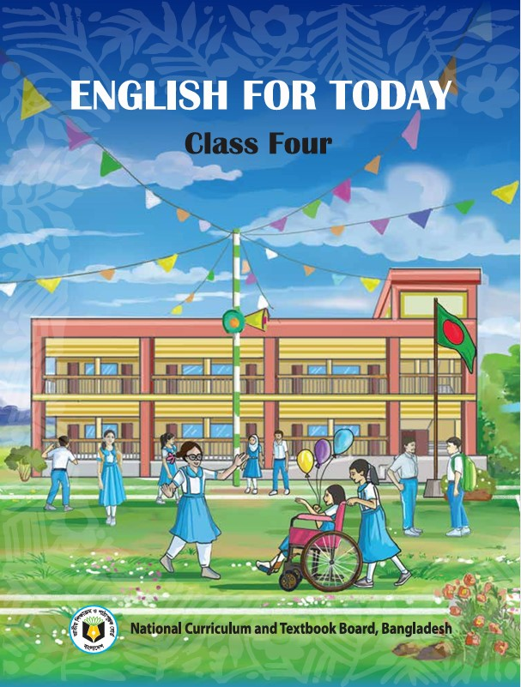
INTRODUCING
Class : Four
Subject : English
Unit : 9
Gardening
Activity : 1.1, 1.2, 1.3, 1.4
Page : 34, 35.
Time : 45 minutes

Slide 4
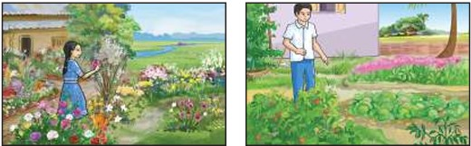
Can you guess what is our today's lesson?
What is the relationship between them?

Slide 5
Today's Our Lesson
Gardening
Unit - 9.
1.1, 1.2, 1.3, 1.4

Slide 6
Learning Outcomes
Students will be able to:-
Listening:-
4.3.1 - enjoy and understand simple stories.
Speaking:-
3.1.1 - ask and answer Wh questions.
Reading:-
5.1.1 - read simple paragraphs.
Writing:-
8.1.3 - write sentence from the text book or model.
10.1.1 - write short and simple paragraphs answering a
set of questions.

Slide 7
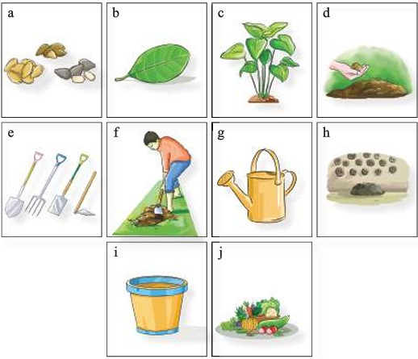
Who can you see in the picture?
New Words
Garden
Where plants are found.
Rina wanted to make a garden. She discussed with her father about gardening. They discussed how to use the land in front of their house. Rina was excited. She and her father used a spade to dig the land. They prepared the soil with cow dung Rina wanted to make the garden colourful. Rina and her father bought different flower plants from a nearby nursery. They also bought some tubs and a watenng pot. Then, they planted the flower plants in the garden. Rina took care of the plants in her leisure time. She also watered the plants early in the morning. The green plants were growing up. Soon, the flowers were in full bloom. The colourful flowers and butterflies made her family happy. Rina's mother also wanted to grow vegetables in this garden. Rina was pleased to see her mother's interest. They collected some seeds to plant in their garden. Rina helped her mother to grow tomatoes, onions and beans. They picked the vegetables together from the garden. They enjoyed the fresh vegetables in their daily meals. Gardening became their favourite pastime.

Slide 8
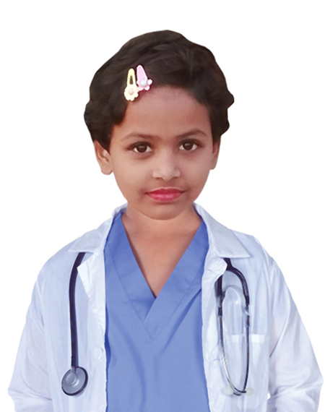
Gardening
Rina wanted to make a garden. She discussed with her father about gardening. They discussed how to use the land in front of their house. Rina was excited. She and her father used a spade to dig the land. They prepared the soil with cow dung Rina wanted to make the garden colourful. Rina and her father bought different flower plants from a nearby nursery. They also bought some tubs and a watenng pot. Then, they planted the flower plants in the garden. Rina took care of the plants in her leisure time. She also watered the plants early in the morning.

Slide 9
Gardening
The green plants were growing up. Soon, the flowers were in full bloom. The colourful flowers and butterflies made her family happy. Rina's mother also wanted to grow vegetables in this garden. Rina was pleased to see her mother's interest. They collected some seeds to plant in their garden. Rina helped her mother to grow tomatoes, onions and beans. They picked the vegetables together from the garden. They enjoyed the fresh vegetables in their daily meals. Gardening became their favourite pastime.

Slide 10
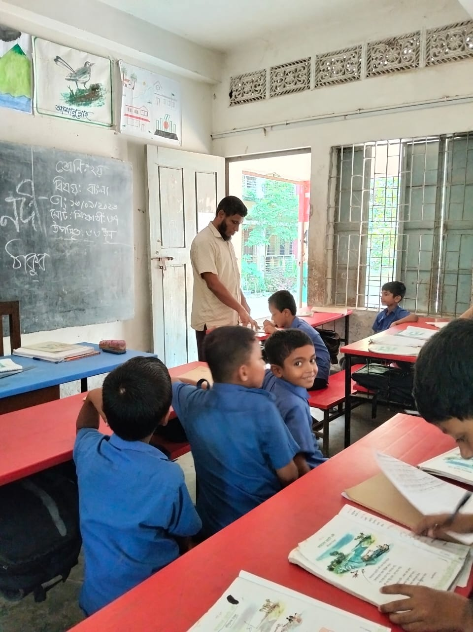
Teacher’s reading

Slide 11
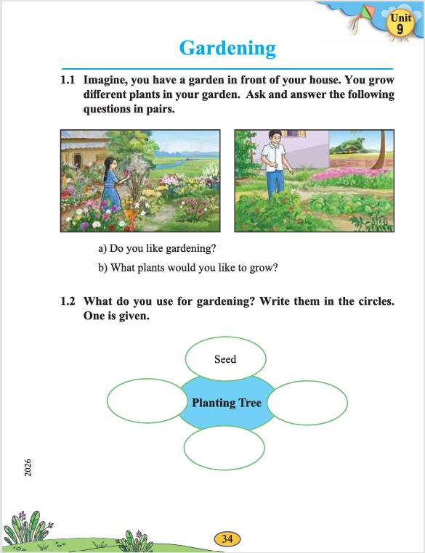
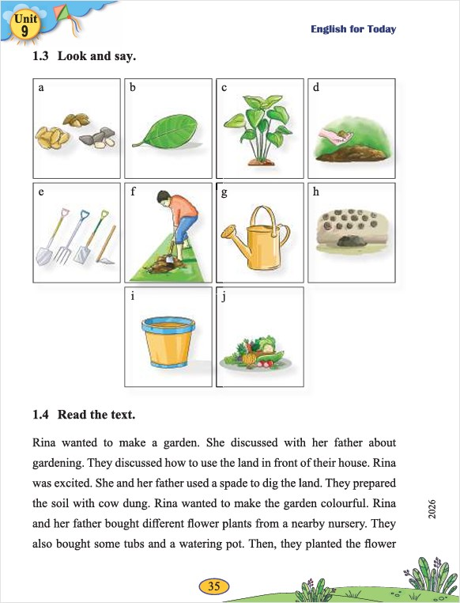
Open your English book at page- 34 & 35.

Slide 12
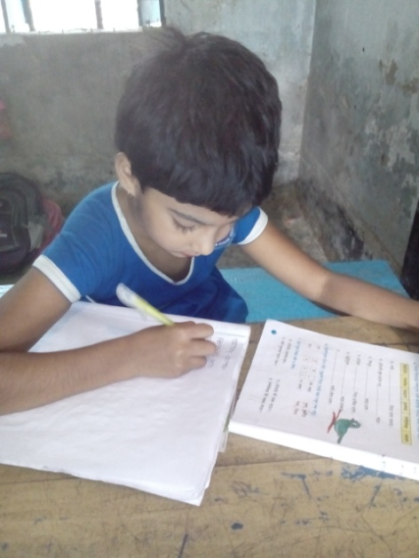
Individual Work
Make sentence by the words:
Garden
Land
Flower

Slide 13
Rina wanted to make a garden. She discussed with her father about gardening. They discussed how to use the land in front of their house. Rina was excited. She and her father used a spade to dig the land. They prepared the soil with cow dung Rina wanted to make the garden colourful. Rina and her father bought different flower plants from a nearby nursery. They also bought some tubs and a watenng pot. Then, they planted the flower plants in the garden. Rina took care of the plants in her leisure time. She also watered the plants early in the morning. The green plants were growing up. Soon, the flowers were in full bloom. The colourful flowers and butterflies made her family happy. Rina's mother also wanted to grow vegetables in this garden. Rina was pleased to see her mother's interest. They collected some seeds to plant in their garden. Rina helped her mother to grow tomatoes, onions and beans. They picked the vegetables together from the garden. They enjoyed the fresh vegetables in their daily meals. Gardening became their favourite pastime.
What does Rina wanted?
Whom does Rina discussed with?
What is used to dig the land?
Who wanted to make the garden colourful?
What were growing up?
Answer
Please click answer button for answer
Pair Work
Answer
Time: 5 minute's
Answer
Answer
Answer

Slide 14
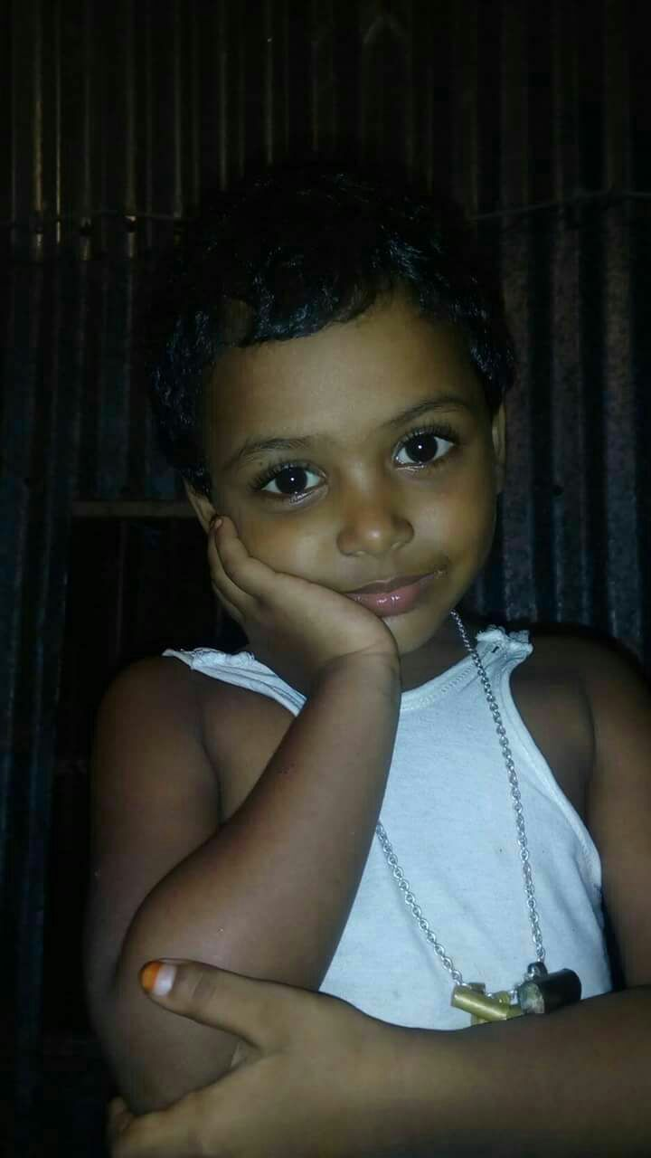
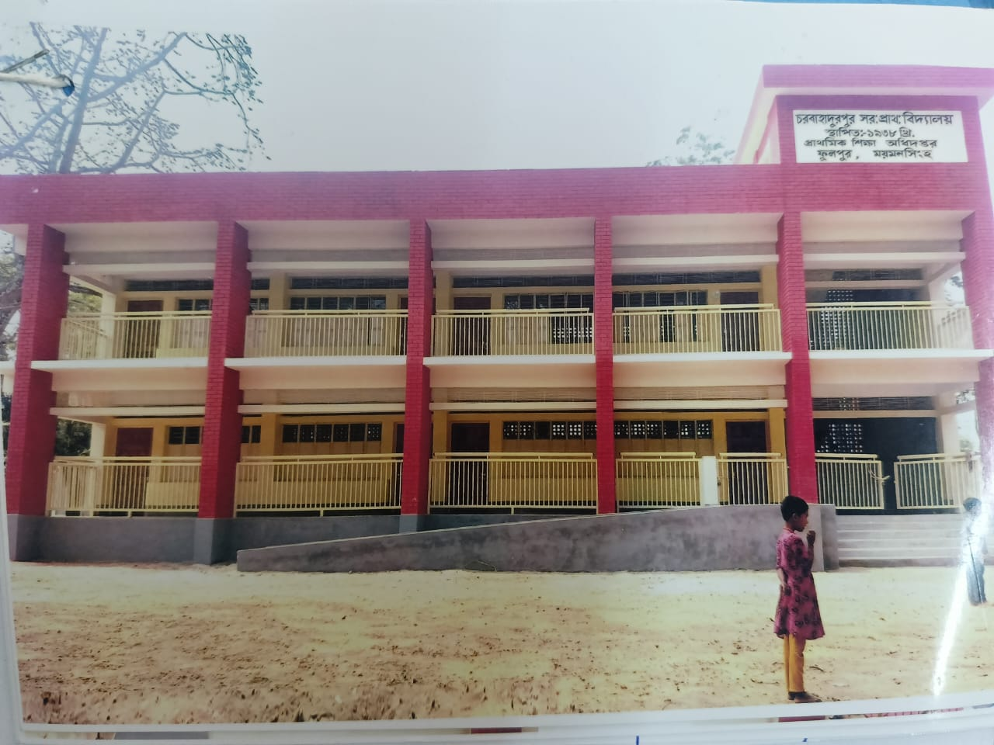
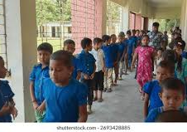
Group Work
Time: 10 minute's
Talk about Uses of Numbers

Slide 15
Individual Work
Read the sentences. Write T for True and F for False.
Rina wanted to make a garden.____
She discussed with her mother. ____
Mina was excited._____
Rina wanted to make the garden colourful.____
She also watered the plants early in the morning. ___
T
F
F
T
T

Slide 16
Pair Work
Ask and answer.
What is the story about?
How did Rina's father help her in gardening?
What did they buy from the nursery?
How did Rina help her mother in gardening?
Why was gardening enjoyable for Rina's family?

Slide 17
Evaluation
Look attentively. Now we play a game. Everybody close your eyes.
Which word is missing?
Open your eyes.
Garden
Land
Colourful

Slide 18
Evaluation
Write three sentences about Gardening.

Slide 19
Thanks to All

