Slide 1

Welcome

Slide 2
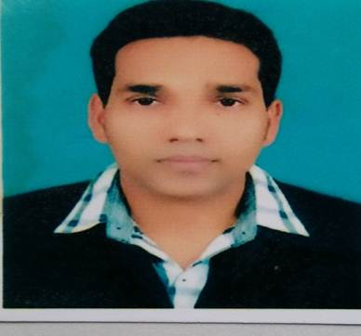
Teacher’s Identity
, Assistant Teacher. MD, Azim Uddin teacher. Latifpur Government Primary School

Slide 3

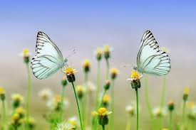
Lesson introduction
English For Today
Class: Five
Unit: 12
Eating Healthy
Activity: 1.1, 1.2, 2.1

Slide 4

Learning Outcomes
3.4.1 Ask simple questions on familiar topics.
3.4.2 Answer simple questions appropriately and confidently.
4.2.1 Read aloud texts with proper stress, intonation.

Slide 5
Review of the prior knowledge
Have you ever bought any thing from a store?
What did you buy from a store?

Slide 6
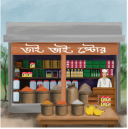
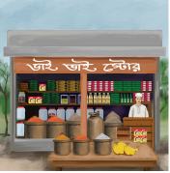
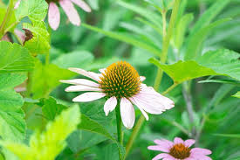
What do you see in the picture?

Slide 7
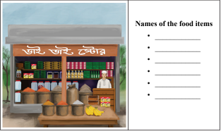

Write down the names of the food seen in the grocery shop.

Slide 8

Title of the lesson
We are going to read a text about
Eating Healthy

Slide 9
Pre-teach the vocabulary
Reasonable - ন্যায্য বা সাশ্রয়ী ।
Sliced – টুকরা করে কাটা ।
Digestion – হজম।
Vocabulary
Delicious সুস্বাদু।
Hastily – তাড়াহুড়ো করে।
Harmful – ক্ষতিকর।

Slide 10
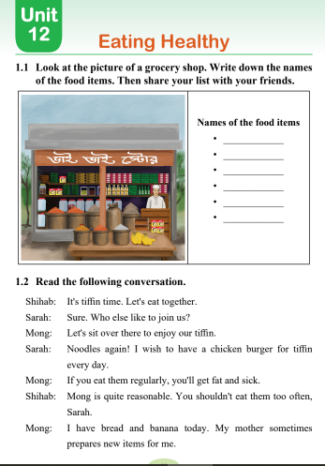
Open at page - 61

Slide 11
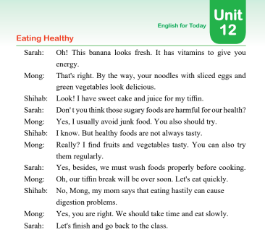
Turn over the page

Slide 12
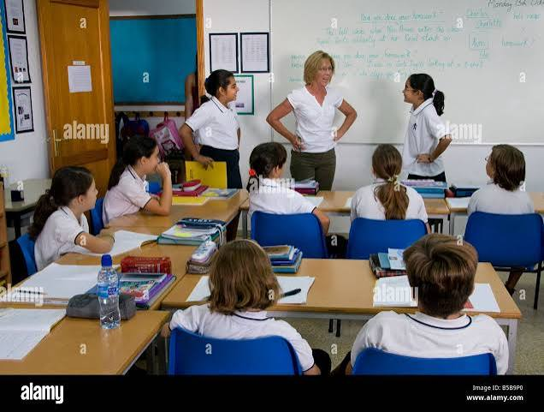
Role play the coversation

Slide 13
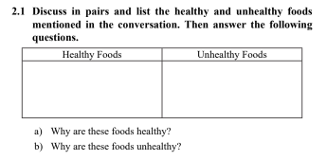

Group work

Slide 14

Evaluation
Tell me three healthy foods name from this conversation.
Is sweet cake a healthy food?
Tell me three unhealthy foods name from this conversation?

Slide 15



